Slide 1
RISCV random instruction generator
Neo Fang, 2/19/2020
Notes:
<number>

Slide 2
Agenda
NV RISCV random generator introduction
Google RISCV random generator introduction
Comparison

Slide 3
Instruction random challenge
Easy part (In control)
ALU/IMD and other instructions like FENCE, SFENCE, ECALL …
Known PC result (pc+4, pc+2 or trap) without knowing GPR/CSR value
Difficult part (Out of control)
Branch, LSU and CSR instructions
PC result depends on GPR/CSR value (branch taken/no taken, branch target, trap/no trap)
Backward branch may cause dead loop
Store could modify instruction/data region and affect other instructions

Slide 4
Common solution
la x10, base_addr
la x10, base_addr
lw x11, x10, 20
JALR x1, x10, 20
Fixed LSU sequence
Fixed JALR sequence
Random
sequence
Backward branch
Direct
sequence
branch
target
CSR changing
Only forward branch
Move from random to direct

Slide 5
Our solution
rand_inst x10 …
rand_inst x10 …
lw x11, x10, 20
Calculate
instruction
JALR x1, x10, 20
Random LSU sequence
Random JALR sequence
GPR=…
CSR=…
Random
sequence
Backward branch
Direct
sequence
target
branch
target
CSR changing
Random forward/backward branch
With dead lock handling
Keep in random sequence
Notes:
<number>

Slide 6
Generator flow
Test initialization for CSR, trap handler, mpu, pmp and etc
Generation loop start. Set current pc with boot start pc
Calculate current instruction. Get next pc and other GPR/CSR result
Necessary handling to make sure generated sequence is valid
CSR random
Generate random instruction with constraint and insert at next pc
branch random
lsu random
Loop until specified amount of instructions are generated

Slide 7
Generator flow
pc advance, gen next instruction
N
Begin loop
Check allowed insert bytes
Gen one inst
enough?
Y
N
Y
Instruction decode
Next pc existed?
Check exit pc valid
Store bin code
New pc pa?
Check override
Check next pc not in reserved region
Insert inst for unexecuted addr
Y
N
Calculate current instruction
Check dead lock
Check store fault address
Exit loop
Notes:
<number>

Slide 8
Add new instructions in generator
Update calculate_op() to include new instruction calculation
Update gen_inst() to generate new instruction with constraint
Other update for internal handling, this depends on instruction feature

Slide 9
Add ALU instruction
pc advance, gen next instruction
N
Begin loop
Check allowed insert bytes
Gen one inst
enough?
Y
N
Y
Instruction decode
Next pc existed?
Check exit pc valid
Store bin code
New pc pa?
Check override
Check next pc not in reserved region
Insert inst for unexecuted addr
Y
N
Calculate current instruction
Check dead lock
Check store fault address
Exit loop
Notes:
<number>

Slide 10
Add LSU instruction
pc advance, gen next instruction
N
Begin loop
Check allowed insert bytes
Gen one inst
enough?
Y
N
Y
Instruction decode
Next pc existed?
Check exit pc valid
Store bin code
New pc pa?
Check override
Check next pc not in reserved region
Insert inst for unexecuted addr
Y
N
Calculate current instruction
Check dead lock
Check store fault address
Exit loop
Notes:
<number>

Slide 11
Add RVC instruction
pc advance, gen next instruction
N
Begin loop
Check allowed insert bytes
Gen one inst
enough?
Y
N
Y
Instruction decode
Next pc existed?
Check exit pc valid
Store bin code
New pc pa?
Check override
Check next pc not in reserved region
Insert inst for unexecuted addr
Y
N
Calculate current instruction
Check dead lock
Check store fault address
Exit loop
Notes:
<number>

Slide 12
TB environment
UVM random instruction generator
On the fly compare
optional
CMOD
RISCV DUT
UVM sequence
HEX
backdoor
write
UVM dummy sequencer
Memory model

Slide 13
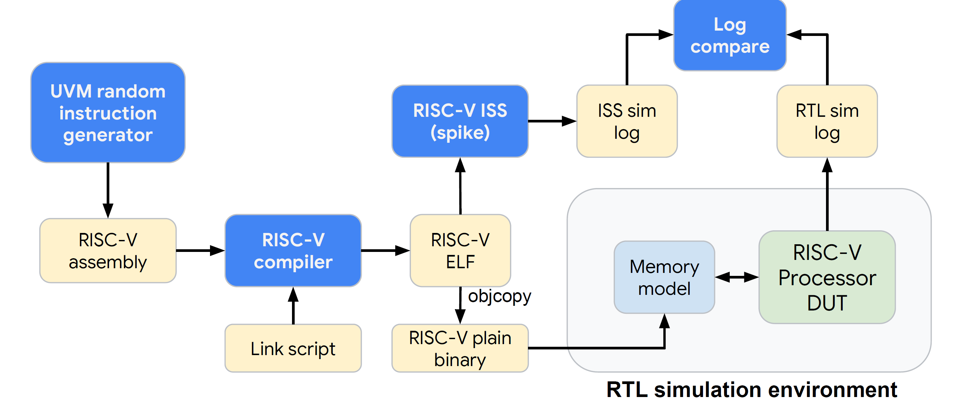
Google TB environment

Slide 14
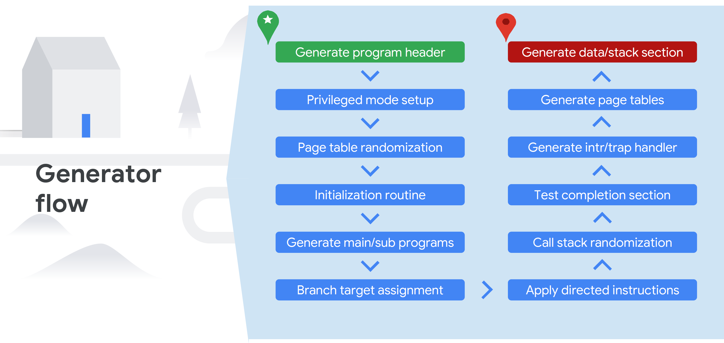
Google generator flow

Slide 15
Main/sub program generation
……
……
directed
instruction
stream
queue
……
……
……
Generate main random stream
with no load/store, configurable forward branch
……
Put directed stream into queue with configured ratio
Mix directed instruction stream into main random stream
B
B
B
Assign forward branch target
Notes:
<number>

Slide 16
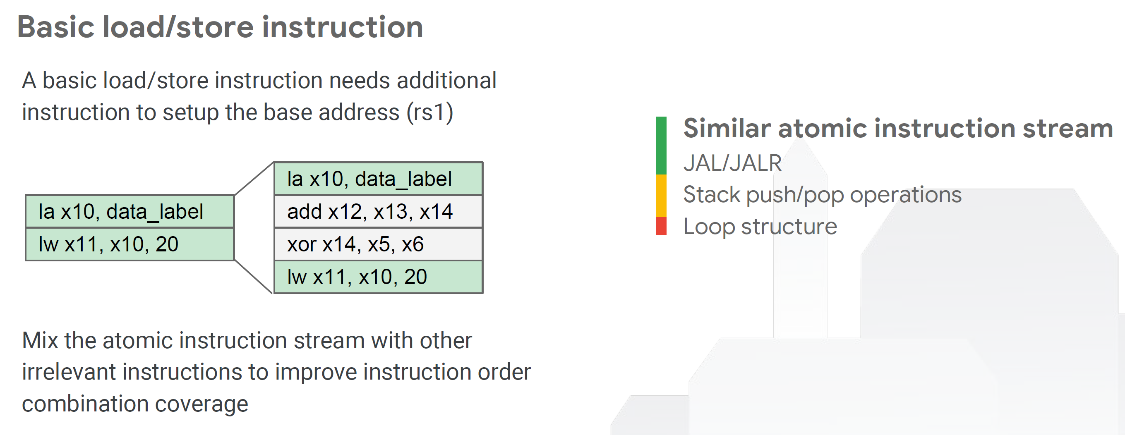
Load/store instruction generation

Slide 17
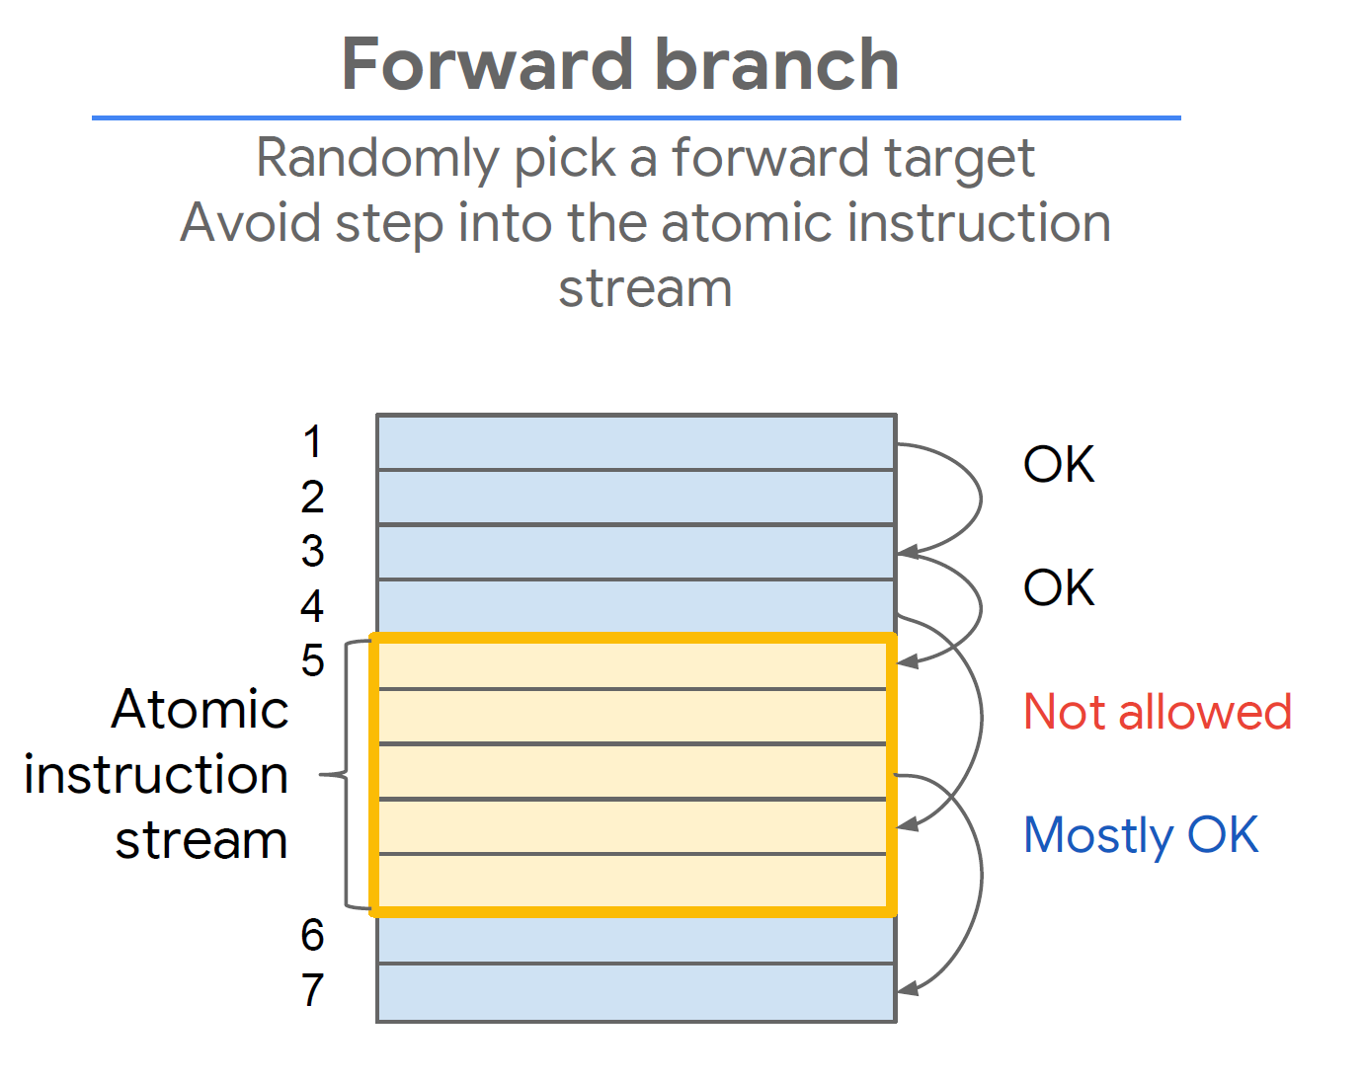
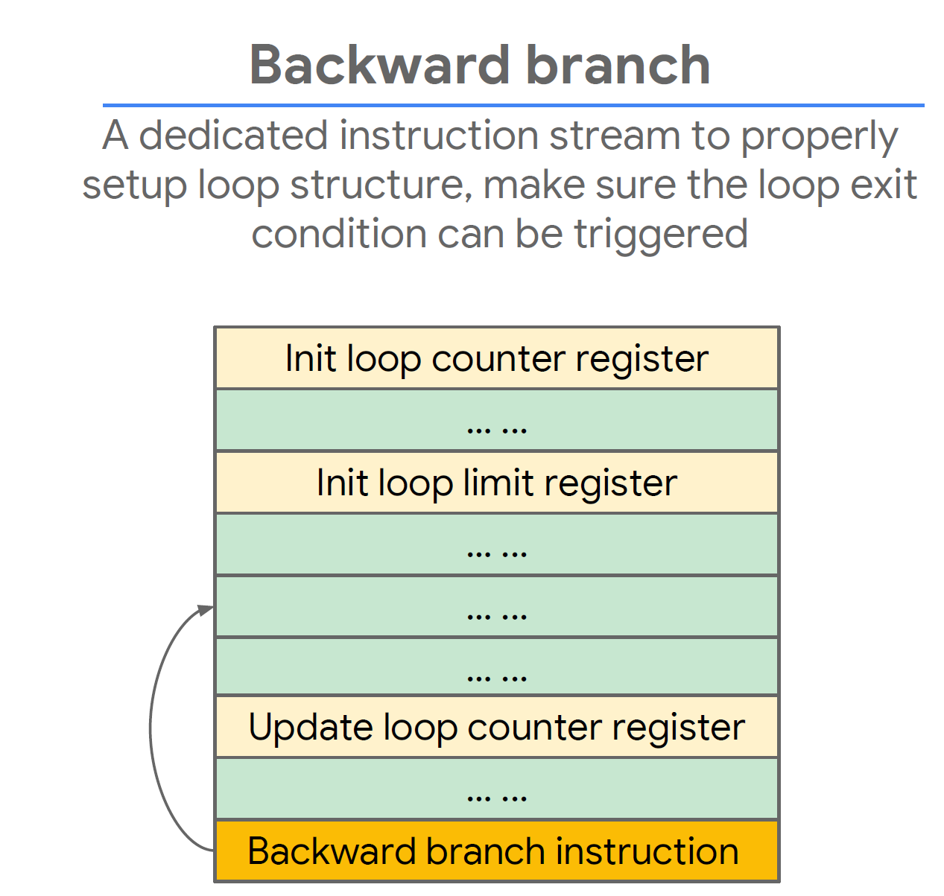
Branch instruction generation

Slide 18
Call stack
main
la rd0, jump_target_label
Level 0
addi rd1, offset, rd0
Level 1
jalr rd, offset, rd1
sub1
sub2
sub3
Generate directed jump sequence
to jump to specified target
Level 2
sub4
sub5
sub6
Level 3
sub7
jump seq
Randomly generate call stack tree structure
to avoid loop function call
Insert jump sequence into program stream
for program call connection

Slide 19
Comparison
 | NV RISCV generator | Google RISCV generator
Implementation | UVM based | UVM based
Output format | UVM sequence(optional HEX) | ASM file
Branch random | Both in random sequence | Forward random, backward in directed sequence
LSU random | Random | Directed sequence
CSR random | Dynamically changing | Not change
Exception | All kinds of exception | Part exception
Simulation performance | Need to improve | Fast
Global configuration | Separate control | Central control
Configurable target | No | Yes

Slide 20
Notes:
<number>

