Slide 1




Die-to-Die Protocols Specs for Chiplet-based Systems
TWG meeting, 13th December, 2021
Davide Schiavone, Denis Dutoit
davide@openhwgroup.org, denis.dutoit@cea.fr

Slide 2
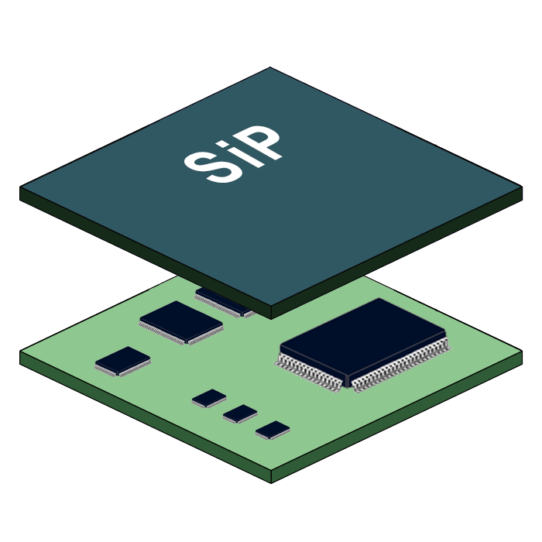
What we want to build
“We” includes as for now: Wavious, CEA, Thales, ETH Zurich, UC Santa Barbara, all WELCOME
MultiCore Application-Class Processor Chiplets (MAPETs)
Chiplet-based systems
System-In-Package
Scalable
Higher Power Efficiency
Reduced Time-To-Market
Lower Cost

Slide 3
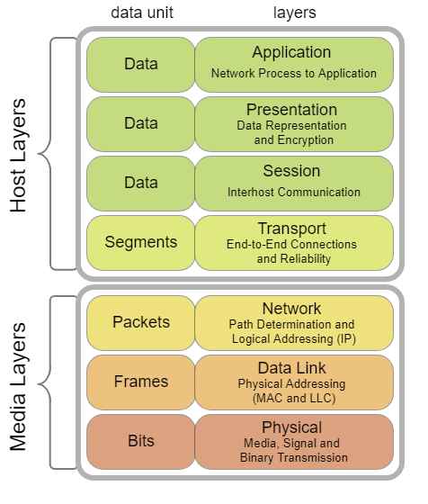
What we have/have not yet
What is available today as open-source?
CVA6: Application-Class RISC-V
OpenPiton: multiple instances of CV64A6 connected with a P-Mesh NOC (goes off-chip)
What is missing?
A standard network-layer specification for Die-to-Die communication
A standard link-layer specification for Die-to-Die communication
Relevant IPs to build the two above

Slide 4
Project Concept Network Layer Spec
Specification of the Die-to-Die network-layer protocol for chiplet-based System-In-Packages - Denis Dutoit, CEA
This protocol will be used by an adaptor to extend on-chip transport level protocols (as AMBA busses, P-Mesh, OBI, etc) off-chip.
This specification is the network layer specification and considers routing/addressing, ordering, coherency, security, and custom features (e.g. power).
A co-specification will define datalink layer aspects.
Test vehicles: the project will create an open-source UVM based verification testbench that may be used by implementers of the specification to verify their RTL implementation of the specification.

