Slide 1
OpenHW Group Project Execution Framework
Duncan Bees
Director, Technical Programs

Slide 2
//////////////////////////////////////////////////////////////////////////////
//
// Copyright 2024 OpenHW Group
//
// Licensed under the Solderpad Hardware Licence, Version 2.0 (the "License");
// you may not use this file except in compliance with the License.
// You may obtain a copy of the License at
//
// https://solderpad.org/licenses/
//
// Unless required by applicable law or agreed to in writing, software
// distributed under the License is distributed on an "AS IS" BASIS,
// WITHOUT WARRANTIES OR CONDITIONS OF ANY KIND, either express or implied.
// See the License for the specific language governing permissions and
// limitations under the License.
//
// SPDX-License-Identifier: Apache-2.0 WITH SHL-2.0
//
///////////////////////////////////////////////////////////////////////////////

Slide 3
OpenHW Group: Open Source Objectives
Open Source Objective | OpenHW Group
Community collaboration | Silicon + Hardware + Software + University + EDA Tools Product-ready baseline features
Enable flexibility and customization | CORE-V building block approach Companies differentiate at value-add
Innovation velocity | Research results flow directly to front end Collaborative project model Infrastructure/governance
Industrial quality | Open scrutiny of all contributions Focus on Industrial quality verification
Enable freedom of action | Open source licenses adapted to hardware Freedom to innovate

Slide 4
OpenHW Overview
Technical Working Group
Cores Task Group
Verification Task Group
Hardware Task Group
Software Task Group
Interconnect Task Group
Safety and Security Task Group
Marketing Working Group
OpenHW CEO + Staff
Facilitating/building project capacity
OpenHW Board
Oversight of working group results
Project framework and decisions
Open-source development
Specification development
Driven by Engineering staff of member companies

Slide 5
Industry Best Practices
Project framework supporting planning, monitoring and community collaboration
Agile/Hybrid Project organization models adapted to project needs
Industry standard toolsets along with mindset: industrial quality
Transparent, open-source contribution process
Technology Readiness Level assessment of project outputs

Slide 6
Project Execution Framework: Goals
Overall
Open, lightweight, and effective
Processor-IP + Enabling Ecosystem
Provide the checkpoints needed for processor design and verification
Industry quality, fully verified IP as project deliverables
Support multiple ecosystem outputs in one framework: RTL, software, hardware, FPGA, MCU, research
Collaborative Way of Working
Bring project concepts forward at an early stage
Project decisions in the hands of the members
Keep the members informed of the full range and status of projects

Slide 7
Stage Gate Flow
Gate Reviews
Gate reviews are held at monthly TWG meetings
Project Team presents review materials
Gate decisions by TWG majority vote
Project concept development
PC
Gate
Project organization
PL Gate
Project Concept
Project Launch
Project plan and requirements spec development
PA Gate
Project Work
PF Gate
Plan Approved
Project Freeze

Slide 8
Gate Details
Gate
Criteria
PC
Project Concept
Concept formulation. Proposed scope. Why do this project? Early view of PL details where available.
PL
Project Launch
Driving requirements, proposed features, work components, project supporters, high level schedule, project risks, license model
PA
Plan Approved
Project plan checklist: project methodology, initial agile backlog, requirements specification (1st section of the user manual)
Project work
PF
Project Freeze
RTL Freeze checklist or other final checklist

Slide 9
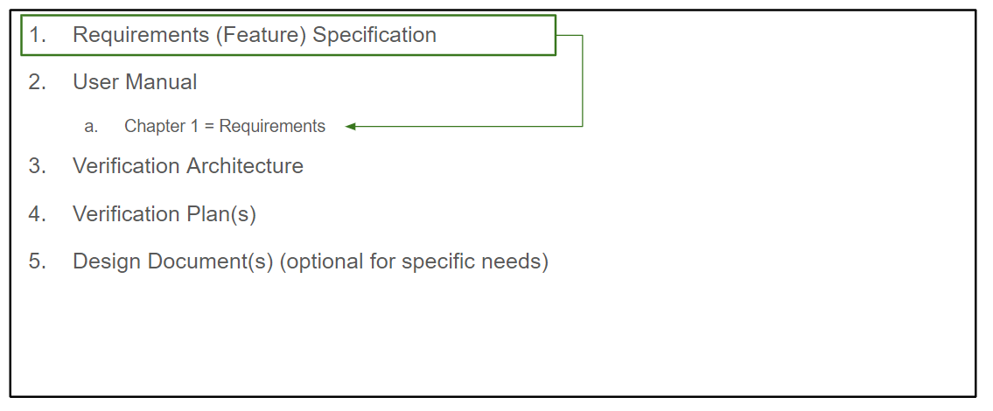
Cores Projects – Document Suite

Slide 10
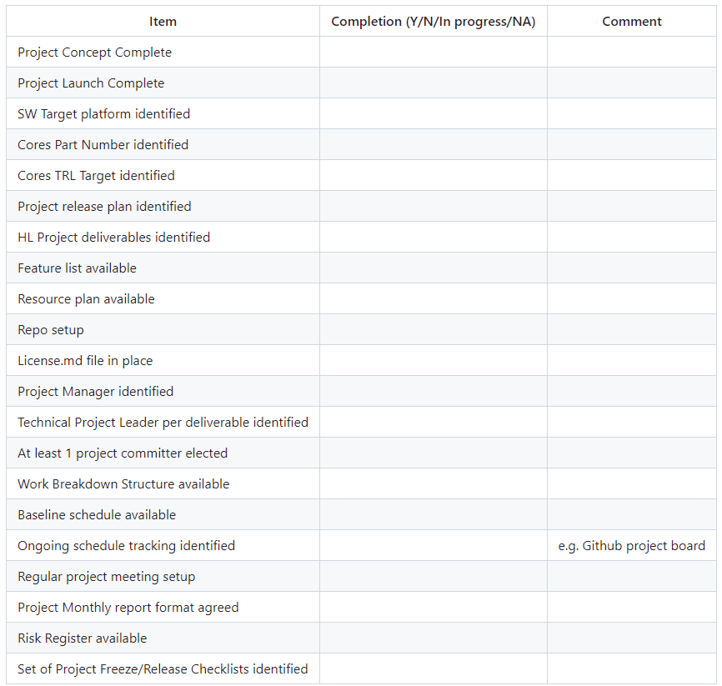
Plan Approved Checklist - extract
June 2024

Slide 11
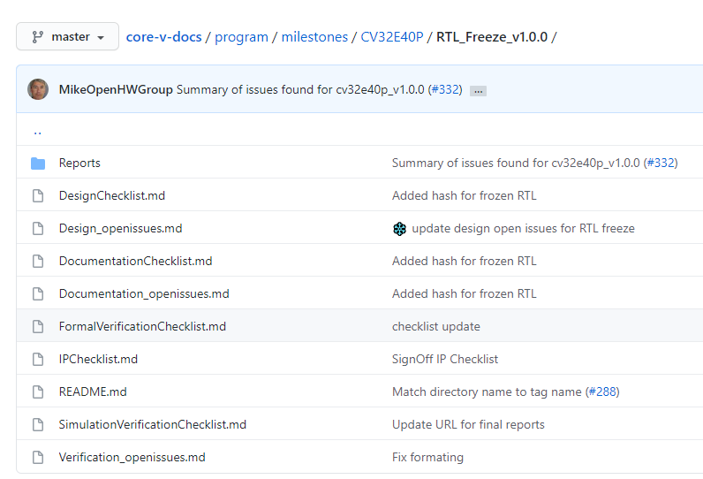
RTL Freeze Checklist - Example
OpenHW Checklists
Detailed sign-off metrics
Established Criteria
Actual signoff by a project committer
When the set of Checklists is completed and reviewed
The project is “frozen”
A Github tag is created for the release
Eclipse Release process initiated
Design rules
Coding rules
Linting
Verification planning
Code coverage
Functional coverage
Regression suites
Final report
All IP reviews complete

Slide 12
Project/Teams Organization
Project organization
TG chairs play a significant role in project oversight
Technical Project Leader(s) drive project coordination
Regular project and TG meetings
Open messaging channels (Mattermost, email)
Many projects use Github Project Boards
Top level schedule view (Waterfall) to at least a coarse granularity often used to initially flesh out a project schedule and create the project board
Coordination at TWG level
Cross-project coordination – for example simulator support for s/w development
Project gate reviews
Requirements specification review

Slide 13
Current Projects
https://github.com/openhwgroup/programs/tree/master/Project-Descriptions-and-Plans

Slide 14
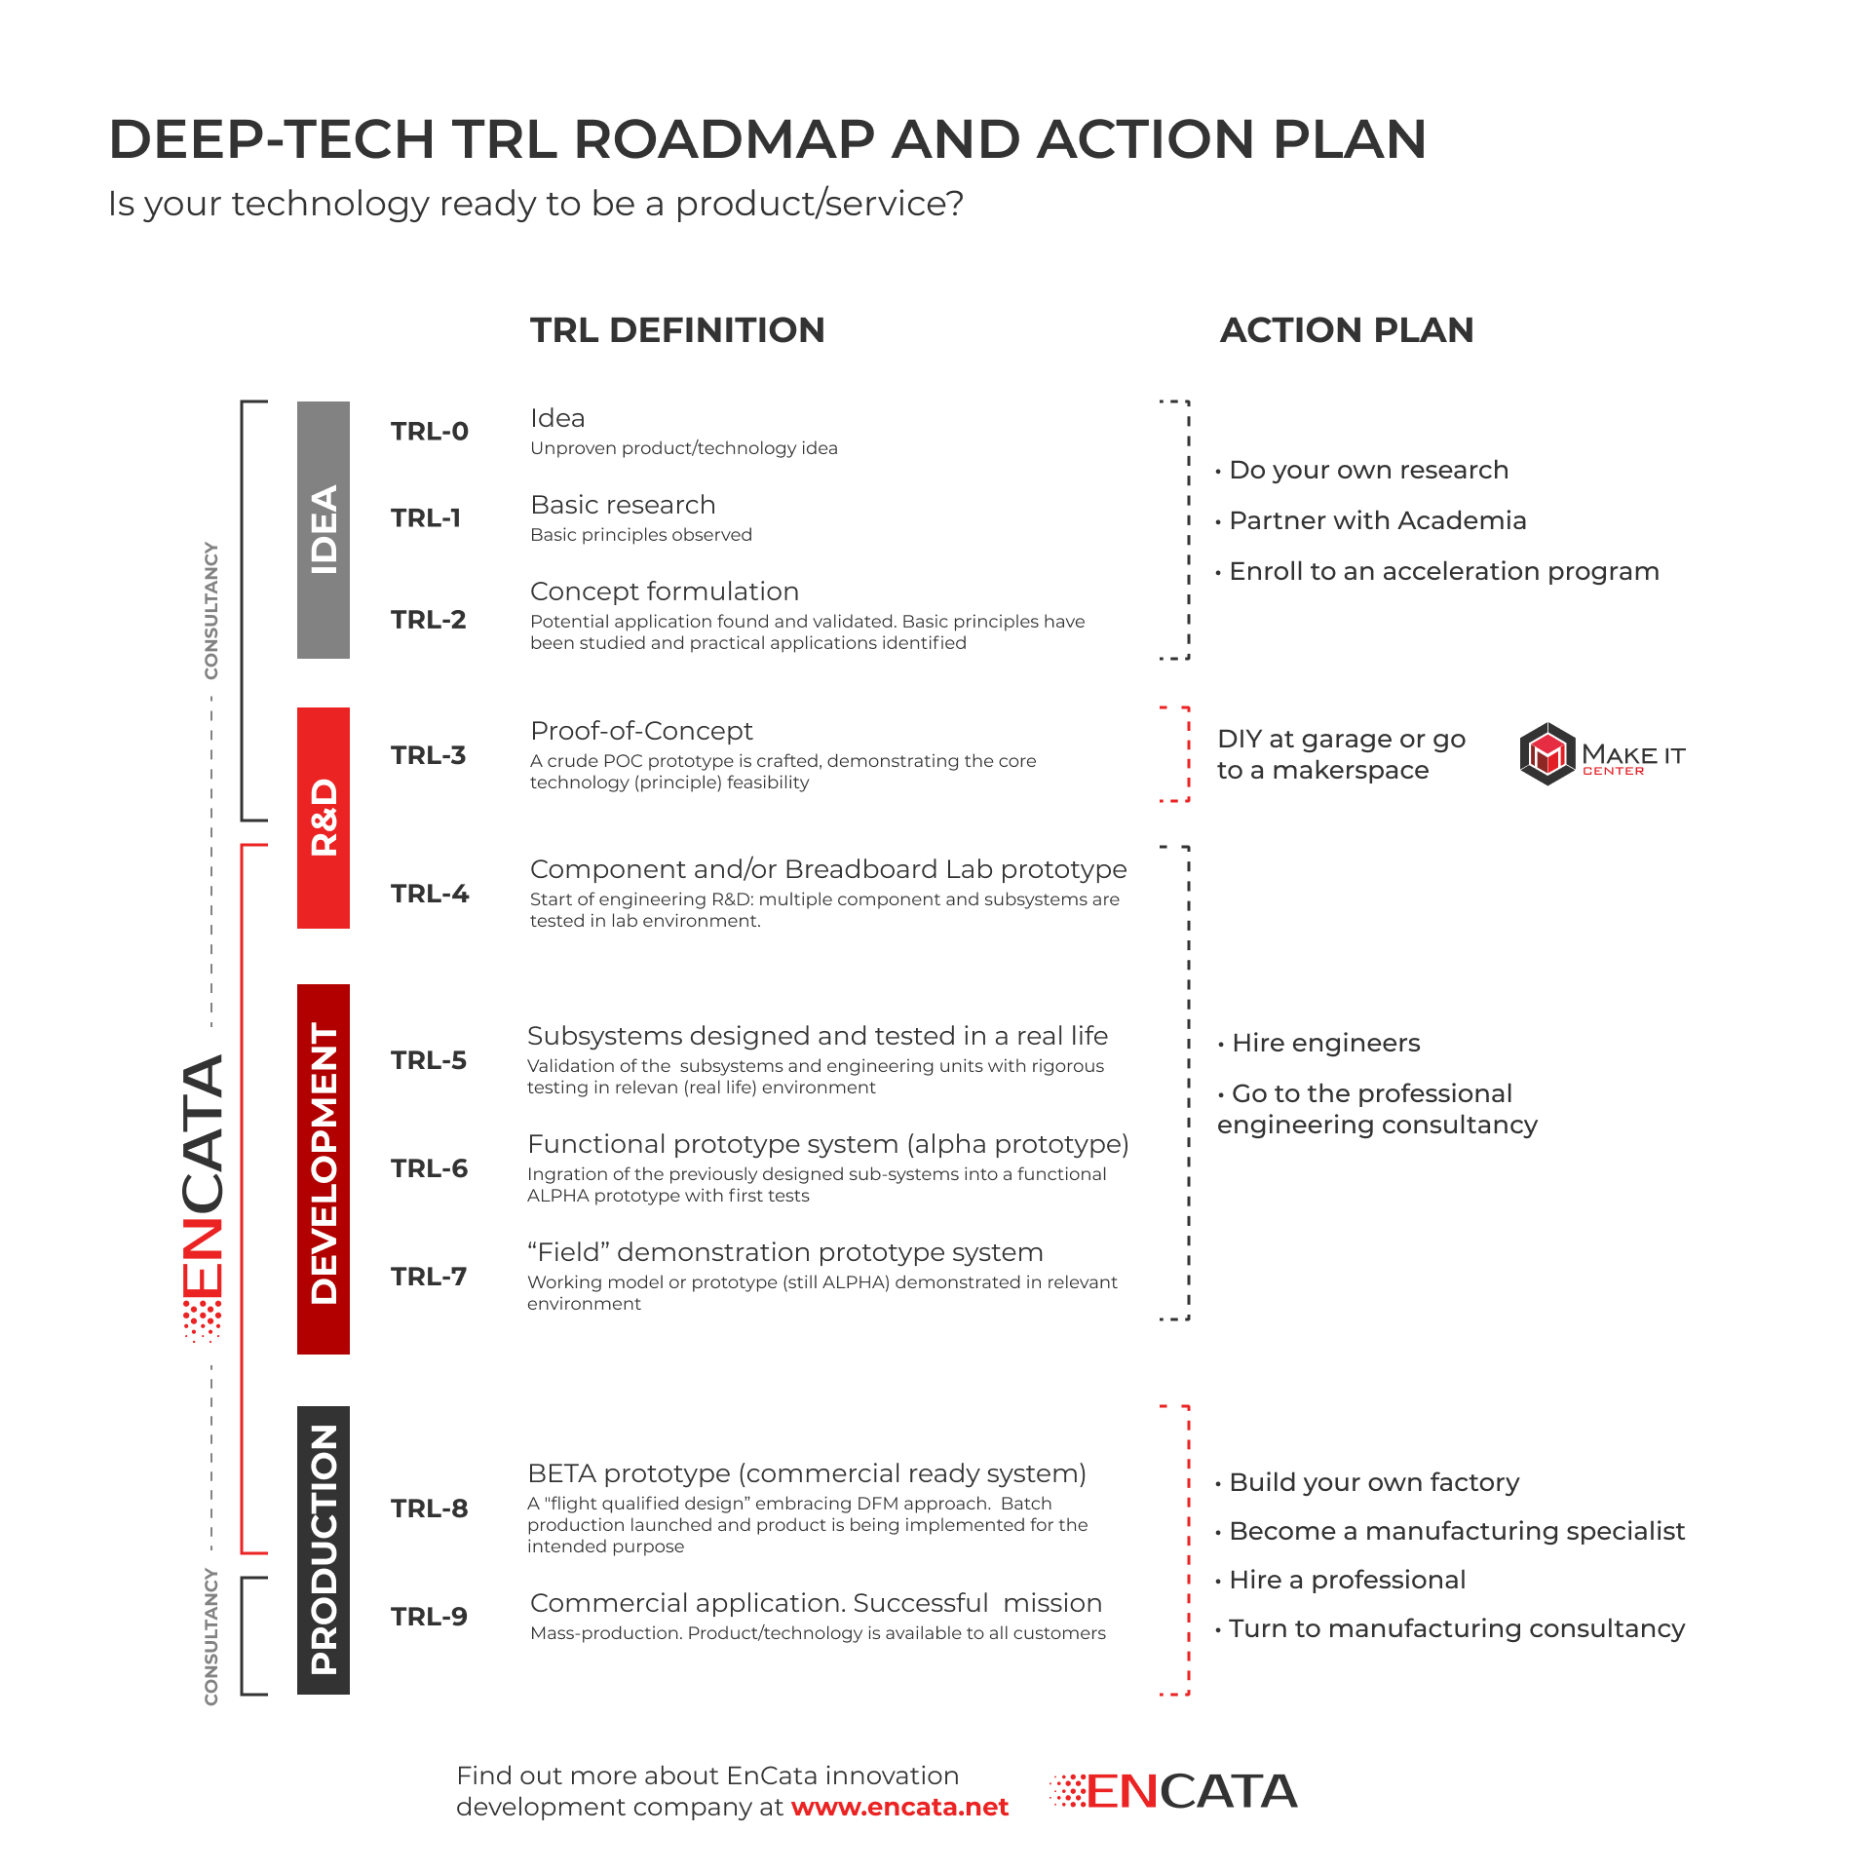
TRL Scale
OpenHW Technology Outputs
OpenHW IP Adopters

Slide 15
TRL Levels as Utilized by OpenHW
TRL | OpenHW Utilization
1-Basic Principles Observed | OpenHW research projects may target TRL-1 as project output, e.g. to develop novel approaches to core or accelerator architecture
2-Concept Formulation | Core IP or accelerator development projects to produce open source technology are typically initiated as TRL-2 concepts, identifying principles and applications of the IP The OpenHW Project Concept Gate includes a TRL-2 description of the Core IP
3- Proof of Concept | Core IP or accelerator development projects will pass through TRL-3 as the (RTL) design completes. Poof of concept is shown by core compilation and demonstration of basic operations (e.g. Linux booted, coremark results, hello-world)
4- Component Prototype | Core IP or accelerator projects will pass through TRL-4 as they produce preliminary PPA results (via synthesis scripts for FPGA or ASIC) and/or run preliminary application code, such as an accelerator running machine learning code.
5- Subsystem Designed and Tested | Core IP projects reach TRL-5 as they complete full verification. The OpenHW RTL Freeze checklist process verifies that the design is fully ready for industrial adoption.
6-Functional (Alpha) Prototype | OpenHW designed IP that is integrated into an MCU system or other device reaches TRL-6 as prototype Silicon is fabricated and demonstrated
7-Field Demonstration Prototype | OpenHW development boards incorporating a prototype Silicon system with OpenHW Software reach TRL-7 as they are demonstrated and deployed

Slide 16


OpenHW and Eclipse Foundation
Project Proposals and Selection
Stage Gate Reviews
Project Freeze Checklist
Team Organization
Continuous Integration
Technology Readiness Level
Processor-specific Ecosystem Requirements
OpenHW Project Framework
Contribution Process
Intellectual Property Review
Committer Responsibilities
Committer Elections
Release Management
Open source foundation
Eclipse Development Process

Slide 17
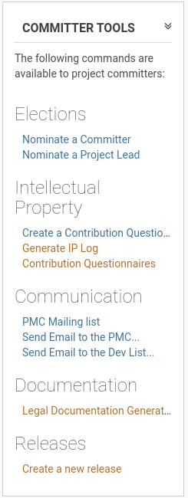

Committers and Contributors
“Committer meritocracy”
Committers are project stewards and have write access
Committer duties
maintain vendor/employer neutrality
operate transparently
enforce IP policy
review pull requests
Merit shown through a pattern of contribution
New Committers elected by existing committers
Any person who has signed the contribution agreement can make a pull request
Both Committers and contributors need to sign appropriate contribution agreements
© OpenHW Group
June 2024

Slide 18
Licenses and IP Review
Permissive project licenses
Solderpad 0.51/2.0
Apache 2.0
EPL 2.0
Automated Git review of Pull Request
Ensure contribution agreements in place
IP reviews on large contributions
IP review on 3rd party content before it can be included in any release
Must be distributed under approved open source
June 2024

Slide 19
Pulling it All Together
OpenHW – CORE-V Ecosystem Development
Full range of ecosystem projects – hardware and software
Industrial project management methods
Stage Gates and Checklists
Industry standard verification tools
Agile teams
Comprehensive open source flow
Full transparency of all artifacts
Technology Readiness Level assessment to identify the target output
Project dashboard at https://github.com/openhwgroup/programs/tree/master/dashboard

