Slide 1
Predictable & High-Performance RISC-V Multicore Framework
Overview

Slide 2
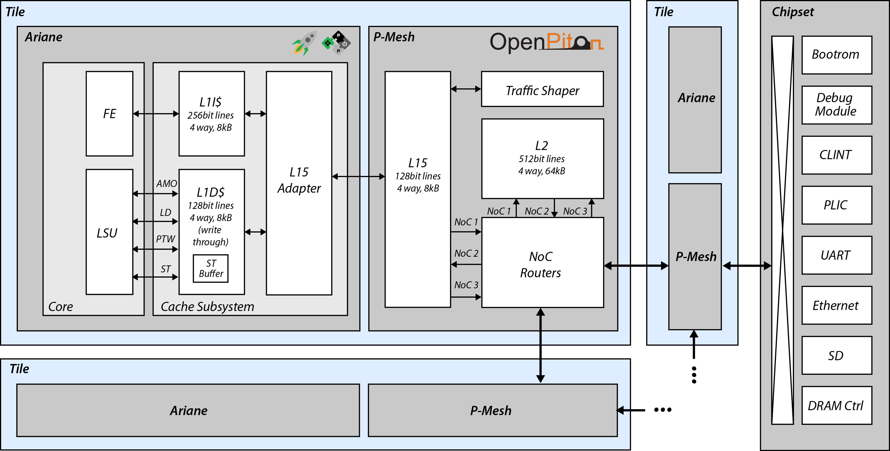
Predictable & High-Performance RISC-V Multicore Framework
State-of-the-art (OpenPiton):
+ Originally designed for scalable many-core platforms
- Trades some average performance for predictability
- Lacks predictable performance
Examples:
Directory-based MESI:
A minimum of three hops per coherence request
Distributed L2:
Different latencies whether you are accessing your tile or others
And also how many “tiles” you need to traverse.
2
Notes:
2

Slide 3

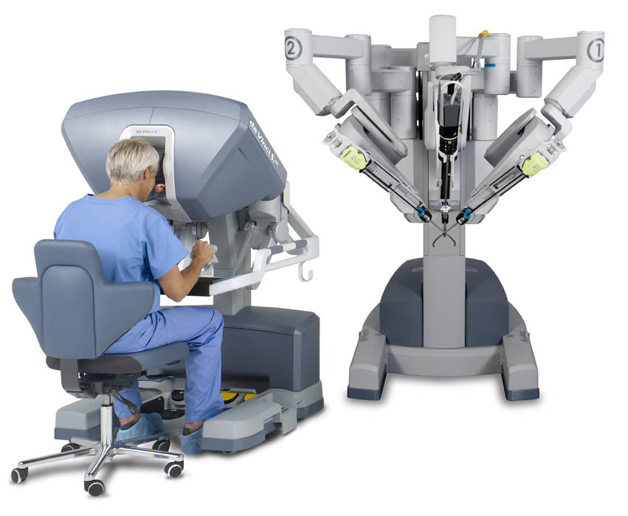
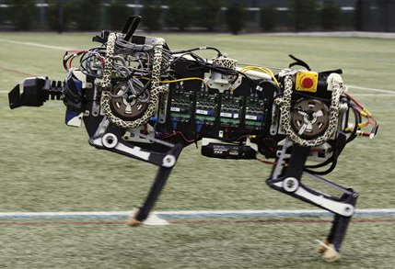
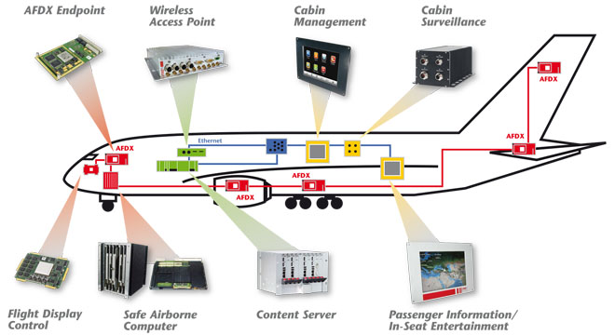
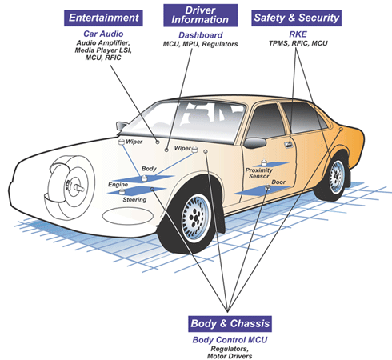
Why Predictable Performance?
A mandate for functional safety
Safety-Critical Systems
EN 50129
IEC 62304
IEC EN 61508
ISO26262
3
Notes:
3

Slide 4
Predictable & High-Performance RISC-V Multicore Framework
Goal:
A predictable and high-performance multi-core RISC-V Infrastructure
(3) Snooping Coherence
(1) Predictable Interconnect
(2) A predictable shared L2
(4) Predictable MC to high-performance DDR4
4
Notes:
4

Slide 5
Duetto: Dual-Mode Arbitration
HPA arbitrates among requests generated by requestors and sends commands to the hw resource
HPA
Resource
(cache, memory, interc. …)
Request Queues
Requestors
(cores, GPU, accelerators, DMA…)
5
Notes:
5

Slide 6

Duetto: Dual-Mode Arbitration
We add a RTA that runs in parallel with the HPA
A monitor provides latency guarantees to requestors
Desired latency requirements can be set for each requestor / type of request (CONFIGURABILITY)
If the system is not heavily loaded, use the HPA output
If the system is pathologically overloaded and latency guarantees could be missed (extremely rare), switch to the RTA
HPA
Resource
(cache, memory, interc. …)
Request Queues
Requestors
(cores, GPU, accelerators, DMA…)
RTA
Monitor
6
Notes:
6

Slide 7
Duetto: Dual-Mode Arbitration
Almost no change required for the HPA
The model works as an add-on functionality to an existing arbiter/resource (INTEGRATABILITY)
If real-time guarantees are not needed, we can disable the RTA/monitor and the system will behave as the original one
The RTA/monitor require some area, but vast majority of power is consumed by the resource
HPA
Resource
(cache, memory, interc. …)
Request Queues
Requestors
(cores, GPU, accelerators, DMA…)
RTA
Monitor
7
Notes:
7

Slide 8
Backup Slides
Notes:
8

Slide 9
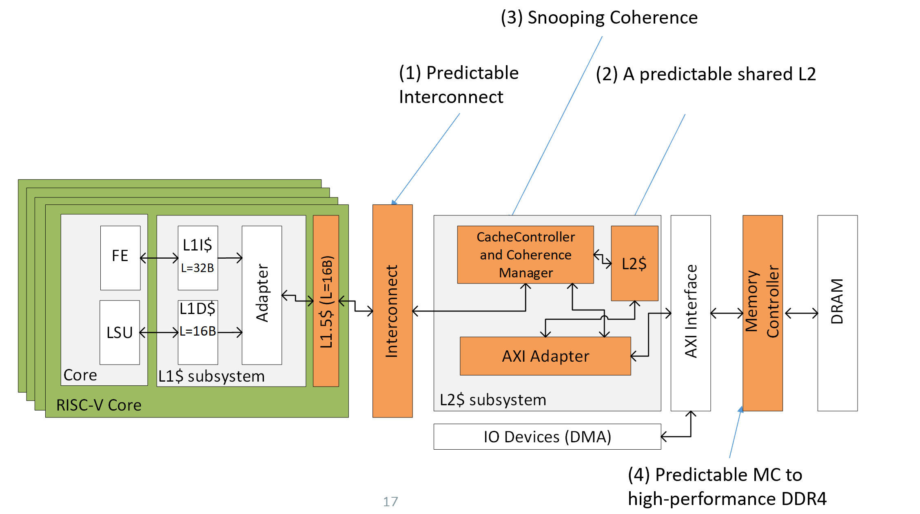
Duetto: Applying to Different Memory Resources
Two resources:
Cache coherent interconnect between private L1 and shared L2
DRAM main memory
For each resource:
Architectural Simulation results (current progress)
Plan for FPGA implementation
9
Notes:
9

Slide 10
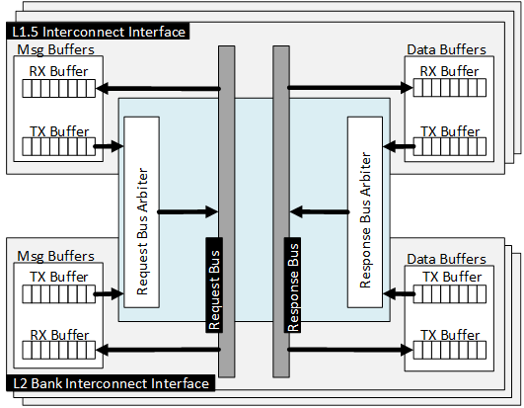
Duetto Resource 1: Caches
10
Notes:
10

Slide 11
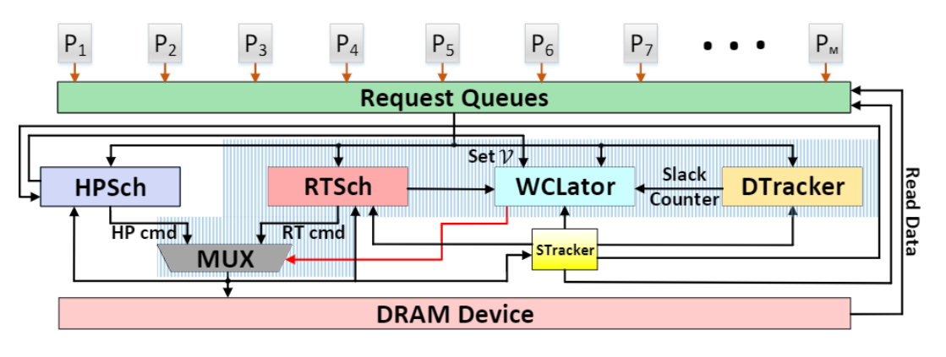
Duetto Resource 2: DRAM
11
Notes:
11

Slide 12
Duetto Resource 2: DRAM
12
Notes:
12

Slide 13
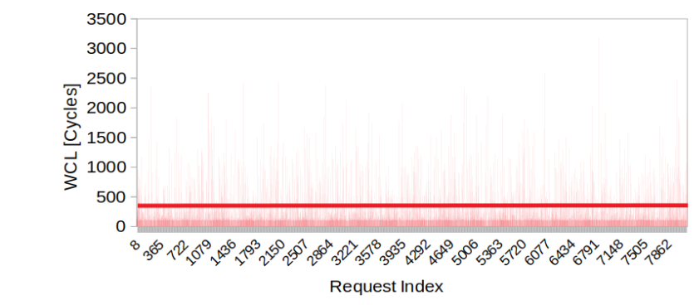
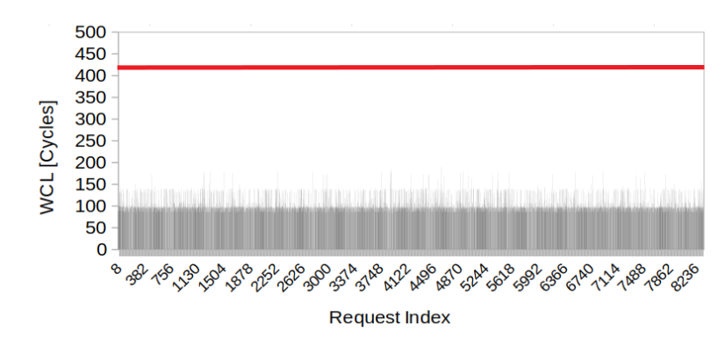
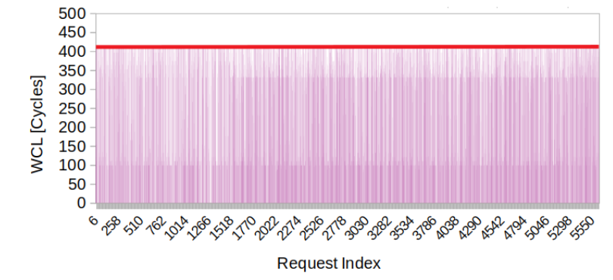
Duetto Architectural Simulation Results
Resource 1: Coherent Interconnect, private L1s and bankized shared L2
HPA
RTA
RTA provides latencies well below the bound…
HPA shows large latency spikes
Duo$
Latencies are now very close to the bound…
13
Notes:
13

Slide 14
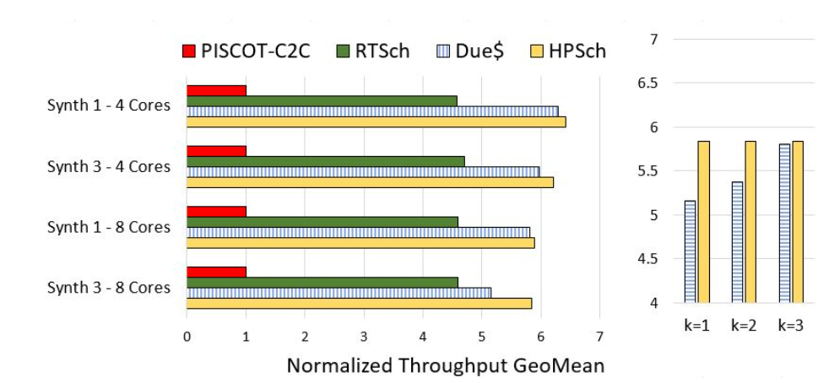
Duetto Architectural Simulation Results
Resource 1: Coherent Interconnect, private L1s and bankized shared L2
>4x performance over state-of-the-art predictable coherence solution
Near-COTS performance with Duetto
Configurable deadline helps in latency vs performance trade-off
14
Notes:
14

Slide 15
Duetto Architectural Simulation Results
Resource 2: DRAM
8 requestors - cores running memory-intensive benchmarks - accessing the same device
Cycle-accurate simulation using our MCsim memory controller simulation framework [1]
Cache and bank-level partitioning for improved isolation [2]
HPA uses standard FR-FCFS arbitration
… with only 3% average IPC reduction
HPA
Dual Mode
RTA
15
Notes:
15

