Slide 1
10xENGINEERS
RISC-V INTERNATIONAL · RFP v1.1
Automatic Test Generation
from the Sail Golden Model
A hybrid framework: symbolic path-solving where the model can be reasoned about,
concrete model-as-oracle where it cannot, and one control layer that decides which.
Technical proposal
10xEngineers
15 weeks · 2 engineers · USD 32,000
Apache-2.0

Slide 2
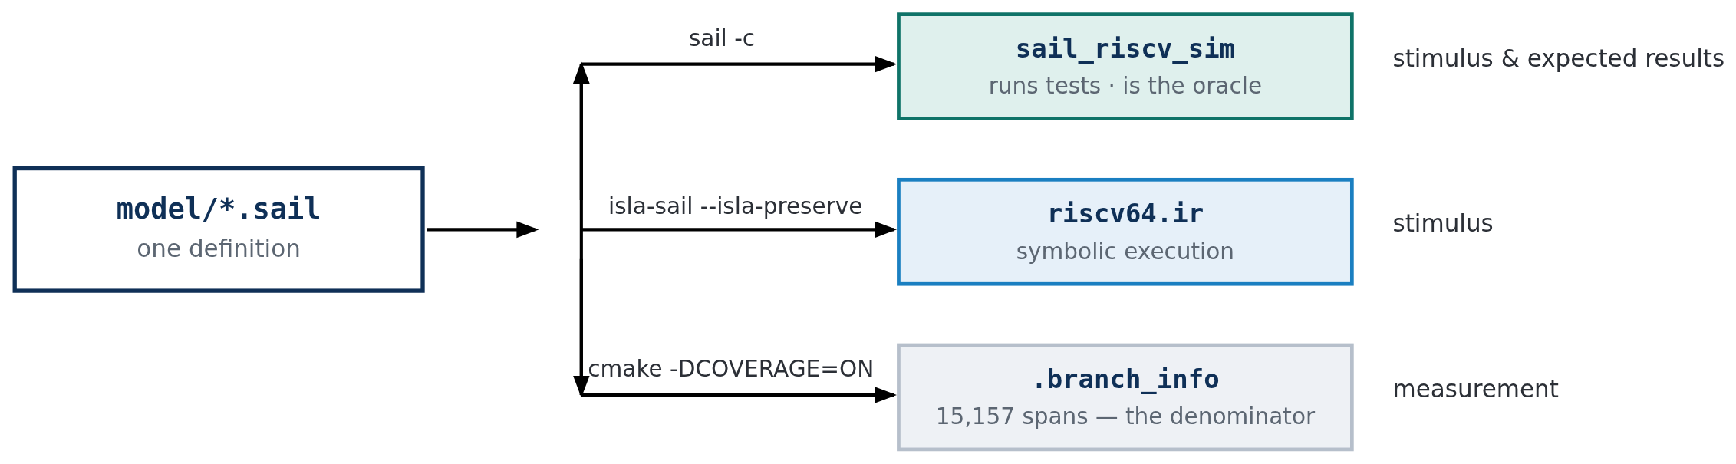
10xENGINEERS
What Sail is, and what it produces
An executable definition of the architecture — simultaneously the specification, the simulator, and the source of the tests.
The same source serves generation and measurement. That is what makes coverage figures meaningful here: the thing being
measured and the thing generating the tests are the same definition, not two independent interpretations of a document.
Every link back to the model — encodings, expected results, coverage denominator — moves when the architecture moves.
No table in this framework needs hand-editing when an instruction is added.
1

Slide 3
10xENGINEERS
How Sail compiles, and why it matters to us
Step
What happens
Why it matters
Parse and type-check
Types depend on values — a bitvector's width is part of its type
Illegal-width code cannot be written; VLEN must be fixed at compile time
Lower to JIB
An imperative IR: no pattern matching, no polymorphism, explicit control flow
JIB is what both back ends consume
C back end
JIB → C → sail_riscv_sim
The executable Golden Model. With -DCOVERAGE=ON it records which spans ran
isla-sail back end
JIB serialised to a .ir text file rather than compiled to C
Lets isla interpret the model with symbolic values
Two compile-time facts shape the whole design. isla-sail is a Sail plugin — it links libsail and registers as a target, so it
tracks the same front end as the C build. And --isla-preserve is mandatory on the entry points: without it they are pruned
as dead code and the IR decodes nothing, with no error message. Configuration is baked in here too — XLEN and VLEN are
frozen in the IR, not chosen at run time.
2

Slide 4
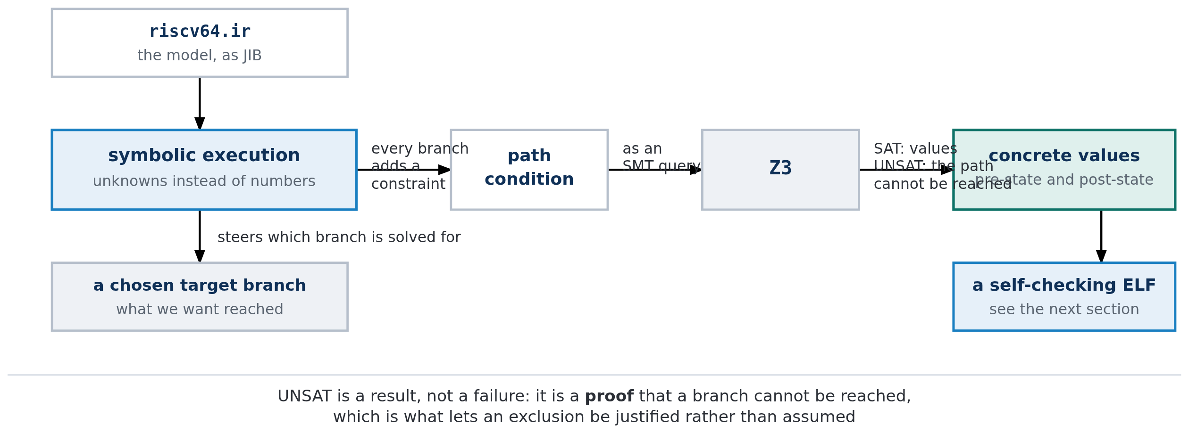
10xENGINEERS
isla-testgen — solving for the inputs that reach a branch
Run the model with unknowns in place of register and immediate values. Every branch adds a condition. Hand the result to an SMT solver.
UNSAT is a result, not a failure. It proves a branch cannot be reached — which is what turns an untested span into a
documented exclusion rather than a permanent, unexplained gap in the coverage figure.
3

Slide 5
10xENGINEERS
From IR to assembly to ELF
Solving gives numbers. Turning numbers into a runnable, self-checking program is a separate job.
What is produced
Detail
1
Concrete pre- and post-state
extract_state.rs asks the solver for a model and reads out every register and memory region. Nothing symbolic survives
2
A .s assembly file
The preamble that builds machine state, the instruction as raw bytes, expected-value tables, a trap handler, pass/fail reporting
3
A .ld linker script
Every section pinned at a fixed, non-overlapping address, with ENTRY(preamble)
4
An .elf
The real GNU assembler and linker are invoked — no bespoke ELF writer
Why raw bytes, not mnemonics
The test must exercise the exact encoding the model decoded — and it lets the generator emit encodings no assembler accepts,
which is how illegal-instruction behaviour gets tested at all.
Why the tests check themselves
Expected values are compiled in as data; the verdict goes out through an HTIF tohost write. So one artefact runs on Sail,
Spike, QEMU and RTL with no harness and no wrapper.
4

Slide 6
10xENGINEERS
What isla-testgen is good at — and what it cannot do
Both lists come from building on it. The limitations are why this proposal is for a hybrid, not for scaling one engine up.
STRENGTHS
LIMITATIONS
Reaches branches on purpose — name one, get a test, or a proof that nothing can
Proves unreachability — UNSAT turns a permanent gap into a justified exclusion
Knows the exact final state — the post-state comes from the same solve
Rare inputs are natural — divide-by-zero, misalignment, boundaries are just constraints
Tracks the model automatically — instructions and encodings read from the .sail sources
Floating point — SoftFloat is external C; symbolically the operations are holes
Vector at realistic VLEN — isla's widest bitvector is 129 bits; VLEN 256 and 512 cannot be represented
Machine state — the solver derives operands, not "put a PMP entry here"
Control transfers into solved code — unsatisfiable, so privilege changes go in the preamble
Cost per test — every test is an SMT solve; wrong tool for bulk volume
isla-testgen is a precision instrument. It is right when you know which branch you want and need to be sure you reached it,
and wrong when you need many tests, wide configurations, or any part of the model it cannot represent.
5

Slide 7
10xENGINEERS
The REMS lineage — use the model as an oracle
The same research programme that produced Sail and isla established the other approach, and it is much older and simpler.
1. Pick an instruction and fill its operand fields
2. Build a small program that sets up registers, executes it, and stops
3. Run it on the model — whatever state comes out is, by definition, correct
4. Emit the same program with that state written in as assertions
5. Run it anywhere. Any implementation that disagrees with the model fails
Symbolic
Model-as-oracle
Question
What inputs reach this branch?
What does the model do with these inputs?
Needs the model to be
symbolically interpretable
runnable
Cost per test
An SMT solve
One simulator run
Reaches deep conditions
By construction
By luck
Proves unreachability
Yes
No
FP and wide vectors
No
Yes — it is just execution
Many configurations
Poorly
Well
The REMS OCaml random generator exists but is not a usable base
Last commit 2019, pinned to a Sail AST shape seven years stale. We took the method and rebuilt it against the current model — which is why our instruction list comes from parsing the model.
Every row is a mirror image.
Each method's weakness is the other's strength, with no overlap in the failure modes. That is unusually clean, and it is the whole argument for combining them rather than picking one.
6

Slide 8
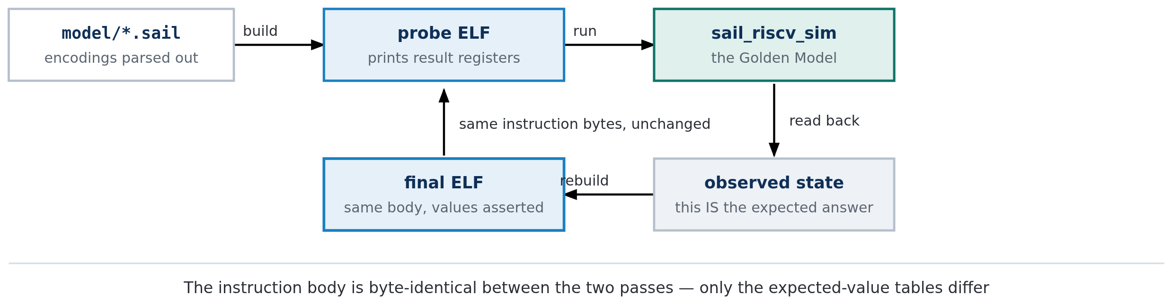
10xENGINEERS
Our concrete oracle — the REMS method, rebuilt
Two deliberate departures: enumerated rather than random, and two ELFs sharing one body.
Not random — enumerated
The instruction list and encodings are parsed from the .sail sources, then swept systematically. Random sampling cannot tell you what it missed; enumeration gives a denominator.
Two ELFs, one body
A probe ELF runs first and prints the result registers; the final ELF is the same program with those values compiled in as assertions. The expected state is observed, never predicted.
The circularity we state openly: expected values come from sail_riscv_sim, so re-running an oracle test on Sail proves only self-consistency.
The independent evidence comes from Spike, QEMU or RTL — and every figure says which simulator produced it.
7

Slide 9
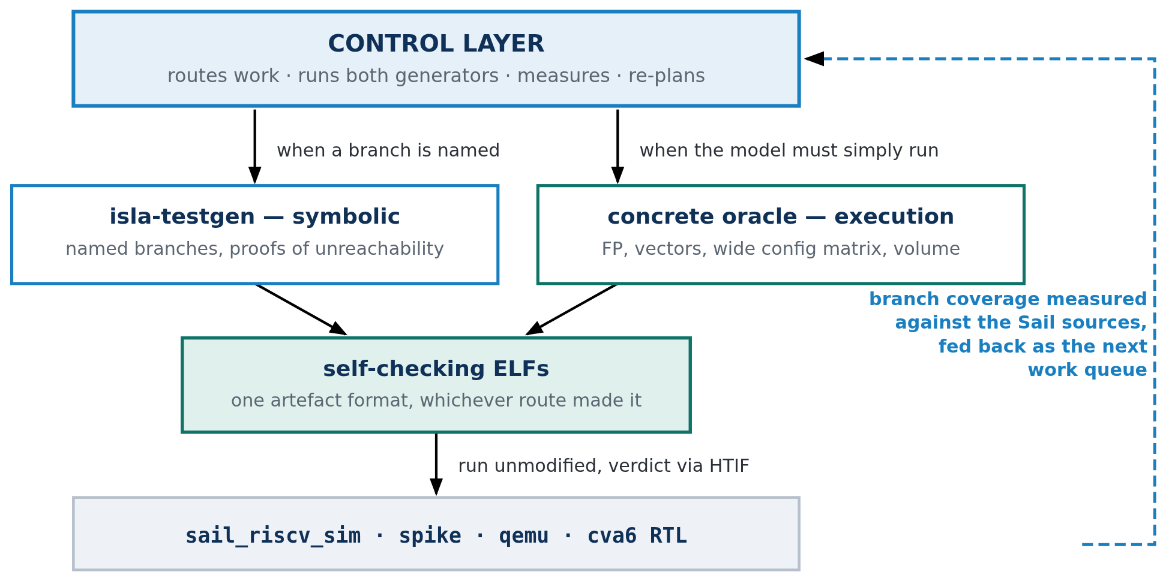
10xENGINEERS
The proposed framework
Two generators that fail in opposite directions, and a control layer that decides which one runs, measures what came back, and turns the shortfall into the next batch of work.
The dashed return path is what makes this a framework rather than two tools: coverage is not only reported, it is the input that
decides what gets generated next.
8

Slide 10
10xENGINEERS
How the control layer operates
Four jobs — the component that turns "we have two generators" into "we have a method".
1
CONFIGURE
One Golden Model configuration, parsed once, deriving everything downstream: the IR to load, the assembler's -march, the simulator's ISA string, which extensions exist. Previously re-derived in four places, which is how they drifted apart.
2
ROUTE
Sends each target to the generator that can reach it. FP arithmetic and wide vectors to the oracle because isla cannot represent them; named privileged branches to isla because random execution reaches them only by luck.
3
EXECUTE & JUDGE
Runs each ELF on the Golden Model and on at least one independent simulator, then classifies every failure as model fault, framework fault, or correctly routed. A bare pass/fail count is not an acceptable output.
4
MEASURE & RE-PLAN
Replays the corpus against the instrumented model, reconciles every span to hit / missed / excluded-with-reason, and turns the remainder into a stimulus queue that names what is missing rather than only where.
One rule above all others: architectural state is built in the preamble, never solved for. The solver derives instruction operands; PMP entries,
page tables and privilege transitions are constructed arithmetically. Attempting the reverse fails outright.
9

Slide 11
10xENGINEERS
Methodology — the scripts, and what each one does
Seventeen scripts in python-isla/, in four groups. Each is a single job with a single output, so any one can be run alone when debugging.
FOUNDATION
GENERATION
MEASUREMENT
REPORTING
· paths.py — where everything lives, resolved once
· model_config.py — one config, parsed once, deriving everything
· model_opcodes.py — encodings straight from the .sail sources
· test_config.py — what each test requires, where a runner can read it
· opcode_sweep.py — per-Sail-file sweep, one instruction at a time
· sweep_all.py — the batch driver across extensions and both XLENs
· sweep_status.py — how far a running sweep has got
· csr_sweep.py — Zicsr across real named CSRs
· scenario_tests.py — the privileged scenarios, each with negative controls
· coverage_report.py — replay the corpus, report Sail branch coverage
· derive_span_exclusions.py — spans no test can reach, with reasons
· coverage_analysis.py — uncovered spans → what stimulus is missing
· coverage_matrix.py — per-instruction status across both generators
· testplan.py / testplan_html.py — a plan derived from the branch structure
· regression.py — what got worse since the baseline; exits non-zero
· status_report.py — per extension, what failed and whose fault it is
scenario_tests.py is where privileged coverage lives: tests that set up architectural state rather than exercising one instruction in isolation.
10

Slide 12
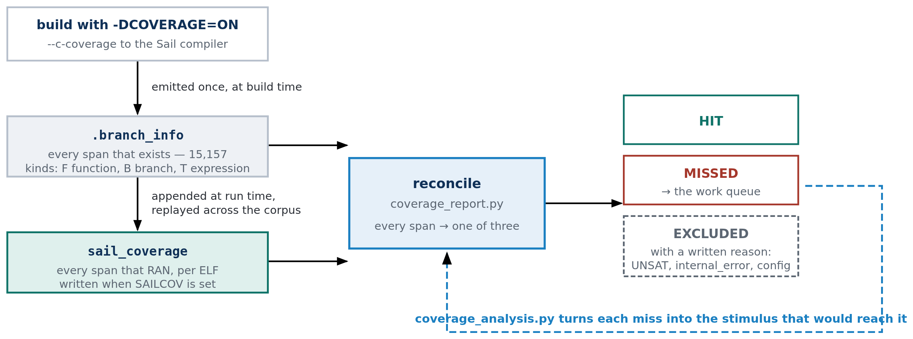
10xENGINEERS
The coverage flow
The RFP asks for coverage in terms of the Sail code — branches in the specification's own source, not instruction counts.
Two files do all the work: a manifest of every span the build contains (15,157), and a trace of the spans a run executed. Coverage is the ratio.
The third bucket — excluded, with a written reason — is what makes a target of 100% honest rather than impossible.
A percentage is only as good as the run behind it. Span totals are stable; percentages depend on which corpus was replayed — so every figure names its corpus and its date.
11

Slide 13
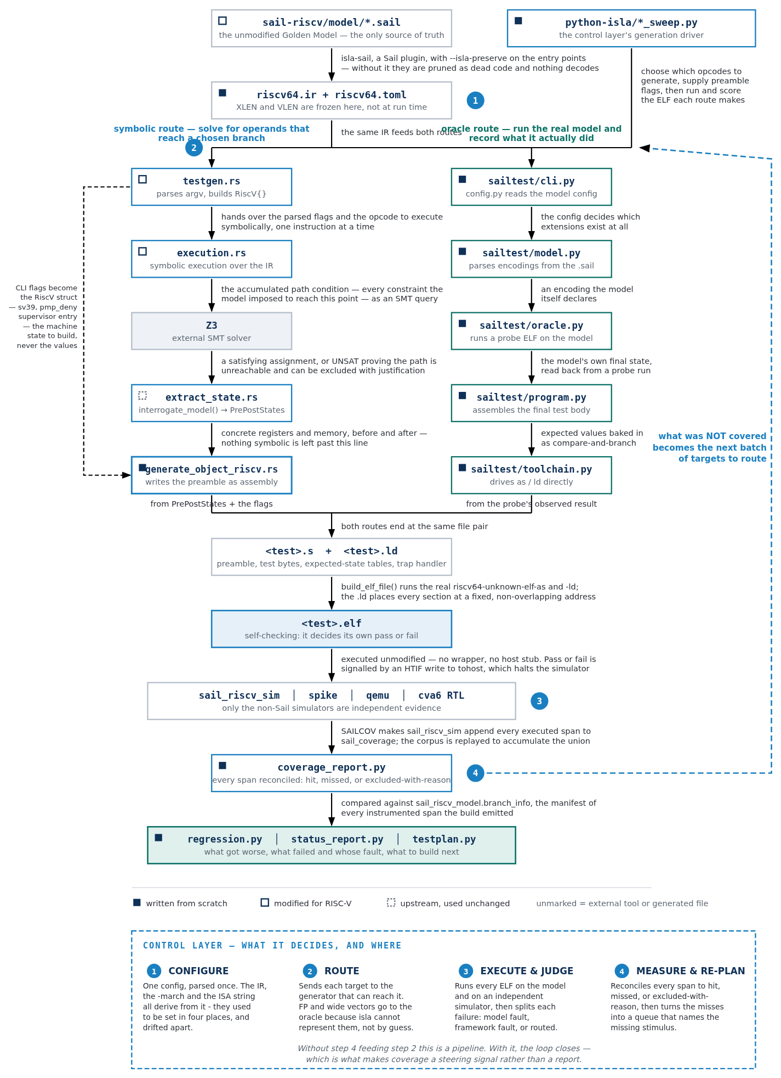
10xENGINEERS
The complete flow, file by file
Each arrow says what that step does. Numbered circles are the control layer's decision points; the long dashed arrow is the loop that closes.
12

Slide 14
10xENGINEERS
Running the tests, and riscv-arch-test compliance
RUNNING — nothing special is required
ACT4 COMPLIANCE — six steps, all implemented
sail_riscv_sim --config <cfg.json> test.elf
spike --isa=rv64imac_zicsr test.elf
1
Cross-check our isla-sail compile config against ACT4's own sail.json
2
Adopt ACT4's exact tohost/fromhost declaration — a real, sized, backed section
A test is a plain ELF that decides its own verdict.
Reporting is an HTIF write to tohost — a nonzero odd value halts the simulator, pass and fail encoded exactly as riscv-arch-test's own macros.
An ecall was tried first and is wrong: that is the syscall-proxy convention, only active under spike pk. On bare metal it traps back into our own handler.
The ISA string, the -march and the model config all derive from one parsed configuration — a mismatch here is the most common cause of a spurious "Sail and Spike disagree".
3
Optional begin_signature / end_signature region behind a flag
4
START_TEST_CONFIG / END_TEST_CONFIG header for test discovery
5
Prove it through config/sail/ first — one ELF through ACT4's own build
6
Directory placement and make integration
QEMU's HTIF reads the symbol's ELF st_size and refuses to start if it is 0 — which is what a bare label gets. That is why step 2 matters and a linker constant will not do.
13

Slide 15
10xENGINEERS
PMP and PMA — the case space is derived, not chosen
PMP register state is 2^4608 configurations. pmpCheck distinguishes about 44, because it composes three stages that read disjoint state.
Stage
Reads
Cases
FIVE ADDRESS POSITIONS
1 entirely below NoMatch
2 straddling the low edge FAULT
3 wholly inside Match
4 straddling the high edge FAULT
5 entirely above NoMatch
Address match
the address and pmpaddr
17
Permission check
the access kind and R/W/X
18
Privilege override
privilege and the lock bit
4
pmpRangeMatch compares only addr and addr+width against the two edges. Positions 2 and 4 fault regardless of permissions — the two a hand-written suite omits.
Structural
entry 0, priority, fall-through, zero entries
5
Total
counts ADD because the stages do not interact
44, not 1,224
PMA works differently
Attributes are per-region fields in the model's own config JSON, not CSRs. A PMA test is "run this access under a config whose region forbids it" — no new generator capability at all.
One case no branch can see
NAPOT computes its bounds with mask arithmetic. A bug there gives wrong bounds without changing any branch — so coverage-guided where branches exist, value-guided where the code is arithmetic.
Measured 27 August 2026: one generated lw against a denied region reaches 35.8% of pmp/. Five tests reach 37.6% and 7 of 19 access arms —
but pmp_regs.sail, two thirds of the file, does not move by a single span. Register semantics need a different campaign, and that is a stated line item.
14

Slide 16
10xENGINEERS
Traps, interrupts, translation and virtual memory
TRAP HANDLERS
INTERRUPTS
TRANSLATION & VM
· Emitted as assembly per test, not linked from a library
· Default: any trap fails the test — mtvec armed by the preamble's first instruction
· --expect-trap-cause: compare mcause, continue only on an exact match
· --trap-is-pass: report success from the handler — required for any violation test
· Advance mepc by 2 or 4 depending on whether the instruction was compressed
· Delegated traps read scause, not mcause — reading the wrong one is how a delegation test passes without delegation
· Three conditions must be arranged, and getting one wrong looks like a pass
· --pending-interrupt: pending + mie, MIE left clear — tests WFI, not delivery
· --deliver-interrupt: adds mstatus.MIE, so the trap is taken
· --delegate-interrupt: a supervisor interrupt with mideleg set and stvec installed
· Machine-level interrupts cannot be delegated — mideleg hardwires MEI/MTI/MSI to zero
· An interrupt cause is the code with the top bit set — tested as a sign bit, so it stays XLEN-independent
· satp.MODE decides the scheme — M-mode never translates, so tests must drop to Supervisor
· The page table is emitted into .data: 512 entries, leaf PTEs at the root, one 1 GiB gigapage each
· Two of 512 mapped — leaving 509 invalid is what makes an unmapped-page test possible
· Permissions are three gates: privilege (SUM allows loads and stores but never a fetch), shadow stack, then R/W/X after MXR
· MXR, SUM and MPRV each change the answer without touching a PTE
Virtual memory cannot be tested apart from PMP. Dropping to Supervisor arms PMP's default-deny, and the walker's own PTE reads are PMP-checked.
The joint case: deny the region the page table itself lives in — a correct model reports an access fault, a wrong one a page fault.
15

Slide 17
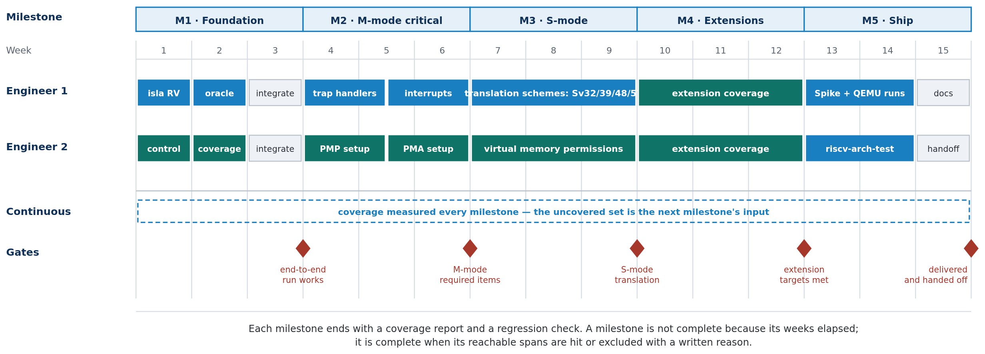
10xENGINEERS
Fifteen weeks, two engineers, five milestones
Engineer 1 works on the generators, Engineer 2 on the control and measurement layer. In M1 that split lets both start on day one; from M2 the pairing
is deliberate — traps and interrupts belong together, PMP and PMA belong together, translation and its permissions are two halves of one feature.
A milestone is not complete because its weeks elapsed. It is complete when its reachable spans are hit, or excluded with a written reason.
16

Slide 18
10xENGINEERS
Milestones, owners and exit gates
Milestone
Wk
Engineer 1
Engineer 2
Exit gate
M1 Foundation
1–3
RISC-V support in isla-testgen (1w)
Custom oracle test generation (1w)
Control layer development (1w)
Coverage collection and analysis (1w)
One instruction generated by both routes, run on Sail and Spike, with a coverage number attached
M2 M-mode critical
4–6
Trap handler generation
Interrupt and exception handling
PMP setup
PMA setup
Every item the RFP marks required for M-mode has generated tests with negative controls
M3 S-mode
7–9
Translation schemes — Sv32/39/48/57
Virtual memory permissions, incl. the joint PMP case
Translation active under all supported schemes; permission failures reachable, not only successes
M4 Extensions
10–12
Every extension the Golden Model supports,
except floating point and vector
Per-extension coverage reported against reachable targets
M5 Ship
13–15
Execution on Spike and QEMU
Documentation finalisation
riscv-arch-test integration
Handoff
The same artefacts run on three simulators; docs complete; repository handed over
17

Slide 19
10xENGINEERS
Cost, and what "complete" means
COST
DEFINITION OF COMPLETE
Duration
15 weeks — five milestones of three weeks
Coverage of the REACHABLE targets in the Sail model's branch structure.
100% is the ideal for every extension and operating mode in scope.
Team
2 engineers, in parallel throughout
Rate
USD 8,000 per month for the team
Three kinds of exclusion, each with a written reason:
Total
USD 32,000
Unreachable by construction
Licence
Apache-2.0 — the RFP's preferred licence
internal_error arms — reaching one means the model is broken
Proved unreachable
One note on the arithmetic
15 weeks is about 3.5 months; at USD 8,000/month that is ~USD 27,700. The 32,000 figure bills four months, covering the delivery weeks plus onboarding and hand-off. Strict pro-rata is 27,700 at unchanged scope — we would rather state the basis than quietly round.
a path the solver returns UNSAT for — the strongest form, unique to the symbolic route
Not in this configuration
a span needing an extension the build does not enable; counted where it is reachable
Two figures are always published, never one. Excluding FP and vector RAISES the percentage — they are the better-covered half — so the in-scope figure alone flatters the work and the combined figure alone hides which half is the deliverable.
18

Slide 20
10xENGINEERS
What already exists
This is not a plan for work that has not started. A working implementation exists today — the strongest evidence that the plan is deliverable.
Both generators, producing self-checking ELFs from the unmodified model
1,280 instructions across 23 extensions, parsed from the model
RV32 and RV64, both routes, verified end to end
Branch coverage against the Sail sources, with justified exclusions
Privileged scenarios — privilege transitions, PMP violations, Sv39 walks, interrupt delivery — each with negative controls
Execution on Sail, Spike, QEMU and CVA6 RTL
riscv-arch-test compatibility, proven through ACT4's own pipeline
A real Golden Model defect found, fixed and filed as a PR
What the 15 weeks buys is not a prototype — it is the difference between a framework that demonstrably works and one that is
complete, measured, documented, and maintainable by the community after we leave.
The gaps are known and named: PMA has no tests yet, 1 of 18 PMP access kinds is exercised, no virtual-memory permission failure is
currently reachable, and the configuration matrix runs two of sixteen. Each is a line item above, not a discovery waiting to happen.
19

