Slide 1
XBox2Classic
User’s Manual - Rev 2.0

Slide 2
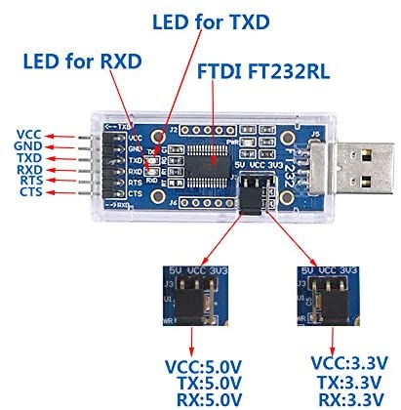
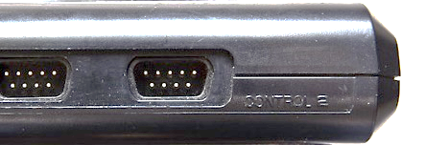
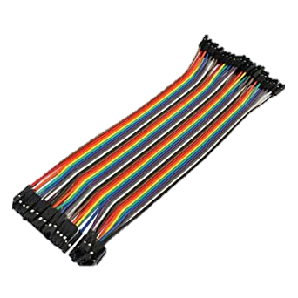
Example FTDI for MSX - Schematic
How to
Buy the following parts.
・1x FTDI2XX dongle (FT232R and so on. Need to support 5V.) ・1x D-SUB 9 pin female connector and DuPont wires
Solder like the following to the JOYSTICK PORT 2.
DTR
DSR
Any FTDI2XX dongle
MSX

Slide 3
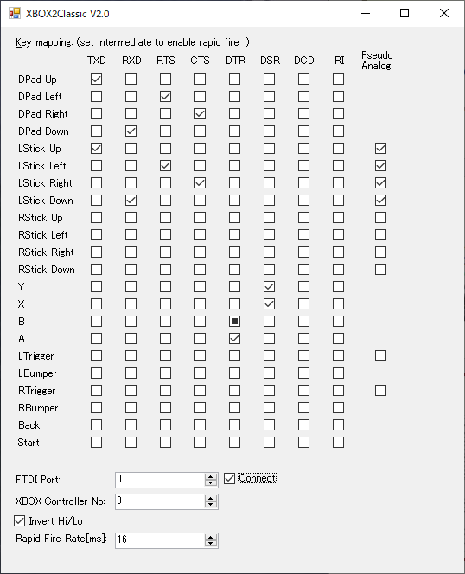
Example FTDI for MSX - Settings
Set the FTDI ID No and click “Connect”
Click “Invert”
Set the XBOX Controller ID No

