Slide 1
XBox2Classic
User’s Manual - Rev 1.0

Slide 2
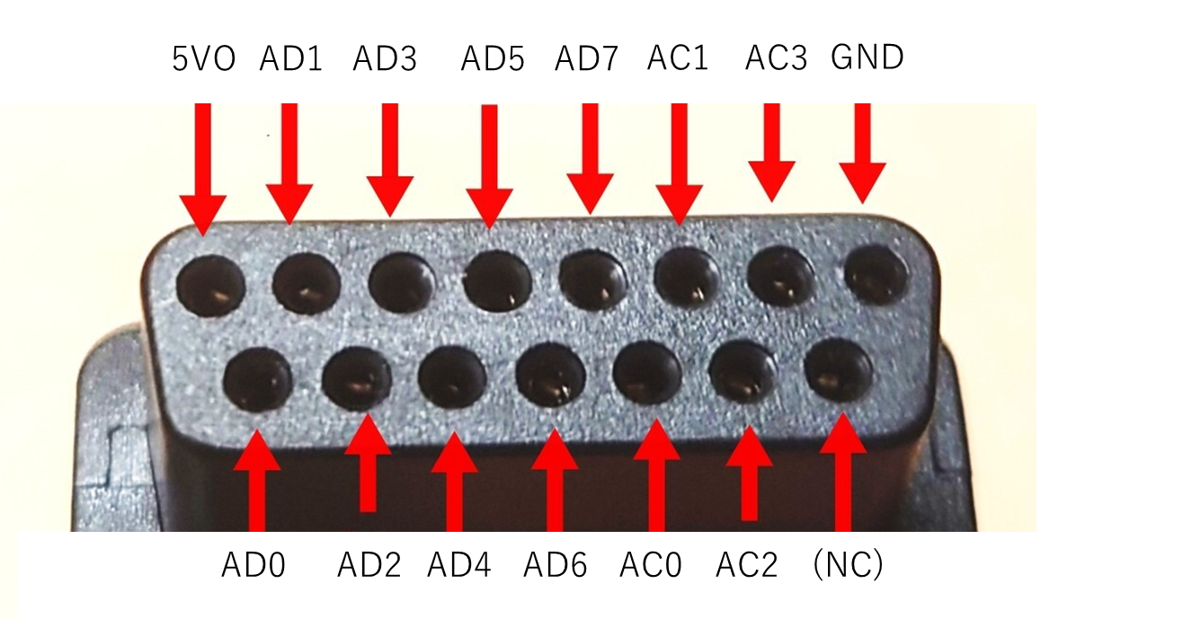
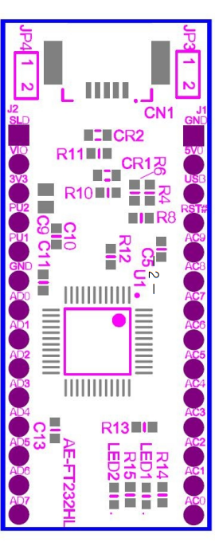
Schematics
Connect to the correspond pin on the FTD232H.
Confirmed with https://akizukidenshi.com/catalog/g/g106503/
*NEVER USE USB BUS POWER. USE ONLY NEOGEO 5V*
*USBバスパワーは使わずネオジオの+5Vを使うようにしてください*

Slide 3
Connection
PC
My tool
Controller Port compatible with NEOGEO
This app
USB
FTD232H
DSUB 16pin
JAMMA
PCB
USB
XBOX Controller

Slide 4
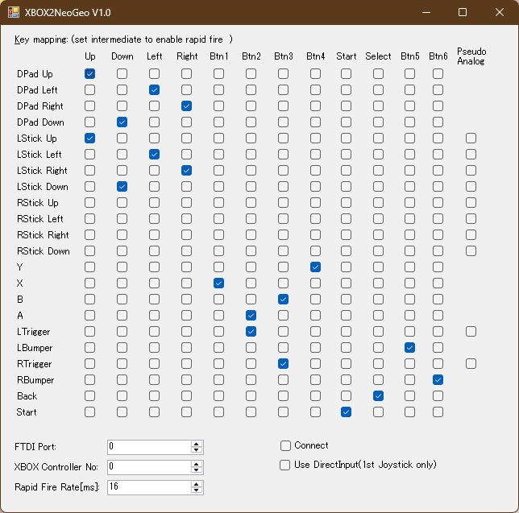
Example Settings
Set the FTDI ID# and check “Connect”

Slide 5
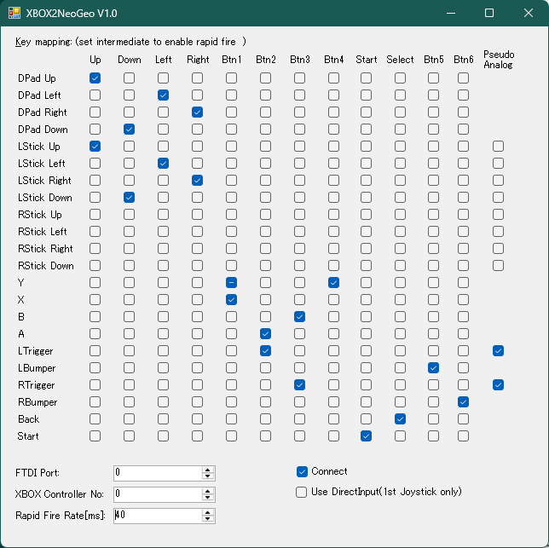
Tips
This settings enabled “Pseudo Analog”.
It means…
- Tilt the stick slightly to move slowly.
This settings enabled “Pseudo Analog”.
It means…
- When you press the trigger slightly, the satellite moves slowly.
- When you press the trigger fully, the satellite moves at full speed.

