Slide 1











YM2612
YM2151
YM2612
YM2612
YM2612
YM2612
YM2612
YM2612
SN76496
YM2612
YM2612
YM2612
YM2612
Y
YM2151
Y
Y
♪M 381 2
MSM5232
+TA7630
RP2A03
®
♪YM3812
SN76496
SN76496
AY-3-8910
AY-3-8910
♪M 381 2
Beep

Slide 2




C140
1
4
0
C
HuC
6280

Slide 3


SPC700
SPC700

Slide 4


POKEY

Slide 5


YM2610B

Slide 6
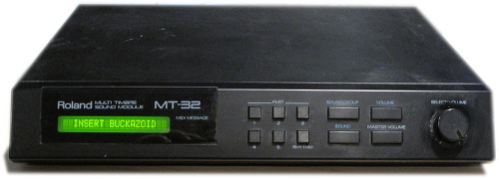





Slide 7





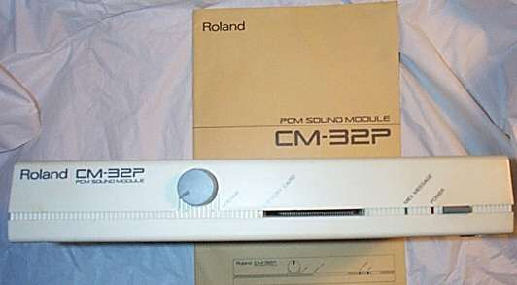

Slide 8

MAmidiMEmo
M

Slide 9





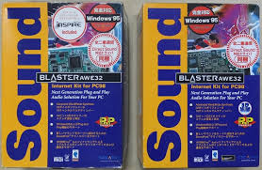
YMF
!

Slide 10

YM-Ⅱ608
YM-Ⅱ608

Slide 11












TMS
&5220

Slide 12


Slide 13



Slide 14

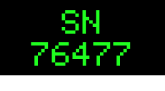
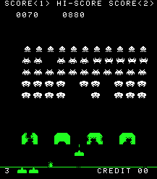
SN
76477

Slide 15
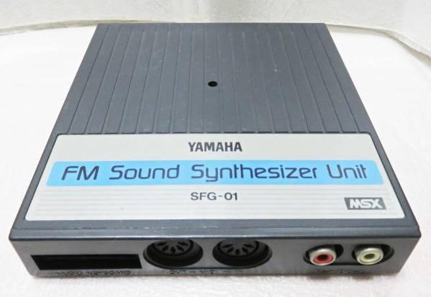
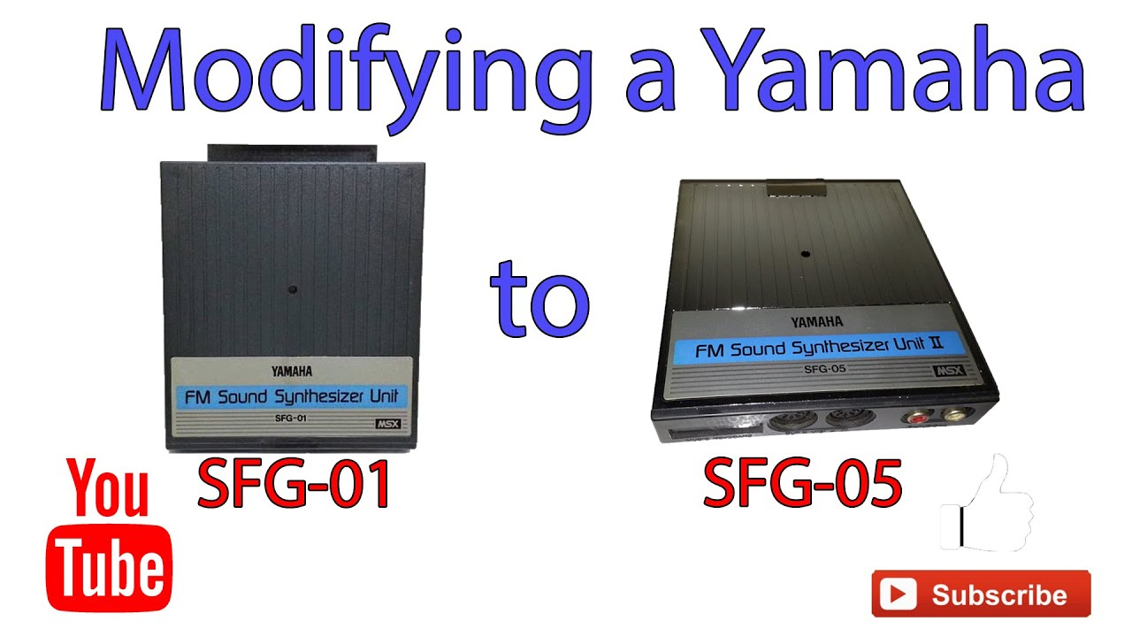



YAMAHA

Slide 16
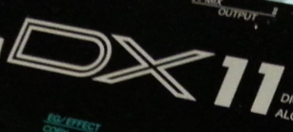



YAMAHA
YAMAHA
YM3806

Slide 17

MIDI Delay Test Tool
PC
MIDI OUT
MIDI IN
[MIDI IN]
MIDI Device
[MIDI THRU]
MIDI THRU
MIDI IN
Connection diagram

Slide 18



Multi
M.P.
PCM

Slide 19


RF5C164

Slide 20



1099
S
AA

Slide 21




Slide 22


Slide 23
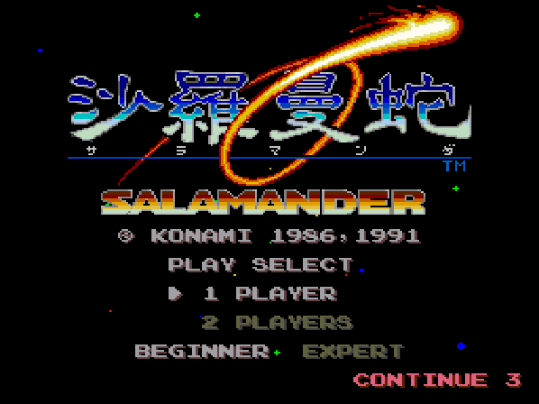

VLM
5030

