Slide 1
MAmidiMEmo The Virtual S/W Synthesizer
User’s Manual – for MAmidiMEmo V5.5.1.0

Slide 2




What is the MAmidiMEmo?
MAmidiMEmo is a virtual chiptune sound MIDI module for Windows
You can use MIDI or DAW to sound the MAmi
MAmi supports various sound chips*
Also, MAmi can drive real hardware chips* via SCCI, VSIF
* Supported chips are the following
PCM: C140, SPC700
FM Synthesis: OPM, OPN2, OPNA, OPLL, OPL, OPL3
WSG: NAMCO CUS30, HuC6280, SCC
PSG: SID, POKEY, GB APU, SN76496, NES APU, MSM5232, AY-3-8910
VOICE: TMS5220, SP0256, SAM
MIDI: MT-32, CM-32P(Simulation)
* Supported hardware is the following
VSIF: Genesis, SMS, Famicom, MSX, C64, PC-6001
SCCI: OPM, OPNA, OPZ
- MIDI Inst
S/W Chips
YM2612
YM2612
Sound Driver
YM2612
- DAW
- MIDI Sequencer
- Tracker
- MML and so on…
Real Chips
YM2612
YM2612
YM2612
SCCI/VSIF

Slide 3
Install & Basic Settings
Install & run
Extract the downloaded zip file.
Will open the MAmidiMEmo. If not, please check the followings.
VC++ 2012 Runtime installed on your PC. https://www.microsoft.com/en-au/download/details.aspx?id=30679
(Execute "DelZoneID.ps1“ to remove “Zone.Identifier” flag.)
Click MAmidiMEmo.exe to run

Slide 4
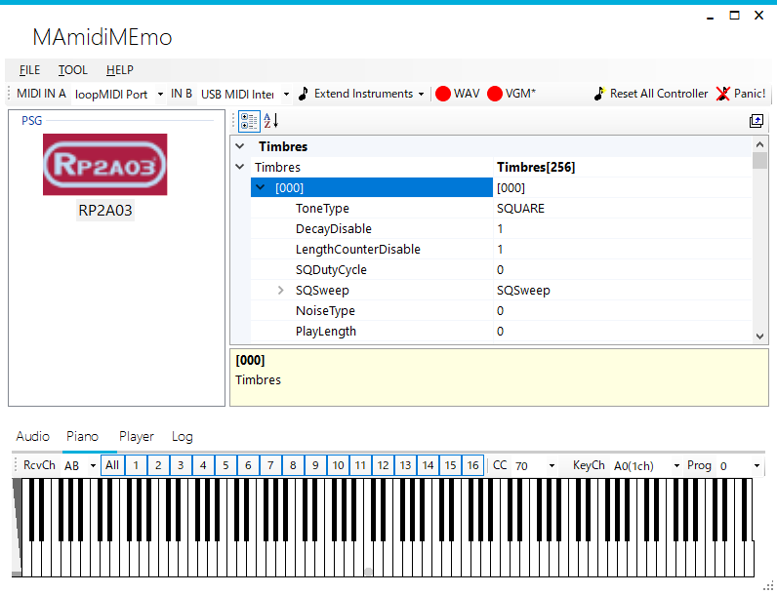
Window Overview
MIDI IN A,B
Selector
Chip Parameter Editor
(see next)
Active Chips
(see next)
Tools

Slide 5
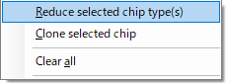
Add and Remove a Chip
To add
Select the chip from this menu.
To remove
Open a context menu and select.

Slide 6
Edit chip and sound parameters
1. Click chip
2. Click parameter
3. Change value

Slide 7
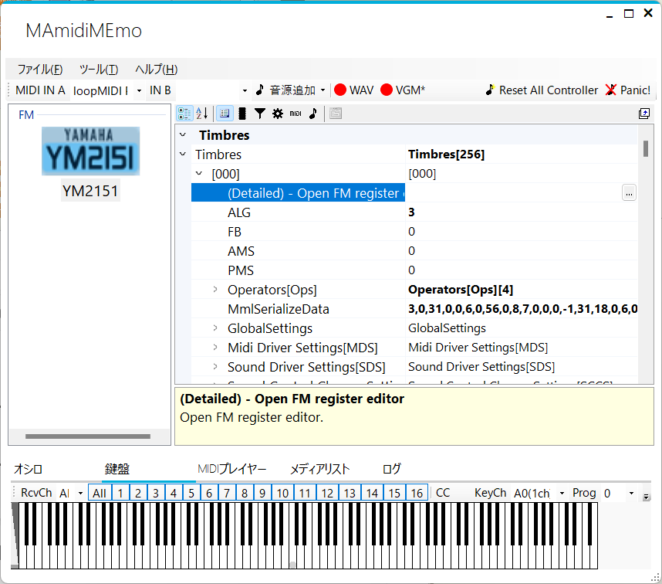
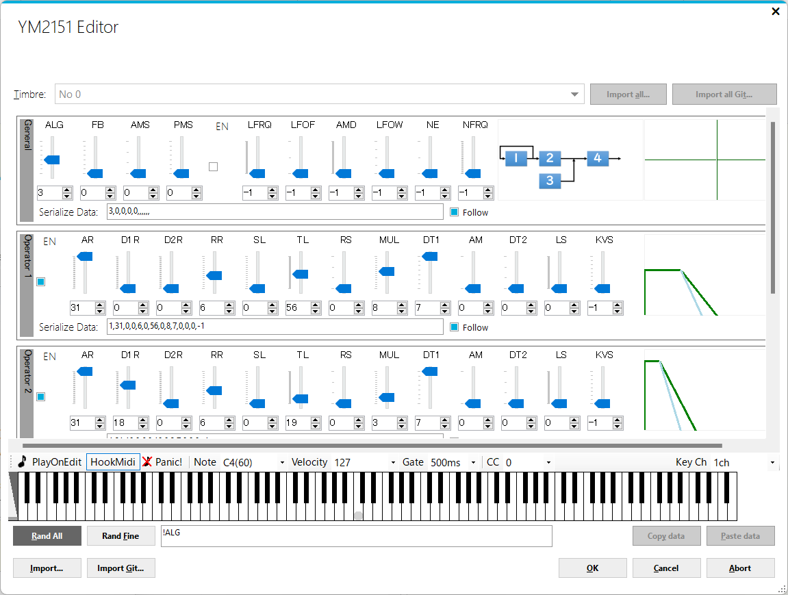
Edit FM registers with a GUI editor
Select a timbre and click the
[…] button on the “(Detailed)” prop.
Change all operator values while [Shift] key pressing.

Slide 8

Between MIDI ch and Chip ch Relation.
You don’t need to concern the Chip ch. , generally. MAmidiMEmo will assign suitable Chip ch. automatically. However, you need to concern a max ch. number of the Chip.
MAmidiMEmo will assign oldest sounding ch. to sound the new sounds.
MAmidiMemo will assign empty ch. or oldest sounsing ch. , generally.
Chip A
MAmidiMEmo
FM ch. 1
Note On Msg from
MIDI ch. X
FM ch. 2
FM ch. 3

Slide 9

Sounding Structure
MAmidiMEmo outputs a sound from MIDI message along with the following structure. So, at least, you need to edit the Timbre parameters to sound something.
Chip A
[MIDI]-[MidiPort]
CombinedTimbre
[MIDI]-[ProgramAssignments]
[MIDI]-
[ChannelTypes]
MIDI IN
[MIDI]-[Channels]
Timbre
DrumTimbre
Chip X

Slide 10
Timbre
Generally, a chip has 256 Timbres, 256 CombinedTimbres, 128 DrumTimbres.
CombinedTimbre can sound multiple Timbers at the same time (up to 4)
DrumTimbre can sound Timbes as a Drum sounds (Ignoring Note Off msg).
You can change the Timbre parameters on the Chip Parameter Editor. Generally, you need to learn the chip specification to edit the chip parameters.
Chip Parameter Editor

Slide 11
Timbre Structure
Sound params are H/W settings.
See the chip manual for more details.
Sound parameter
Chip
FM Op parameters
Timbres
Timbre
PSG parameters
Timbre
DrumTimbres
Sound parameter
PCM parameters
DrumTimbre
Timbre
Timbre
Driver parameter
Driver parameter
CombinedTimbres
ADSR parameter
CombinedTimbre
MIDI parameter
Timbre
Timbre
Timbre
ARP parameter
Timbre
Timbre
Timbre
Driver params are the MAmidiMEmo settings.
Fx & Env parameter

Slide 12
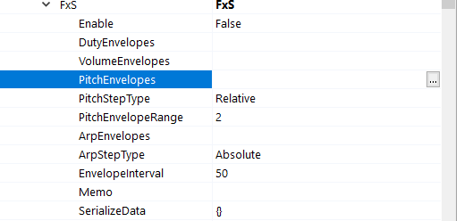
Driver parameters - Fx & Env Structure
You can make for a rich sound by using driver params. Especially, FxS can do it.
Fx & Env parameter
Volume Env
Pitch Env
Click here to open the GUI Editor.
Arp Env
Dedicated Env

Slide 13
Sample sounds
There are sample sound files in the “Samples” folder. You can drop a sample file “*.MAmi" to the left pane.

Slide 14
Additional files
YM2608
Place legitimate “ym2608_adpcm_rom.bin” file in the MAmidiMEmo directory to sound ADPCM rhythm sounds.
MT-32
Place legitimate “MT32_CONTROL.ROM” and “MT32_PCM.ROM” in the MAmidiMEmo directory to sound ADPCM sounds.

Slide 15
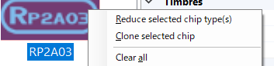
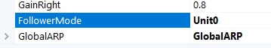
Limit Break
Any chip can output only a few voices. However, MAmidiMEmo can break this limitation by the following steps.
Add a chip and complete all settings the chip.
Select the [Clone selected chip] Cloned chip added.
Select the cloned chip and set the [Follower Mode] value to “Unit0*”. * If clone source chip ID is 0.
When the clone source chip consumed all voices, the cloned chip sound for the chip.
If you want to extend max voices more, select the [Clone selected chip] of the cloned chip. And set the [Follower Mode] value to “Unit0”.

Slide 16
Use a real hardware
You can use a real hardware by using the VSIF / PCI device.

Slide 17
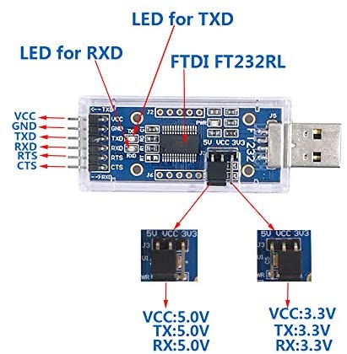
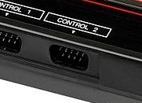
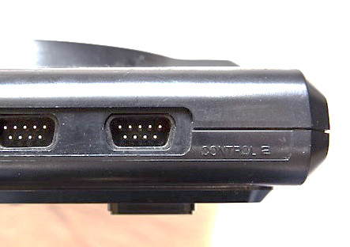
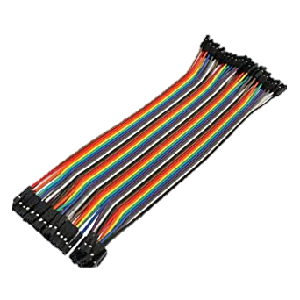
VGM Sound Interface(VSIF - UART) for Genesis/SMS
MAmidiMEmo and VGMPlayer can drive real machine chips. Currently supports NTSC SMS(2, MkⅢ) for SN76489, OPLL and NTSC Genesis(MD) for SN76489, OPN2.
How to
Buy the following parts. ・1x UART dongle (Note: FT232R and so on. CH340 and CP2102 may not work 163,840bps, only 115,200bps.) ・1x FLASH Cart for SMS or Genesis and 1x D-SUB 9 pin female connector and DuPont wires
Solder like the following and connect it to the JOYSTICK PORT 2.
Any UART dongle
Do not
short any pin.
*Need to support
163,840bps for MD
115,200bps for MD, SMS
SMS/2 or MkⅢ
Genesis/MD

Slide 18
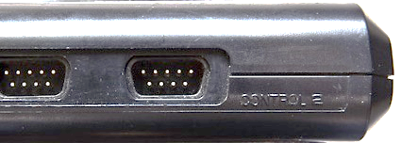
VGM Sound Interface(VSIF - FTDI) for Genesis
MAmidiMEmo and VGMPlayer can drive real machine chips more faster if you use FTDI2xx(232R, 232H and so on). Currently supports NTSC Genesis(MD) for SN76489, OPN2.
How to
Buy the following parts.
・1x FTDI2XX dongle (FT232R or FT2232H and so on. Need to support 5V. *WARN* Please use a genuine dongle.) ・1x FLASH Cart for Genesis and 1x D-SUB 9 pin female connector and DuPont wires
Solder like the following and connect it to the JOYSTICK PORT 2.
DTR
DSR
DCD
Any FTDI2XX dongle
Do not
short any pin.
Genesis/MD

Slide 19
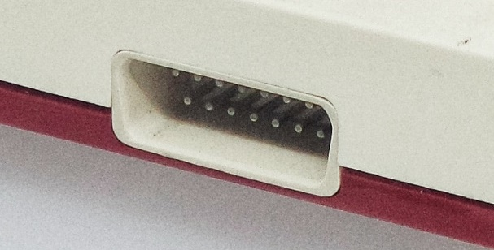
VGM Sound Interface(VSIF - FTDI) for Famicom
MAmidiMEmo can drive real machine chips more faster if you use FTDI2xx(232R, 232H and so on). Currently supports NTSC Famicom and RP2A03(No DAC)/FDS/VRC6.
How to
Buy the following parts.
・1x FTDI2XX dongle (FT232R and so on. Need to support 5V. *WARN* Please use a genuine dongle.) ・1x FLASH Cart for Famicom and 1x D-SUB 15 pin female connector for FC and DuPont wires
Solder like the following.
Audio
(Optional)
DTR
Do not
short any pin.
Any FTDI2XX dongle
Famicom

Slide 20
VGM Sound Interface(VSIF - FTDI) for MSX/PC-6001
MAmidiMEmo can drive real chips on MSX/P6 if you use FTDI2xx(232R, 232H and so on). Currently supports NTSC MSX for AY-3-8910,OPLL,SCC+,OPM,OPNA,OPL3,Y8950. NOTE1: Be sure to select proper SLOT# for SCC to use SCC. Set FTDI clk value to 25 for each chip on normal MSX. If you have a tR, you can decrease value. NOTE2: You can not use the VGM_P6M.ROM on 戦士のカートリッジ for PC-6001
How to (You can also create a dedicated dongle from the Gerber file.)
Buy the following parts.
・1x FTDI2XX dongle (FT232R and so on. Need to support 5V. *WARN* Please use a genuine dongle.) ・1x D-SUB 9 pin female connector and DuPont wires
Solder like the following and connect it to the JOYSTICK P2(MSX), P1(P6).
Any FTDI2XX dongle
DTR
DSR
Do not
short any pin.
MSX/PC-6001

Slide 21
VGM Sound Interface(VSIF - FTDI) for Commodore 64(C64)
MAmidiMEmo can drive real MSX machine chips if you use FTDI2xx(232R, 232H and so on). Currently supports NTSC/PAL C64 for SIDs. I recommend to use ARMSID with ADSR bud fixing.
How to
Buy the following parts.
・1x FTDI2XX dongle (FT232R and so on. Need to support 5V. *WARN* Please usea genuine dongle.) ・1x D-SUB 9 pin female connector and DuPont wires
Solder like the following and connect it to the JOYSTICK PORT 2.
DTR
DCD
RI
Any FTDI2XX dongle
Do not
short any pin.
Commodore 64

Slide 22
VGM Sound Interface(VSIF - AMIGA) for AMIGA
MAmidiMEmo can drive real AMIGA machine chips via Serial Port eg) - YFFSFDC RS232C USB シリアル変換ケーブル CH340チップ内蔵 Need to use old driver for CH340 for Windows - DB9 DB25 adapter
How to
Buy Serial Cross Cable(NULL MODEM)
Connect PC and AMIGA directly
UART uses high speed ( 31250 bps ) transfer rate. So, you should not launch other apps and so on.
NOTE: You can import SoundFont(*.sf) file and export imported pcm data to “default.vpcm” file. And, the VSIF_AMIGA.exe can read the default.vpcm on startup.

Slide 23
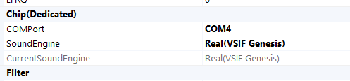
VGM Sound Interface(VSIF) Settings
Burn VGMPlay_md.bin(for Genesis), VGMPlay_sms.sms(for SMS), VGMPlay_nes*.* (for Famicom^{*1}), VGM_msx*(for MSX^{*2}), P6*.rom(for PC-6001), VGMPlay_c64.prg(for V64) to your FLASH Cart/ROM/Tape and so on.
*1 VGMPlay_nes_vrc6/fds/mmc5 ROM does not show any screen but same UI with VGMPlay_nes.nes UI *2 VGM_msx_Vkey.rom can skip booting from this ROM while the [V] key is NOT pressed at boot time.
Set the COMPort/FTDI ID and select “VSIF ***” you wish.
Reset your console and push [Panic!] button
(Famicom only)Re-send DPCM data.
Done!
If you can not sound sounds, make sure soldering and COMPort name. Or, please contact me. *Some UART dongles may not work properly. *Compatible consoles may not work properly.

Slide 24
VGM Sound Interface(VSIF) for Famicom spec
Sound | VGMPlay_nes.nes (Mapper 0) | VGMPlay_nes_fds.fds (FDS IMAGE) ^{*2} | VGMPlay_nes_vrc6.nes (Mapper 24) ^{*2} VGMPlay_nes_mamicart_vrc6.nes | MMC5 ROM^{*2*3} (Mapper 5)
Square | OK | OK | OK | OK
Tri | OK | OK | OK | OK
Noise | OK | OK | OK | OK
DPCM | NO | OK(Up to 8KB) | NO | OK^{*1} (Up to 64KB)
Ext. Snd FDS | NO | OK | NO | NO
Ext. Snd VRC | NO | NO | OK | NO
Ext. Snd MMC | NO | NO | NO | NO
*1 Not Tested
*2 China flash cart may not work properly
*3 PRG-RAM 32x2 KB

Slide 25
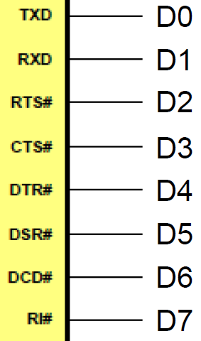
MEMO: FTDI UART NAME <-> Bit Number

Slide 26
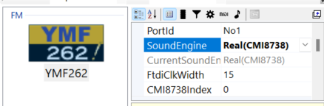
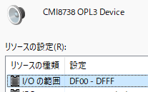
Use CMI8738(OPL3) PCI Board *Please use at your own risk*
Attach the CMI8738 Board to your PC. *Only for 64bit Windows*
Disable Driver Signature enforcement
(*Uninstall and remove* old CMI8738 OPL3 driver if installed. )
Install the CMI8738 OPL3 driver located in “.\CMI8738OPL3” folder.
Set [SoundEngine] prop to the “Real(CMI8738)”.
Have fun!!
*Technical information* If you want to use the OPL3 of the CMI8738 directly from your app…
Use the helper DLL “CMI8738OPL3Library.dll”.
Or, direct access I/O port with admin rights. eg) DF00H+50H is the OPL3(CMI8738) port.

Slide 27
VGMPlayer

Slide 28
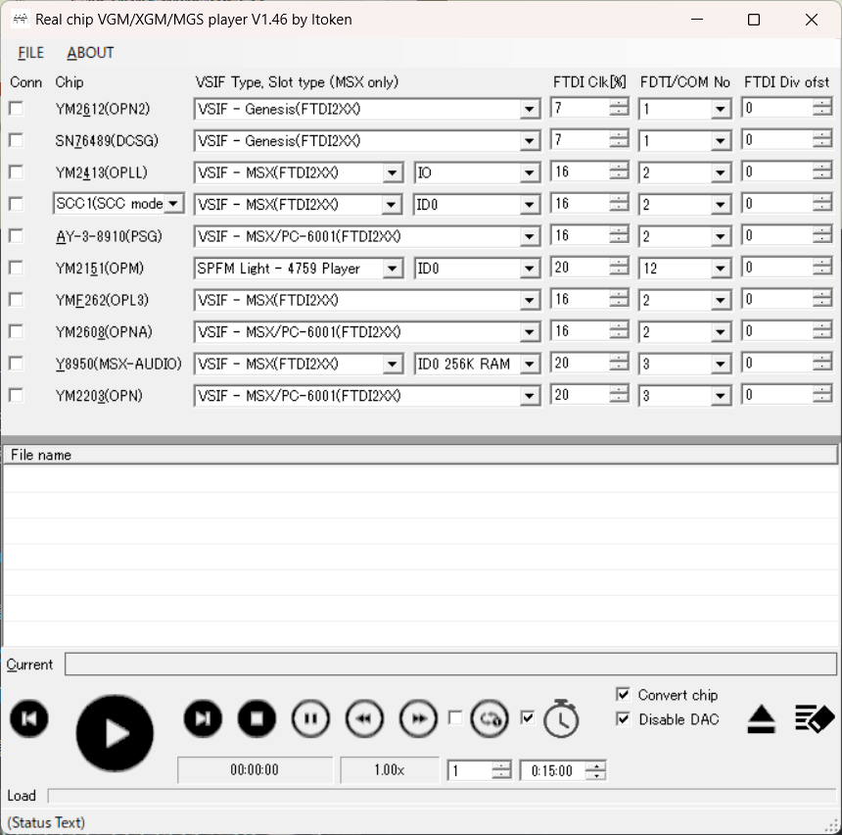
VGMPlayer
VGMPlayer can play a vgm/xgm/mgs file on a real chip via VSIF or SPFM. Substitutes for similar chips are also available. For example, an OPL track can be played on an OPL3 chip.
(2)
(3)
(2)
1) Select interface type
NOTE: Bandwidth of UART is narrow. So you can not play heavy track data properly.
2) Adjust FTDI Clk for FTDIxxx mode for your environment
NOTE: Usually the default value is fine, but if the sound is strange, increase the value. If the performance is slow, decrease the value. If you can not adjust by FTDI Clk, please adjust FTDI Div ofst value.
3) Specify COMPort# for UART/SPFM:
Specify FDTI ID# for FTDI2xxx
4) Check to connect
5) Drop vgm/XGM/MGS files to here
6) Push to play.
7) If the pitch/tempo is wrong, click here.
(1)
(4)
(5)
(6)
(7)

Slide 29
Known issues and limitations

Slide 30
Known issues and limitations
MT-32 & CM32-P can not store/restore last settings.
HuC6820 suddenly stop sounding. Please restart MAmi.
MAmidiMEmo process stuck after sound interface changed if you used SCCI interface.
You need to save the data manually on the DAW (Cubase and so on). Or, keep open the dummy editor window of the MAmidiMemo.

Slide 31
Appendix

Slide 32
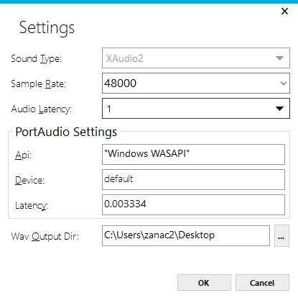
Trouble Shooting for MAmi
If you noticed “sound lag” or “stutter”, open the Settings dialog from [TOOL] menu. Check [Sound Type] and [Audio Latency] value.

Slide 33
MIDI Implementation Chart 1 General
*Depends on the chip
Function | Transmitted | Recognize | Remarks
Basic Channel | - | 1-16: Defaut 1-16: Changed
Note Number* | - | 0-127
Velocity* | - | Yes: Note ON No: Note OFF
After Touch | - | No
Pitch Bend* | - | Yes | 8192: Default
Program Change | - | 0-127 | 0: Default

Slide 34
MIDI Implementation Chart 2 Modulation, Vol, Pan, GPCS
*Depends on the chip
Function | Transmitted | Recognize | Remarks
Control Change 1 | - | Modulation | 0: OFF, 64: ON
5 |  | Portamento Time | 0: Default
6 38 |  | Data Entry MSB Data Entry LSB
7 |  | Volume* | 127: Default
10 |  | Panpot* | 64: Default 0: Left, 127: Right
11 |  | Expression* | 127: Default
16-19 |  | GPCS1 | Modify params

Slide 35
MIDI Implementation Chart 3 Hold, Portamentom, Modulation, SCCS
*Enabled only MONO = 1 and SlotAssignAlgorithm = RecentlyUsedSlot
Function | Transmitted | Recognize | Remarks
Control Change 64 |  | Hold 1 | 0: OFF, 64: ON
65 |  | Portamento | 0: OFF, 64: ON
68 |  | Legato* | 0: OFF, 64: ON
70-75,79 | - | SCCS | Modify current timbre params
76 77 78 | - - - | Mod. Rate Mod. Depth Mod. Delay | 64: Default 64: Default 64: Default
80-83 | - | GPCS2 | Modify parameters
84 | - | Portamento Ctrl | 0: OFF, 64: ON
91-95 | - | VST Plugin Ctrl | Modify VST params

Slide 36
MIDI Implementation Chart 4 NRPN, RPN, Mono, Poly
*Depends on the chip
Function | Transmitted | Recognize | Remarks
Control Change 98 99 | - - | NRPN LSB NRPN MSB | See after pages
100 101 | - - | RPN LSB RPN MSB | Sett after pages
121 | - | Reset All Ctrl
126 | - | Mono Mode | 0: OFF 1-127: Max Voice Num.*
127 | - | Poly Mode | 0: OFF 1-127: Reserve Voice Num.* *Reset Mono Mode when set

Slide 37
MIDI Implementation Chart 5 Pitch, Tune, Modulation Depth
Function | MSB | LSB | Remarks
RPN | 0 | 0 | Pitch Bend Range 0 ～ 2 ～ 127 [Half Note]
 | 0 | 1 | Fine Tune[cent] -8193 ～ 0 ～ 8192 [-100 cent ～ 99.9 cent]
 | 0 | 5 | Mod Depth 0 ～ 127 [Relative]

Slide 38
MIDI Implementation Chart 6 GPCS, SCCS
Function | MSB | LSB | Remarks
NRPN | 0 | 16-19 80-83 | GPCS[1-4] Value GPCS[5-6] Value 0-127
 | 0 | 70-75 79 | SCCS[1-6] Value SCCS[10] Value 0-127

Slide 39
MIDI Implementation Chart 7 Manage Instruments
Function | Change Receiving MIDI ch. dynamically. | Remarks
NRPN | NRPN MSB Bx 63 41 … for MIDI ch(1-7) NRPN LSB Bx 62 <Device ID> ... Specify Device ID of existing instrument. DATA MSB Bx 26 <Unit No> ... Specify Unit No of the above Device ID of existing instrument. DATA LSB Bx 06 <Receiving MIDI ch(1-7) bit sets. 1=On, 0=Off> bit 6 5 4 3 2 1 0 ch 7 6 5 4 3 2 1 NRPN MSB Bx 63 42 ... for MIDI ch(8-14) NRPN LSB Bx 62 <Device ID> ... Specify Device ID of existing instrument. DATA MSB Bx 26 <Unit No> ... Specify Unit No of the above Device ID of existing instrument. DATA LSB Bx 06 <Receiving MIDI ch(8-14) bit sets. 1=On, 0=Off> bit 6 5 4 3 2 1 0 ch 14 13 12 11 10 9 8 NRPN MSB Bx 63 43 ... for MIDI ch(15-16) NRPN LSB Bx 62 <Device ID> ... Specify Device ID of existing instrument. DATA MSB Bx 26 <Unit No> ... Specify Unit No of the above Device ID of existing instrument. DATA LSB Bx 06 <Receiving MIDI ch(15-16) bit sets. 1=On, 0=Off> bit 6 5 4 3 2 1 0 ch xx xx xx xx xx 16 15

Slide 40
MIDI Implementation Chart 8 XGM Recording
Function | MSB | LSB | Remarks
NRPN | 1 | 6 | XGM Recording Command DATA MSB 0: Start Recording 1: Set Loop Start Point 2: Set Loop End Point 3: Stop Recording
NOTE: If you stop playing in the middle of a sequence, “Stop Rec” is not called and the recording will not stop.
Please press the XGM recording button manually.

Slide 41
MIDI Implementation Chart 9 XGM2 Recording
Function | MSB | LSB | Remarks
NRPN | 2 | 6 | XGM2 Recording Command DATA MSB 0: Start Recording 1: Set Loop Start Point 2: Set Loop End Point 3: Stop Recording
NOTE: If you stop playing in the middle of a sequence, “Stop Rec” is not called and the recording will not stop.
Please press the XGM2 recording button manually.

Slide 42
VSIF – Generic (UART 115K), SMS(UART 115K) SPECIFICATION for AY-3-8910, YM2413
Baud rate: 115,200 bps
Protocol: 8 bits, None parity bit, 1 stop bit
1 packet : 2 bytes
1st
2nd
Reg #
Value

Slide 43
VSIF – MSX/P6(FTDI) SPECIFICATION for AY-3-8910, OPLL, SCC-I, OPL3, OPM, OPNA/OPN2, OPN
Baud rate : 38,400 bytes / sec
1 packet : 5 bytes + α
1byte : 4bit(data) + 2bit(Start + Clk bit)
Type:
0 AY-3-8910: Write value to address
1,2,(12) YM2413: 1 is write value to address, 2 is set OPLL cartridge slot number
3～9 SCC-I: (in preparation)
10～11 YMF262: 10 is write value to address of port L , 11 is Write value to address of port H
(13),14 OPM: Write value to address
15 DCSG: Write value to address
16 ～17 OPNA/OPN2: Write value to address
18 OPN: Write value to address
1st(Start)
2nd(clk=0)
3rd(clk=1)
4th(clk=0)
5th(clk=1)
Type
Address(Hi)
Address(Lo)
Value(Lo)
Value(Hi)
…
7
0
Start
1
Type
Type
Type
Type
Type
Clk
0
clk
Data
Data
Data
Data
MSB
LSB

Slide 44
VSIF – C64(FTDI) SPECIFICATION for SID
Baud rate : 31,250 bytes / sec
1 packet : 6 bytes(1 byte value) or 9 bytes (2 bytes value) mode
1byte : 3bit(data) + 2bit(Start(Active low) + Clk(Active low) bit)
9 bytes mode flag:
1st
2nd
3rd
4th
5th
6th
7~9th
Address(Lo 3bit)
Address(Mid 3bit)
Address(Hi 2bit)
Value(Hi 3bit)
Value(Mid 3bit)
Value(Lo 2bit)
Same as 4,5,6 th
7
0
Start
Clk
Data
Data
Data
MSB
LSB
7
0
6th byte data
Start
Clk
9bytes flag
Data
Data
MSB
LSB
7th
8th
9th
NOTE: In 9bytes mode, send value for Address+1 data first, second is Address+0 data
…
7~9th byte data
Value(Hi 3bit)
Value(Mid 3bit)
Value(Lo 2bit)

Slide 45

Integrate with MAmidiMEmo via RPC
MAmidiMEmo will starts RPC server on port 30000 at startup with “-chip_server” option. So, your application can be integrate with the MAmidiMEmo via RPC. MAmidiMEmo provides the following API //Write the value to the address to the specific chip void DirectAccessToChip(unsigned char DeviceID, unsigned char UnitNo, unsigned int address, unsigned int data) * You can confirm the DeviceID and UnitNumber from the property. * Currently, OPLL(ID9), SCC(ID7), AY8910(ID11), YM2608(ID23) chips are supported. * If you want to use SCC1(aka SCC+), you need to add 0x100 to the address.
Ex)
rpc::client* m_rpcClient = new rpc::client("localhost", 30000); //Open RPC port
try {
//Check connection
m_rpcClient->call("DirectAccessToChip", (unsigned char)0, (unsigned char)0, (unsigned int)0, (unsigned int)0);
} catch(...) { //Failed }
:::
//Write SCC1 wave form
m_rpcClient->async_call("DirectAccessToChip", (unsigned char)7, (unsigned char)0, (unsigned int)0x100, (unsigned int)10);
//All sound off for AY8910
m_rpcClient->async_call("DirectAccessToChip", (unsigned char)11, (unsigned char)0, (unsigned int)7, (unsigned int)0x3f);
//Key off 1ch for OPLL
m_rpcClient->async_call("DirectAccessToChip", (unsigned char)9, (unsigned char)0, (unsigned int)0x20, (unsigned int)0x0);
:::
m_rpcClient->~client(); //Close RPC port(But, may not working properly. Recommend commenting out this line.)

