Slide 1

Predict Churning Customers
GROUP 2
107703035 朱宇方 107703046 林子恩
107308016 郭家瑜 109971003 穆永綸

Slide 2


Overview of Goals
Predict who is going to stop using their credit card services
- Target Variable: Attrition_Flag
- Existing Customer(Negative) / Attrited Customer(positive)
What are business problems can be solved?
identify behavior patterns of customers who are likely to churn
improve customer retention
save money on acquiring new customers

Slide 3
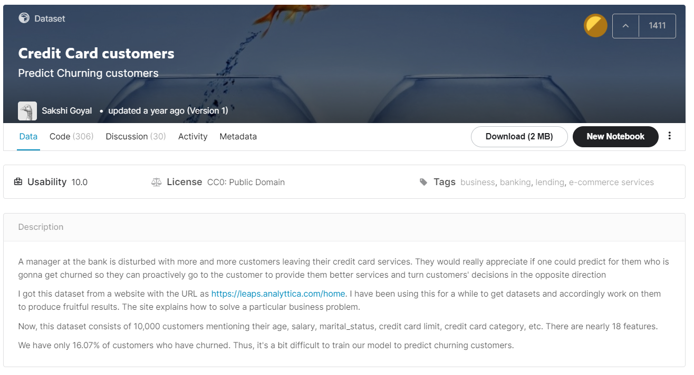
Data Source: Kaggle

Slide 4
Data Dictionary (1)
Variable Name | Description | Type
Gender | M=Male, F=Female | categorical
Education_Level | Educational Qualification of customers | categorical
Marital_Status | Married, Single, Divorced, Unknown | categorical
Income_Category | Annual Income Category | categorical
Card_Category | Type of Card | categorical
Total_Amt_Chng_Q4_Q1 | Change in Transaction Amount (Q4 over Q1) | Continuous
Total_Ct_Chng_Q4_Q1 | Change in Transaction Count (Q4 over Q1) | Continuous
Avg_Utilization_Ratio | Average Card Utilization Ratio | Continuous

Slide 5
Data Dictionary (2)
Variable Name | Description
Customer_Age | Customer's Age in Years
Dependent_count | Number of dependents
Months_on_book | Period of relationship with bank
Total_Relationship_Count | No. of products held by the customer
Months_Inactive_12_mon | No. of months inactive in the last 12 months
Contacts_Count_12_mon | No. of Contacts in the last 12 months
Credit_Limit | Credit Limit on the Credit Card
Total_Revolving_Bal | Total Revolving Balance on the Credit Card
Avg_Open_To_Buy | Open to Buy Credit Line
Total_Trans_Amt, Total_Trans_Ct | Total Transaction Amount/Count (Last 12 months)

Slide 6
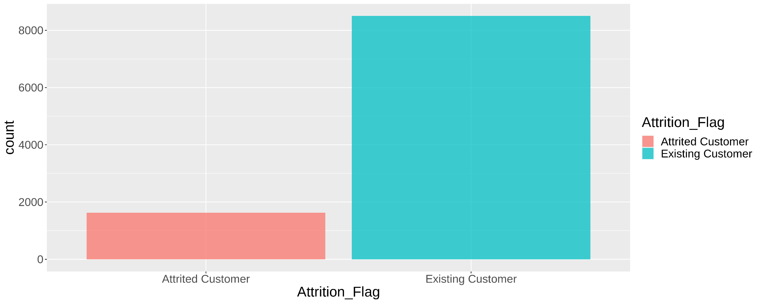
Attrition_Flag
exists class-imbalanced problem

Slide 7
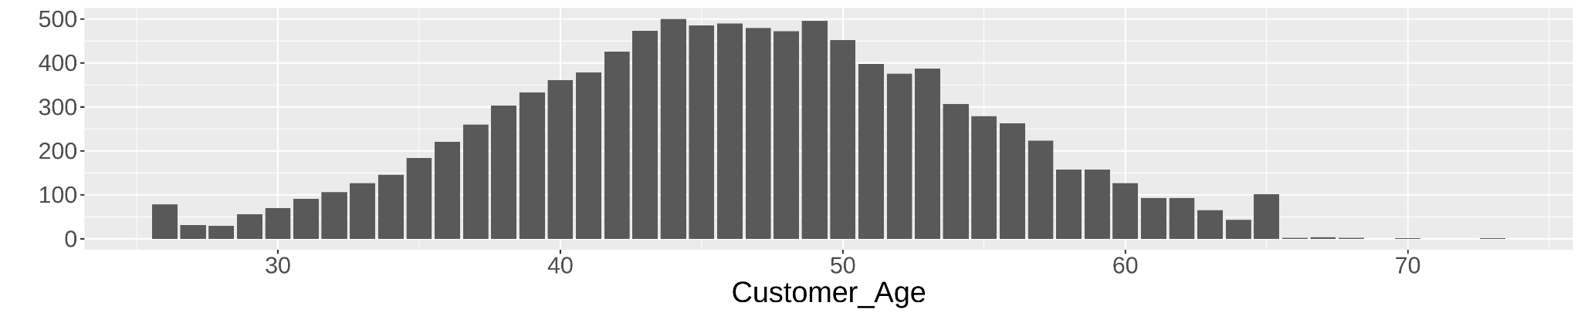
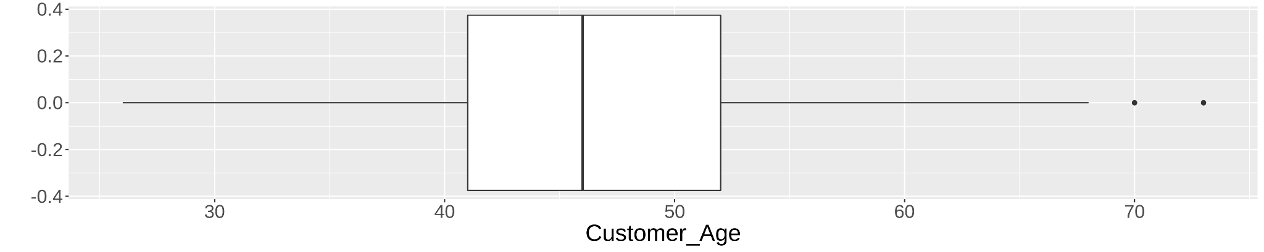
Customer_Age:
close to a normal distribution

Slide 8
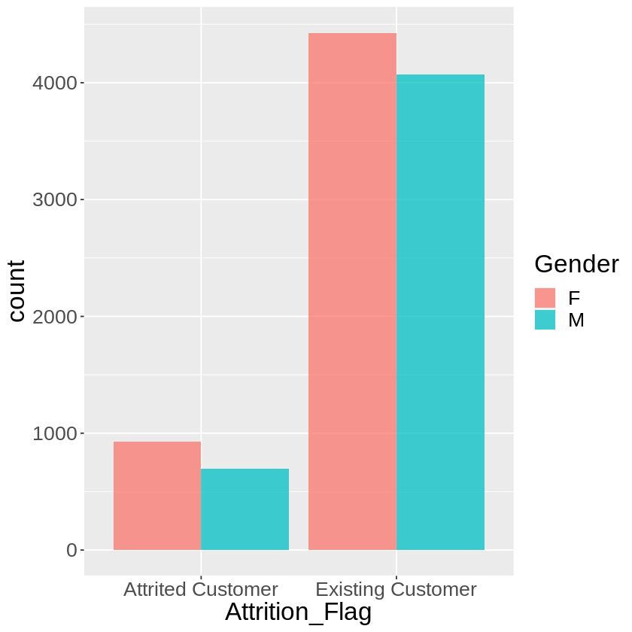
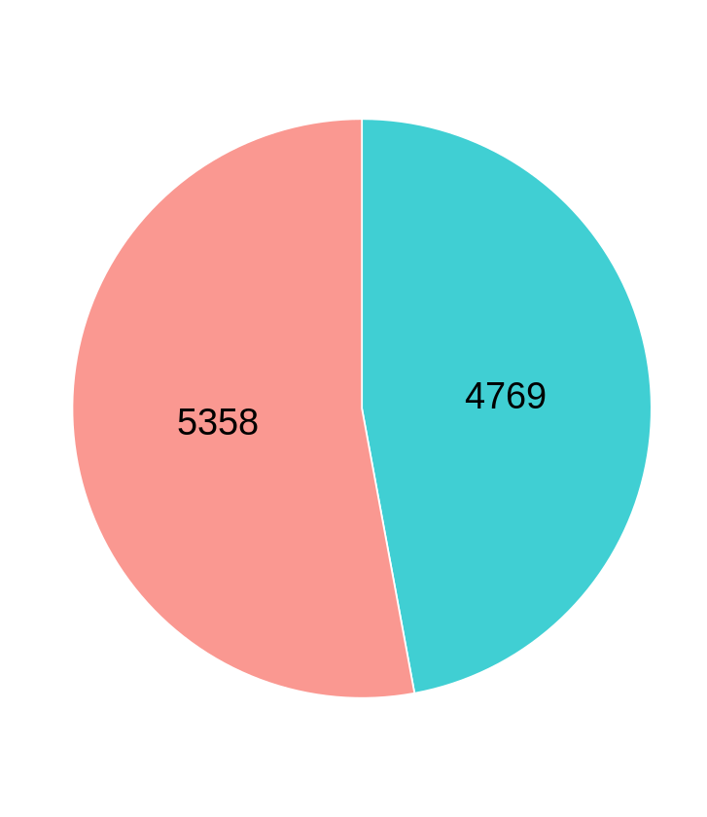
Gender

Slide 9
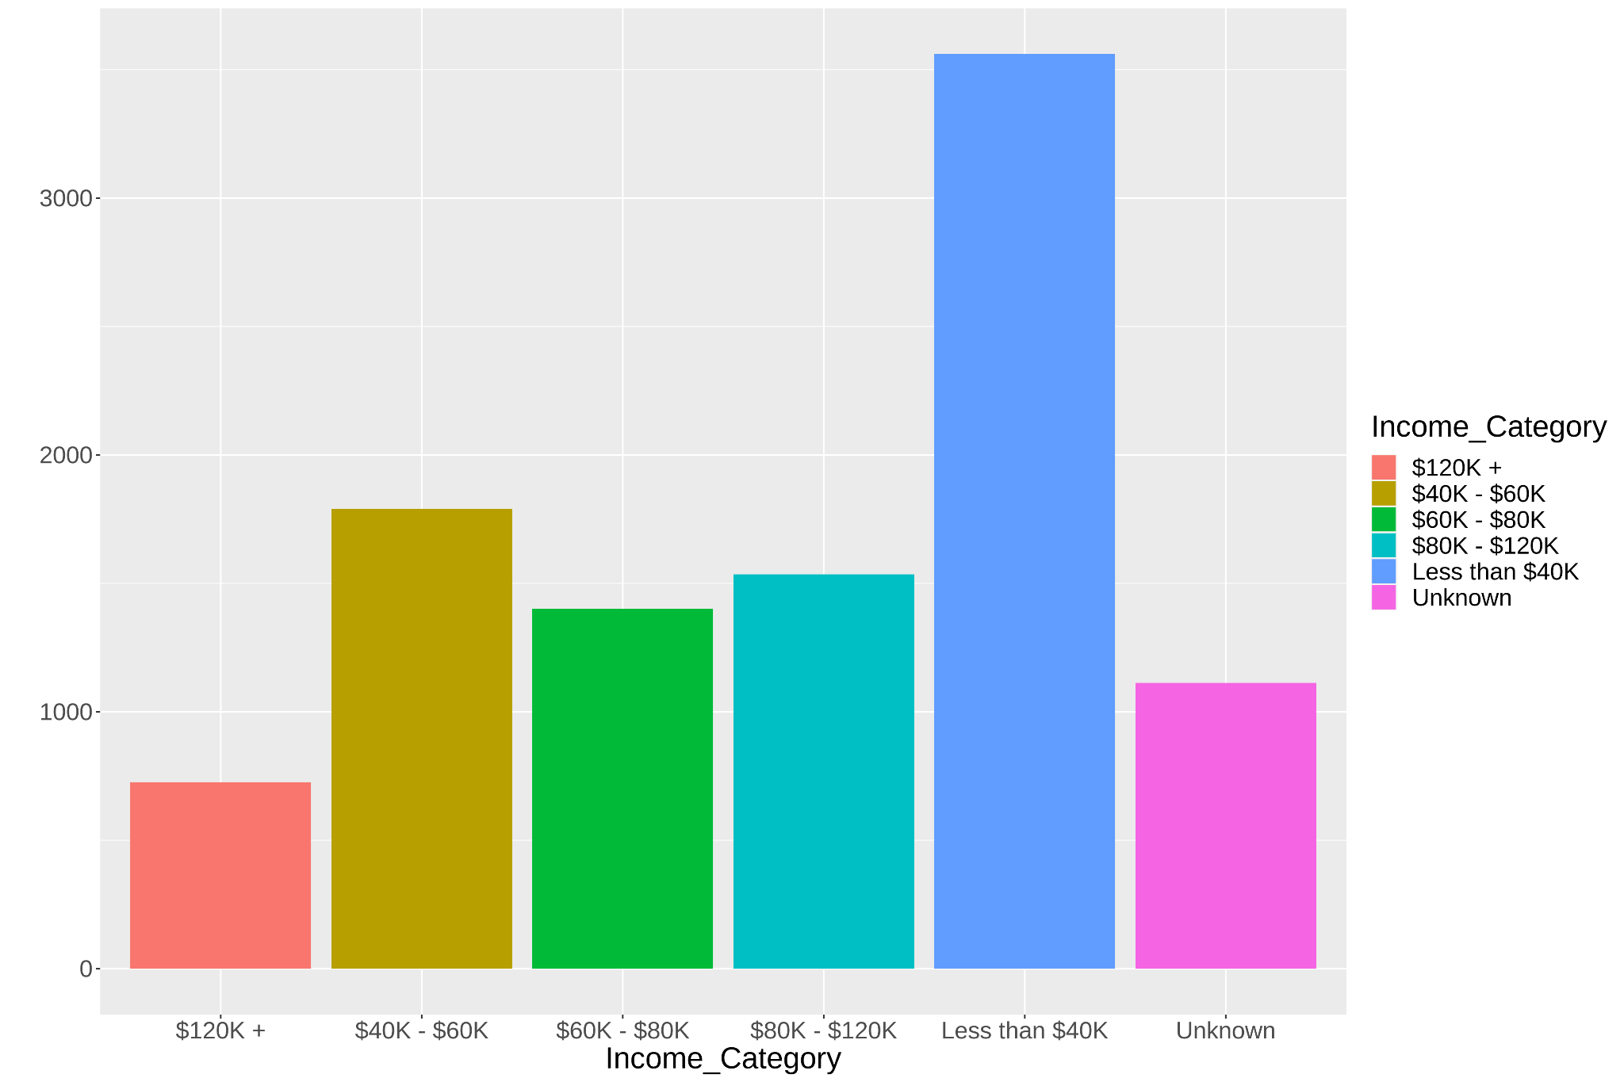
Income_Category:
contain unknown values
→ Use mode value ( x < $40K) to replace Unknown value.

Slide 10
Preprocessing
SMOTE (Synthetic Minority Oversampling Technique)
Problem : Imbalanced data, and the minority is the focal point.
Solution : Generate the minority by k nearest neighbors, and under-sample the majority.
R Package : DMwR (https://www.rdocumentation.org/packages/DMwR/versions/0.4.1/topics/SMOTE)
 | Before SMOTE | After SMOTE
Attrited Customer | 1,139 | 3,417
Existing Customer | 5,950 | 4,556

Slide 11
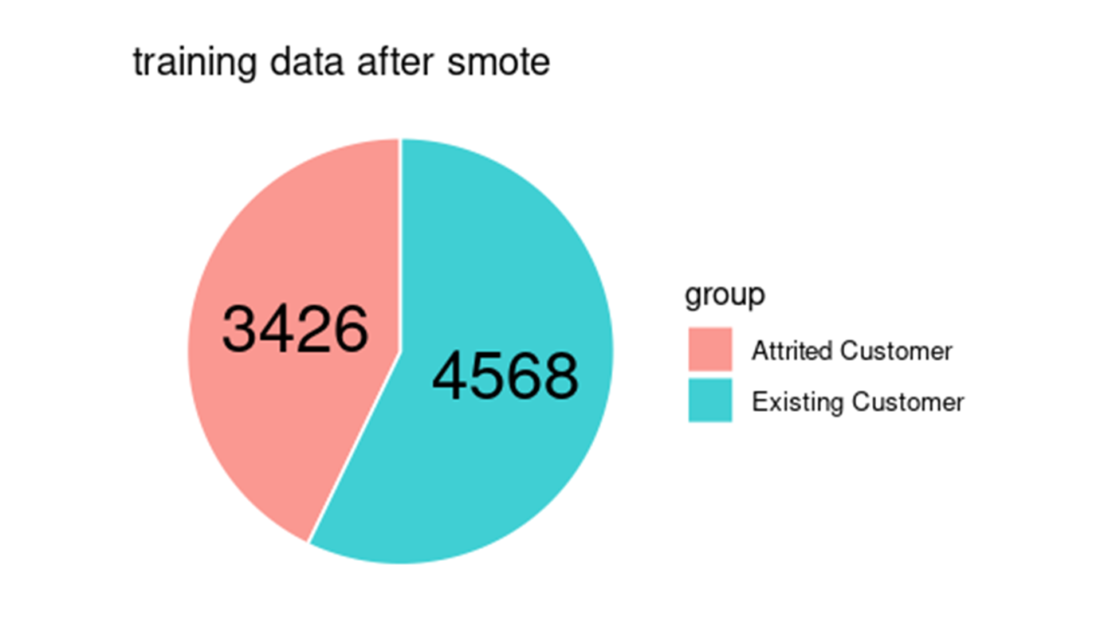
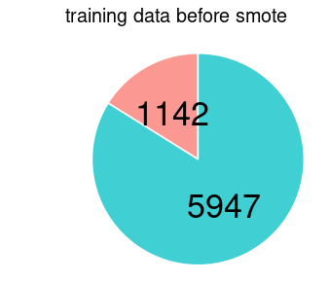
Preprocessing

Slide 12
Modeling
Which method do you use?
Models for Classification Task
SVM
NaiveBayes
XGBoost
Random Forest
What is a null model for comparison?
Null Model : All Negative (Existing Customer)
Accuracy of Null Model : 0.8393

Slide 13
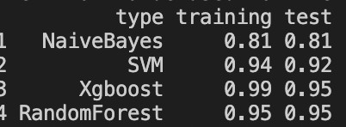
Result

Slide 14
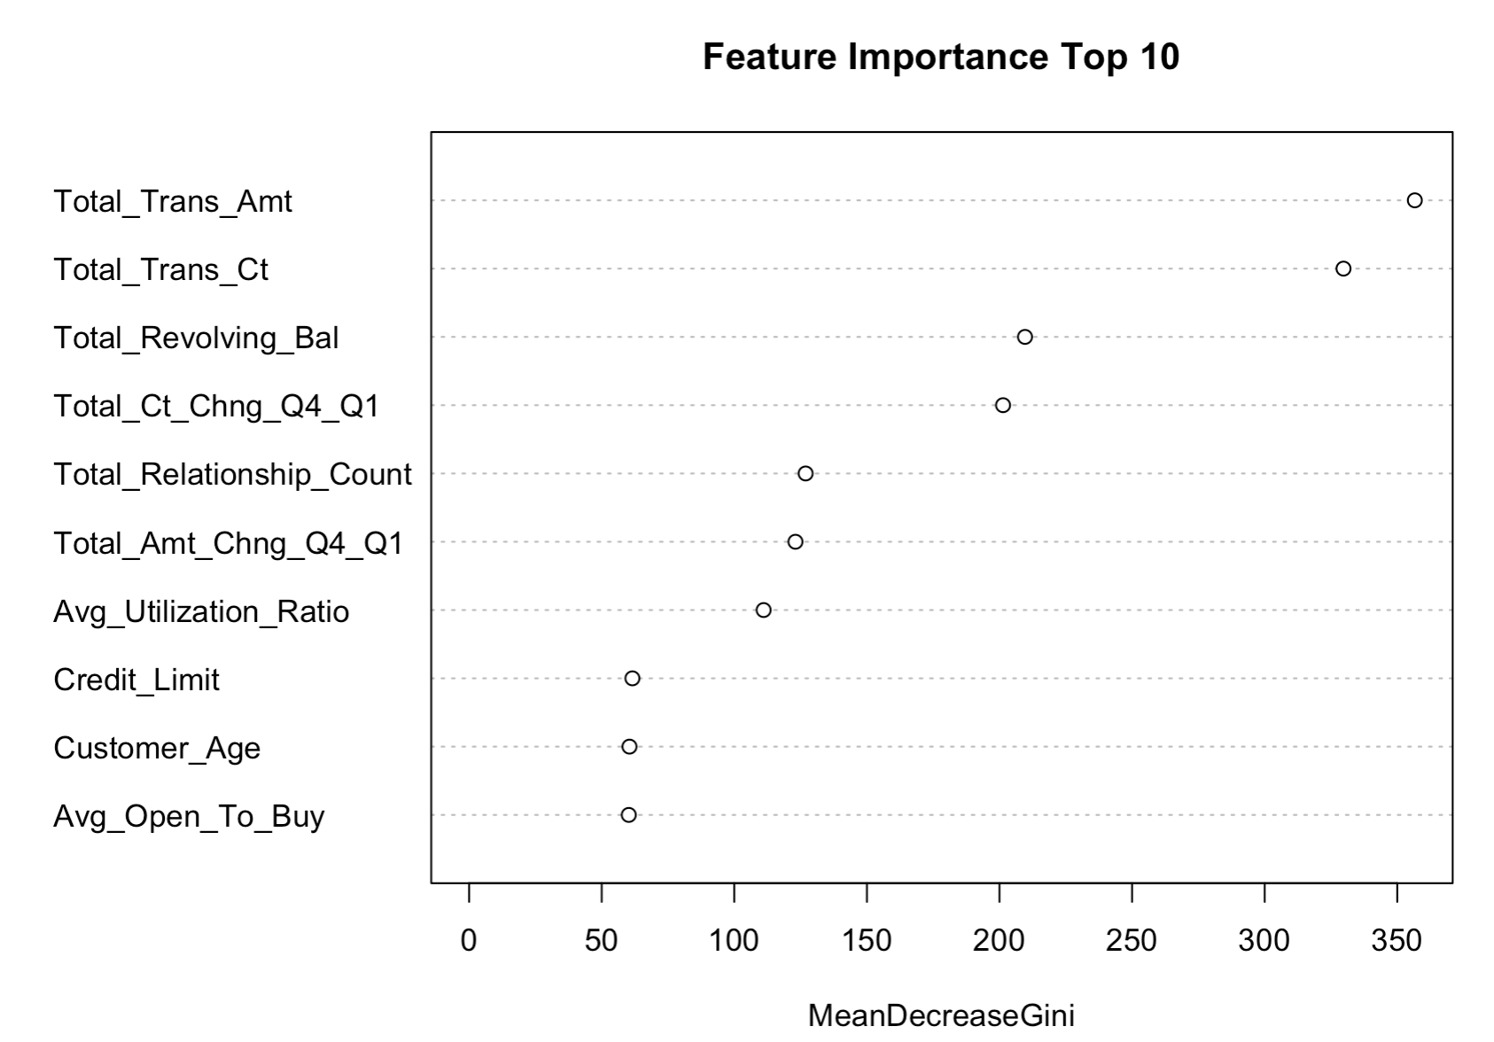
Random Forest Feature Importance

Slide 15
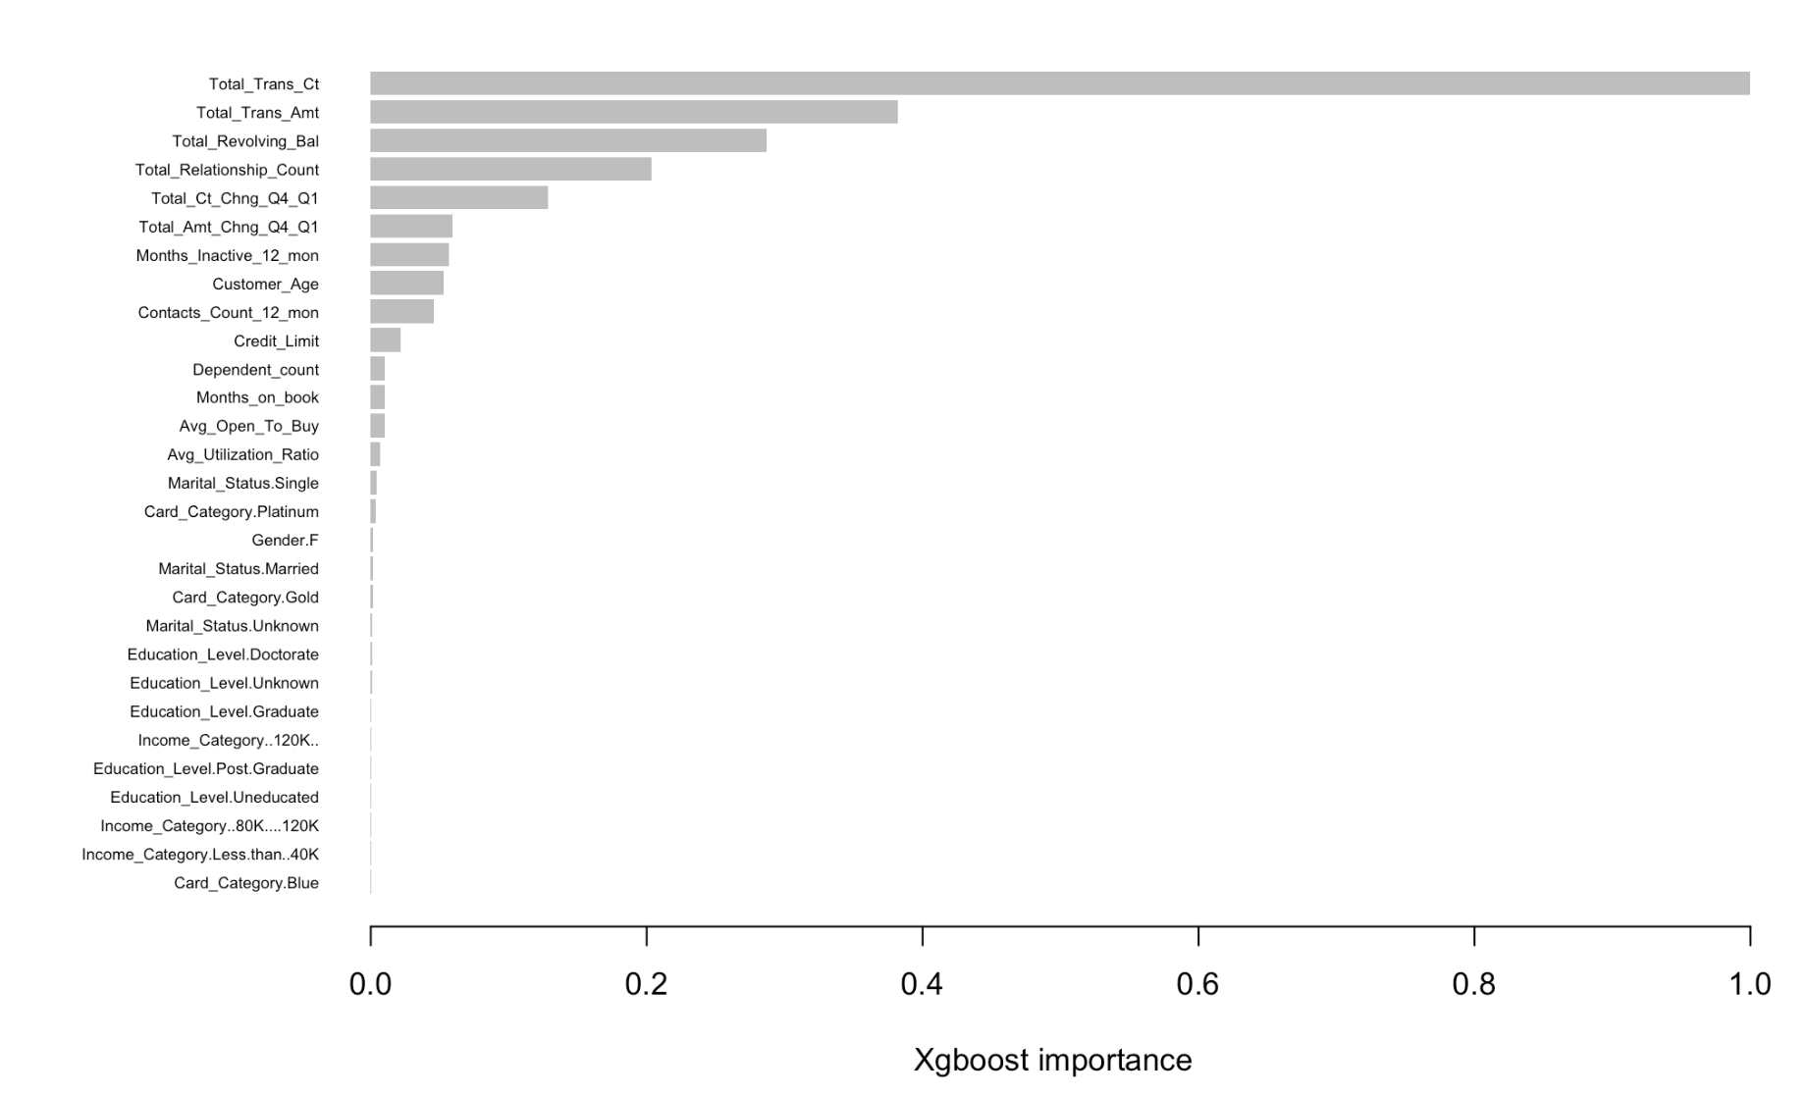
Xgboost Feature Importance

Slide 16
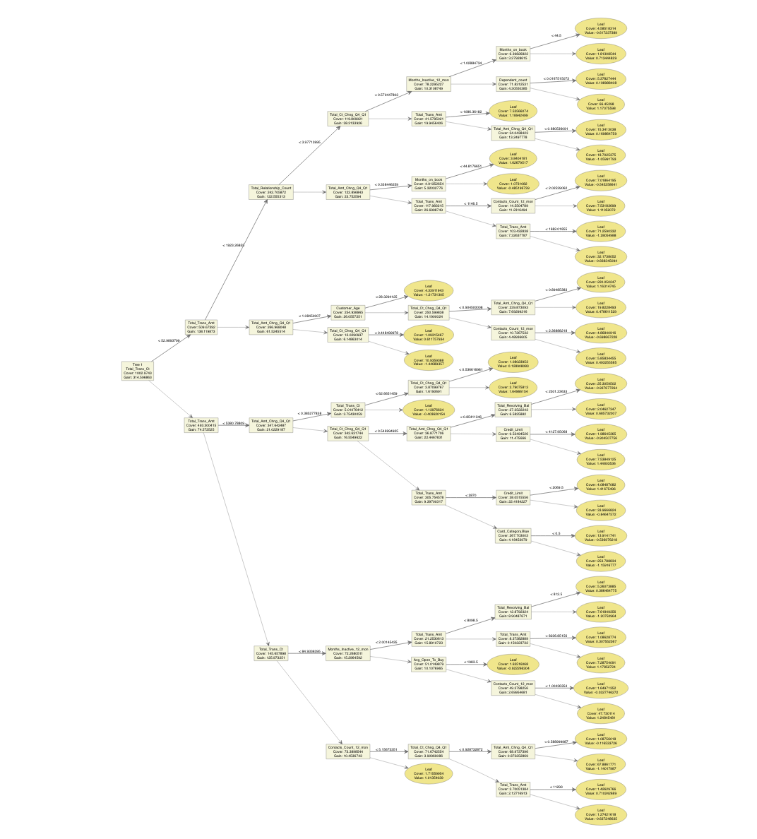
One of XGBOOST Tree

Slide 17

DEMO
Rscript code/merged.R --input data/BankChurners.csv --output results/performance.csv
Shinyapps
BankChurners (shinyapps.io)

Slide 18
Reference
SMOTE: https://www.rdocumentation.org/packages/DMwR/versions/0.4.1/topics/SMOTE
Chawla, N. V., Bowyer, K. W., Hall, L. O., & Kegelmeyer, W. P. (2002). SMOTE: synthetic minority over-sampling technique. Journal of artificial intelligence research, 16, 321-357.
Mode: https://www.tutorialspoint.com/r/r_mean_median_mode.htm
Naive Bayes: https://www.edureka.co/blog/naive-bayes-in-r/
SVM: https://www.rdocumentation.org/packages/e1071/versions/1.7-9/topics/svm
One-hot Encoding: https://www.rdocumentation.org/packages/caret/versions/6.0-90/topics/dummyVars
Xgboost: https://www.rdocumentation.org/packages/xgboost/versions/1.5.0.2/topics/xgb.train
ggplot2: https://ggplot2.tidyverse.org/index.html
Random Forest: https://rpubs.com/phamdinhkhanh/389752

Slide 19
Thank you!

