Slide 1
Salary Prediction
Group 7

Slide 2
Table of contents
01
03
02
04
Motivation
Model Experiment
You can describe the topic of the section here
You can describe the topic of the section here
Dataset intro.
Comments
You can describe the topic of the section here
You can describe the topic of the section here

Slide 3
Motivation
To help limit distractions or make video calls more fun, you can now blur your background or replace your background with an image

Slide 4





Slide 5





Slide 6
Dataset Introduction

Slide 7

Dataset Resource
https://www.kaggle.com/jackogozaly/data-science-and-stem-salaries

Slide 8
Feature | Type | Description | Example
timestamp | Nominal | 時間戳記 | 6/7/2017 11:33:27
company | Nominal | 所任職的公司 | Oracle
level | Nominal | 職業層級 | L3
title | Nominal | 職稱 | Product Manager
totalyearlycompensation | Numeric | 總體薪酬 | 127000
location | Nominal | 公司所在地區 | Redwood City, CA
yearsofexperience | Numeric | 從事這行業的時長 | 1.5
yearsatcompany | Numeric | 在這公司任職的時長 | 1.5
tag | Nominal | 職業屬性別 | API Development (Back-End)

Slide 9
Feature | Type | Description | Example
basesalary | Numeric | 基本薪水 | 107000
stockgrantvalue | Numeric | 股票分紅 | 20000
bonus | Numeric | 獎金 | 10000
gender | Nominal | 性別 | Male
otherdetails | Nominal | 備註 | New grad offer -- intern conversion
cityid | Numeric | 公司所在地區編號 | 7392
dmaid | Numeric | 地區區碼 | 807
rowNumber | Numeric | 編號 | 1
Race | OneHotEncoding | 種族 | White
Education | OneHotEncoding | 教育程度 | Master's Degree

Slide 10
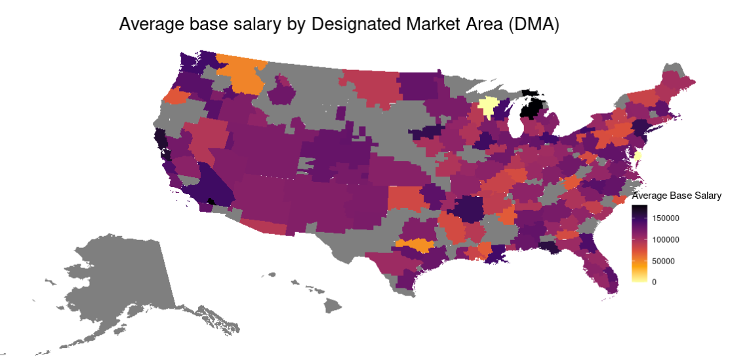
Exploratory Data Analysis

Slide 11
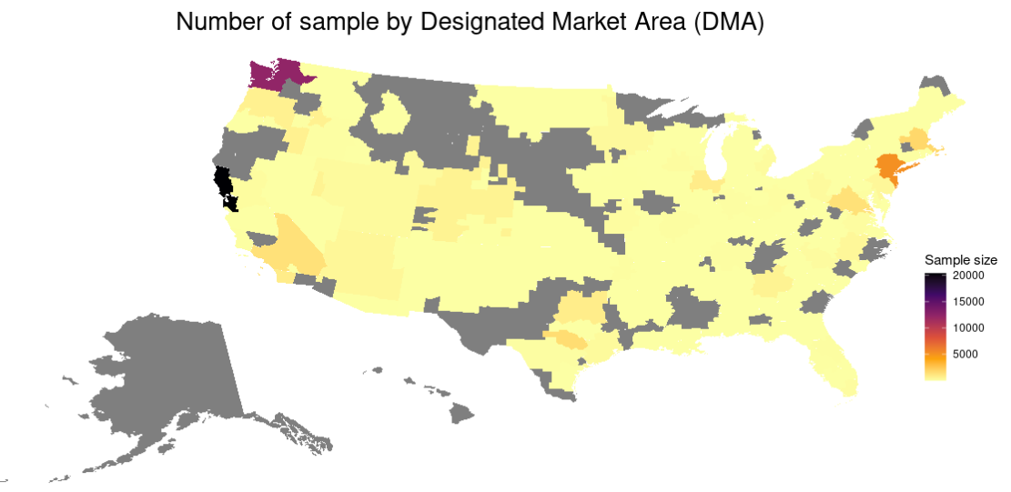
Exploratory Data Analysis

Slide 12
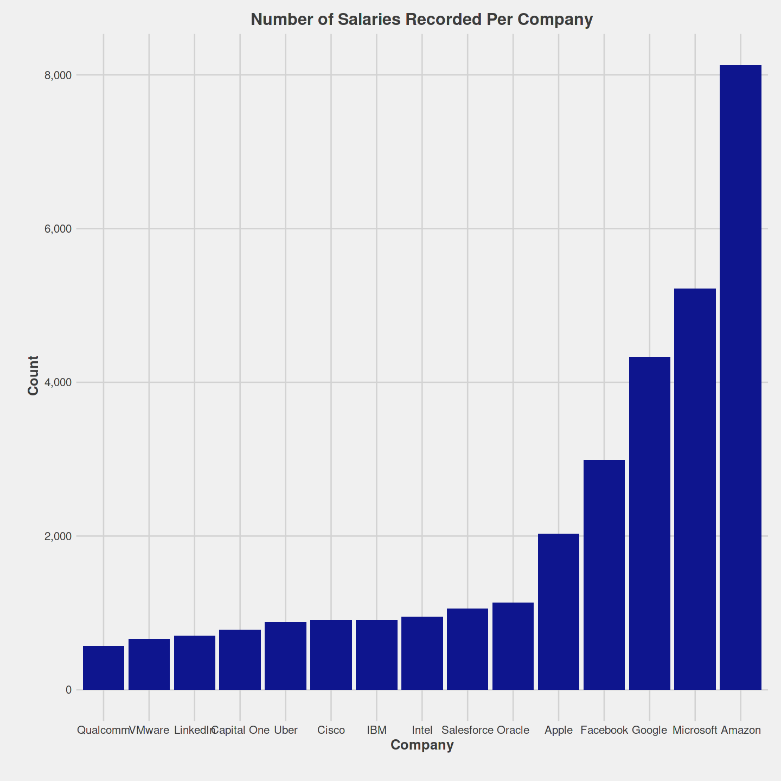
Exploratory Data Analysis

Slide 13
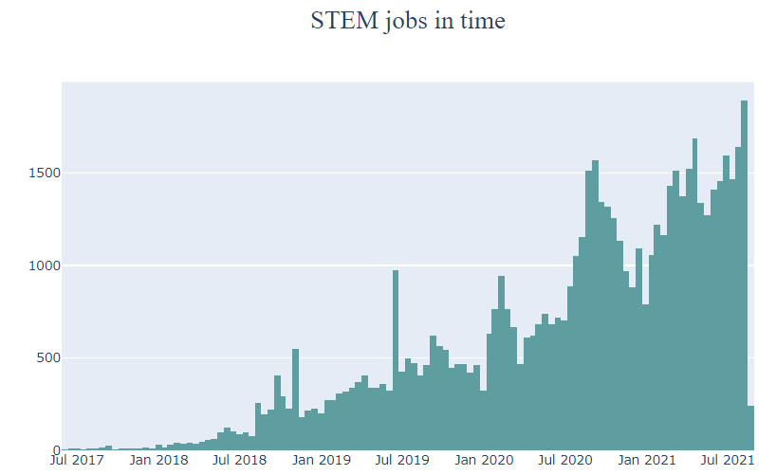
Exploratory Data Analysis

Slide 14
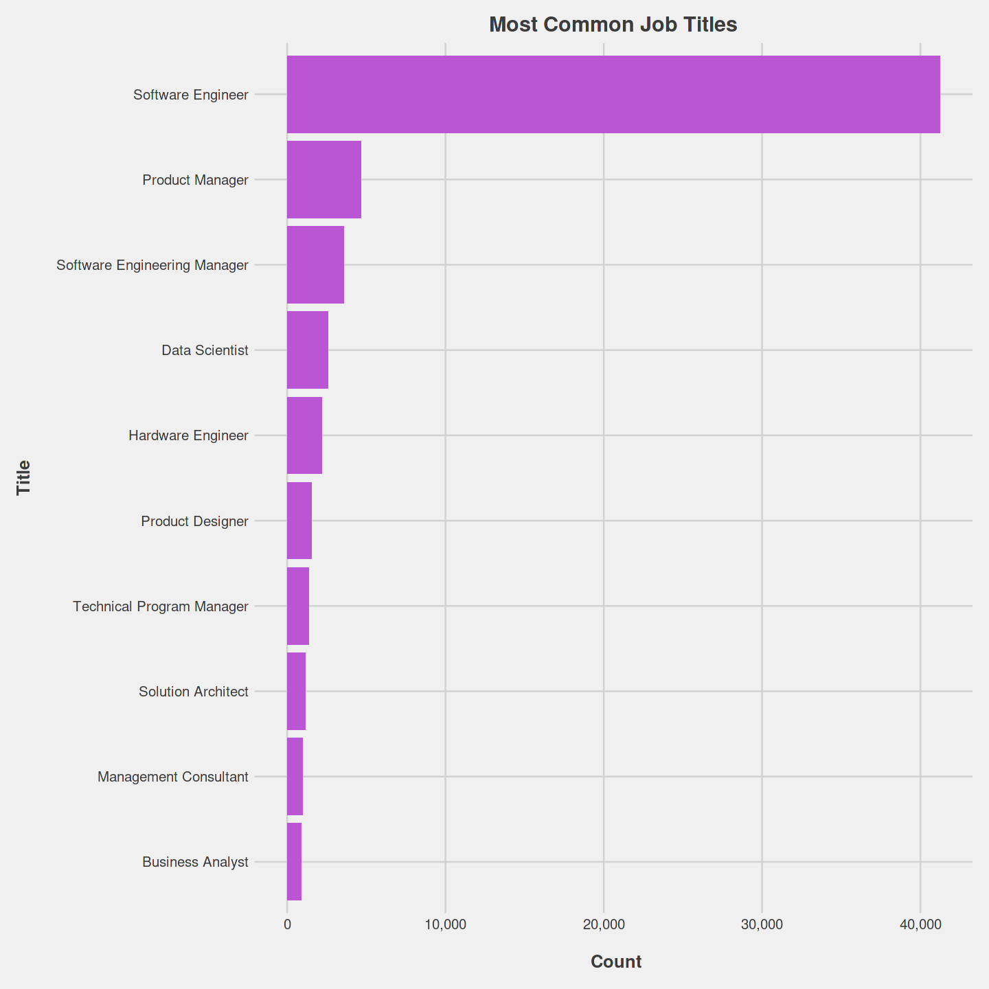
Exploratory Data Analysis

Slide 15
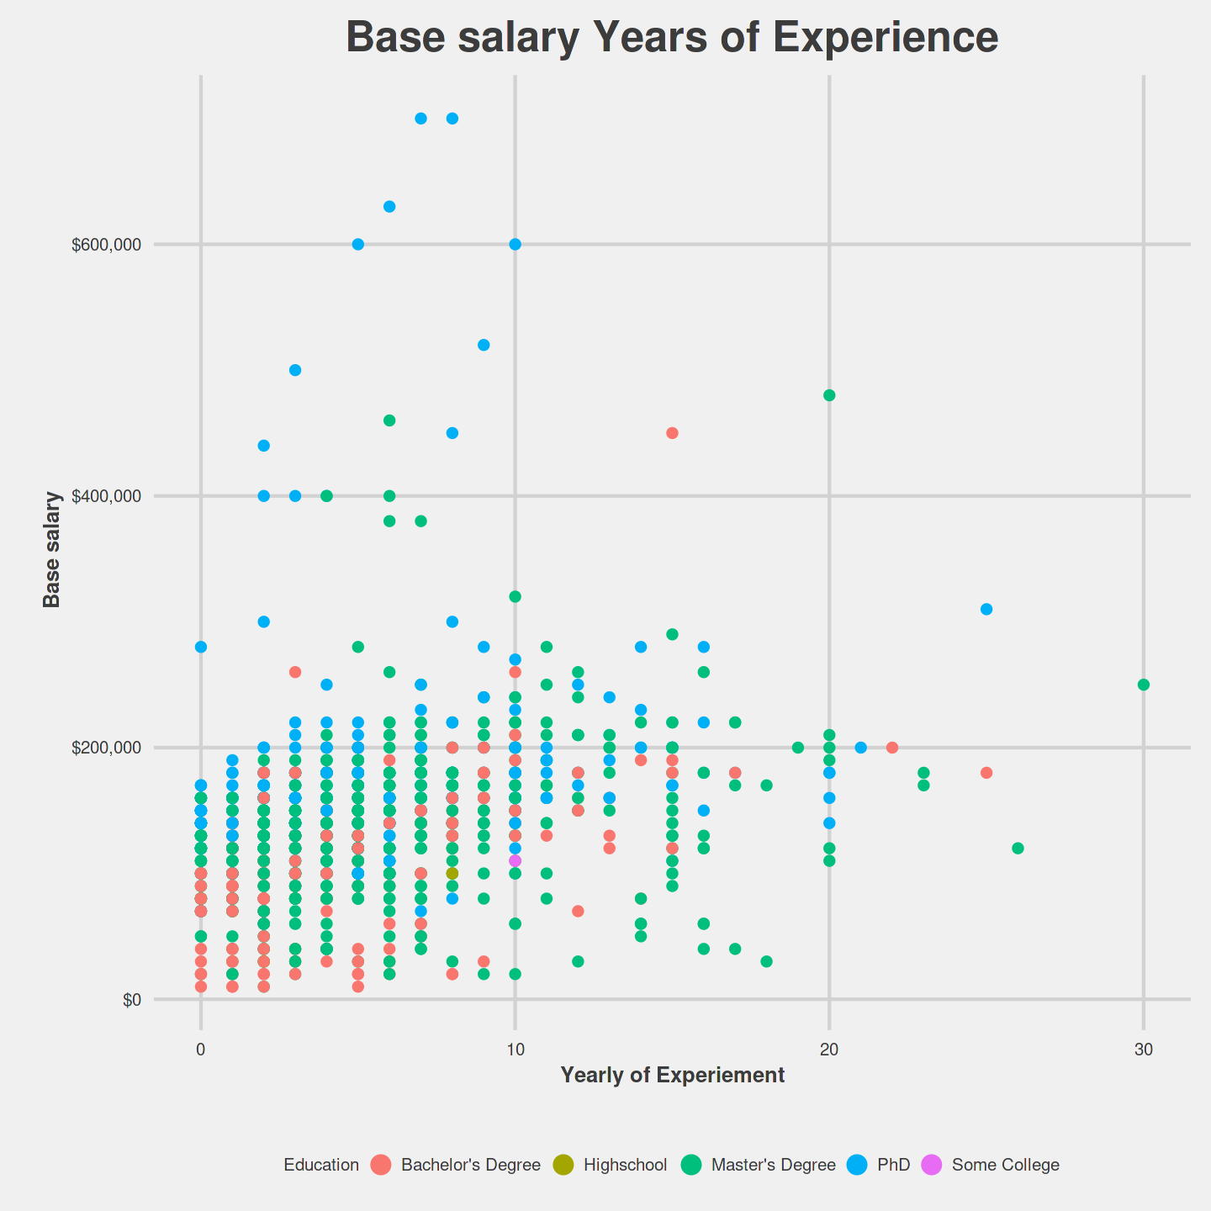
Exploratory Data Analysis
Data Scientist

Slide 16
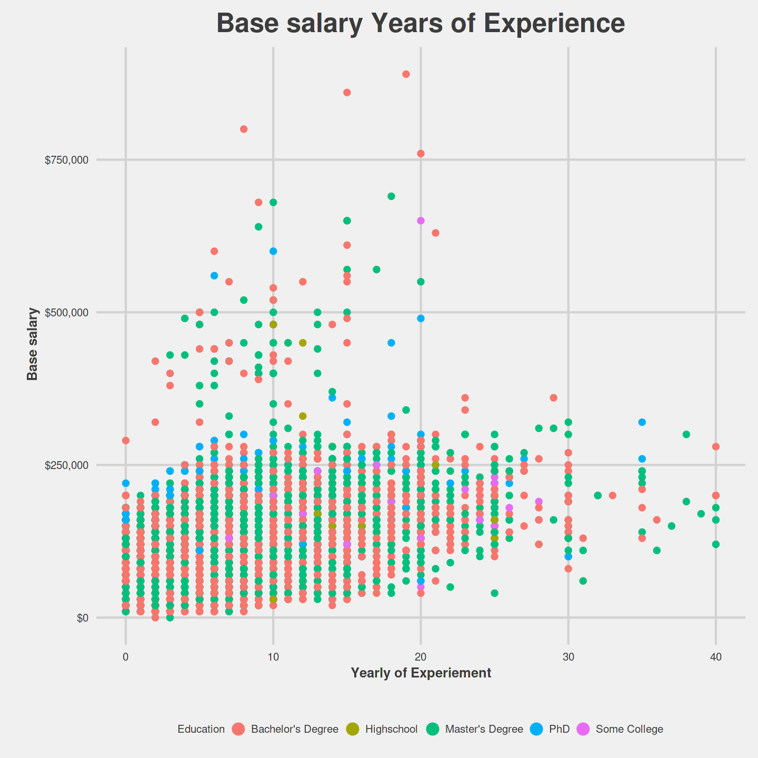
Exploratory Data Analysis
Software Engineer

Slide 17
Model experiment

Slide 18
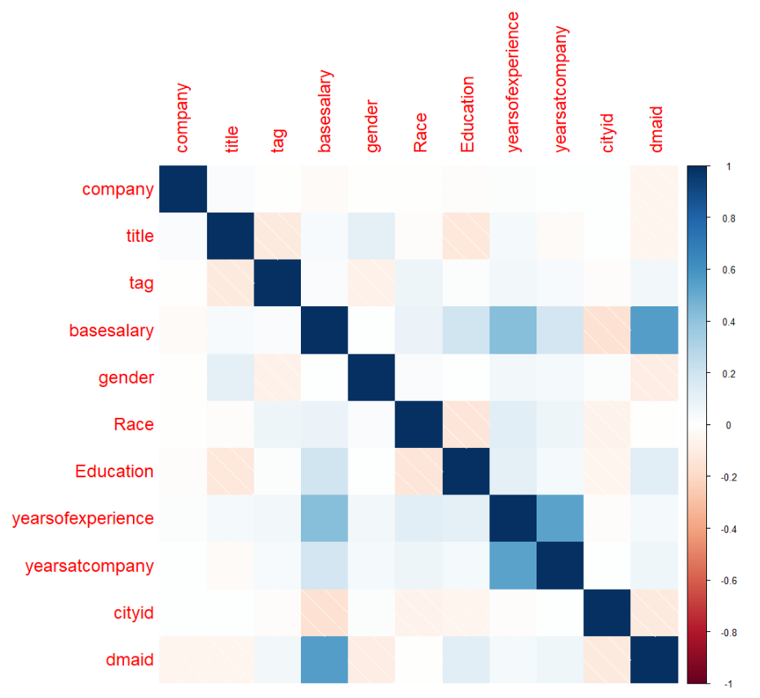
Corrleation Plot

Slide 19
Data Pipeline
Training Data
Preprocess
K-fold Val Data
Models
Split data
Testing Data
Result

Slide 20
Split dataset
Training data
Testing data
Original data

Slide 21
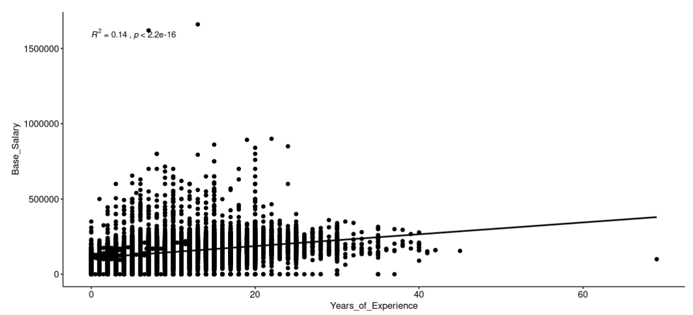
Preprocess
outlier
Delete the outlier

Slide 22
Preprocess
Label encoding categorical data
Product Manager
0
Software Engineer
1
Data scientist
2

Slide 23
Performance
 | Valid MAE | Test MAE
NULL MODEL | 41651.24 | 41809.7
Linear Regression | 3619013 | 35596.49
SVM | 35923.4.9 | 35614.69
Decision Tree | 33123.33 | 34400.99
Random forest | 19671.20 | 21822.02
XGBtree | 18185.23 | 20744.34

Slide 24
10-Fold Performance
 | Valid MAE | Test MAE
Linear Regression | 41651.24 | 35596.49
SVM | 35921.92 | 35614.69
Decision Tree | 33123.33 | 34400.99
Random forest | 19473.32 | 21822.02
XGBtree | 18048.19 | 20677.39

Slide 25
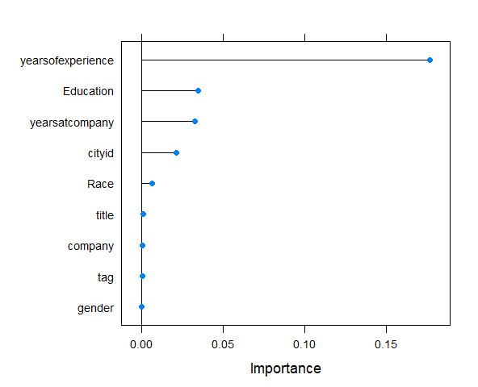
Variable Importance
Notes:
R^2 square

Slide 26
DEMO

Slide 27
https://yhqchiu.shinyapps.io/code/

Slide 28
Comment

Slide 29
Challenging points
NA值很多，嘗試用KNN來補效果卻不大好
Shiny app 呈現會有一些大小的問題，以及無法正確visualization
data science的project分工以及merge code是一個大問題

Slide 30
Thank for listening !

