Slide 1
Expression Divergence of Chemosensory Genes between Drosophila sechellia and Its Sibling Species and Its Implications for Host Shift
Shiao, M. S., Chang, J. M., Fan, W. L., Lu, M. Y. J., Notredame, C., Fang, S., ... & Li, W. H. (2015). Genome biology and evolution, 7(10), 2843-2858.
Group members:
Daga, Ryan Rey
Muluneh, Mequanent Argaw
Addis, Assefa Chekole

Slide 2
Data
Tools
Output
Introduction
Outline

Slide 3
Introduction

Slide 4
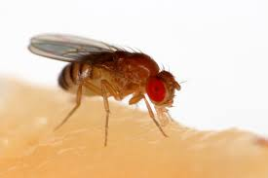
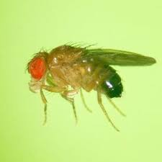
Fruit fly

Slide 5
D. sechelia
D. melanogaster
D. simulans
Genus:
Drosophila

Slide 6
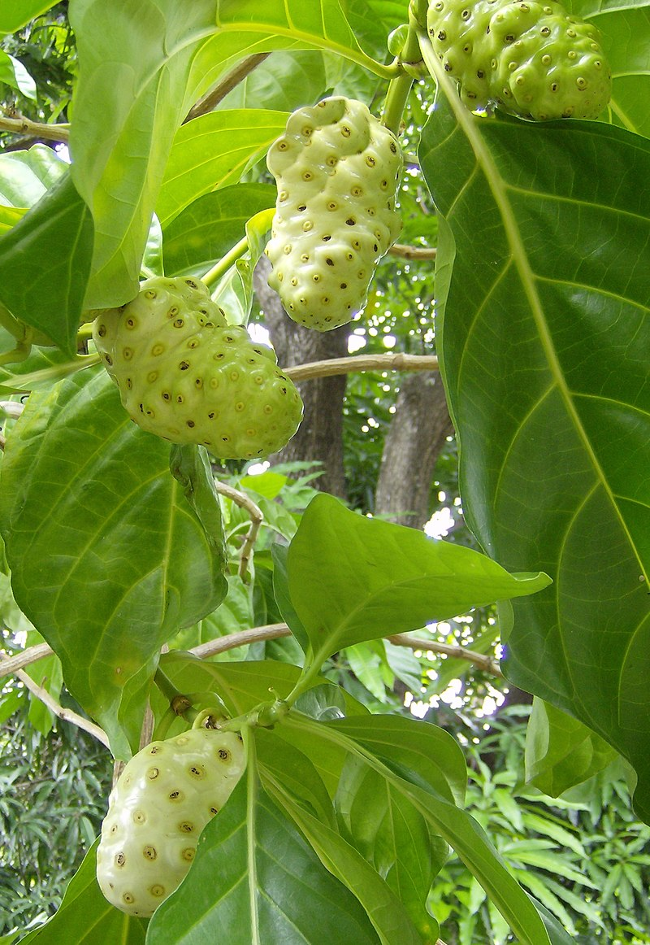


D. sechelia
D. melanogaster
D. simulans
Morinda citrifolia

Slide 7
Chemosensory genes
Odorant binding protein (Obp)
Chemosensory protein (Csp & CheA/B) genes
Transmembrane receptor gene families
Olfactory receptor (Or)
Gustatory receptor (Gr)
Ionotropic receptor (Ir)
responsible for sensing odors and essential for finding food sources and reproduction of most animal species

Slide 8
The study hypothesize that the adaptation of D. sechelia to the new host was achieved by changing expression levels of existing genes and it is expected that there is enrichment of differentially expressed chemosensory genes in the D. sechelia lineage.
Hypothesis

Slide 9
Data

Slide 10
Data
Species | Source | File Size
D. sechelia (TW) | NCBI Gene Expression Omnibus (GEO) | 3 Mb / 4Gb
D. sechelia (JAP)
D. sechelia | Shiao et. al (2013) | 1.5 Mb
D. melanogaster
D. simulans
D. simulans | NCBI Gene Expression Omnibus (GEO) | 3 Mb / 4Gb

Slide 11
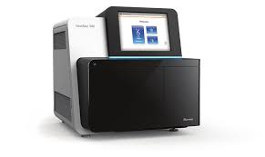
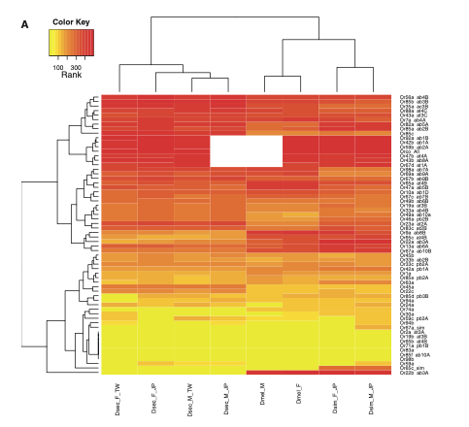
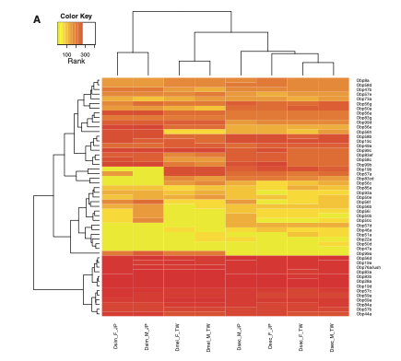
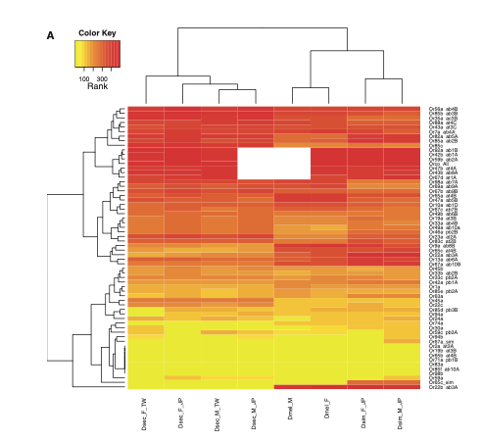

TopHat
+
Cufflinks
Drosophila sechila & Drosophila simulans (TW & JP)
Drosophila melanogaster

Slide 12
Process and Tools
Read Processed reads using Pandas
Annotate reads to their gene names using Pandas and list of orthologous genes list
Generate dendrogram for Obp, Or, and Ir genes using Seaborn
D. sechelia
D. simulans
D. melanogaster

Slide 13
Output

Slide 14
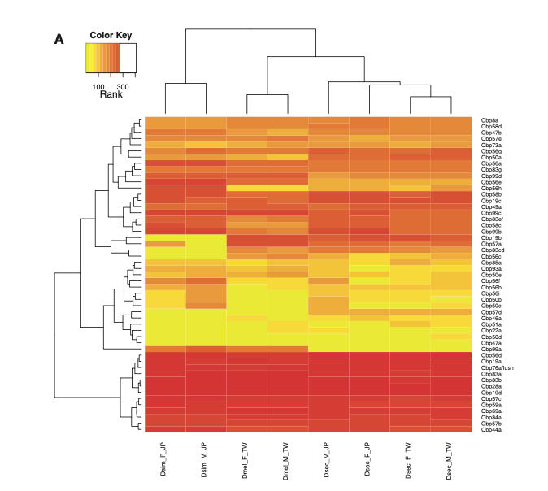
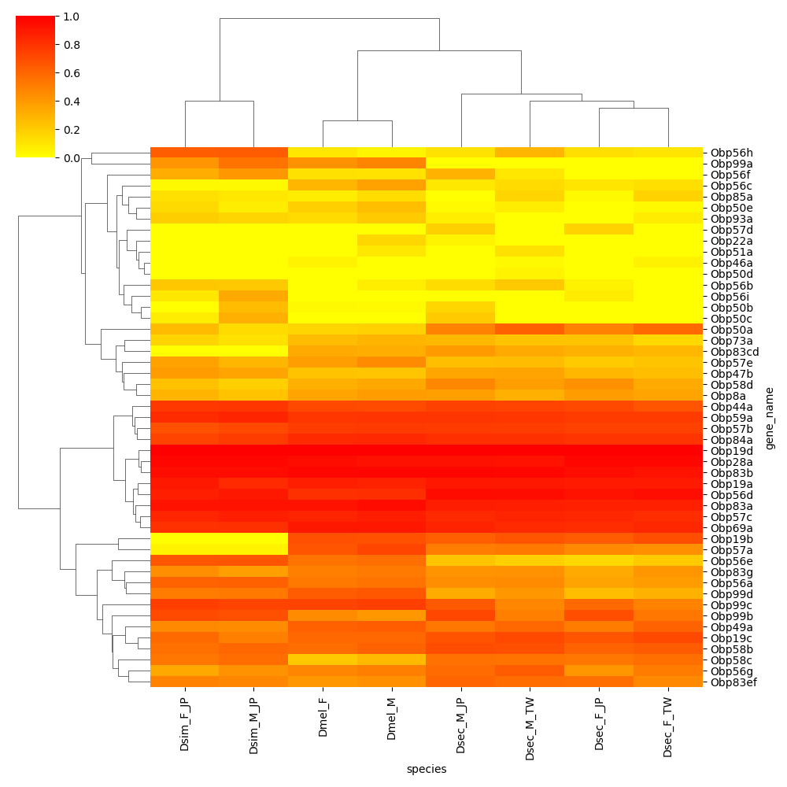
Obp Genes
Shiao et. al (2015)
Derived results

Slide 15
Obp Genes
Shiao et. al (2015)
Derived results

Slide 16

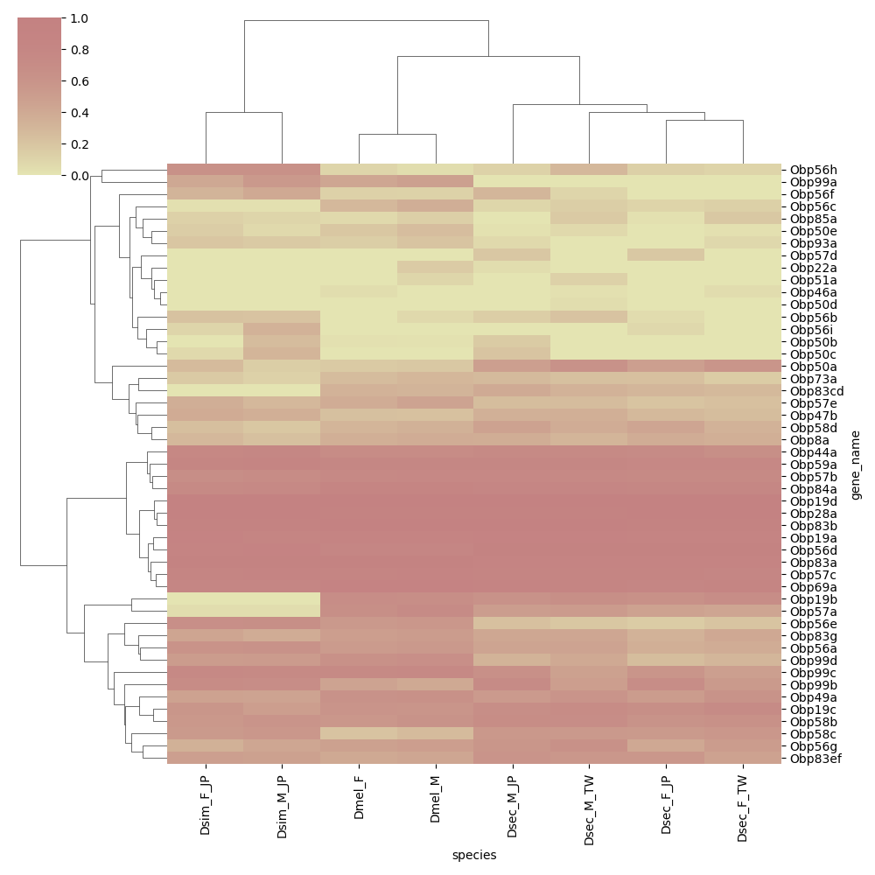
Obp Genes
Shiao et. al (2015)
Derived results

Slide 17
Obp Genes
Shiao et. al (2015)
Derived results

Slide 18
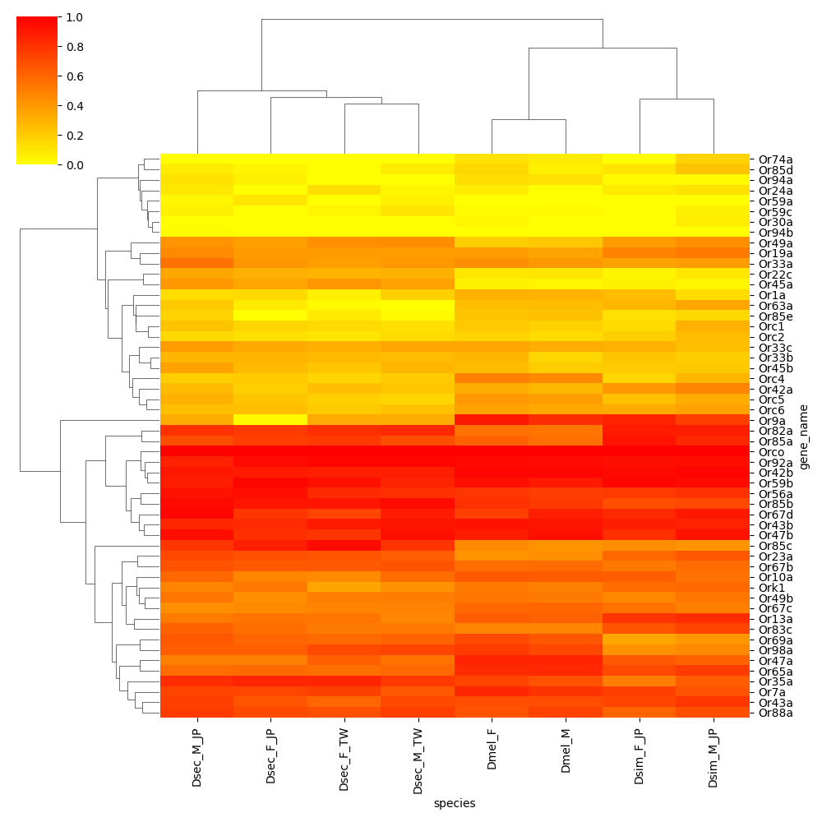
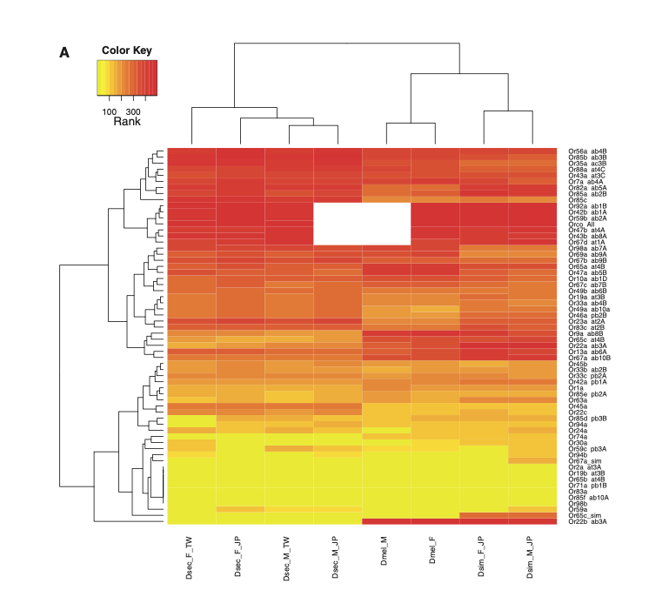
Or Genes
Shiao et. al (2015)
Derived results

Slide 19
Or Genes
Shiao et. al (2015)
Derived results

Slide 20
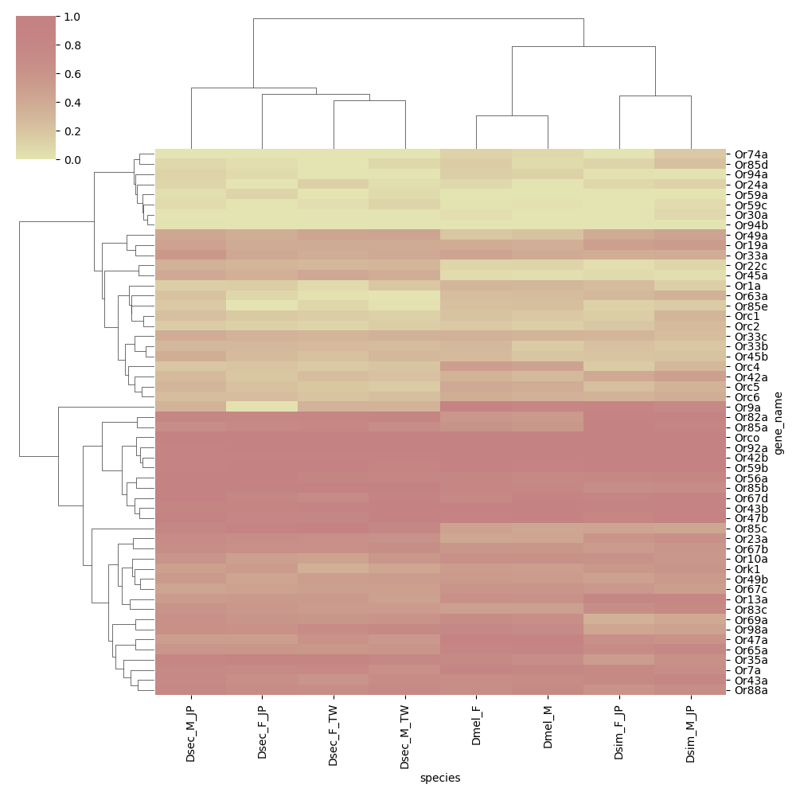
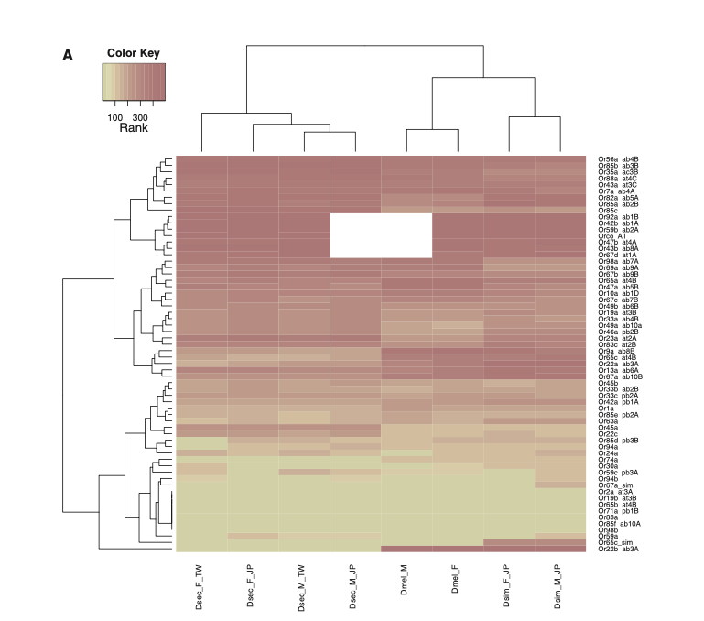
Or Genes
Shiao et. al (2015)
Derived results

Slide 21
Or Genes
Shiao et. al (2015)
Derived results

Slide 22
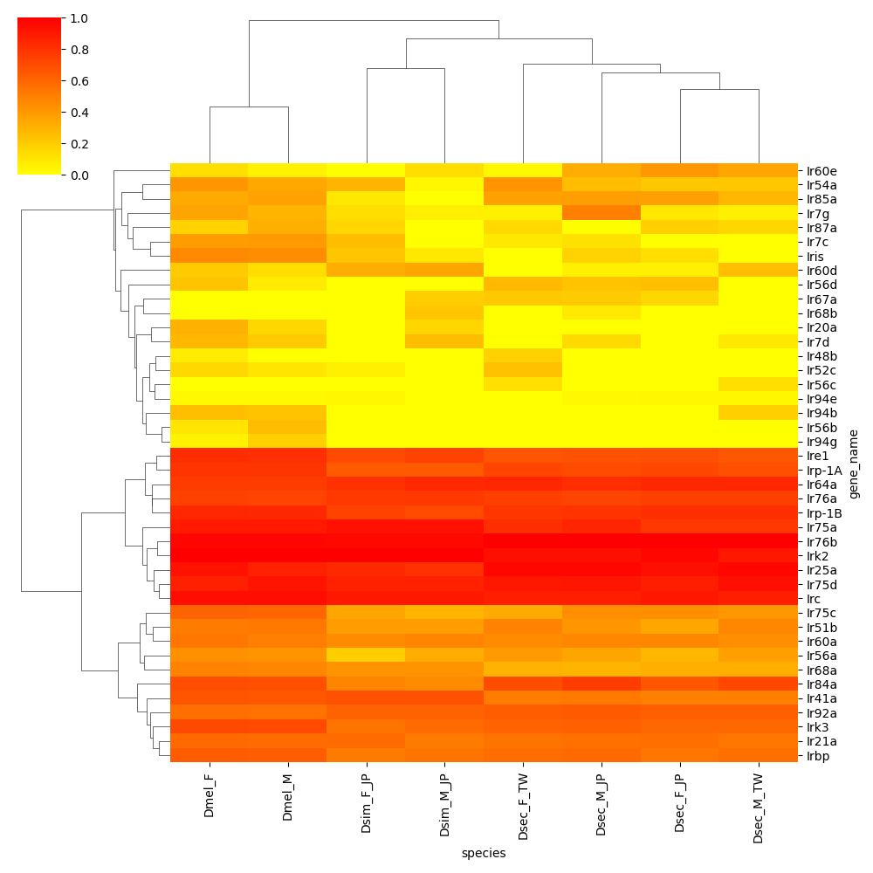
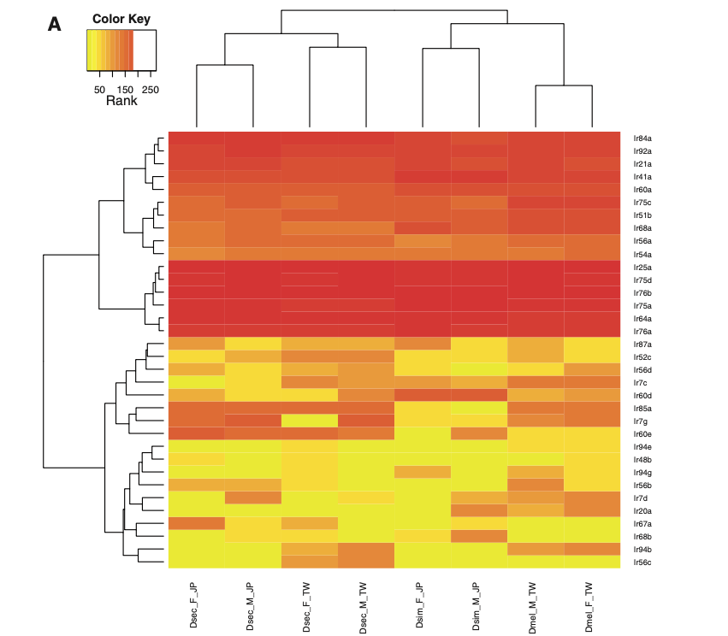
Ir Genes
Shiao et. al (2015)
Derived results

Slide 23
Ir Genes
Shiao et. al (2015)
Derived results

Slide 24
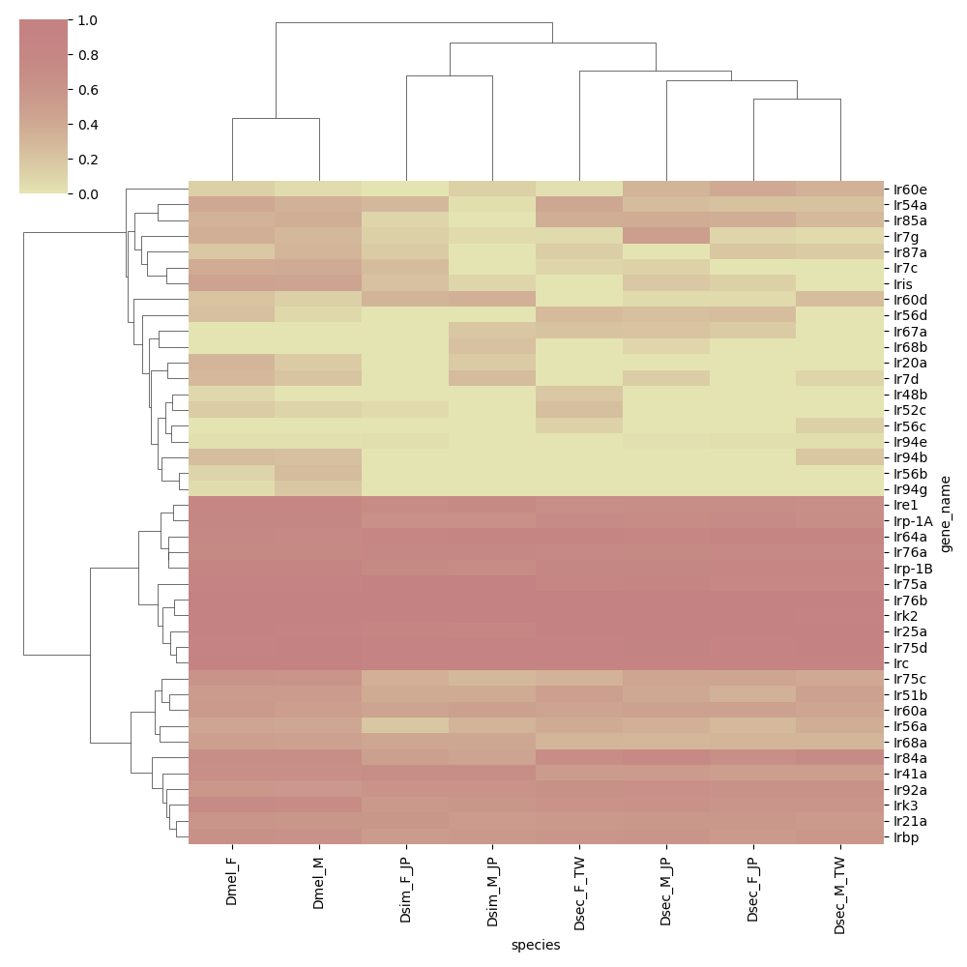
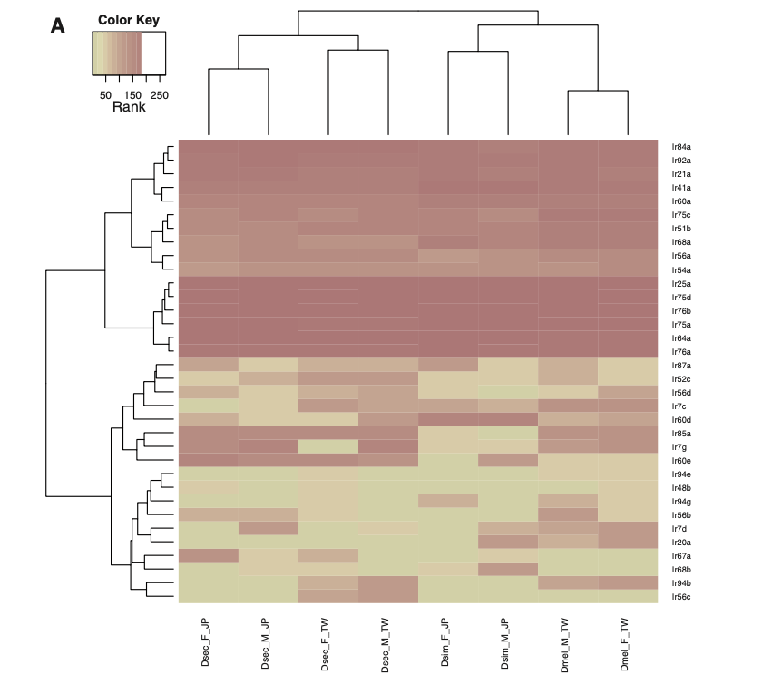
Ir Genes
Shiao et. al (2015)
Derived results

Slide 25
Ir Genes
Shiao et. al (2015)
Derived results

Slide 26
References
Shiao, M. S., Chang, J. M., Fan, W. L., Lu, M. Y. J., Notredame, C., Fang, S., ... & Li, W. H. (2015). Expression divergence of chemosensory genes between Drosophila sechellia and its sibling species and its implications for host shift. Genome biology and evolution, 7(10), 2843-2858.
Shiao, M. S., Fan, W. L., Fang, S., Lu, M. Y. J., Kondo, R., & Li, W. H. (2013). Transcriptional profiling of adult Drosophila antennae by high-throughput sequencing. Zoological Studies, 52(1), 1-10.
https://www.ncbi.nlm.nih.gov/geo/query/acc.cgi?acc=GSE67587
https://www.ncbi.nlm.nih.gov/geo/query/acc.cgi?acc=GSE67861
https://www.ncbi.nlm.nih.gov/geo/query/acc.cgi?acc=GSE67862

Slide 27
Thank you!

