Slide 1
Power Delivery
Based on slides from tutorial by Visvesh Sathe and Shiddhartha Das

Slide 2
Outline
Opening Remarks
Understanding supply noise
Power supply delivery – A case study
De-coupling capacitance
Microarchitecture techniques
Break (5m)
Adaptive Clocking
Generation: Intel Nehalem
Generation: AMD Steamroller
Distribution: Qualcomm
Integrated Voltage Regulation

Slide 3
Margins in Design
CLK
Notes:
When we do design, we design for the worst-case. What that means is that we try and predict the worst-case situations that can exist on die and margin for the same. Thus, we add margins for phenomenon such as clock-jitter which refers primarily to cycle-cycle jitter. All synchronous systems depend upon a good quality clock source for correct functionality. However, some cycles may be shorter than the rest because of device noise within the PLL or because of the noise induced due to the on-chip clcock tree. So, we need to margin for the same.

Slide 4
Margins in Design
CLOCK JITTER
cycle to cycle jitter
PLL + clock tree
CLK
jitter
Notes:
When we do design, we design for the worst-case. What that means is that we try and predict the worst-case situations that can exist on die and margin for the same. Thus, we add margins for phenomenon such as clock-jitter which refers primarily to cycle-cycle jitter. All synchronous systems depend upon a good quality clock source for correct functionality. However, some cycles may be shorter than the rest because of device noise within the PLL or because of the noise induced due to the on-chip clcock tree. So, we need to margin for the same.

Slide 5
Margins in Design
COUPLING NOISE
capacitive coupling between nets
victim & aggressor both switch
CLK
coupling
jitter
Notes:
We add margins for coupling noise effects. This refers to increase in internconnect delay of a victim net due to an aggressor init siwtching..

Slide 6
Margins in Design
TEMPERATURE
transistors
temperature inversion
-40ºC worse case
interconnect
linear dependency
125ºC worse case
CLK
temp
coupling
jitter
Notes:
Temperature effects: We know that temperature varies on-chip. We can have local hot-sprts as well as variations in ambient temperature. Temperature affects transistors differently from wires whose resistivity goes up linearly with temperature. So, temperature variations can be interesting.

Slide 7
Margins in Design
TEMPERATURE
transistors
temperature inversion
-40ºC worse case
interconnect
linear dependency
125ºC worse case
VOLTAGE
VRM offset
regulator noise and response
IR drop
Ldi/dt drop
PROCESS
global corners
local mismatch
device + wire
CLOCK JITTER
cycle to cycle jitter
PLL + clock tree
FFF
VDD
FF*
TT
SS*
SSS
CLK
voltage
temp
coupling
jitter
Notes:
Supply voltage non-idealities. Supply voltage on-chip can droop because of the resistive nature of the power-grid and because of inductive droops due to the interaction between the package and the die. As we shall see in this talk, voltage mragins are often the largest contributor to the overall margins.

Slide 8
Margins in Design
PROCESS
global corners
local mismatch
device + wire
FFF
FF*
TT
SS*
SSS
CLK
process
voltage
temp
coupling
jitter
Notes:
Process variations effects, both inter-and intra-die process variations

Slide 9
Margins in Design
SAFETY MARGIN
human nature
2nd/3rd order effects
“unknown unknowns”
?
CLK
process
voltage
safety
temp
coupling
jitter
Notes:
Finally some extra margin is always budgeted as margins for safety. This refers to the so-called “unknown unknowns” of the design process, the 2nd and 3rd effects such as test and measurement uncertainties and the human nature of engineering where to be absolutely safe, some extra margin is always added. So, a combinattion of all these margins implies that our processors do not execute as fast as they are natively capable of doing or as low power as they are natively capable of doing, leading to quite large power and performance overheads.

Slide 10
The State of Supply Noise in Modern SoCs
High-Performance Design
V_{dd} → αV_{dd} => I_{dd} → I_{dd}/α
Z_{targ} → Z_{targ}/α² (For the same target VDD drop)
Low-Power Design
↓V_{dd}, ↑V_{th}
↑delay sensitivity to supply noise
Increased voltage-domain count (finer V_{dd} control)
Supply noise significantly impacts performance
Supply distribution network, supply noise are critical

Slide 11
Design Margins - Taxonomy
STATIC
DYNAMIC
EXTREMELY SLOW
SLOW-CHANGING
FAST-CHANGING
Inter-die process variations Life-time degradation (NBTI, TDDB) | Package/Die VDD fluctuations Ambient temperature variations | PLL jitter Ldi/dt IR Drop
Intra-die process variations | Temperature hot-spots | Coupling noise Local Clock-jitter (IR drop in clock-tree)
SPATIAL REACH
GLOBAL
Easy to
Handle
Difficult
to Handle
LOCAL
TEMPORAL RATE OF CHANGE

Slide 12
Energy-Efficient Design: Traditional Approaches
Industry: Other approaches prioritized till recently
Continued scaling
Clock gating
Power gating
DVFS
Multi-V_{th}
Academia, focus on more exotic approaches
Adiabatic logic / Charge-recycling techniques
Super-pipelining (voltage-scaling)
Low-power logic topologies

Slide 13
Voltage Margins: Challenging Perceptions
Industry
Traditionally recognized importance but…
Until recently, not addressed as a design problem
Mitigated using binning and test
Academia
Largely unheralded
Not seen as highly impactful effort in low-power design
Reality
Dominant source of inefficiency
Solutions (particularly supply noise) span variety of areas (PDN design, Voltage Regulation, Clocking, Micro-architecture)

Slide 14
Outline
Opening Remarks
Understanding supply noise
Power supply delivery – A case study
De-coupling capacitance
Microarchitecture techniques
Break (5m)
Adaptive Clocking
Generation: Intel Nehalem
Generation: AMD Steamroller
Distribution: Qualcomm
Integrated Voltage Regulation

Slide 15
Power Delivery Network
L_{VRM}
L_{PCB}
ESR_{PCB}
L_{PKG}
R_{PKG}
R_{DIE}
I_{DIE}
PCB
ESL_{PCB}
C_{DIE}
Chip
C_{PCB}
C_{PKG}
L_{PCB}
Wires
Package
DC IR Drop
AC Ldi/dt Droop
Reduced by
On-die decap insertion, Cdie↑
Reduce Lpkg
Additional metallization
Notes:
The power-delivery network can be simplistically decomposed into the die-side, the package and the PCB side including the VRM (or the board regulation module). The die is modeled as a current source (representing switching Xtors), a Cdie (representing non-switching Xtors) and a Rdie (representing power-grid resistance). The package planes and traces are modeled as an RL circuit (similar to traces on PCB). A package may have decaps modeled by a cap with ESR and ESL. The PCB has bulk capacitors that are much larger compared to package decaps but have larger ESR and ESL. For such a simple model of the PDN, it is possible to solve for the die-side voltage drop analytically. The drop can be composed into two parts, a DC IR drop component proportional to total R which is addressed by increasing overall metallization (for eg, top 2 metal layers on die). The AC Ldi/dt component is proportional to Lpkg/Cdie. So, to address it, we increase decap insertion, Cdie increases or work on reducing package inductance.

Slide 16
Understanding Decap

Slide 17
Power Delivery Network
L_{VRM}
L_{PCB}
ESR_{PCB}
L_{PKG}
R_{PKG}
R_{DIE}
I_{DIE}
PCB
ESL_{PCB}
C_{DIE}
Chip
C_{PCB}
C_{PKG}
Wires
Wait – what’s this RLC?
L_{PCB}
Package
DC IR Drop
AC Ldi/dt Droop
Reduced by
On-die decap insertion, Cdie↑
Reduce Lpkg
Additional metallization
Notes:
The power-delivery network can be simplistically decomposed into the die-side, the package and the PCB side including the VRM (or the board regulation module). The die is modeled as a current source (representing switching Xtors), a Cdie (representing non-switching Xtors) and a Rdie (representing power-grid resistance). The package planes and traces are modeled as an RL circuit (similar to traces on PCB). A package may have decaps modeled by a cap with ESR and ESL. The PCB has bulk capacitors that are much larger compared to package decaps but have larger ESR and ESL. For such a simple model of the PDN, it is possible to solve for the die-side voltage drop analytically. The drop can be composed into two parts, a DC IR drop component proportional to total R which is addressed by increasing overall metallization (for eg, top 2 metal layers on die). The AC Ldi/dt component is proportional to Lpkg/Cdie. So, to address it, we increase decap insertion, Cdie increases or work on reducing package inductance.

Slide 18
Understanding Decap Parasitics

Slide 19
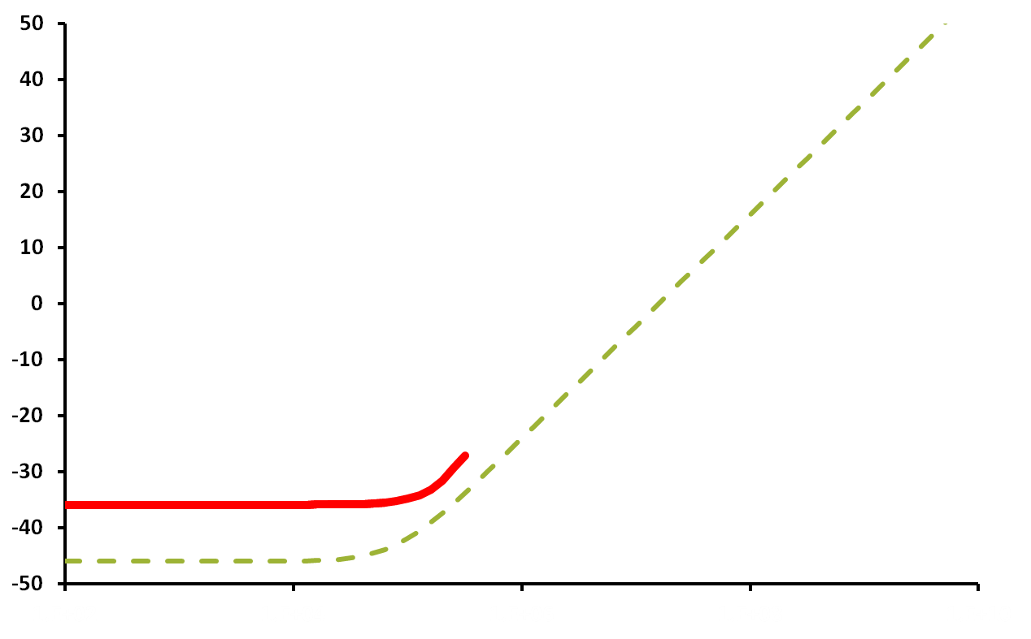
Supply Impedance – Frequency Domain
Impedance (dBΩ)
Z_{total}
Z_{VRM}
100
10K
1M
100M
10G
Frequency (Hz)
Notes:
Looking at the frequency domain response of the power-grid. X-axis shows frequency on a log scale. Y axis shows the impedance in dbOhms. 20logZ. In absence of any planes or decoupling capacitor, the overall impedance would resemble an inductor at high-frequencies ie have infinite impedance.

Slide 20
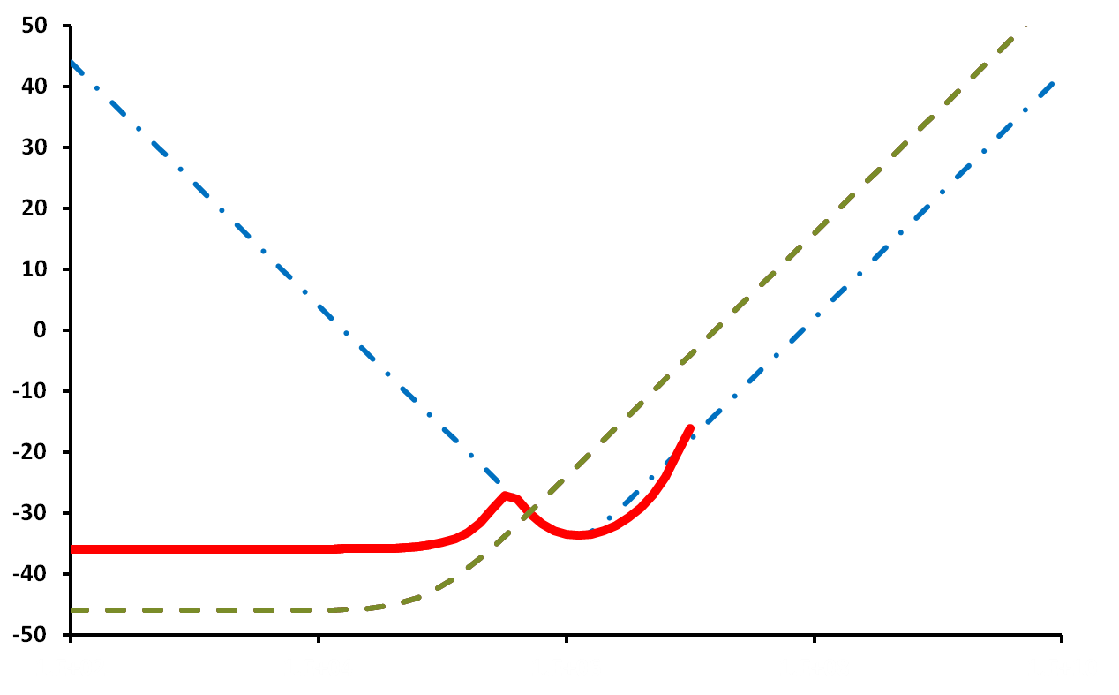
Supply Impedance – Frequency Domain
Z_{BULK}
Impedance (dBΩ)
Z_{total}
Z_{VRM}
100
10K
1M
100M
10G
Frequency (Hz)
Notes:
The PCB bulk capacitors begin to act at 100KHz order frequencies bringing the overall impedance down. However, as frequency increases their series inductance limits and hence Ztot again begins to increase.

Slide 21
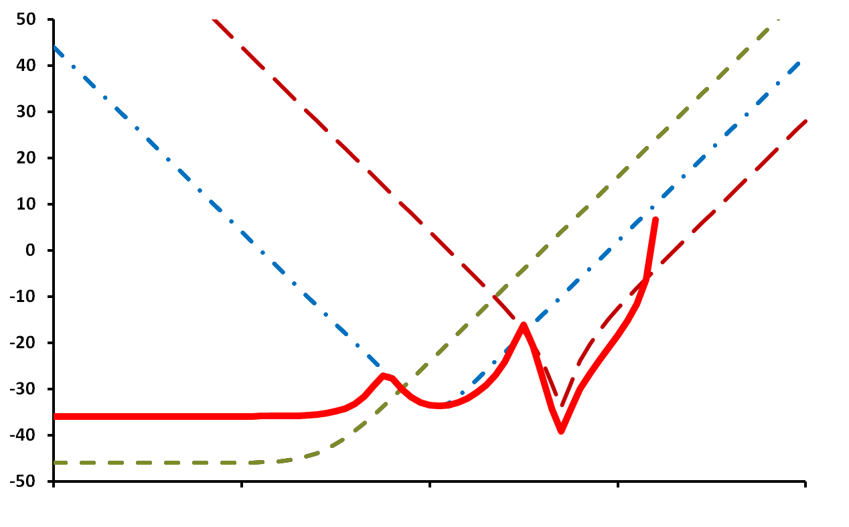
Supply Impedance – Frequency Domain
Z_{BULK}
Z_{PKG_DECAP}
Impedance (dBΩ)
Z_{total}
Z_{VRM}
100
10K
1M
100M
10G
Frequency (Hz)
Notes:
The package decaps start kicking in at higher frequencies but run out of steam around 100Mhz (assuming SMD capacitors with low ESL.)

Slide 22
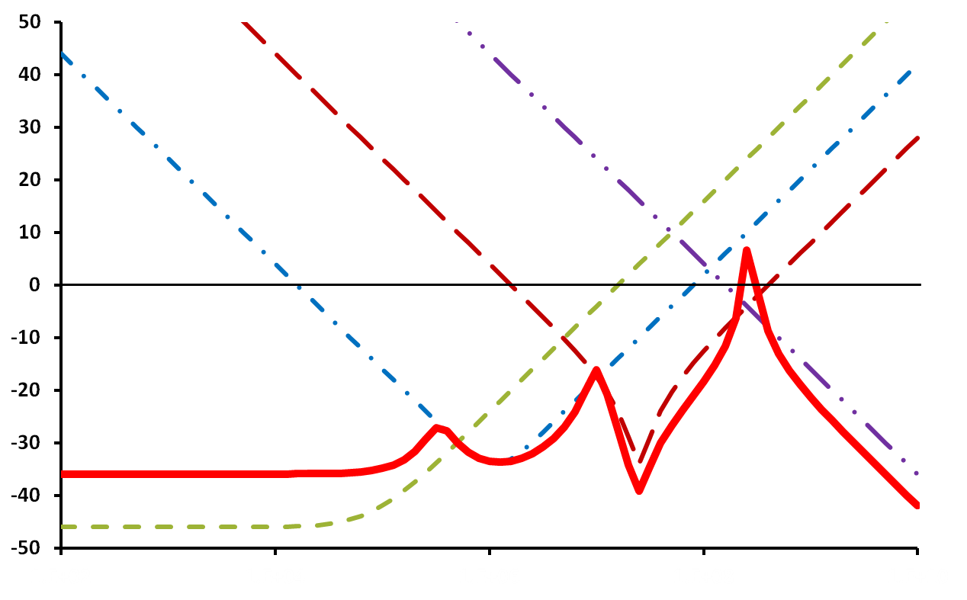
Supply Impedance – Frequency Domain
Z_{DIE_DECAP+PLANE}
Z_{BULK}
Z_{PKG_DECAP}
L_{PKG}C_{DIE}
Impedance (dBΩ)
L_{PCB}C_{PKG}
L_{VRM}C_{Bulk}
Z_{total}
Z_{VRM}
100
10K
1M
100M
10G
Frequency (Hz)
Notes:
Finally, at very high frequencies, the die-side decaps and package/PCB planes are the only sources that can provide charge and bring the impedance down. Each impedance peak occurs at the resonance between a cap and the inductor that feeds it. For example, the first peak is due to resonance between Bulk cap and VRM inductance, the second is between pkg decap and PCB inductance, the highest peak is between package inductance and die-decap. Again, reiterating that highest peak is limited by Lpkg.

Slide 23
Supply Impedance – Frequency Domain
Z_{DIE_DECAP+PLANE}
Z_{BULK}
Z_{PKG_DECAP}
Z_{targ}
Impedance (dBΩ)
Z_{total}
Z_{VRM}
100
10K
1M
100M
10G
Frequency (Hz)
Notes:
Key for a good PDN design is to estimate a target impedeance Ztarg and by insertion of planes, Bulk caps and Package decaps, ensure that Ztotal is always less than a target impedance.

Slide 24
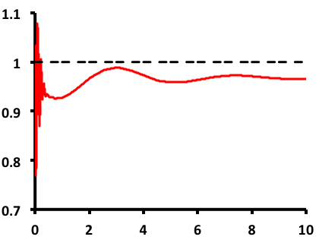
Supply Impedance – Time Domain
Nominal VDD
3rd Order Resonance
Voltage (V)
2nd Order Resonance
1st Order Resonance
Time (ns)

Slide 25
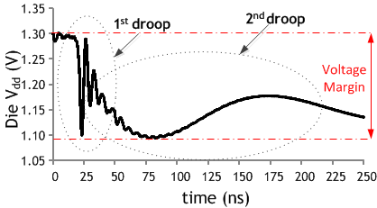
The Power Supply Noise Problem
Resistive Droop (fast, more localized)
LdI/dt droop (slower, not-localized)
Multiple modes (1st, 2nd and 3rd droops)
1st and 2nd droops typically dominant
Sufficiently slow to enable mitigation
Focus of this
tutorial
Notes:
Plot shows measured voltage response at a die due to a step in load current
2 components to droop.
-Res droop is more localized, and very fast
Compneation difficult
Thankfully, also less pronounced
Ldi/dt is slower and more global. Also most pronounced. Can account for as much as 15% of supply in margin.
Focus of this tut.

Slide 26
Supply Noise: Stimulus and Response
Step response to current ramp
Faster Ramp → Higher first droop

Slide 27
Power Delivery Network: Frequency Response
Droops correspond to LC resonance with different passives in the network

Slide 28
Side-note High-density Decap
Droops correspond to LC resonance with different passives in the network

Slide 29
High-density Decap
[7] B. Jayaraman, et al., ICICDT 2012.
[7] C. Auth, et al., VLSI Tech. 2012.
Makes 1st droop slower, less significant
2nd droop can be significant but easier to manage

Slide 30
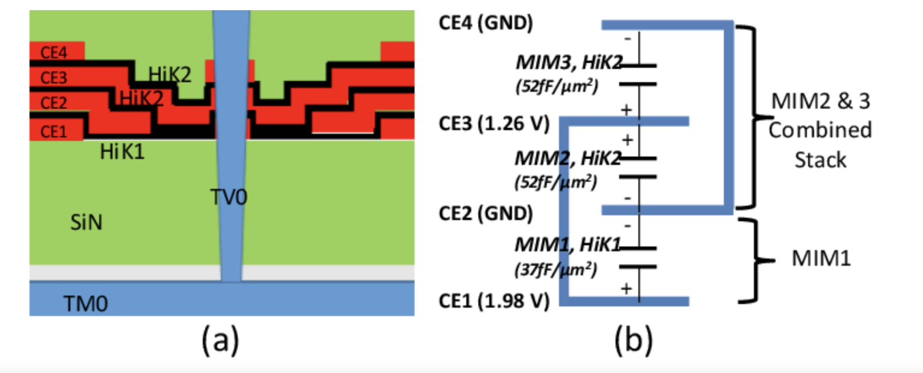
High-density Decap
MIM cap @500f/um² enabled by Hi-K Dielectrics
Significant ESR

Slide 31
Mitigating Droop: Microarchitecture
Instruction throttling
Gradually fill compute pipeline (e.g. after a cache miss).
Slow ramp-up → Slow current build-up
Strongly diminishes 1st droop
Minor performance impact

Slide 32
Limitations of Throttling
Throttling for 2nd droop requires slow performance ramp-up (to control current ramp )
Significant performance loss. May be ill-suited to some applications

Slide 33
Doing Better (Worse) than a Step
Step load does not cause worst case droop
Pulsed load can result in ↑ margin requirement
Especially if 1st droop dominates

Slide 34
Worst-case Supply Noise : Step vs. Pulse

Slide 35
Persistent Pulsing ….
Taking the idea further → package resonance!
Can be caused by loops in code
High reliability and robustness impact
[8] Xu et al, ISSCC 2009

Slide 36
Integrated Voltage Regulation (IVR)
Energy-efficiency demand → ↑ spatio-temporal V_{dd} scaling
Off-chip regulators overwhelmingly in use today
Area-cost
PDN degradation (per-domain)
Slow transient response (Control far away from load)

Slide 37
Integrated Voltage Regulation (IVR)
Integrated Voltage Regulation is a key enabler
Buck
Low-Dropout Regulators (LDO)
Switched-Capacitor (SC)
Advantages in resolution, speed, pin-count, board-area
Focus on advantages and trends. Elementary (cursory) introduction provided.

Slide 38
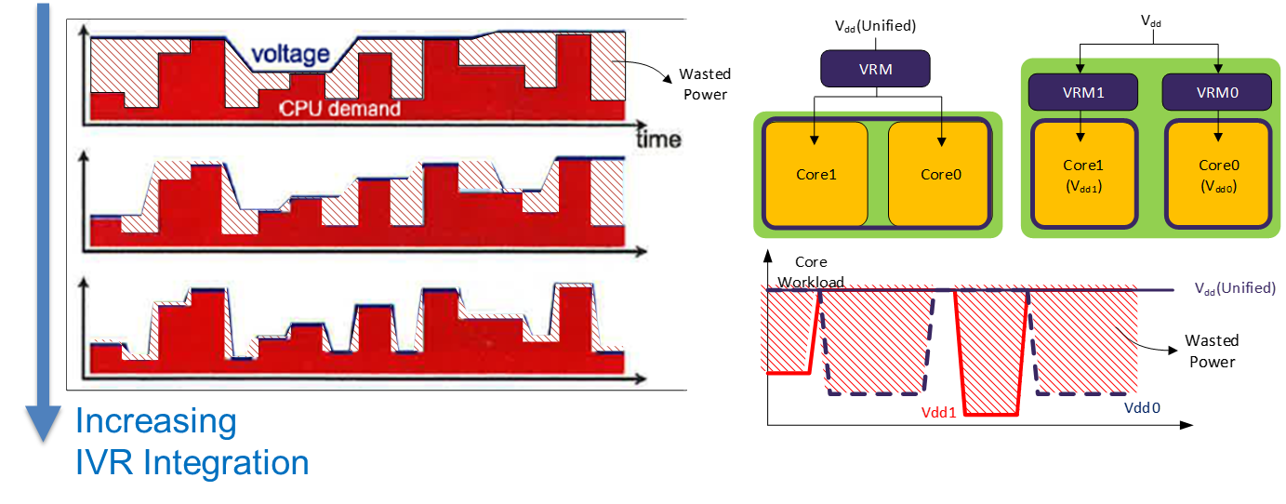
IVR – Improved Spatio-Temporal Resolution
Adapted from Wonyoung Kim
Integrated Voltage Regulation is a key enabler
Buck
Low-Dropout Regulators (LDO)
Switched-Capacitor (SC)
Advantages in speed, pin-count, board-area and resolution

Slide 39
Integrated Voltage Regulation (Buck)
Advantages | Disadvantages/Challenges
Enhanced DVFS (spatio-temporal) | 2-stage converter for Li-cell devices
Board size/cost reduction | Lower converter efficiency
Lower input current draw | Line-side supply-noise

Slide 40
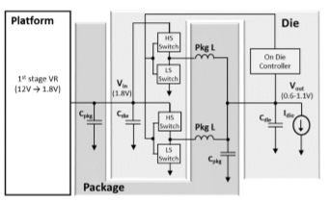
FIVR(Intel Haswell)
2-stage regulator
Inductors built on package layer
Decap offered by on-chip MIMCAP
[9] E. Burton, et al., APEC 2014.

Slide 41
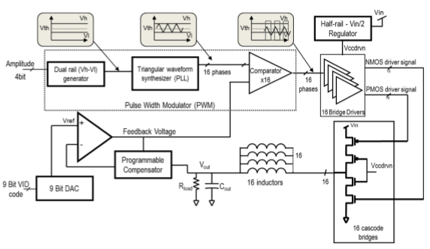
FIVR(Intel Haswell)
16-phase operation, 140MHz switching frequency
Phase-shedding to optimize efficiency across load
Decap offered by on-chip MIMCAP
[9] E. Burton, et al., APEC 2014.

Slide 42
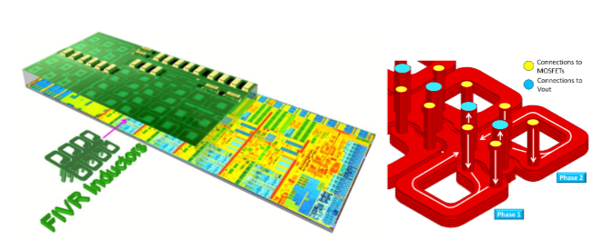
Inductor Integration
Inductor windings distributed over individual voltage domains
Improved granularity
Relief in bump current density
Winding orientation to exploit mutual inductance
[9] E. Burton, et al., APEC 2014.

Slide 43
Phase Shedding
Processors feature large dynamic current range
Dynamic phase-shedding to achieve optimal efficiency across load-range
Peak efficiency of ~90% @ 0.75A/phase
[9] E. Burton, et al., APEC 2014.

Slide 44
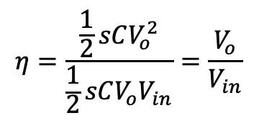
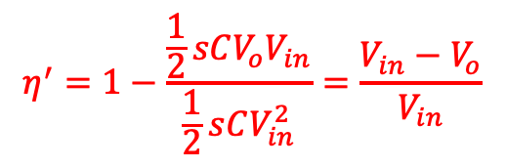
Linear Regulators (Low Dropout)
$$η^{′}=1−\frac{\frac{1}{2}sCV_{o}V_{in}}{\frac{1}{2}sCV_{in}^{2}}=\frac{V_{in}−V_{o}}{V_{in}}$$
$$η=\frac{\frac{1}{2}sCV_{o}^{2}}{\frac{1}{2}sCV_{o}V_{in}}=\frac{V_{o}}{V_{in}}$$
Efficiency drops linearly with output voltage*
Typical use: Voltage control for smaller modules
Fast regulation
Low area overhead
Low-dropout (Low voltage drop across PMOS device)

Slide 45
LDO Stability
On-chip implementations typically feature dominant error-amplifier output pole
Stability challenges at low current (high R_{out}) configurations
Require careful compensation techniques to maintain stability

Slide 46
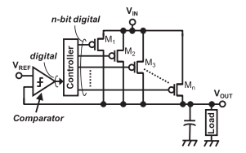
Digital LDOs
Recently receiving a lot of attention for SoC applications
Consistent with largely digital workflow
Potentially easy to port across designs and process tech.
Key challenge: Transient droop response and efficiency
[10] O. Yasuyuki, et al.,CICC 2010.

