Slide 1
Your everyday normal traffic lights
A computational study towards optimization flows

Slide 2
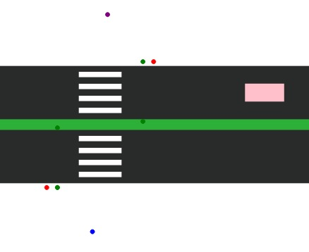
Introduction
Problem
Pedestrian dynamics
Vulnerable
Car Dynamics
Optimization
Research question
Overview – Liu et al.
Agents
Cars
Pedestrians
Lights

Slide 3
Cars – Nagel-Schreckenberg
Agents
Nagel Schrekenberg
Discrete
Time/instanteneous acceleration/deceleration
Proportions
Cars
Try to get to max speed
Break/accelerate ~0.2 m/s^2
Emergency break ~0.4 m/s^2
Red light
Pedestrian
Too adaptive (not much jamming)

Slide 4
Pedestrians – Liu et al.
Agents
Pedestrians
Lots of parameters

Slide 5
Lights
Induction
Strategies
Simultaneous
Non-simultaneous
Free

Slide 6
Sensitivity Analysis
??

Slide 7
Experiments
Traffic flow Regimes:
Free flow – Pedestrians move freely
Bottlneck – Pedestrians are starting to become inhibited
Blockage – Pedestrians are stopping flow
Variables of interest:
Flow rate out – peds/minute
Density of pedestrians – average pedestrans in crosswalk?
Density of cars -
Traffic regiemes used:
Free flow
Lane specific lights
Simultaneous lights

Slide 8
Results
What are we measuring
How long, how many
Show some results

Slide 9
Discussion & Outlook
What are we measuring
How long, how many
Show some results

Slide 10
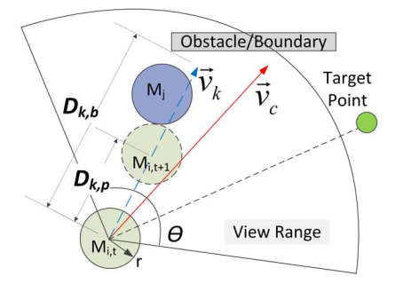
Pedestrian utility calculations
What are we measuring
How long, how many
Show some results

