Slide 1








The role of d orbitals in metal ligand bonds
Julian Ruijter, 11154128
Natasja Wezel, 11027649
Advanced Computational Chemistry 2019
Célia Fonseca Guerra, Matthias Bickelhaupt

Slide 2
Outline
Introduction
Our systems
Information about the level of theory
Methods
Energies
Conclusions

Slide 3
Goals
Interaction mechanism of each coordination complex
Ni, Fe, Cr
Analysis with
Kohn-Sham Molcular Orbital theory
Energy Decomposition Analysis
Voronoi Deformation Density analysis
Metal-ligand bonds with and without d orbitals
Group 13 elements (no d orbitals)
Sc (Transition Metal, d orbitals present)

Slide 4
The Role of d Orbitals
What is synergy?

Slide 5
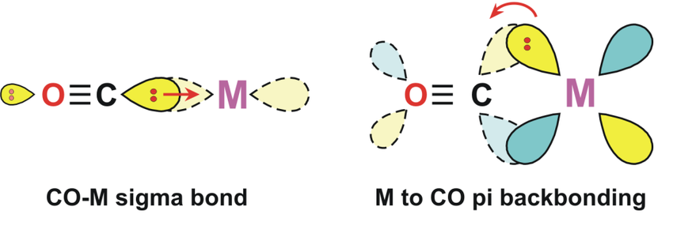
Synergetic bonding
Common consensus for TM-CO bonding
CO donates σ electrons into empty TM d orbitals
Backdonation from metal center into π* orbitals of CO ligands
Mitigated by M-C π bonds due to large overlap of TM d and CO π*
Figure adapted from: Kaushik, Manish & Singh, Ayodhya & Kumar, Munesh. (2016). 604-4481-2-PB.

Slide 6
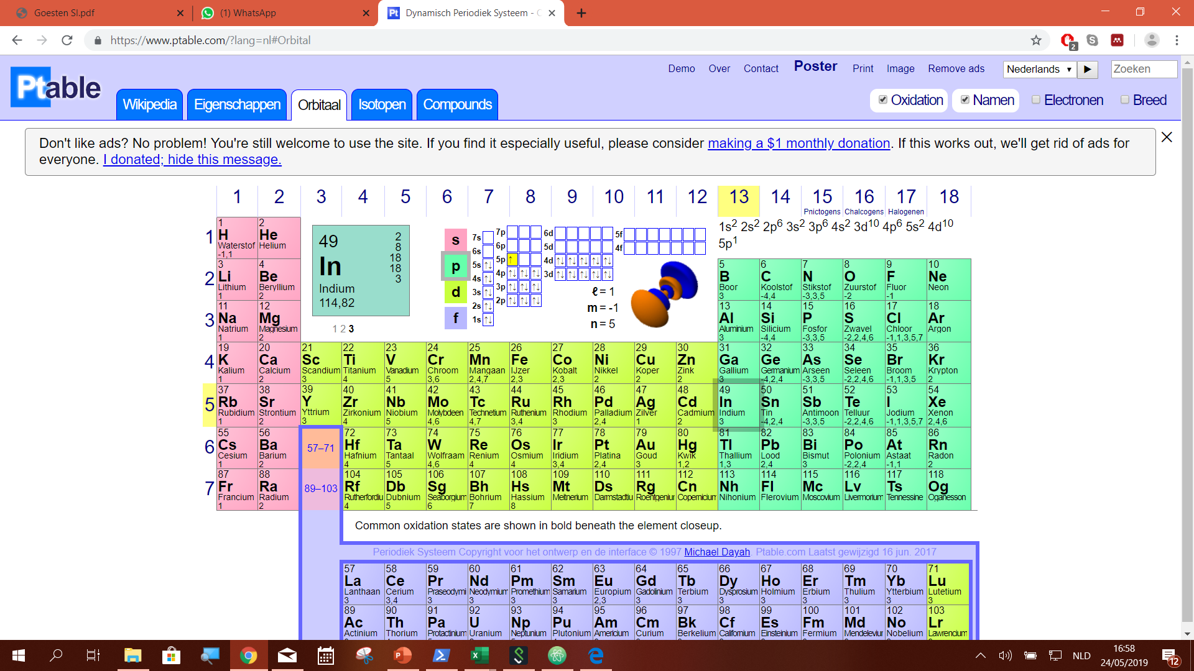
Studied complexes
Metal-ligand bonds in Transition Metal Complexes
NiCO₄
FeCO₅
CrCO₆
Metal-ligand bonds in Group 13 Metal Complexes
Empty Valence Shell
BCO₆³⁺
AlCO₆³⁺
GaCO₆³⁺
InCO₆³⁺
TlCO₆³⁺
ScCO₆³⁺

Slide 7
Fragments and their symmetry
Complex
MCO₆ Oh
MCO₅ D3h
MCO₄ Td
Ligand cage same symmetry as complex
Metal atom corresponding symmetry
One CO as fragment
MCO₅ C4v
MCO₄ C4v
MCO₃ C3v
CO fragment corresponding symmetry

Slide 8
Level of Theory
Functional: BLYP
Basis set: TZ2P
Frozen core: None

Slide 9
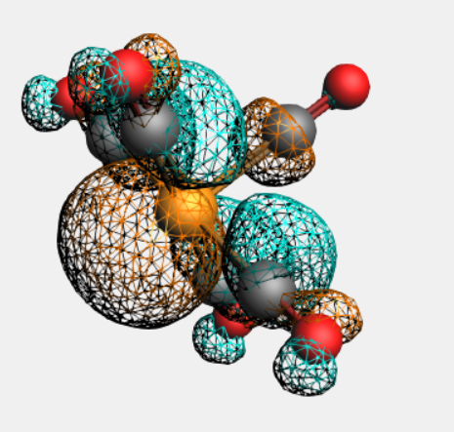
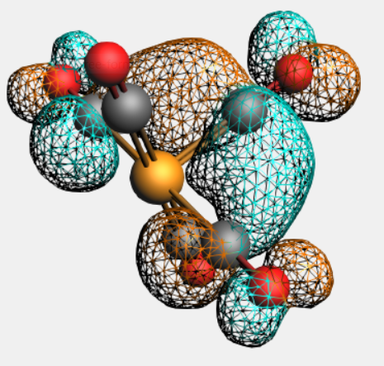
Method
Virtual σ and π orbitals

Slide 10
Bond energy and bond lengths
Als B opnieuw is gedaan nieuwe grafiek

Slide 11
EDA and KS-MO analysis
Virtual σ and π orbitals

Slide 12
Synergy between σ and π
Virtual σ and π orbitals

Slide 13
Conclusions
Virtual σ and π orbitals

Slide 14
Thanks you for your attention!
Are there any questions?
Advanced Computational Chemistry 2019
Célia Fonseca Guerra, Matthias Bickelhaupt

