Slide 1
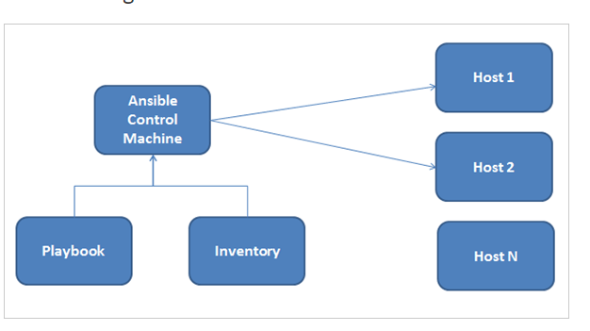
ANSIBLE

Slide 2
ANSIBLE
Ansible is an open source tool that helps in task automation, application deployment, cloud provisioning and configuration management
Ansible installation on AWS
Step 1 : Create a common id on all the machines
# useradd ansible
# passwd ansible
Step 2: Edit the /etc/ssh/sshd_config file on the control machine and uncomment out the lines forPasswordAuthentication and PermitRootLogin
Perform the above steps on all the machines. Once completed, restart the sshd service on both the machines
# systemctl restart sshd

Slide 3
For complete automation of tasks, we will need passwordless SSH authentication
Step 3 : To enable passwordless authentication to perform the steps shown below. Firstly add the user ansible to the /etc/sudoers file on all the machines which will enable the user ansible to run any command which requires root privileges
Step 4: Create private and public key in all the machines to communicate one and each
other with ssh
[ansible@ip-172-31-21-70 ~]$ ssh-keygen
Step 5: Copy the public key to the target machine and vice versa.
ssh-copy-id <IP-Address-Host-Machine>
We are now able to log in without entering the password. After the check out of the ssh connectivity on both the machines and be logged in as ansible user
Step 6: install ansible on the Control machine only by enabling the EPEL repo from fedora which provides add-on software packages. Perform the following steps to install ANSIBLE

Slide 4
$ wget http://dl.fedoraproject.org/pub/epel/epel-release-latest-7.noarch.rpm
$ sudo rpm -ivh epel-release-latest-7.noarch.rpm
$ sudo yum install ansible -y
$ ansible --version
Step 7: Edit the ansible.cfg file and enable the inventory file parameter on the Control machine
sudo vi /etc/ansible/ansible.cfg
Ansible uses the concept of Inventory to manage and track the target machines. By default, this file is located in /etc/ansible/hosts and can be changed as well. A host file consists of groups for better classification and multiple machines under the group. All the required machines can be added to those groups.
Every group is denoted by a square bracket and a group name within. A server can actually exist in multiple groups.

Slide 5
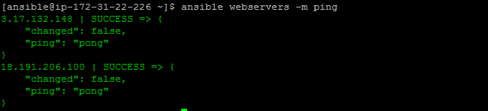

Modules
ansible hostORgroup -m module_name -a "arguments" -u username --become
Ping : To test the connectivity of the servers under the webserver’s group run the ansible ping command as shown. Here ping is a module which performs a particular function to test whether the hosts can be connected as defined in the inventory file or not.
ansible webservers –m ping
To list the hosts in the inventory file, you can run the below command
ansible webservers --list-hosts

Slide 6
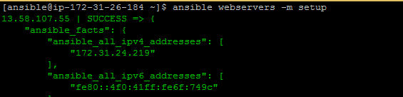
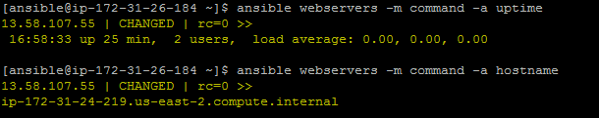
Setup Module
To get information about the network or hardware or OS version or memory related information
ansible webservers –m setup
Command Module
ansible webservers -m command -a uptime
ansible webservers -m command -a hostname

Slide 7
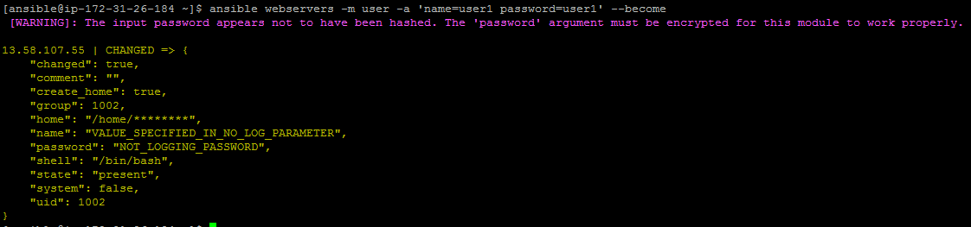
Shell Module
To execute any command in the shell of your choice you can use the Shell module. The shell module commands are run in /bin/sh shell
ansible webservers -m shell -a 'ls -l > temp.txt'
File will be created on the node
User Module
Using this module one can create or delete users.
ansible webservers -m user -a 'name=user1 password=user1' --become

Slide 8
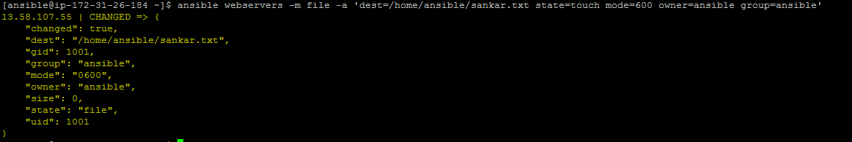
To delete user
ansible webservers -m user -a 'name=user1 state=absent' --become
Options:
become – Privilege to the superuser to run the command
state=absent to delete the user
File Module
This module is used to create files, directories, set, or change file permissions and ownership etc
ansible webservers -m file -a 'dest=/home/ansible/sankar.txt state=touch mode=600 owner=ansible group=ansible'

Slide 9
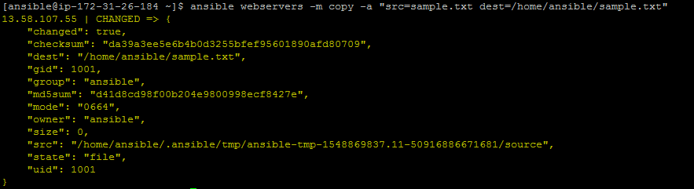
Create a directory
To create a directory using the file module, you need to set two parameters.
Path(alias – name, dest) – This is the absolute path of the directory to be created.
State – You should enter the value as ‘directory.’ By default, the value is ‘file’.
ansible webservers -m file -a "dest=/home/ansible/vndir state=directory mode=755"
Copy Module
It is used for copying files to multiple target machines.
ansible webservers -m copy -a "src=sample.txt dest=/home/ansible/sample.txt"

Slide 10
Managing Software Packages
If you need to install software packages through ‘yum’ or ‘apt’ you can use the below commands
ansible webservers -m yum -a "name=git state=present" --become
Install Apache Webserver
ansible webservers -m yum -a "name=httpd state=present" --become
Manage services
State=started
State=stop
State=restarted
All the Modules list:
https://docs.ansible.com/ansible/2.8/modules/list_of_all_modules.html
Ansible-doc –l (from command line)
To Check Particular module details
Ansible-doc modulename (ex : ping)

Slide 11
Ansible Playbooks
Playbooks contain the steps which the user wants to execute on a particular machine. Playbooks are run sequentially. Playbooks are the building blocks for all the use cases of Ansible.
Playbook is written in YAML format with a .yml file extension. One needs to be very careful with the format and alignment which makes it very sensitive
It contains the following sections:
Every playbook starts with 3 hyphens ‘—‘
Host section – Defines the target machines on which the playbook should run. This is based on the Ansible inventory file.
Variable section – This is optional and can declare all the variables needed in the playbook. We will look at some examples as well.
Tasks section – This section lists out all the tasks that should be executed on the target machine. It specifies the use of Modules. Every task has a name which is a small description of what the task will do and will be listed while the playbook is run.

Slide 12
Sample playbook format
--- Playbook start
- hosts: webservers Specify the group or servers as per inventory to execute tasks
become: true
tasks:
- name: Copy Tomcat ZIP file to install location Short description of the task
copy: src=/home/ansible/niranjan/apache-tomcat-8.5.31.tar.gz dest=/opt/niranjan/tomcat
To run playbook
ansible-playbook <playbook.yml>
To check the playbook for syntax errors
ansible-playbook <playbook.yml> --syntax-check

Slide 13
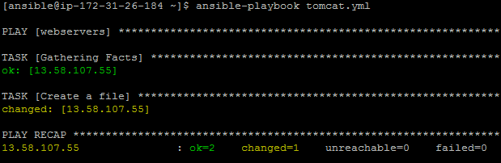
Create the file on the target machines
---
- hosts: webservers
become: true
tasks:
- name: Create a file
file: path=/home/ansible/sankar.txt state=touch
In the above example, we have used the file module to create the file.

Slide 14
Create a directory with the mode as 775 and owner/group as Ansible.
---
- hosts: webservers
become: true
tasks:
- name: Create directory
file: path=/home/ansible/sankar state=directory mode=775 owner=ansible group=ansible
Create multiple directories. To create multiple directories with one single task you can use the loop with_items statement
---
- hosts: webservers
become: true
tasks:
- name: Create multiple directories
file: path={{item}} state=directory
with_items:
- '/home/ansible/vn1'
- '/home/ansible/vn2'
- '/home/ansible/vn3'

Slide 15
Create user
---
- hosts: webservers
become: true
tasks:
- name: Create User
user: name=sankar password=sankar groups=ansible shell=/bin/bash
Delete user
---
- hosts: webservers
become: true
tasks:
- name: Remove User
user: name=sankar state=absent remove=yes force=yes
In the above playbook, remove=yes will remove the home directory and force=yes will remove the files in the directory.

Slide 16
Replace word
- hosts: webservers
tasks:
- name: Replace example
replace:
path: /home/ansible/passwd
regexp: 'shutdown'
replace: "breakdown"
Zip content
---
- hosts: webservers
tasks:
- name: Ansible zip directory example
archive:
path:
- /home/ansible
dest: /home/ansible/sankar.zip
format: zip

Slide 17
Apache installation.
---
- hosts: webservers
become: true
tasks:
- name: Install Package
yum: name=httpd state=present
- name: Start httpd service
service: name=httpd state=started
GIT installation.
---
- hosts: webservers
become: true
tasks:
- name: Install Package
yum: name=vim,git state=latest

Slide 18
Maven installation.
---
- hosts: webservers
become: true
tasks:
- name: Install Java
command: yum install java-1.8.0-openjdk -y
command: yum install java-1.8.0-openjdk-devel -y
- name: Setup Environment variables
copy:
content: "export JAVA_HOME=/usr/lib/jvm/jre-1.8.0-openjdk \n"
dest: "/etc/profile.d/maven.sh"
- lineinfile:
path: /etc/profile.d/maven.sh
line: 'export JRE_HOME=/usr/lib/jvm/jre'
- name: Create directory
file: path=/opt/sankar state=directory
- name: Download Maven
get_url: url=https://mirrors.estointernet.in/apache/maven/maven-3/3.6.3/binaries/apache-maven-3.6.3-bin.tar.gz dest=/opt/sankar/apache-maven-3.6.3-bin.tar.gz
- name: Extract Maven
command: tar xvf /opt/sankar/apache-maven-3.6.3-bin.tar.gz -C /opt/sankar
- name: Move to a smaller directory
command: mv /opt/sankar/apache-maven-3.6.3 /opt/sankar/maven
- lineinfile:
path: /etc/profile.d/maven.sh
line: 'export M2_HOME=/opt/sankar/maven'
- lineinfile:
path: /etc/profile.d/maven.sh
line: 'export PATH=${M2_HOME}/bin:${PATH}'
- name: Source profile
shell: source /etc/profile

Slide 19
Tomcat Installation:
---
- hosts: webservers
become: true
tasks:
- name: Install Java
command: yum install java-1.8.0-openjdk -y
command: yum install java-1.8.0-openjdk-devel -y
- lineinfile:
path: /etc/profile
line: 'export JRE_HOME=/usr/lib/jvm/jre'
- lineinfile:
path: /etc/profile
line: 'export JAVA_HOME=/usr/lib/jvm/jre-1.8.0-openjdk'
- name: ensure a list of packages installed
yum:
name: "{{ packages }}"
vars:
packages:
- tomcat
- tomcat-webapps
- tomcat-admin-webapps
- tomcat-docs-webapp
- tomcat-javadoc
state: present
- name: Copy fil
copy:
src: /home/ansible/tomcat-users.xml
dest: /usr/share/tomcat/conf/tomcat-users.xml
- name: enable service tomcat
systemd:
name: tomcat
enabled: yes
- name: start service tomcat
systemd:
name: tomcat
state: started

Slide 20
Tomcat Installation:

Slide 21
pre_tasks, post_tasks, and tags
You can use pre_tasks and post_tasks to run certain tasks before or after running the main task.
---
- name: Pre , Post tasks and Tags example
hosts: webservers
become: true
tags:
- sankar
pre_tasks:
- debug: msg="Started task with tag - sankar."
tasks:
- name: Going to execute the main task
debug: msg="Currently in the target server"
post_tasks:
- debug: msg="Completed task with tag - sankar."
- name: Play without tags
hosts: webservers
become: true
tasks:
- name: Command to list files
shell: ls -lrt > sankar.txt

Slide 22
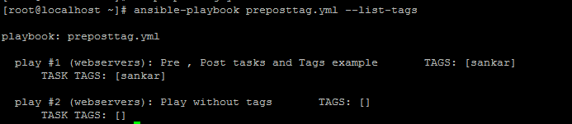
playbook with the –list-tags option
ansible-playbook preposttag.yml --list-tags
playbook with the tags
The second play is not executed and the file is not created
ansible-playbook preposttag.yml --tags sankar
ansible-playbook preposttag.yml --skip-tags sankar

Slide 23
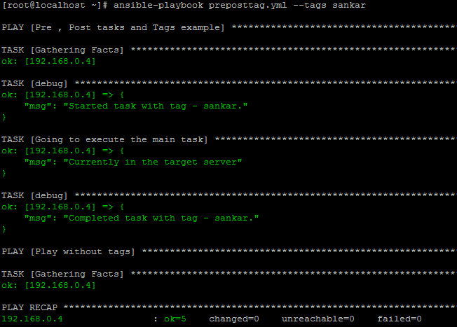

Slide 24
Create EC2 Instance
Step1 : Create AWS Account
Step2 : Create User with Full EC2 Privilage
Step 3 : Export Access key and Secret Key on the machine where ansible is running
export AWS_ACCESS_KEY_ID=“Access Key"
export AWS_SECRET_ACCESS_KEY=“Secret Key“
Step 4 : Create Key if key not exist
Step 5 : Install Ansible
Yum install Ansible (centos)
Step 6 : Install Python PIP
Yum install python-pip
Step 7 : Install boto and boto3
pip install boto boto3
Step 8 : check ansible and boto versions to confirm successfully installed
ansible - - version
pip show boto
pip show boto3
Step 9 : Write the playbook to launch ec2 instance and run

Slide 25
Launchec2.yml
- name: ec2 launcher
hosts: localhost
connection: local
tasks:
- name: launching ec2 instance
ec2:
instance_type: t2.micro
key_name: aws-key
image: ami-f4f4cf91
region: us-east-2
group: default
count: 1
wait: yes
assign_public_ip: yes
vpc_subnet_id: subnet-b586acdd
Trouble Shoot :
IF it throws error ec2-connect related (upgrade boto versions)
pip install boto3/boto –upgrade

Slide 26
Handlers : Any software package will have configuration files and any changes to it will have effect only when the service is restarted. So you need to have the service set to restart
---
- hosts: webservers
become: true
become_user: root
tasks:
- name: install tomcat
yum: name=tomcat state=latest
- name: start httpd
service: name=tomcat state=started
- name: deploy the war
copy: src=sample.war dest=/usr/share/tomcat/webapps
notify: restart tomcat
handlers:
- name: restart tomcat
service: name=tomcat state=restarted
Sample.war file location : https://tomcat.apache.org/tomcat-5.5-doc/appdev/sample/
Note : Handlers used to execute tasks which specified under handlers, these tasks will execute at the end and only once.
nofify will call these handlers

Slide 27
When Condition
---
- hosts: webservers
become: true
become_user: root
tasks:
- name: install httpd
yum: name=httpd state=present
when: ansible_os_family == “Redhat“ or “centos”
- name: start httpd
service: name=httpd state=started
If the os is Redhat then only httpd will ne istalled

Slide 28
Variables
---
- hosts: webservers
become: true
become_user: root
vars:
src_path: /root/ansible
dest_path: /var/www/html
tasks:
- name: Install httpd
yum: name=httpd state=present
- name: start httpd
service: name=httpd state=started
- name: deploy html file
copy: src={{src_path}}/index.html dest={{dest_path}}
notify: restart httpd
handlers:
- name: restart httpd
service: name=httpd state=restarted

Slide 29
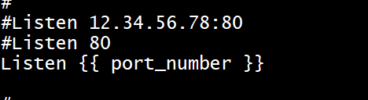
Jinja2 Template
Jinja2 templates are simple template files that store variables that can change from time to time. When Playbooks are executed, these variables get replaced by actual values defined in Ansible Playbooks
Create template with extension .j2
ex : apache-conf.j2 (hard coded port number changed with variable)
---
- hosts: webservers
become: true
vars:
port_number: 81
tasks:
- name: Install Package
yum: name=httpd state=present
- name: Jinja2 template
template:
src: apache-conf.j2
dest: /etc/httpd/conf/httpd.conf
- name: Start httpd service
service: name=httpd state=started
Run the playbook and test it (apache will be reachable on port 81 instead of default 80)

Slide 30
Roles:
Roles provide a framework for fully independent, or interdependent collections of variables, tasks, files, templates, and modules. In Ansible, the role is the primary mechanism for breaking a playbook into multiple files. This simplifies writing complex playbooks, and it makes them easier to reuse.
Go to /etc/ansible/roles
2. Create directory for the role (ex : tomcat)
3. Create the directories files, handlers, meta, tasks and vars
Create file main.yml under tasks directory and place the below code(tasks)
- name: install tomcat
yum: name=tomcat state=latest
- name: start httpd
service: name=tomcat state=started
- name: deploy the war
copy: src=sample.war dest=/usr/share/tomcat/webapps
notify: restart tomcat
Note : ansible-galaxy init tomcat –offline (instead of creating individual direcotories with
command we can create role

Slide 31
Create file main.yml under handlers directory and place the below code(handler)
- name: restrat tomcat
service: name=tomcat state=restarted
Tree structure of the tomcat role
[root@localhost roles]# tree
.
└── tomcat
├── files
│ └── sample.war
├── handlers
│ └── main.yml
├── meta
├── tasks
│ └── main.yml
└── vars

Slide 32
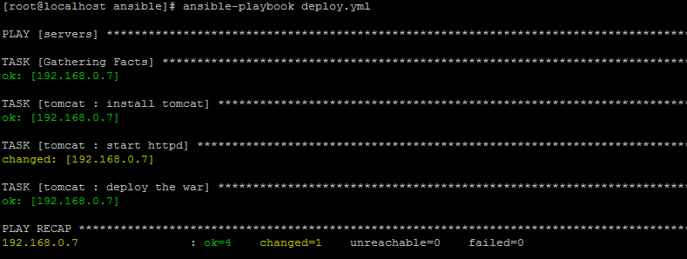
Execute the Role
Go to the directory /etc/ansible and create a file deploy.yml and place the code
---
- hosts: servers
become: true
become_user: root
roles:
- tomcat
Execution of the playbook

Slide 33
Apache Role:
Go to /etc/ansible/roles
2. Create directory for the role (ex : apache)
3. Create the directories files, handlers, meta, tasks and vars
Create file main.yml under tasks directory and place the below code(tasks)
- name: install httpd
yum: name=httpd state=present
- name: start httpd
service: name=httpd state=started
- name: deploy html file
copy: src=index.html dest={{dest_path}}
notify: restart httpd
Create file main.yml under vars directory and place the below code(variables)
dest_path: /var/www/html
Note : ansible-galaxy init tomcat –offline (instead of creating individual direcotories with
command we can create role

Slide 34
Create file main.yml under handlers directory and place the below code(handler)
- name: restart httpd
service: name=httpd state=restarted
Create file index.html under files directory and place some content
Execute the Role
Go to the directory /etc/ansible and create a file deploy.yml and add the role
---
- hosts: servers
become: true
become_user: root
roles:
- tomcat
- apache
ansible-playbook deploy.yml

Slide 35
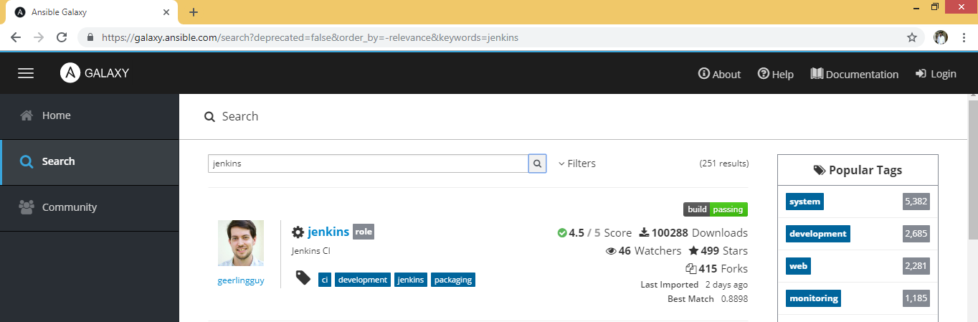
Roles from community
Site : galaxy.ansible.com
Install jenkins on the machines using jenkins role
Go to the site and click on search and search for jenkins

Slide 36
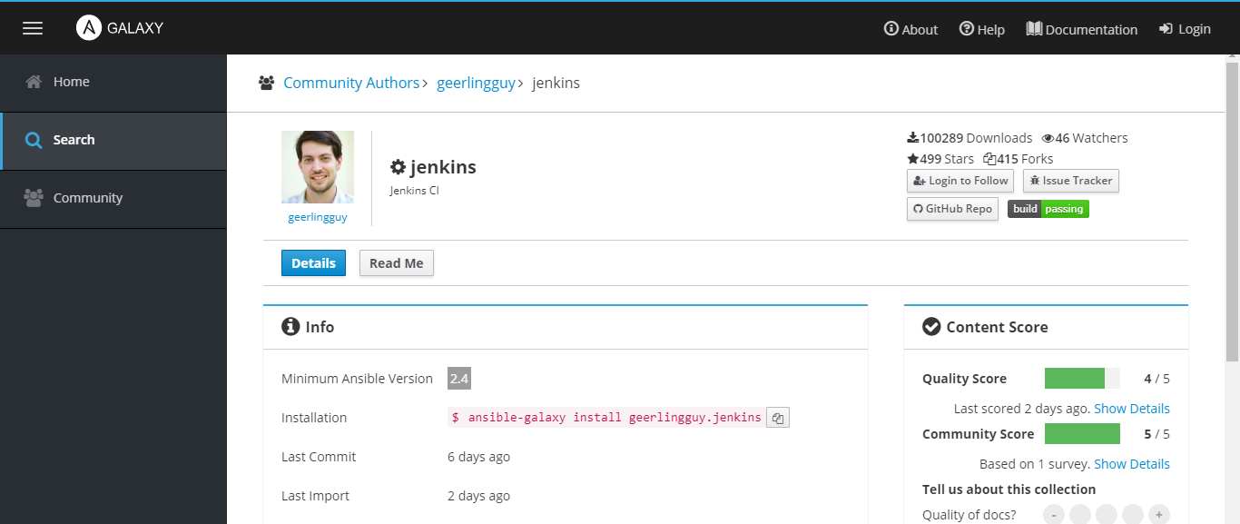
Click on jenkins , we can see the installation command
Click on Read Me for more details

Slide 37
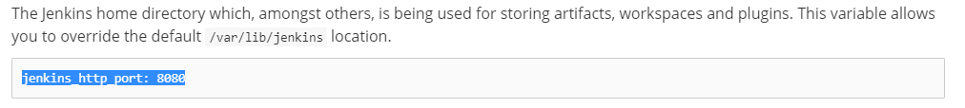
Installation command
ansible-galaxy install --roles-path /etc/ansible/roles geerlingguy.jenkins
Since jenkins runs on java, so two roles will be installed java and jenkins
Check the port number details in the read me section
For JAVA installation
vars:
- __java_packages: ['java-1.8.0-openjdk-1.8.0.161']

Slide 38
Add the roles to the playbook
---
- hosts: servers
become: true
become_user: root
vars:
jenkins_http_port: 9090
roles:
- tomcat
- apache
- geerlingguy.java
- geerlingguy.jenkins
Add the jenkins port variable in the playbook since tomcat already running with port 8080
Execute the playbook, jenkins will be installed on the nodes
For JAVA installation
vars:
- __java_packages: ['java-1.8.0-openjdk-1.8.0.161']

Slide 39
What is Ansible Vault
Vault is a mechanism that allows encrypted content to be incorporated transparently into Ansible workflows. A utility called ansible-vault secures confidential data by encrypting it on disk.
Creating New Encrypted Files
ansible-vault create vault.yml
You will be prompted to enter and confirm a password:
Output
New Vault password:
Confirm New Vault password:
[ansible@ip-172-31-24-185 playbooks]$ cat vault.yml
$ANSIBLE_VAULT;1.1;AES256
37336261613935653832306436653866633037396234313239326366656438653738383139663234
6134643739376336323637656661613065313130376530310a383261363936393162376439616661
65646633303062346136613739343839616462353538383964333137383861623034393666363230
3961396266626630370a656462373263613165346134393339656261343138663434663932393532
66623138666530636635303231656232373036356236613861373764613230373864363437396335
3166663364306363376437386163643761626233343832356462

Slide 40
Encrypting Existing Files
echo 'unencrypted stuff' > encrypt_me.txt
ansible-vault encrypt encrypt_me.txt
Viewing Encrypted Files
[ansible@ip-172-31-24-185 playbooks]$ ansible-vault view vault.yml
Vault password:
Hello this is first line of playbook
Editing Encrypted Files
ansible-vault edit vault.yml
Manually Decrypting Encrypted Files
ansible-vault decrypt vault.yml
Changing the Password of Encrypted Files
ansible-vault rekey encrypt_me.txt

Slide 41
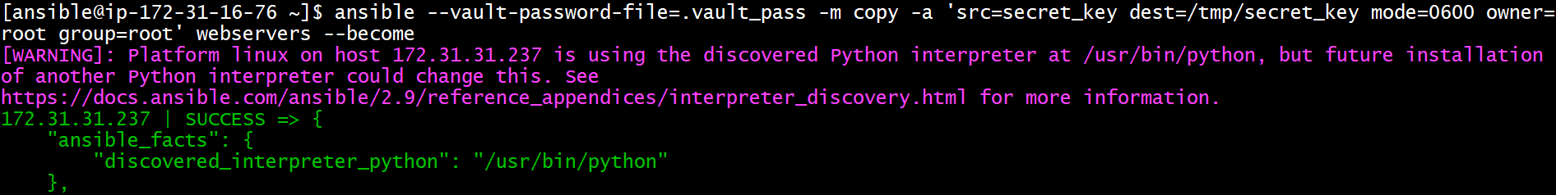
Vault example:
ansible-vault create secret_key
ansible --ask-vault-pass -m copy -a 'src=secret_key dest=/tmp/secret_key' webservers
Without Prompting vault password
echo 'ansible' > .vault_pass
ansible --vault-password-file=.vault_pass -m copy -a 'src=secret_key dest=/tmp/secret_key mode=0600 owner=root group=root' webservers --become
Reading the Password File Automatically
(Create environment variable)
export ANSIBLE_VAULT_PASSWORD_FILE=./.vault_pass
ansible -m copy -a 'src=secret_key dest=/tmp/secret_key mode=0600 owner=root group=root' webservers --become

Slide 42
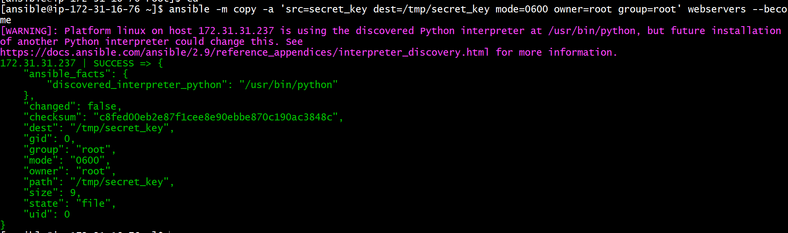
To make Ansible aware of the password file location across sessions, you can edit your ansible.cfg file
ansible -m copy -a 'src=secret_key dest=/tmp/secret_key mode=0600 owner=root group=root' webservers --become

Slide 43
Import Playbook example (calling one playbook in another)
User.yml
---
- hosts: webservers
become: true
tasks:
- name: Create User
user: name=visual password=visual groups=ansible shell=/bin/bash
- name: Include a play after another play
import_playbook: filecreate.yml
Note :Filecreate.yml is being called in the play book user.yml with the help of import_playbook

Slide 44
filecreate.yml
---
- hosts: webservers
become: true
tasks:
- name: Create a file
file: path=/home/ansible/visual.txt state=touch
Import Task example (calling tasks of one into another)
/etc/ansible/roles/tomcat/tasks/main.yml
- name: install tomcat
yum: name=tomcat state=latest
- name: start httpd
service: name=tomcat state=started
- name: deploy the war
copy: src=sample.war dest=/usr/share/tomcat/webapps
notify: restart tomcat
Note : This is tomcat role tasks file

Slide 45
/etc/ansible/roles/foo/tasks/main.yml
- import_tasks: "/etc/ansible/roles/tomcat/tasks/main.yml"
Note : Role Foo is created , in the tasks imported tomcat role tasks
copy sample.war file into files directory of foo role
Deploy.yml
---
- hosts: webservers
become: true
become_user: root
roles:
- foo
Note : Execute the foo role using deploy.yml file

Slide 46
Include Tasks in another :
Create Role : ansible-galaxy init mytest --offline
Go to tasks /etc/ansible/roles/mytest/tasks
Create main.yml file with some tasks
Create deploy.yml file outside of roles
cat deploy.yml
---
- hosts: webservers
become: true
become_user: root
tasks:
- include: /etc/ansible/roles/mytest/tasks/main.yml

Slide 47
EC2-Instance creation:
Creating security group
Creating aws key to connect instance
Creating instance

Slide 48
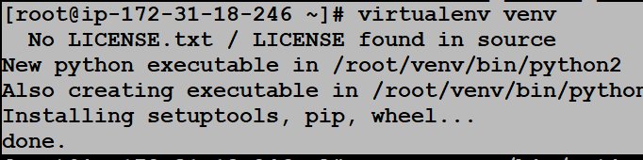

Dynamic Inventory
Dynamic Inventory Setup:
Create IAM user with EC2 full access
Install virtualenv
pip install virtualenv
Download EC2 ec2 external inventory script file(ec2.py) and settings file(ec2.ini)
git clone https://github.com/raknas999/devops-1.git
Export User secret key and access key
export AWS_ACCESS_KEY_ID=<your_aws_access_key_id> export AWS_SECRET_ACCESS_KEY=<your_aws_secret_access_key>
Pip package to run your ansible and the scripts by using virtualenv
virtualenv venv
source venv/bin/activate

Slide 49

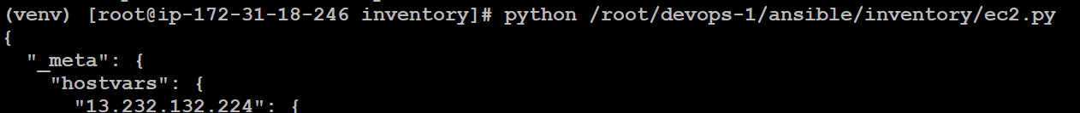
cd to/my/cloned/github/repository
pip install -r ansible/requirements.txt
export ANSIBLE_INVENTORY and EC2_INI_PATH to be tied with Ansible
export EC2_INI_PATH=/to/my/cloned/github/repository/ansible/inventory/ec2.ini
export ANSIBLE_INVENTORY=/to/my/cloned/github/repository/ansible/inventory/ec2.py
Give execu chmod +x ec2.pytable permission to ec2.py
chmod +x ec2.py
Execute ec2.py

Slide 50
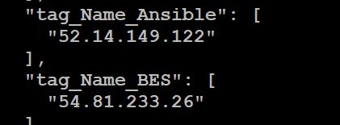
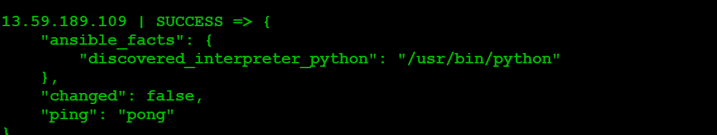
We ca observer ansible node is created with tag in the dynamic inventory
Test Dynamic Inventory
ansible -m ping tag_Name_my_instance_1 -u your_ssh_user
Ex : ansible -i /root/devops-1/ansible/inventory/ec2.py --private-key /home/ec2-user/qentelli.pem -u ec2-user tag_Name_nexus -m ping

Slide 51

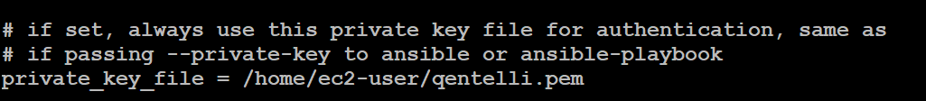
Note : Host file can be passed with option -i or in the ansible.cfg file point the dynamic
file
Private key can be passed with the option --private-key or in the ansible.cfg file
point the private key file path
More Details:
https://medium.com/happy5/aws-dynamic-inventory-and-ansible-thank-god-i-can-sleep-more-4d2aeadbc6f
https://github.com/raknas999/DevOpsDemos/blob/master/Ansible/Dynamic_Inventory.MD

Slide 52
Create User and add public key on Remote server with sudo privileges
Clone the below repository
git clone https://github.com/raknas999/ansible-playbooks.git
Do the required changes in vars file (user, pub key lookup etc..)
---
create_user: sankar
copy_local_key: "{{ lookup('file', '/home/sankar/.ssh/id_rsa.pub') }}"
sys_packages: [ 'curl', 'vim', 'git']
If the remote machine is not Ubuntu, comment the Ubuntu related code in playbook
Control Machine changes:
Create user sankar on control machine and generate private key and public key
Use default user ec2-user to connect remote machine
ex : ansible-playbook playbook.yml --private-key /home/ec2-user/sankar-devops.pem -u ec2-user
Note : Copy the private key(.pem) into control machine

Slide 53
Patterns
https://docs.ansible.com/ansible/latest/user_guide/intro_patterns.html

