Slide 1
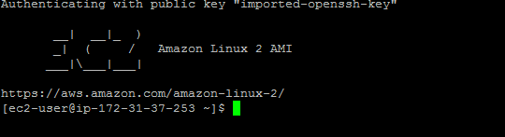

SSH PROCESS
Create Two EC2 instances (one is workstation another is server)
Step 1 : Connect to Instance- Workstation
Step 2 : Create New User, default the user will be ec2-user
Ste 3 : switch to root user

Slide 2
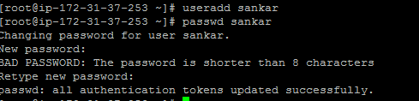


Ste 4 : Create new user (sankar) and setup password
Ste 5 : change the attribute PasswordAuthentication as yes(default value is no) in sshd_config file
file location : /etc/ssh/sshd_config
Ste 6 : restart sshd service (service sshd restart)

Slide 3
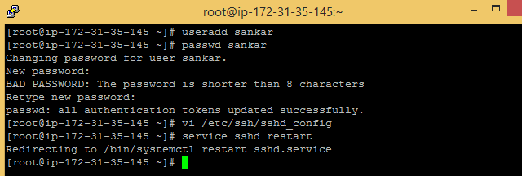

Connect to instance – server
Repeat the steps from step 1 to step 6 on the second machine - server
Go to Instance – workstation
Switch to new user (sankar)

Slide 4
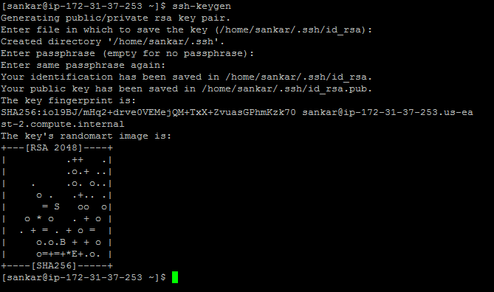
Create Private key and public key for the new user (sankar)
Command : ssh-keygen
Note : During creation of the keys it will ask file name and passphrase , don’t enter any values just hit enter key(means leaving default values)

Slide 5

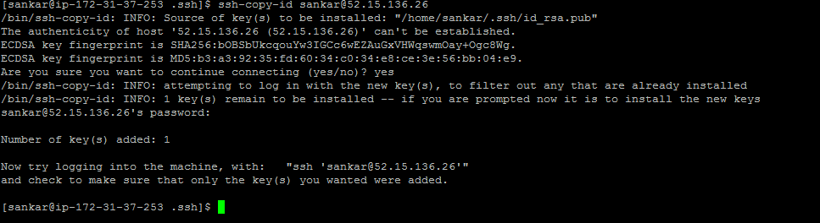
Private key(id_rsa) and public key(id_rsa.pub) generated and placed in .ssh directory
Copy public key into instance – server
Command : Ssh-copy-id username@instanceip
During copy it will ask password of the user , enter password

Slide 6

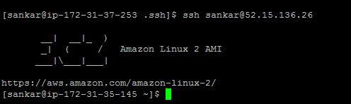
If key is successfully copied, below message will be displayed on the screen
Login into the instance – server using ssh
Ssh username@instanceip
Once the machine is connected we can observer ipaddress is change in the prompt
Ex : ip-172-31-37-253(workstation) is changed to ip-172-31-35-145(server)

Slide 7
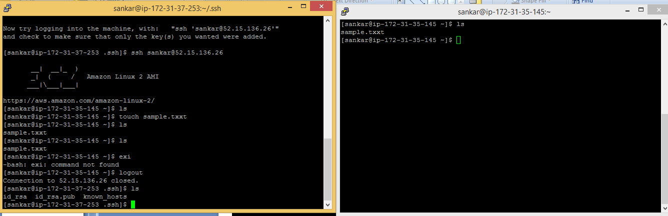
Connected the instance -server from the instance – workstation and created sample file
Left side screen is workstation instance screen
Connected to instance server and verified, sample file is created (right side screen)
erna

Slide 8
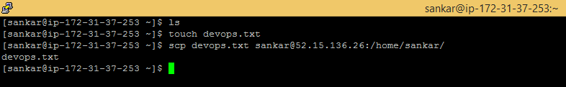
SCP
SCP or secure copy allows secure transferring of files between a local host and a remote host or between two remote hosts. It uses the same authentication and security as the Secure Shell (SSH) protocol
Instance – workstation , created a text file (devops.txt) then copied into the instance – server
Using scp
Scp command : scp file/folder username@ipaddress:destination_path
Scp devops.txt sankar@52.15.136.26:/home/sankar/

Slide 9
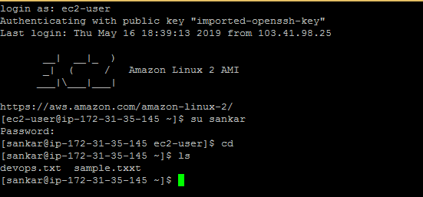
Login into the instance – server and switch to user (sankar) and verify , devops.txt file is
present

