Slide 1
Artificial Intelligence Week 8: Search Algorithms
Chia-Hui Chang
2022.11.3

Slide 2
AI course at U. Washington and Stanford
AI course @ U. Washington

Slide 3
Introduction to AI: Slides Sources
CSE473 @U. Washington
CS221@Stanford
Search
Constraint Satisfaction Problem
Knowledge and Reasoning
Learning
CNN
Vision
Reflex - Machine Learning
State-based - Search
Variable-based - CSP
Reinforcement Learning
Bayesian
Logoic

Slide 4
CS221@Stanford

Slide 6
Formal Search Problem
Search Problem = (S, A, C, T, s, g)
S = state space
A = set of actions
C = cost function
T = state transition function
s = initial state
g = goal test function
a
C(a)
x
y
T=?
State-Space Model

Slide 7
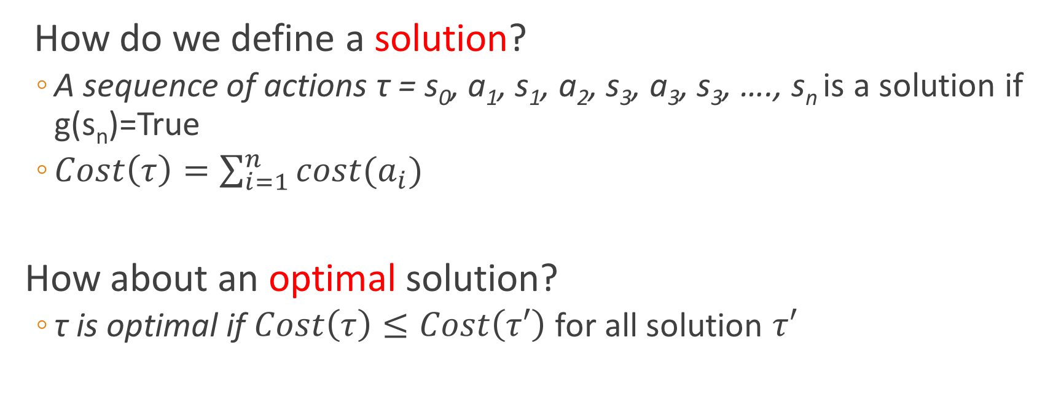
State-Space Model Search Problem = (S, A, C, T, s, g)
How do we define a solution?
A sequence of actions τ = s₀, a₁, s₁, a₂, s₃, a₃, s₃, …., s_{n} is a solution if g(s_{n})=True
$Cost\left(τ\right)=\sum_{i=1}^{n}{cost(a_{i})}$
How about an optimal solution?
τ is optimal if $Cost\left(τ\right)≤Cost\left(τ′\right)$ for all solution $τ′$

Slide 8
Outline
Search in Data Structure
vs. Search in AI?
Terminologies
State
State Space
Initial State
Goal Test
Action
Step Cost
Path Cost
State Change Function
State-Space Search
Uninformed (Blind) Search
Depth-First Search
Breadth-First Search
Iterative Deeping
Uniform-Cost Search
Informed (Heuristic) Search
Heuristic Search
Greedy Search
A* search
Graph search

Slide 9
The 8-Puzzle Problem
one
initial
state
1 2 3
8 4
7 6 5
1 2
3 4 5
6 7 8
goal
state
B=blank
What data structure easily represents a state?
How many possible states are there?
How would you specify the state-change function?
What is the path cost function? uniform cost (=1)
5. What is the complexity of the search?

Slide 10
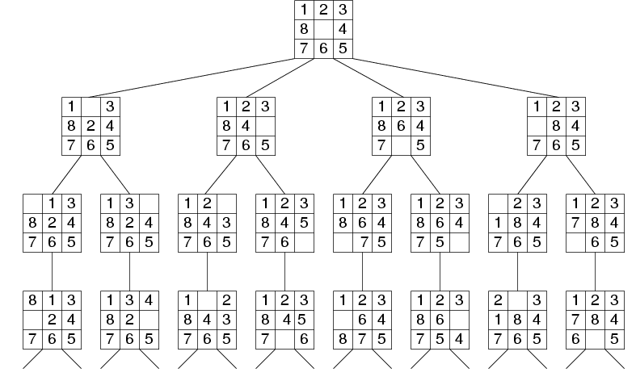
Search Tree Example: Fragment of 8-Puzzle Problem Space

Slide 11
Another Example: N Queens Place exactly one Q in each column so that no two Q’s are in the same row or diagonal
Input:
Set of states
Operators [and costs]
Start state
Goal state (test)
Output: positions of the N Queens
Q
Q
Q
Q

Slide 12
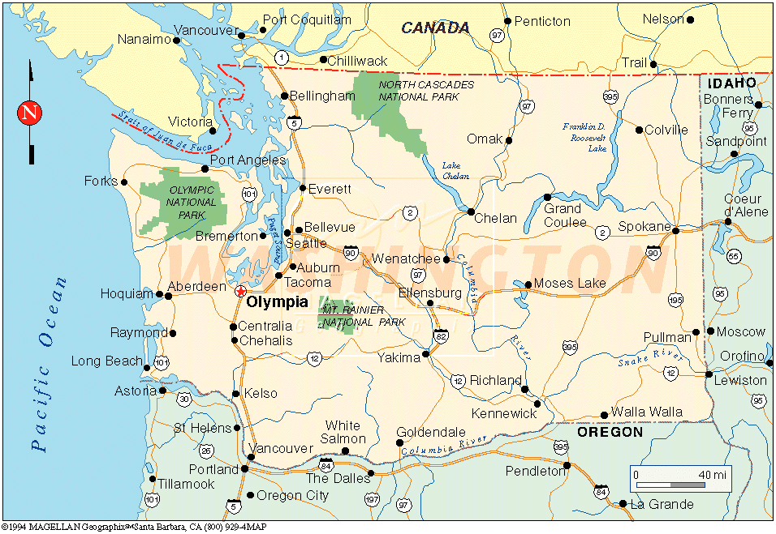
Example: Route Planning
Find the shortest route from the starting city to the goal city given roads and distances.
Input:
Set of states
Operators [and costs]
Start state:
Goal state (test)
Output: Goal state
Notes:
States = cities
Start state = starting city
Goal state test = is state the destination city?
Operators = move to an adjacent city; cost = distance
Output: a shortest path from start state to goal state
SUPPOSE WE REVERSE START AND GOAL STATES?

Slide 13
Search in AI
Search in Data Structures
You’re given an existent tree.
You search it in different orders.
It resides in memory.
Search in Artificial Intelligence
The tree does not exist.
You have to generate it as you go.
For realistic problems, it does not fit in memory.

Slide 14
Search Strategies
Uninformed Search
The search is blind, only the order of search is important.
Informed Search
The search uses a heuristic function to estimate the goodness of each state.

Slide 15
General Search Paradigm (Figure 3.7 in text)
function TREE-SEARCH(problem) returns solution or failure
initialize frontier using the initial state of problem
loop do
if frontier is empty then return failure
choose a leaf node and remove it from frontier
if the node contains a goal state then return the solution
expand the node, adding the resulting nodes to frontier
What is the frontier?
How do we choose?
What does expand mean?

Slide 16
General Search Paradigm (Figure 3.7 in text)
function GRAPH-SEARCH(problem) returns solution or failure
initialize frontier using the initial state of problem
initialize the explored set to be empty
loop do
if frontier is empty then return failure
choose a leaf node and remove it from frontier
if the node contains a goal state then return the solution
add the node to the explored set
expand the node, adding the resulting nodes to frontier
only if they are not in the frontier or the explored set
OPEN CLOSED

Slide 17
Basic Idea
Start with the initial state
Maintain a (general) queue of states to visit
Depth-First search: the queue is LIFO (stack)
Breadth-First search: the queue is FIFO (queue)
Uniform-Cost search: the queue is ordered by lowest path cost g (path from start to node)
Depth-Limited search: DFS with a depth limit
Iterative-Deepening search: DFS with depth limit sequence 1, 2, 3, …. till memory runs out
Bidirectional Search

Slide 18
Performance Criteria
Completeness: Does it find a solution when there is one?
Optimality: Does it find the optimal solution in terms of cost?
Time complexity: How long does it take to find a solution
Space Complexity: How much memory is needed?

Slide 19
Breadth-First Search
Maintain FIFO queue of nodes to visit
Evaluation (branching factor b; solution at depth d)
Complete?
Time Complexity?
Space?
a
Yes (if enough memory)
b
c
O(b^d)
d
e
f
g
h
O(b^d)

Slide 20
Depth-First Search
Maintain stack of nodes to visit
Evaluation (branching factor b; solution at depth d)
Complete?
Time Complexity?
Space ?
a
Not for infinite spaces
O(b^d)
b
e
O(d)
c
d
f
g
h

Slide 21
Iterative Deepening Search
DFS with depth limit; incrementally grow limit l = 0, 1, 2, ...
Evaluation (for solution at depth d)
Complete?
Time Complexity?
Space Complexity?
Yes, if l >= d
a
b
e
O(b^d)
c
f
d
i
O(d)
g
h
j
k
l

Slide 22
Cost of Iterative Deepening
b | ratio IDS to DFS
2 | 3:1
3 | 2:1
5 | 1.5:1
10 | 1.2:1
25 | 1.08:1
100 | 1.02:1

Slide 23
Uniform-Cost Search
Expand the node n with the lowest path cost g(n)
Implement by storing the frontier as a priority queue ordered by g(n).
Apply the goal test when the node is selected for expansion
If a newly generated node n is already on the frontier as node n´ and if pathcost(n) < pathcost(n´),
then replace n’ with n.

Slide 24
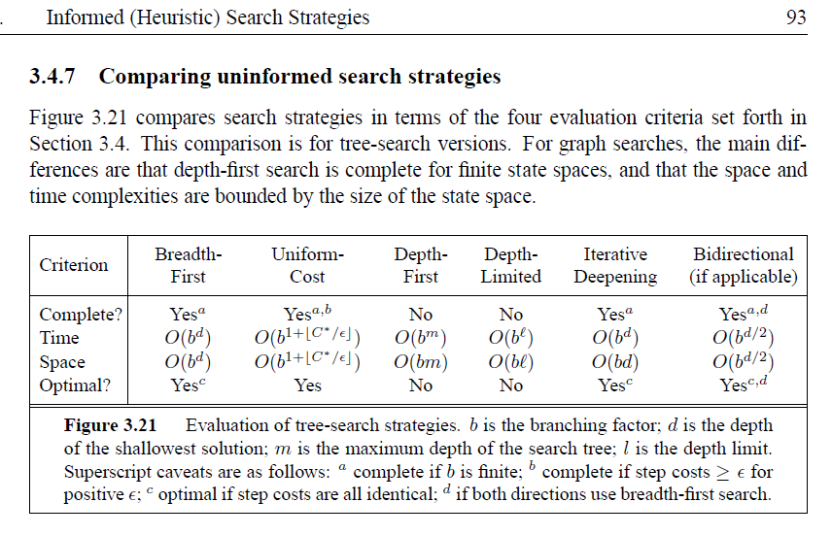
Comparison of Blind Methods

Slide 25
Problem
All these blind methods are too slow for real applications
Solution → add guidance
→ “informed search”

Slide 26
Informed (Heuristic) Search
Idea: be smart about what paths to try.

Slide 27
Blind Search vs. Informed Search
What’s the difference?
How do we formally specify this?
A node is selected for expansion based on an evaluation function that estimates cost to goal.

Slide 28
General Tree Search Paradigm
function tree-search(root-node)
fringe ← successors(root-node)
while ( notempty(fringe) )
{node ← remove-first(fringe)
state ← state(node)
if goal-test(state) return solution(node)
fringe ← insert-all(successors(node),fringe) }
return failure
end tree-search
How do we order the successor list?
root-node
successors list

Slide 29
Best-First Search
Use an evaluation function f(n) for node n.
Always choose the node from fringe that has the lowest f value.
3
5
1
4
6

Slide 30
Heuristics
What is a heuristic?
What are some examples of heuristics we use?
We’ll call the heuristic function h(n).
A function that estimates how close a state is to a goal

Slide 31
Greedy Search
You need Heuristic:
estimate of distance to nearest goal for each state
A common case:
Best-first takes you straight to the (wrong) goal
Worst-case: like a badly-guided DFS
Strategy: expand a node that you think is closest to a goal state

Slide 32
Romanian Route Finding
Problem
Initial State: Arad
Goal State: Bucharest
c(s,a,s´) is the length of the road from s to s´
Heuristic function: h(s) = the straight line distance from s to Bucharest

Slide 33
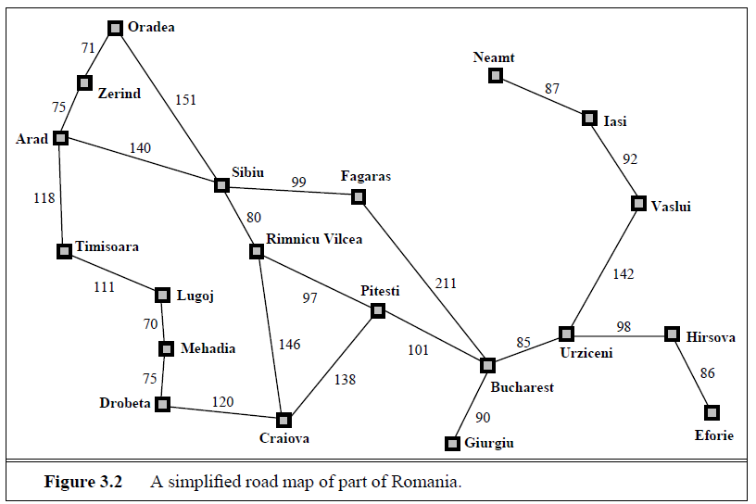
Original Road Map of Romania
What’s the real shortest path from Arad to Bucharest?
What’s the distance on that path?

Slide 34
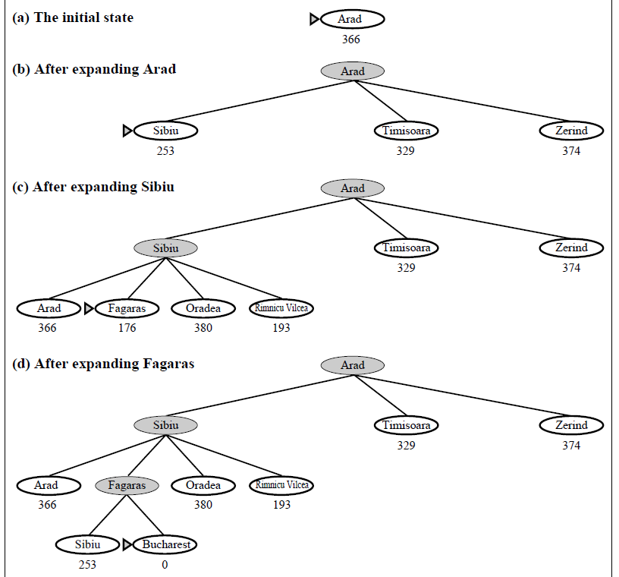
Greedy Search in Romania
140
99
211
Distance = 450

Slide 35
Greedy Best-First Search
Is greedy search optimal?
Is it complete?
No, can get into infinite loops in tree search.
Graph search is complete for finite spaces.
What is its worst-case complexity for a tree search with branching factor b and maximum depth m?
time
space
O(b^{m})
O(b^{m})
Notes:
No. Resulting path to Bucharest is not the shortest!

Slide 36
A* Search
Combining UCS and Greedy
Uniform-cost orders by path cost, or backward cost g(n)
Greedy orders by goal proximity, or forward cost h(n)

Slide 37
A* Search
Hart, Nilsson & Rafael 1968
Best-first search with f(n) = g(n) + h(n)
where g(n) = sum of edge costs from start to n
and h(n) = estimate of lowest cost path n-->goal
If h(n) is admissible then search will find optimal solution.
{
Never overestimates the true
cost of any solution which
can be reached from a node.
Space bound since the queue must be maintained.

Slide 38
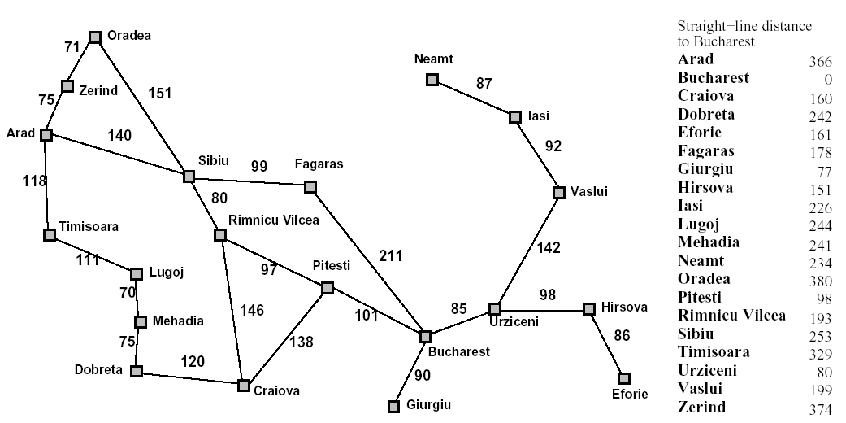
Back to Romania
h(x)
start
end

Slide 39
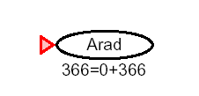
A* for Romanian Shortest Path

Slide 40
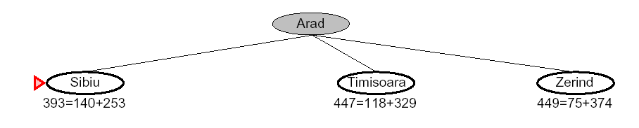
f(n) = g(n) + h(n)

Slide 41
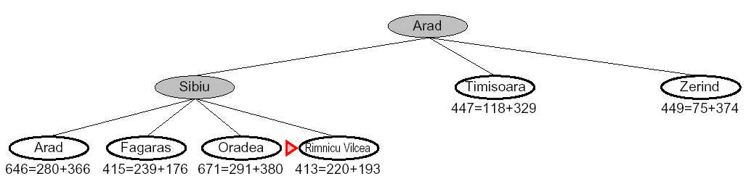

Slide 42
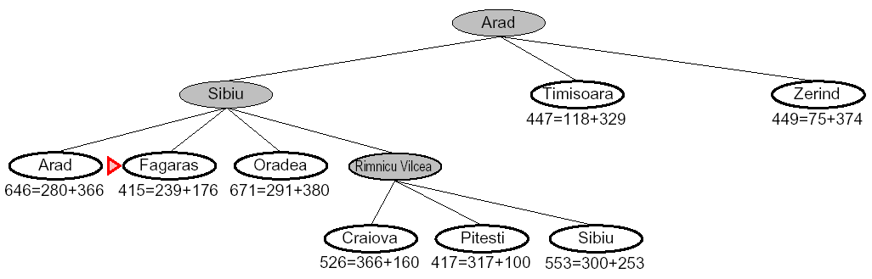

Slide 43
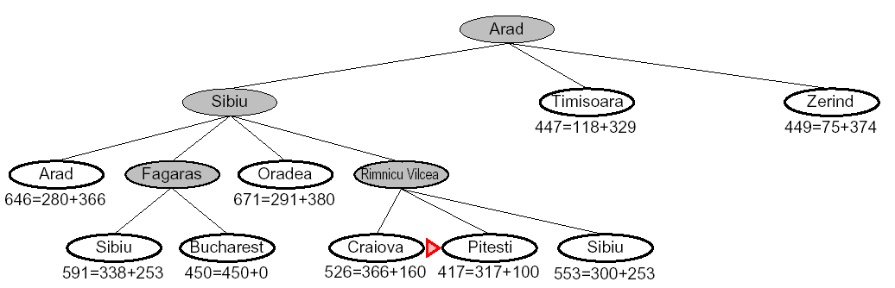

Slide 44
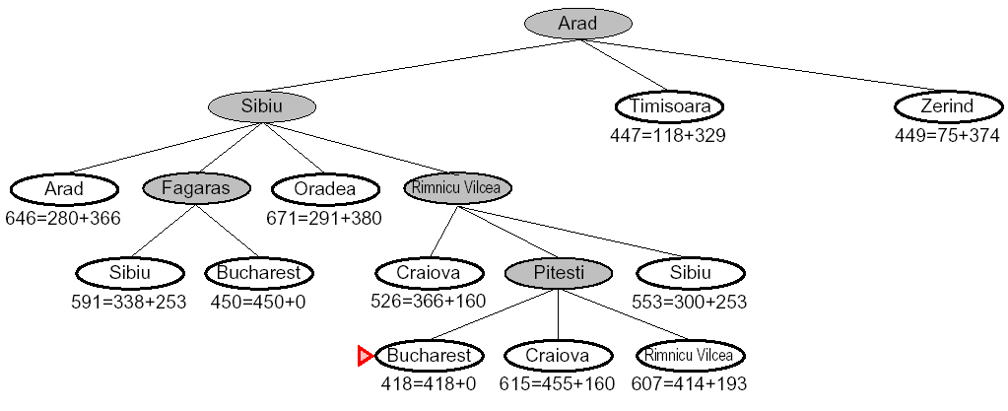

Slide 45
8 Puzzle Example
f(n) = g(n) + h(n)
What is the usual g(n)?
two well-known h(n)’s
h1 = the number of misplaced tiles
h2 = the sum of the distances of the tiles from their goal positions, using city block distance, which is the sum of the horizontal and vertical distances (Manhattan Distance)

Slide 46
8 Puzzle Using Number of Misplaced Tiles
2 3
4
7 6 5
8 3
6 4
7 5
g=0
h=4
f=4
goal
2 8 3
4
7 6 5
2 8 3
1 6 4
7 5
2 8 3
1 6 4
7 5

Slide 47
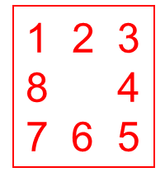
2 8 3
1 4
7 6 5
Exercise:
What are its children and their
f, g, h?

Slide 48
Optimality of A* with Admissibility (h never overestimates the cost to the goal)
Suppose a suboptimal goal G2 has been generated and is in the queue. Let n be an unexpanded node on the shortest path to an optimal goal G1.
f(n) = g(n) + h(n)
< g(G1) Why?
< g(G2) G2 is suboptimal
= f(G2) f(G2) = g(G2)
So f(n) < f(G2) and A* will never select
G2 for expansion.
n
G1
G2

Slide 49
Algorithms for A*
Since Nillsson defined A* search, many different authors have suggested algorithms.
Using Tree-Search, the optimality argument holds, but you search too many states.
Using Graph-Search, it can break down, because an optimal path to a repeated state can be discarded if it is not the first one found.
One way to solve the problem is that whenever you come to a repeated node, discard the longer path to it.

Slide 50
Graph Search
Failure to detect repeated states can cause exponentially more work.

Slide 51
Graph Search
Idea: never expand a state twice
How to implement:
Tree search + set of expanded states (“closed set”)
Expand the search tree node-by-node, but…
Before expanding a node, check to make sure its state has never been expanded before
If not new, skip it, if new add to closed set
Important: store the closed set as a set, not a list
Can graph search wreck completeness? Why/why not?
How about optimality?

Slide 52
A* Graph Search Gone Wrong

Slide 53
Consistency of Heuristics
Main idea: heuristic costs ≤ actual costs
Admissibility: heuristic cost ≤ actual cost to goal h(A) ≤ actual cost from A to G
Consistency: heuristic “arc” cost ≤ actual cost for each arc
h(A) – h(C) ≤ cost(A to C)
Consequences of consistency:
The f value along a path never decreases h(A) ≤ cost(A to C) + h(C)
A* graph search is optimal

Slide 54
Optimality of A* with Consistency (stronger condition)
h(n) is consistent if
for every node n
for every successor n´ due to legal action a
h(n) <= c(n,a,n´) + h(n´)
Every consistent heuristic is also admissible.
n
h(n)
c(n,a,n´)
h(n´)
n´
G

Slide 55
Optimality of A* Graph Search
Sketch: consider what A* does with a consistent heuristic:
Fact 1: In tree search, A* expands nodes in increasing total f value (f-contours)
Fact 2: For every state s, paths that reach s optimally are expanded before paths that reach s suboptimally
Result: A* graph search is optimal

Slide 56
The Heuristic Function h
If h is a perfect estimator of the true cost then A* will always pick the correct successor with no search.
If h is admissible, A* with TREE-SEARCH is guaranteed to give the optimal solution.
If h is consistent, too, then GRAPH-SEARCH is optimal.
If h is not admissable, no guarantees, but it can work well if h is not often greater than the true cost.

Slide 57
Complexity of A*
Time complexity is exponential in the length of the solution path unless for “true” distance h*
|h(n) – h*(n)| < O(log h*(n))
which we can’t guarantee.
But, this is AI, computers are fast, and a good heuristic helps a lot.
Space complexity is also exponential, because it keeps all generated nodes in memory.
Big Theta notation says 2 functions have about the same growth rate.

