Slide 1
Progress Slides - 1
Yingming Luo
06/02/2023

Slide 2
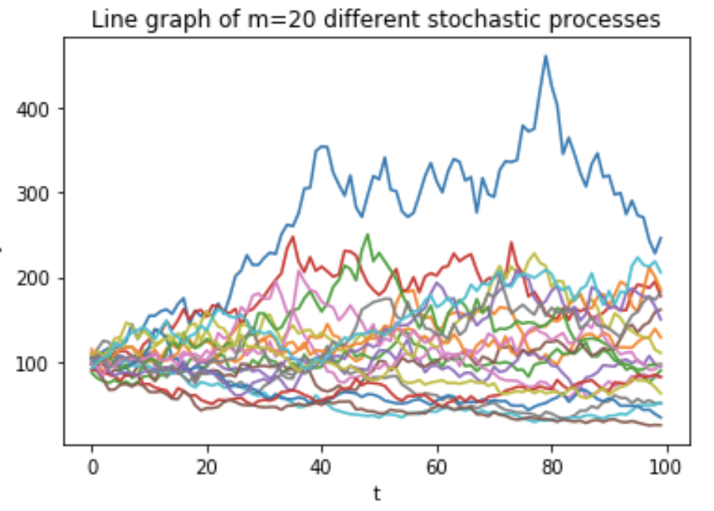
Background
I enjoyed last term’s modules on quant finance and Python programming. In addition to studying stochastic calculus and the Black-Scholes framework, we looked at two numerical techniques:
· Finite Difference methods
· Monte Carlo techniques

Slide 3
Motivation
I am interested in applying maths and coding to study problems in finance, in particular pricing of derivatives, i.e. options contracts.
Given the importance of simulations, my focus will be on the Monte Carlo method.
I also appreciate the importance of relying on numerical schemes when doing mathematical modelling of problems in finance.

Slide 4
Plan 1
· Start by reviewing Monte Carlo from last term
· Extend to the underlying theory
· Consider more advanced methods of Monte Carlo to simulate asset classes

Slide 5
Plan 2
· Compare Euler Maruyama with Milstein
· Consider the pricing of European options for more complex scenarios

Slide 6
References
· Wilmott, P. Paul - Wilmott Introduces Quantitative Finance, 2nd Ed. (2007). John Wiley and Sons
· Paul Glasserman – Monte Carlo Methods In Financial Engineering

