Slide 1
Progress Slide - 2
Yingming Luo
26/02/2023

Slide 2
Project Problem, Aims and Objectives
Project Problem: A very popular and important problem in Finance is how to price derivatives, such as option contracts, within a margin of error.
Aims: Study how to apply different Monte Carlo methods to price derivatives, understanding the different factors that may influence the results.
Objectives:
Study the mathematics behind different time discretisation methods.
Implement the Monte Carlo simulations of these different methods:
So far implemented Euler-Maruyama and Milstein methods.
Study how to compare the results of these simulations.
Investigate how these methods may be extended.
Investigate how to incorporate real world data into the simulation.
Improve the efficiencies of the programme.

Slide 3
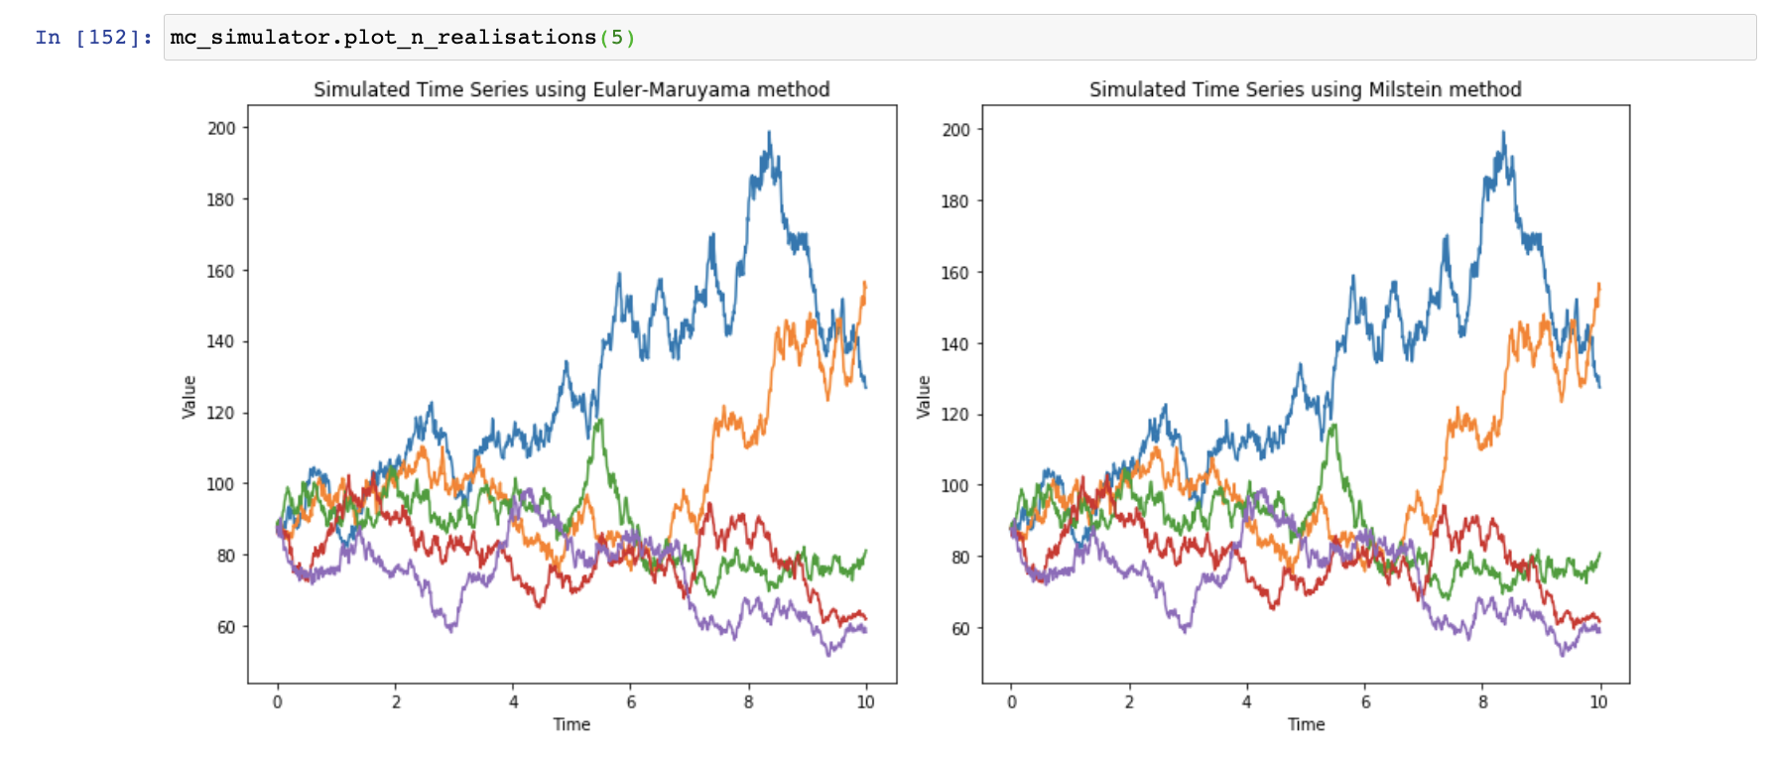
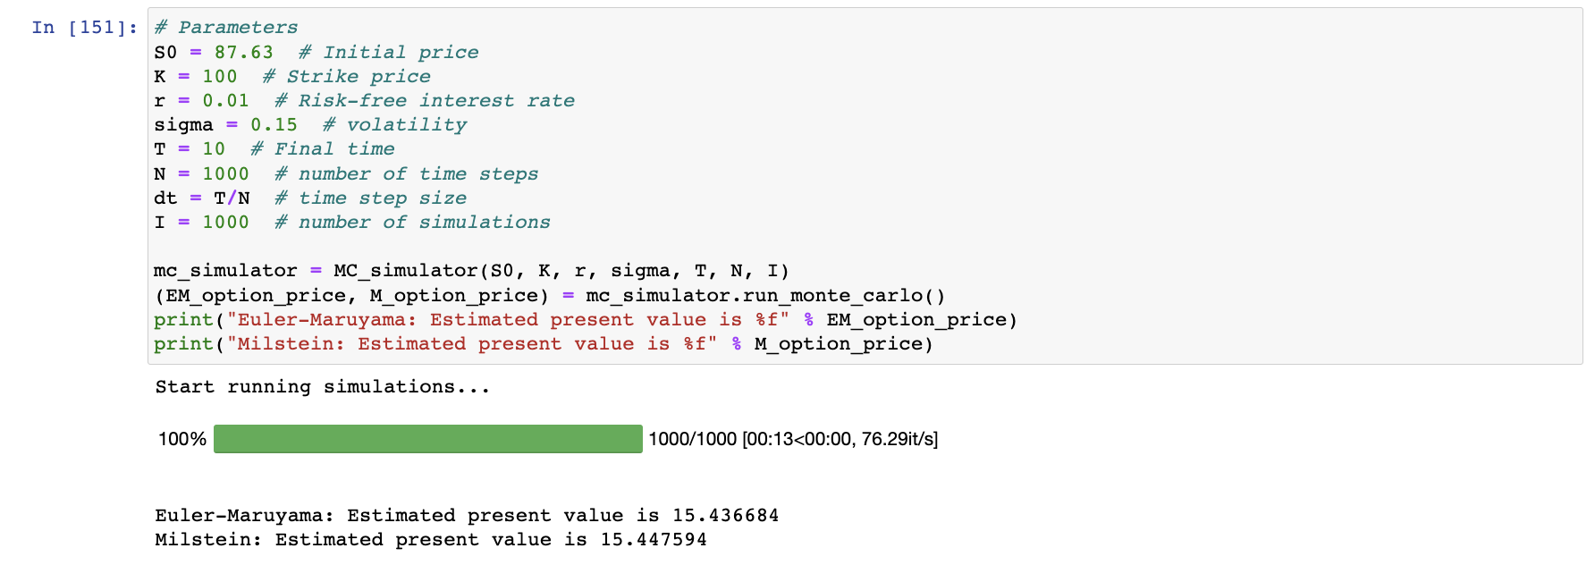
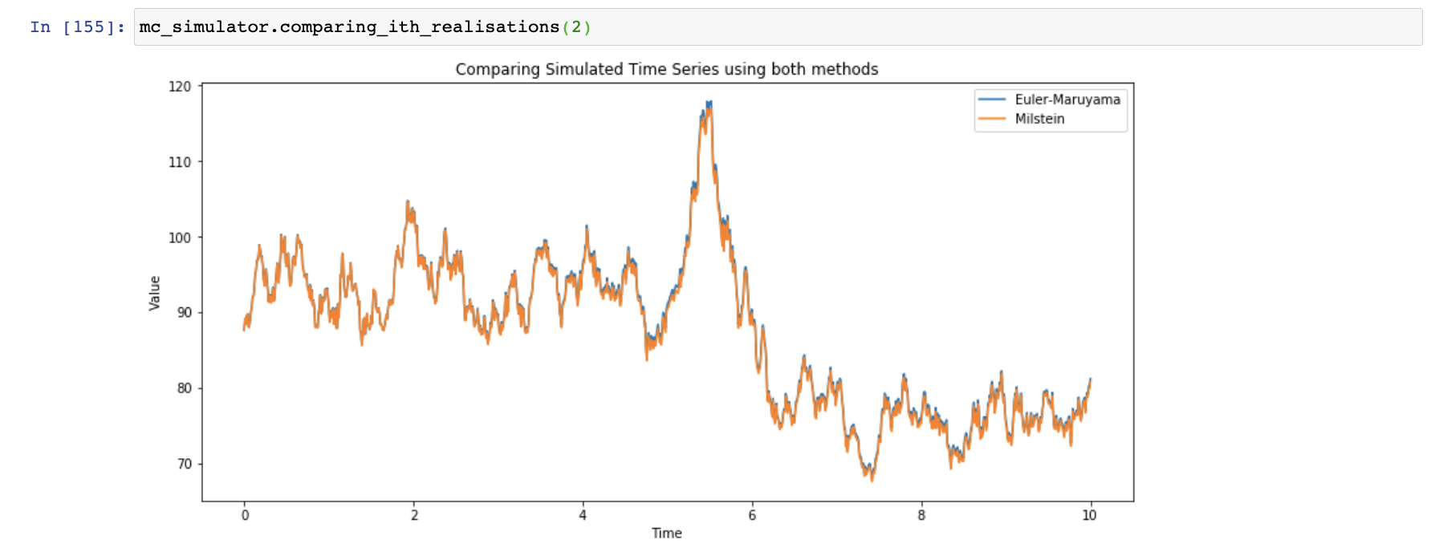
Progress
Implemented Euler-Maruyama and Milstein methods, assuming that the underlying asset price follows a lognormal random walk with known volatility and risk-free interest rate, in Jupyter Notebook.
Fig 2. Plots of first 5 complete realisations produced by Euler-Maruyama and Milstein methods. In each sample sample path, the two methods share the same set of noises.
Fig 1. Estimating price of an option with the above parameters by running 1000 Monte Carlo simulations
Fig 3. Plot of one realisation using both methods, which shares the same set of noises.

Slide 4
Tools
Language: Python
Python packages: Numpy, Pandas, Matplotlib, Jupyter Notebook

Slide 5
Literature Review
Glasserman, P. (2004). Monte Carlo Methods in Financial Engineering. New York, NY: John Wiley & Sons.
Wilmott, P. (2007). Wilmott Introduces Quantitative Finance, 2nd Edition. New York, NY: Springer
Fabrice, R. Euler and Milstein Discretization. https://frouah.com/finance%20notes/Euler%20and%20Milstein%20Discretization.pdf

Slide 6
Difficulties and objectives to work on for the next stages
Need to study how to analyse the results obtained from the Monte Carlo simulations.
How to perform statistical analysis on the simulated results.
What are the different mathematical approaches to minimise error.
Implement these analysis in Python code
How to extend the current time series discretisation methods, in other words how to incorporate real world data into the simulator.
Determine what are the appropriate values to use for time steps, risk-free rate, volatility and strike price to use.

