Slide 1
Diagnostic potential for a serum miRNA neural network for detection of ovarian cancer

Slide 2
Table of contents
1
Introduction
4
Results & Demo
2
5
Reproducibility
Input
Flowcharts & Tools
3
6
Summary

Slide 3
Introduction
ovarian cancer
ovarian cancer is a major cause of cancer death among women
previous methods are too late to diagnose the disease
CA125
CA125 is a protein that may be found in high amounts in the blood of patients with ovarian cancer.
disadvantages include poor sensitivity and limited specificity
microRNAs
microRNAs are short non-coding RNAs
many ovarian cancers have defects in microRNAs
computer program learned to identify ovarian cancer based on microRNAs
paper objective
develop a serum-based microRNA model for the diagnosis of ovarian cancer

Slide 4
Inputs
Excel dataset
Supplemental Dataset 1:
unadjusted miRNA sequencing data
119 women samples from PMP/NECC, 60 samples from ERASMOS
Supplemental Dataset 2:
batch-adjusted
192 miRNA variables
Supplemental Dataset 6:
normalized qPCR data
14 miRNA variables
Example code
Source code 1. miRNA-seq neural network source code
Source code 2. qPCR 14-miRNA neural network source code
Source code 3. qPCR 7-miRNA neural network source code
Source code 4. neural network applied to the Keller, et al dataset

Slide 5
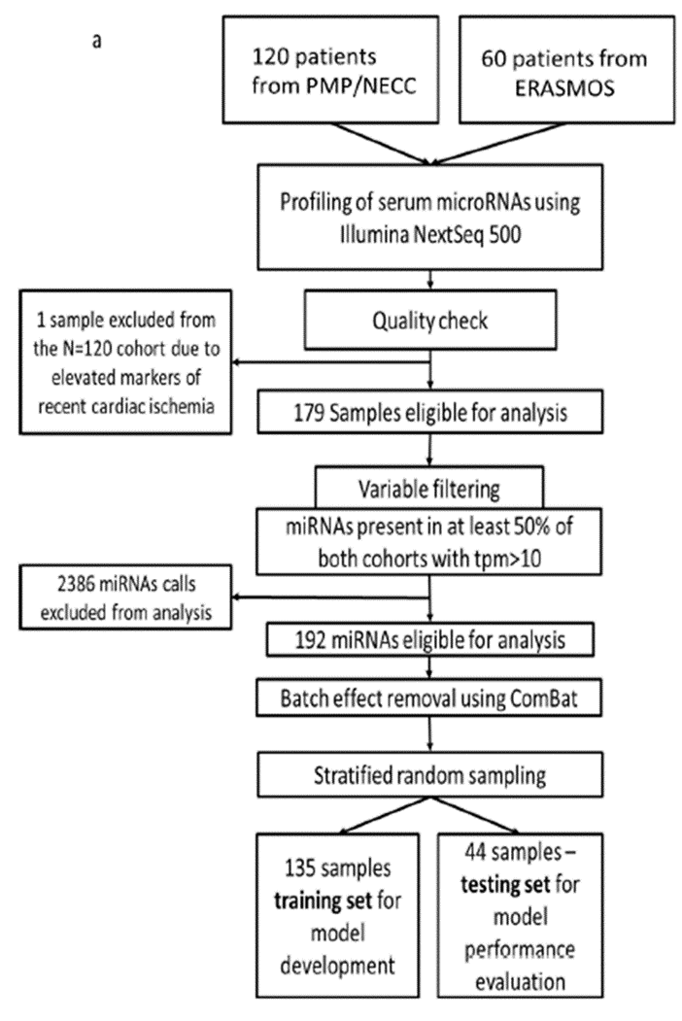
Flowcharts
Pre-processing
Import samples selected from three independent studies
Do the RNA sequencing experiments
Filter variables and samples
Remove batch effect
192 miRNAs remain
Split training and testing set
75% training, with 179 samples
135 training set
44 testing set

Slide 6
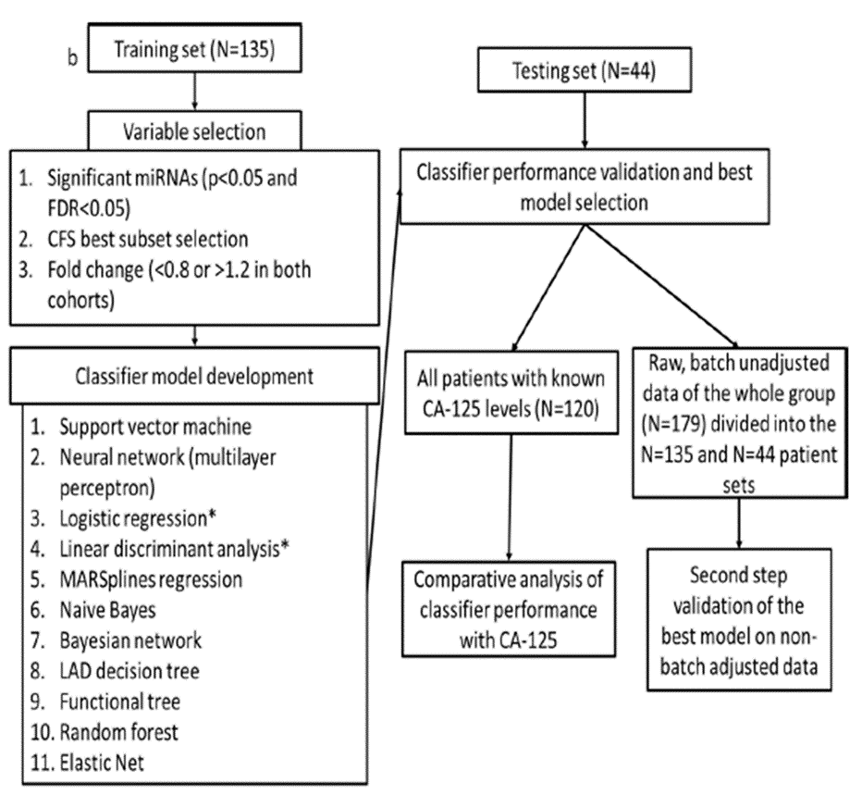
Flowcharts
3 variable subsets
11 miRNAs
5 miRNAs
14 miRNAs
11 models
Performance validation
compare to CA-125
compare with other models

Slide 7
Tools
Statistica
a flexible analytics system
allows users to:
create analytic workflows
explore interactively and visualize
create and deploy statistical, predictive, data mining, machine learning, forecasting, optimization, and text analytic models
we are able to try many different ML models and parameters and compare the results
python
Sklearn
Logitboost
Plotly
Matplotlib

Slide 8
What Do We Find

Slide 9
Understanding the Datasets
Based on Supplementary File 1B, we have new understandings about PMP, NECC, and ERASMOS
Combine Supplemental Dataset 2 with Supplemental Dataset 6
Finally, we get 3 experiment dataset

Slide 10
Matching the Results Published

Slide 11
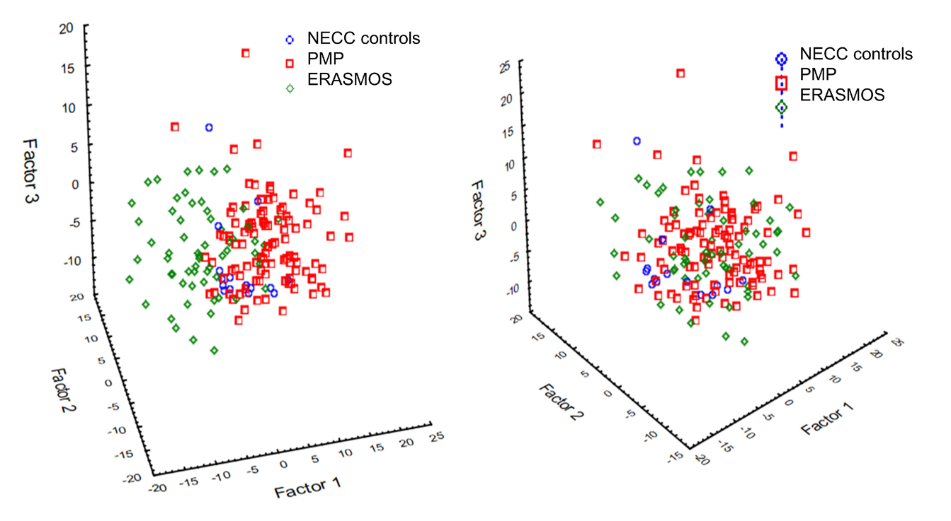
Figure 9. Principal component analysis identified a prominent batch effect among the study populations.
Paper result: Principal component analysis
Before batch effect removal.
After batch effect removal

Slide 12
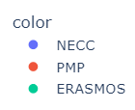
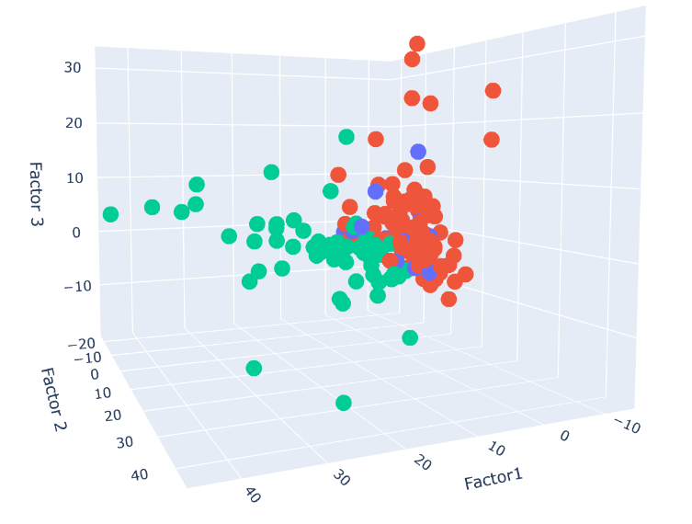
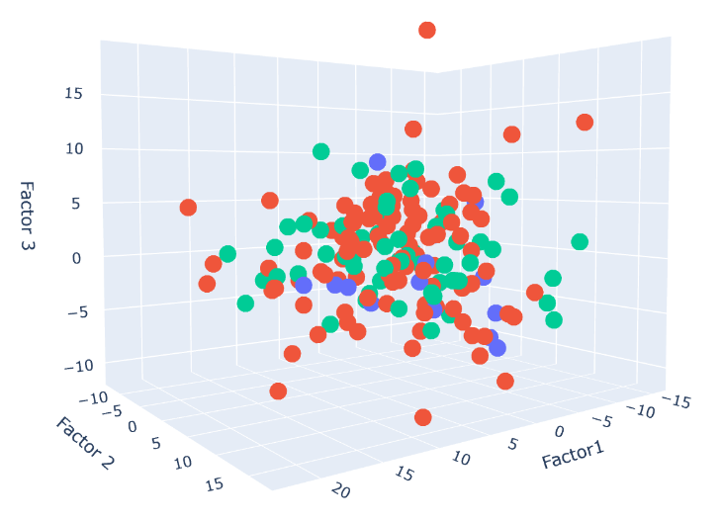
Figure 9. Principal component analysis identified a prominent batch effect among the study populations.
Our result: Principal component analysis
Before batch effect removal.
After batch effect removal

Slide 13
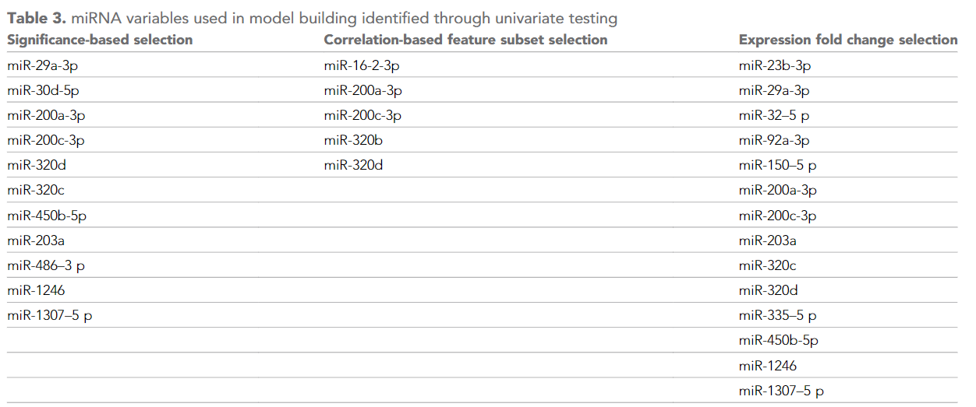
variable selections:
3 variable subsets for building models

Slide 14
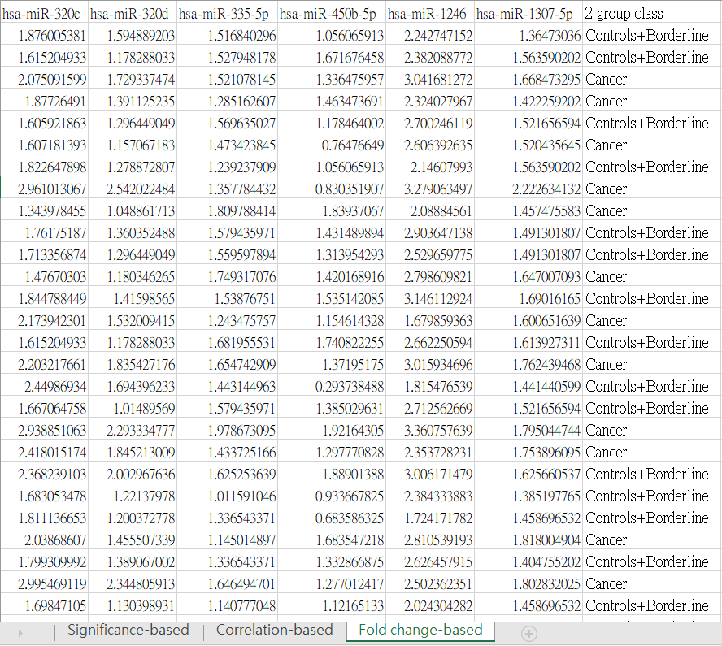
variable selections:
find all subsets and 2 group class (diagnosis) for each case
Prepare our Training dataset
Worksheet 2
Batch adjusted,miRNA
Worksheet 6
Normalized qPCR data
in supplement dataset 6

Slide 15
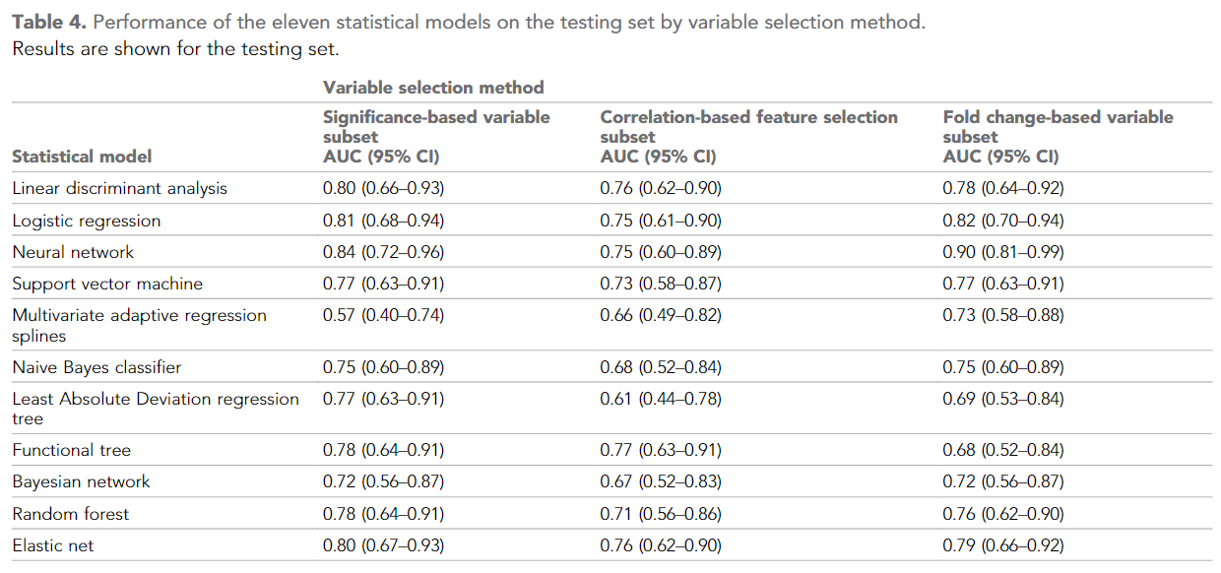
Table 4. Performance of the eleven statistical models on the testing set by variable selection method
Paper result (AUC score)

Slide 16
Table 4. Performance of the eleven statistical models on the testing set by variable selection method
Paper result (AUC score)

Slide 17
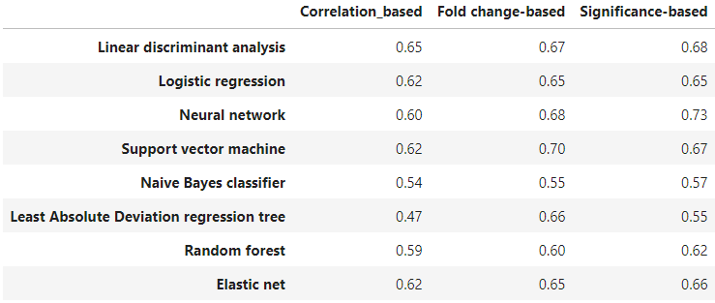
Table 4. Performance of the eleven statistical models on the testing set by variable selection method
Our result (AUC scorie) – python version

Slide 18
Table 4. Performance of the eleven statistical models on the testing set by variable selection method
Our result (AUC scorie) – Statistica version
 | Significance-based | Correlation-based | Fold change-based
Neural network | 0.84 | 0.76 | 0.92
Support vector machine | 0.61 | 0.62 | 0.55
Naive Bayes classifier | 0.54 | 0.58 | 0.56

Slide 19
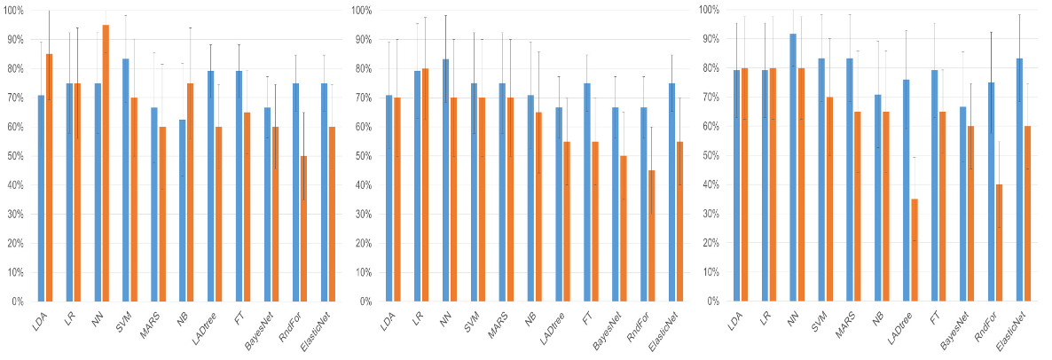
Figure 2. Clinical performance characteristics of the tested models
Paper result: Sensitivity (blue bars) and specificity (orange bars)
Significance-based
Correlation-based
Fold change-based

Slide 20
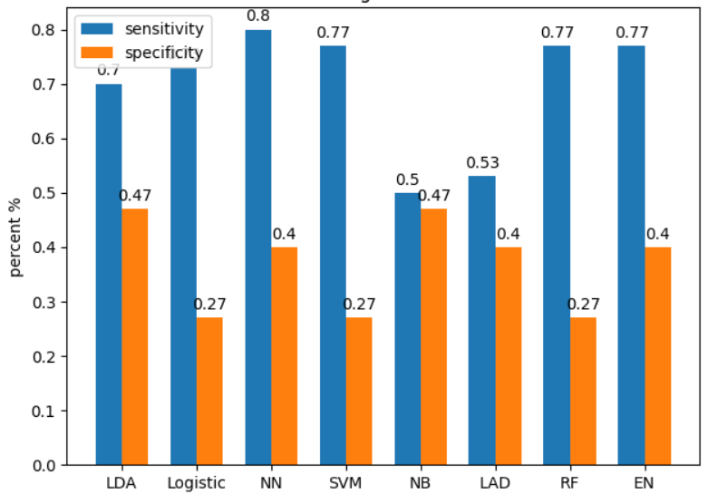
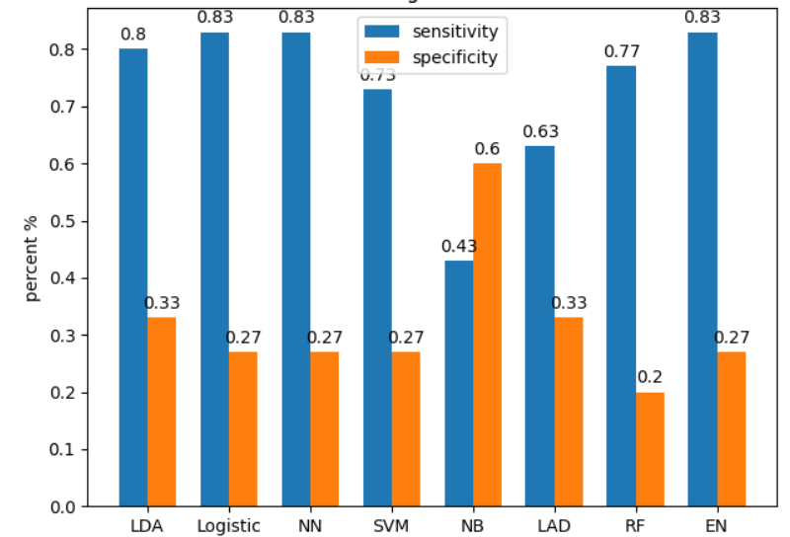
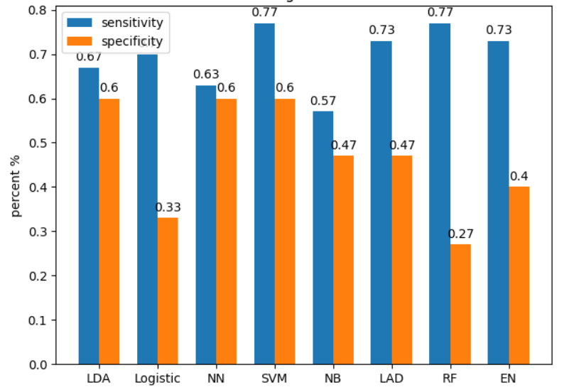
Figure 2. Clinical performance characteristics of the tested models
Our result: Sensitivity (blue bars) and specificity (orange bars)
Significance-based
Correlation-based
Fold change-based

Slide 21
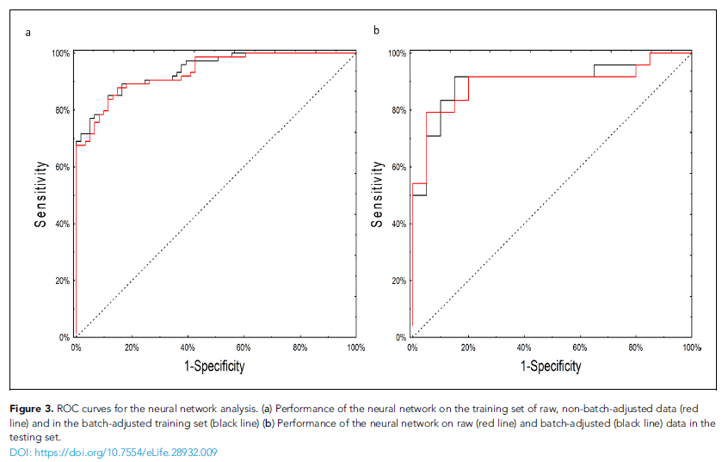
Figure 3. ROC curves for the neural network analysis (paper result)

Slide 22
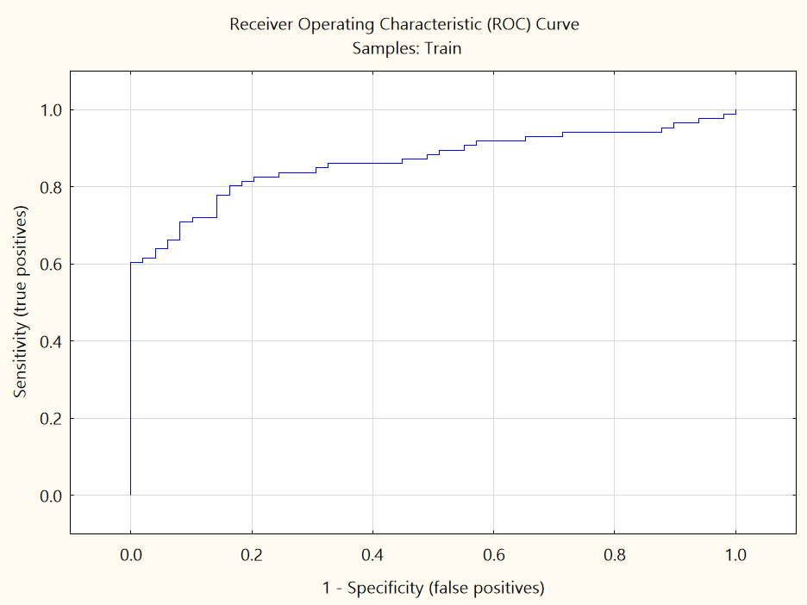
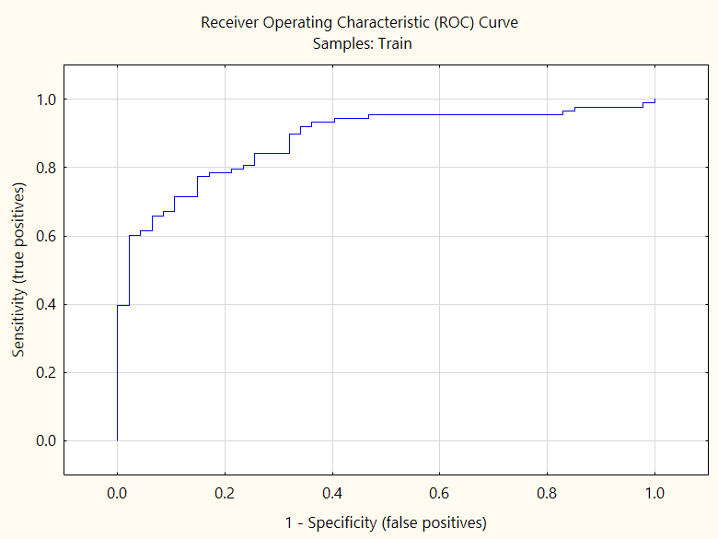
Figure 3. ROC curves for the neural network analysis (our result: training set)
raw data (select 192 miRNAs from dataset 1) batch-adjusted data (dataset 2)

Slide 23
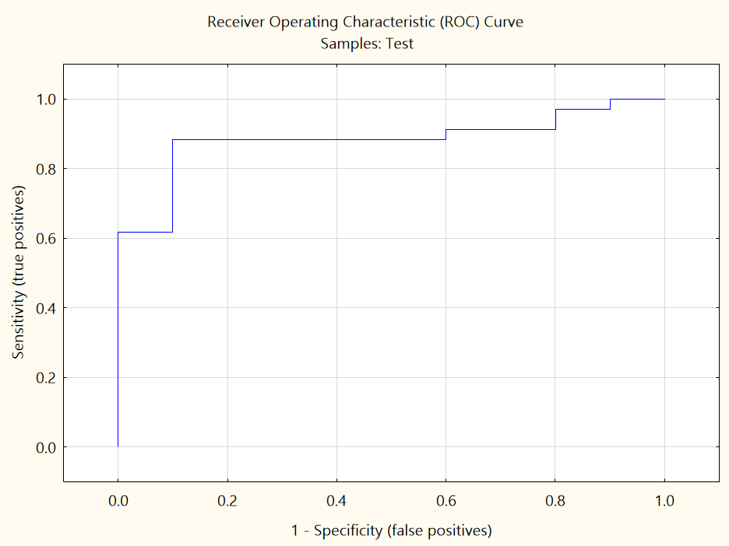
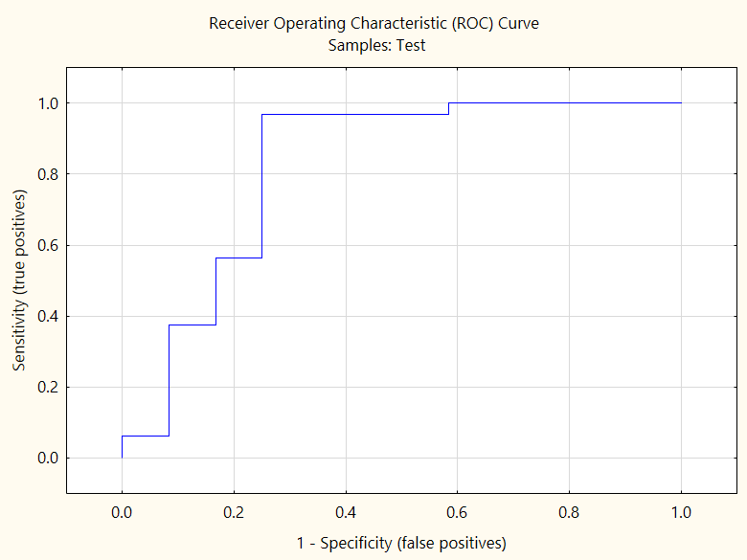
Figure 3. ROC curves for the neural network analysis (our result: testing set)
raw data (select 192 miRNAs from dataset 1) batch-adjusted data (dataset 2)

Slide 24
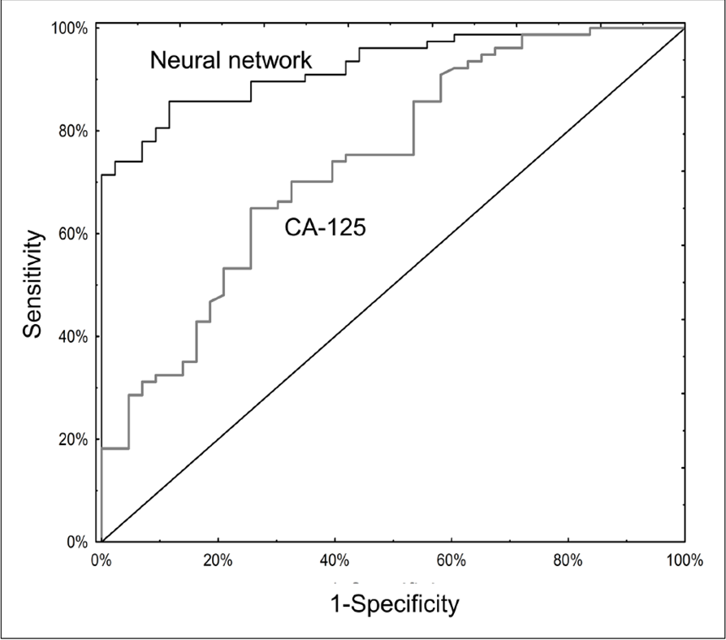
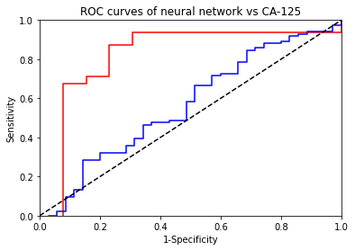
Figure 4. ROC curves of neural network vs CA-125
Neural network
CA125

Slide 25
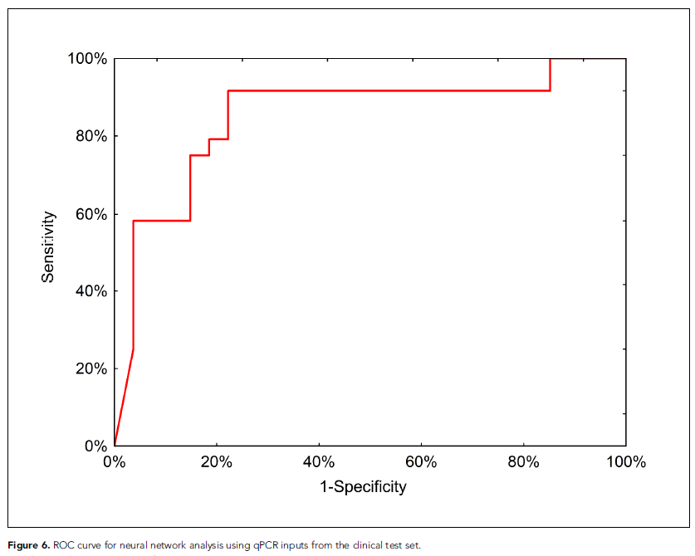
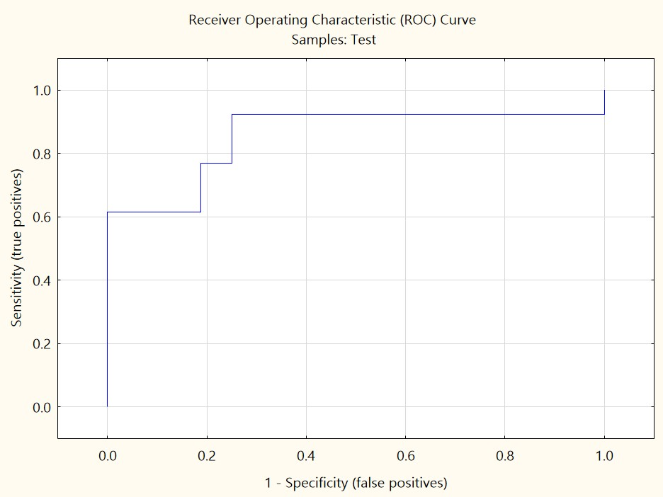
Figure 6. ROC curve for neural network analysis using qPCR inputs
AUC = 0.85
AUC = 0.85

Slide 26
Demo

Slide 27

Reproducibility – python

Slide 28
Reproducibility – Statistica
save models as source code (XML file)
deploy models from previous analysis to reproduce the process

Slide 29
Summary
The performance are not as good as paper
Not easy to figure out how to utilize the software & source code
The relation between Datasets and figures are not that clear
There are some naming & number mistakes in The datasets

Slide 30
Resources
Sklearn
https://scikit-learn.org/1.0/index.html Black man with clipboard near colleagues
Logitboost
https://logitboost.readthedocs.io/ Landing page template for essential oil bottle podium with geometric shapes
Plotly
https://plotly.com/python/
Matplotlib
https://matplotlib.org/stable/index.html#
Statistica
https://docs.tibco.com/products/tibco-statistica-14-0-1

