Slide 1
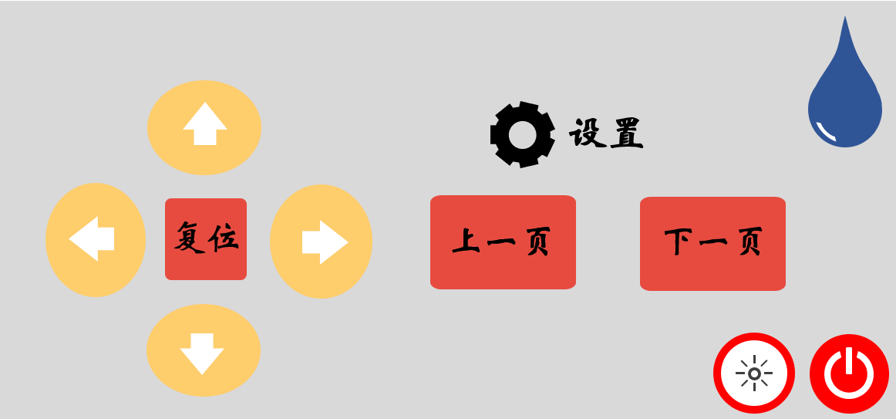
125
117.5
110
107.5
87.5
80
60
45
25
5
15
30
32.5
42.5
50
65
20
7.5
12.5
10
15

