Slide 1
Group 1

Slide 2
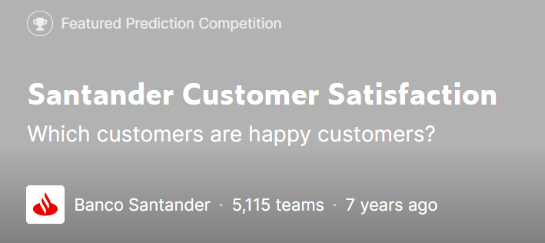
Contest

Slide 3
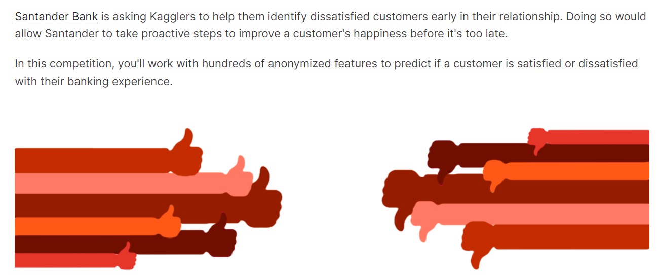

Slide 4
Reference
https://www.kaggle.com/code/zfturbo/to-the-top-v3
https://www.kaggle.com/code/cast42/exploring-features

Slide 5
Data Explore

Slide 6
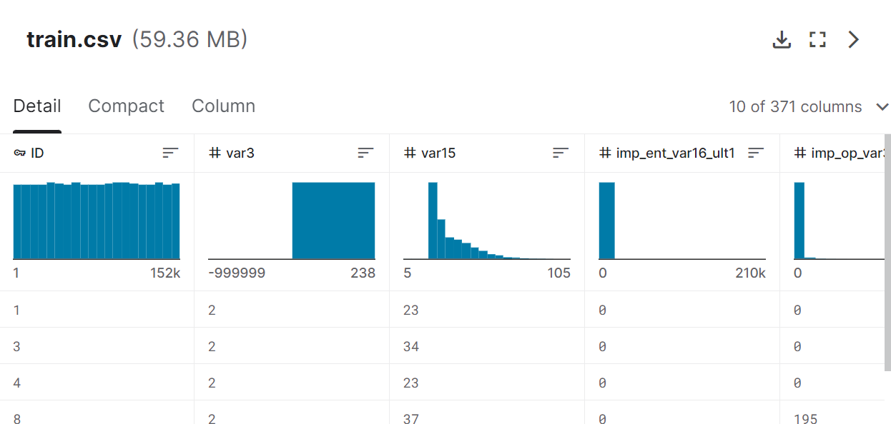

Slide 7
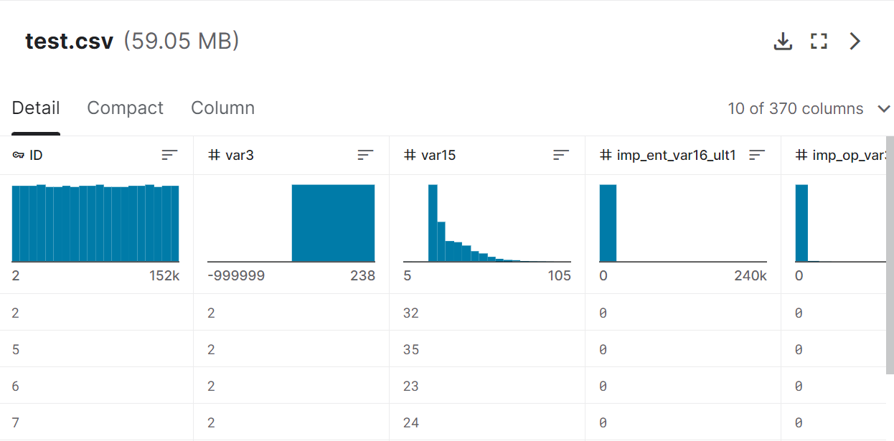

Slide 8
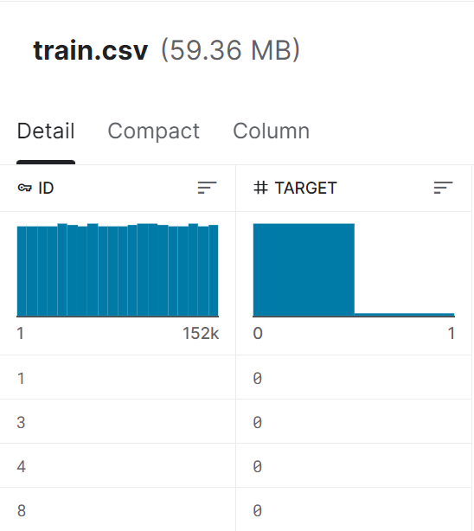
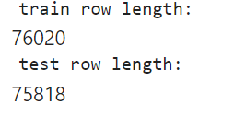

Slide 9
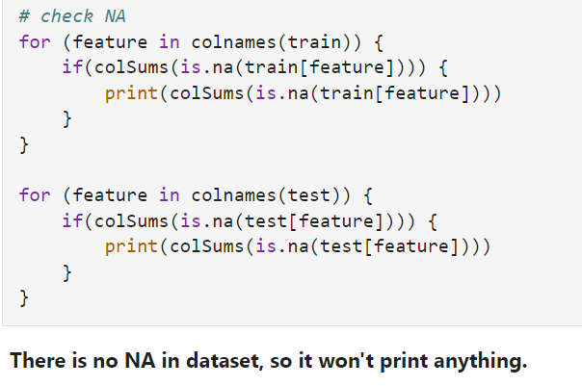

Slide 10
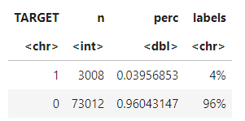
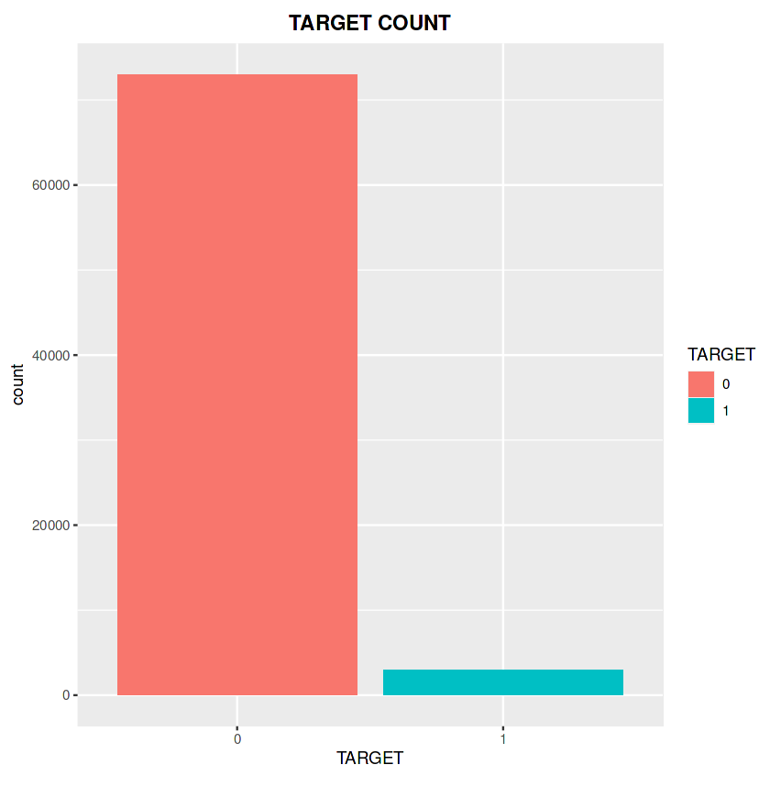
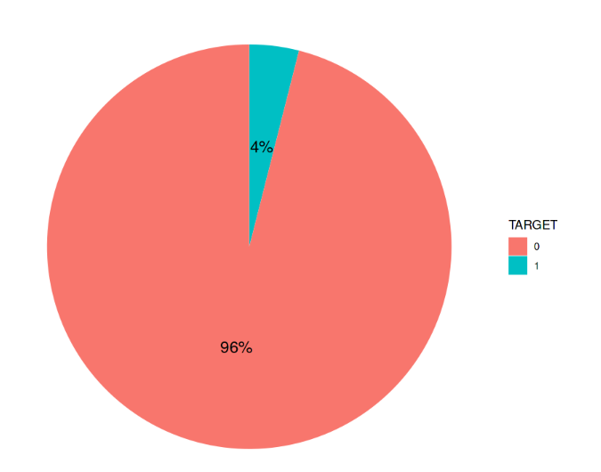
TARGET
The dataset is extremely unbalanced.

Slide 11
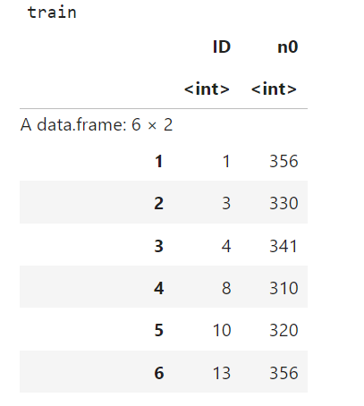
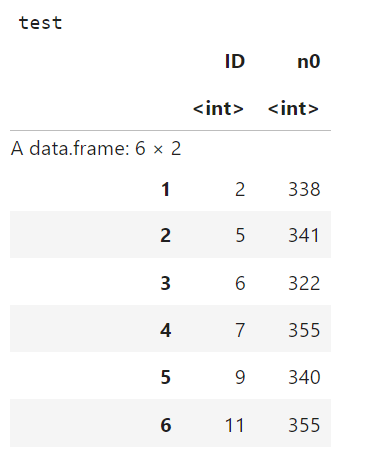

Slide 12
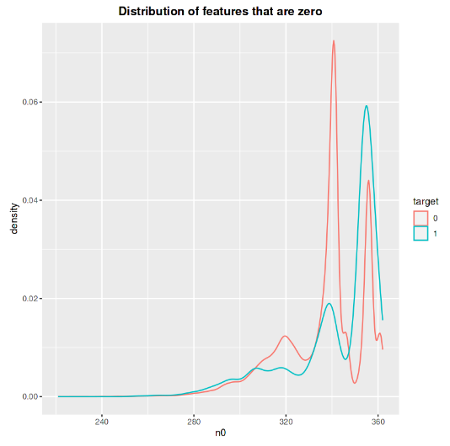
Unsatisfied customers have
slightly more features that are zero.

Slide 13


var3: nationality of the customer
-999999 means the nationality is unknown, replace it with 2(the most common value) in this column.

Slide 14
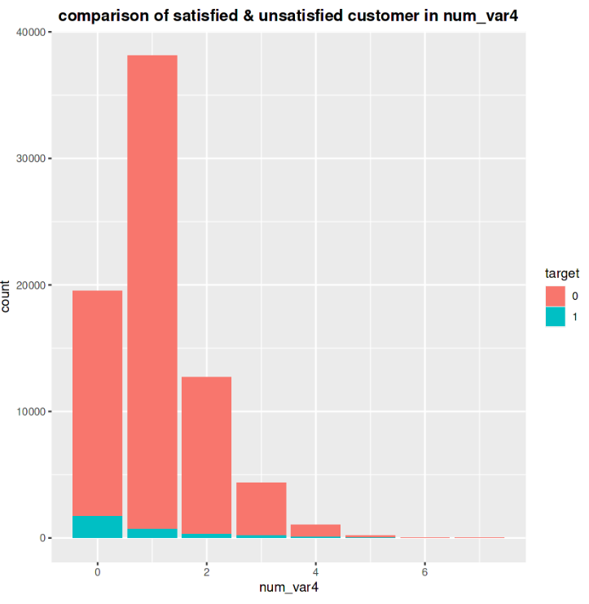
num_var4 : number of bank products
Most customers have 1 product.
Unsatisfied cosutomers have less products.

Slide 15
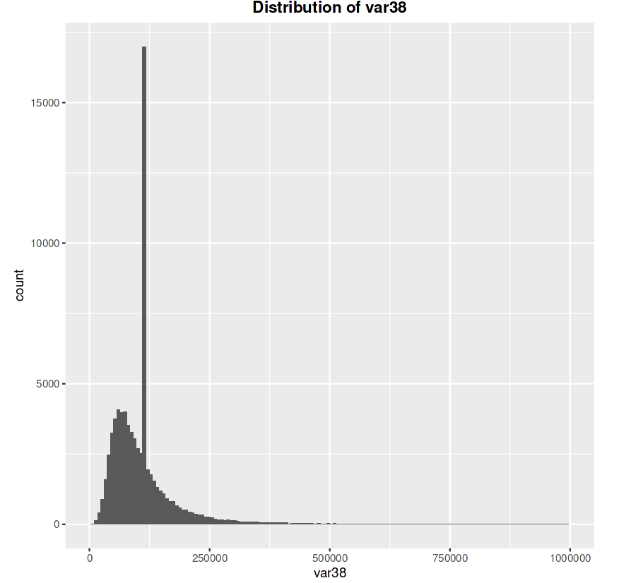
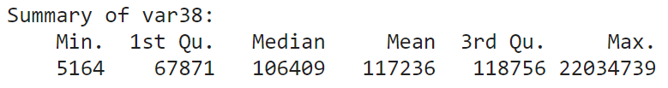

var38:
var38 is not normal distributed.

Slide 16
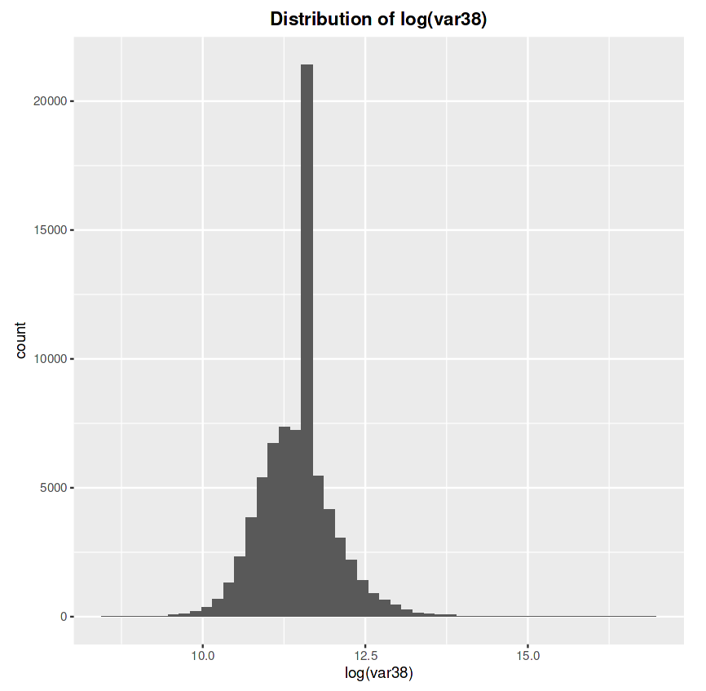
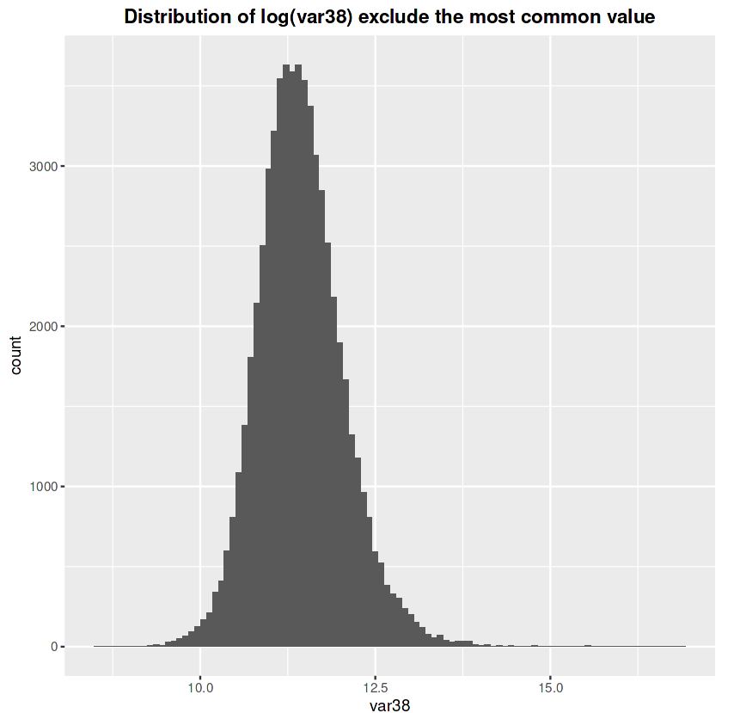
log(var38)
log(var38) become normal distributed after exclude the most common value.

Slide 17
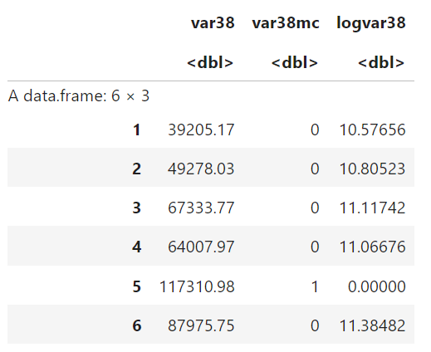

Slide 18

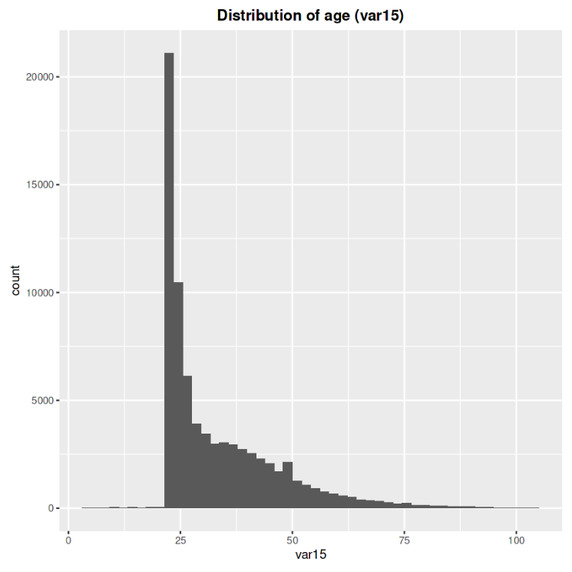
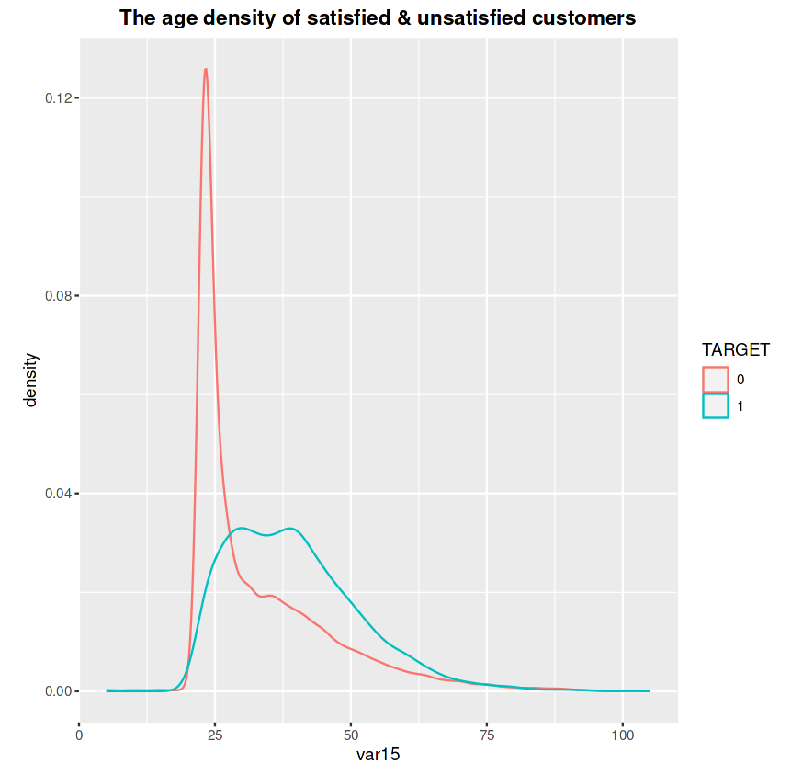
var15: the age of the customer
Unhappy customers are slightly older.

Slide 19
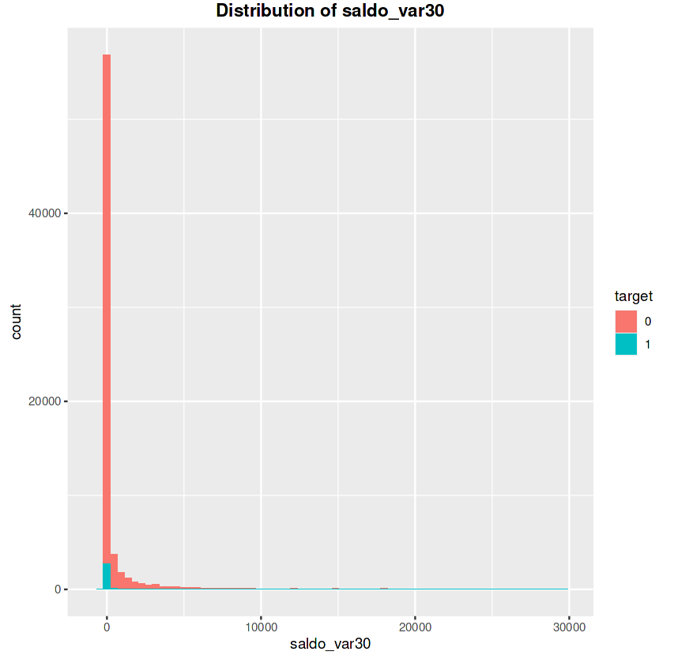
saldo_var30
Most of the unsatisfied customers have a saldo_var30 value equal to 0.

Slide 20
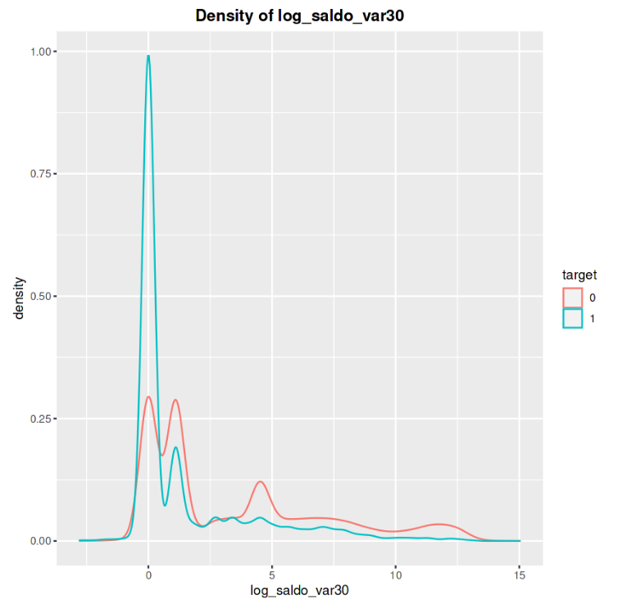
log_saldo_var30

Slide 21
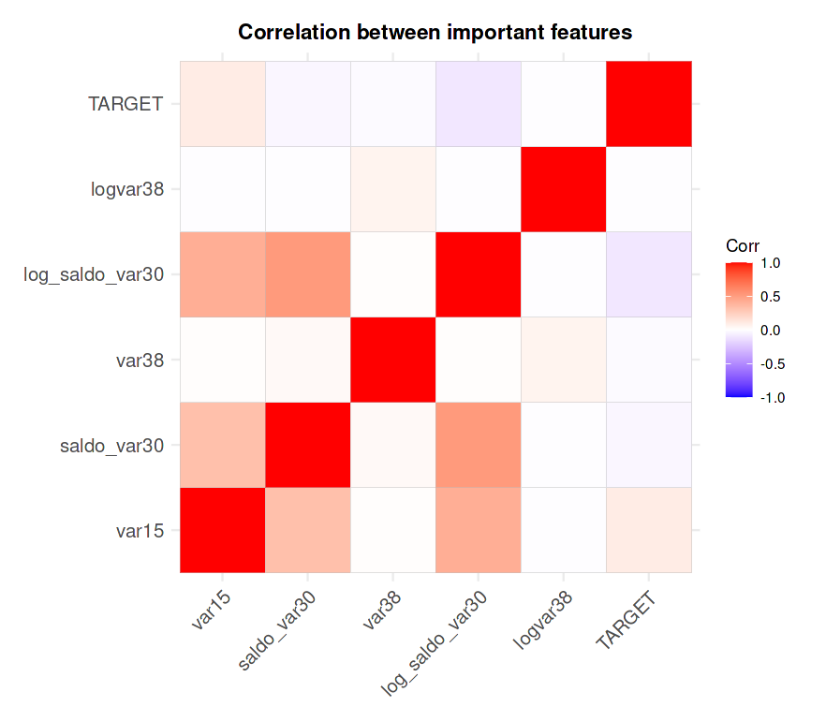
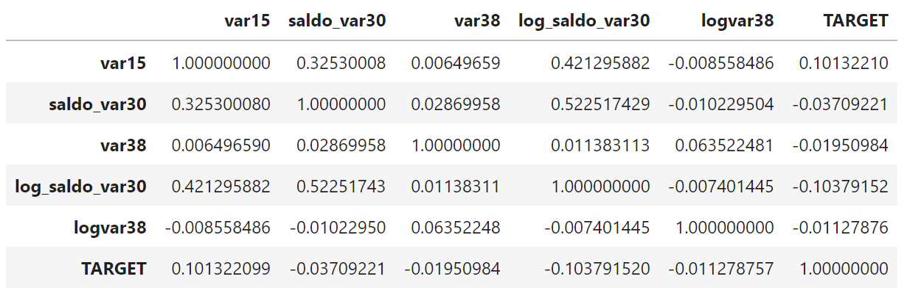
Correlation

Slide 22
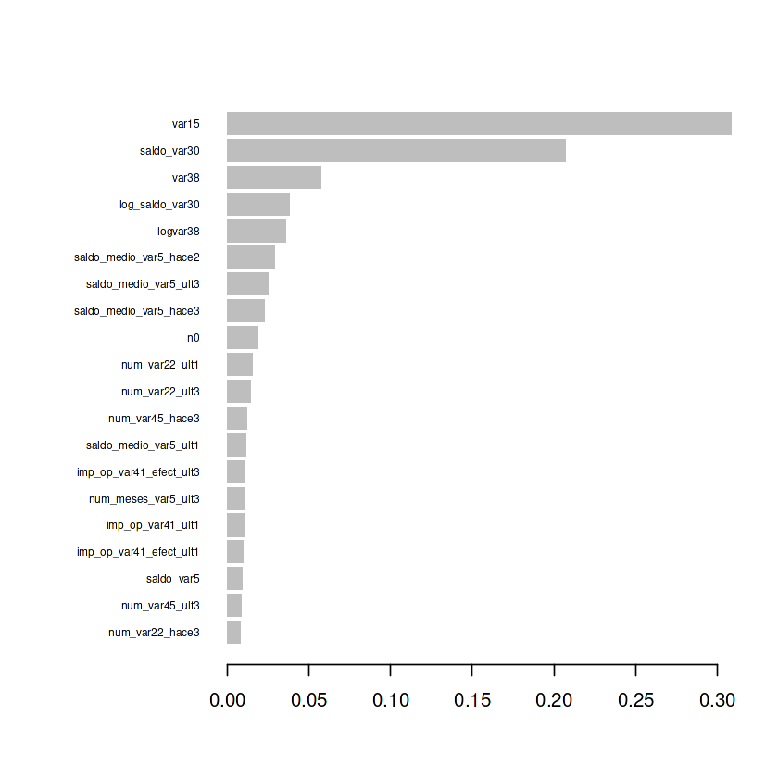

Slide 23
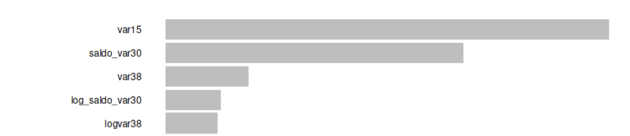

Slide 24
Model

Slide 25
Model
logistic regression
naive bayes
knn
xgboost
null model(target=0)
null model(target=1)
SVM
random forest

Slide 26
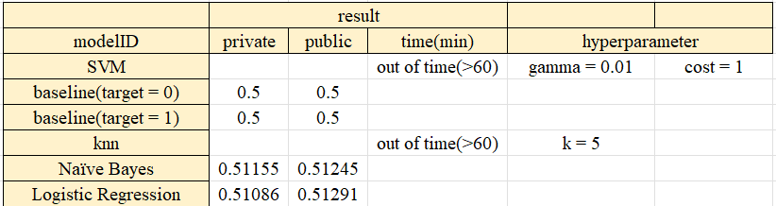

Slide 27
Demo

