Slide 1
Group 1 :
Review Santander Customer Satisfaction Contest with R
程至榮 資碩一 111753151
高語謙 資碩一 111753130
吳家瑋 資碩一 111753141
顧以恩 統計三 109304033
張翊鞍 統計四 108304004

Slide 2
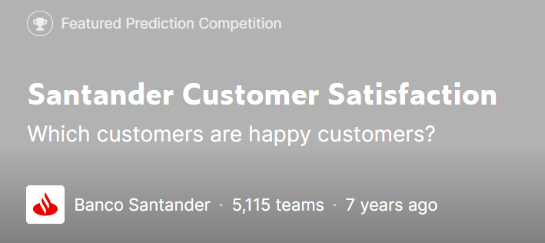
Conpetition Description

Slide 3
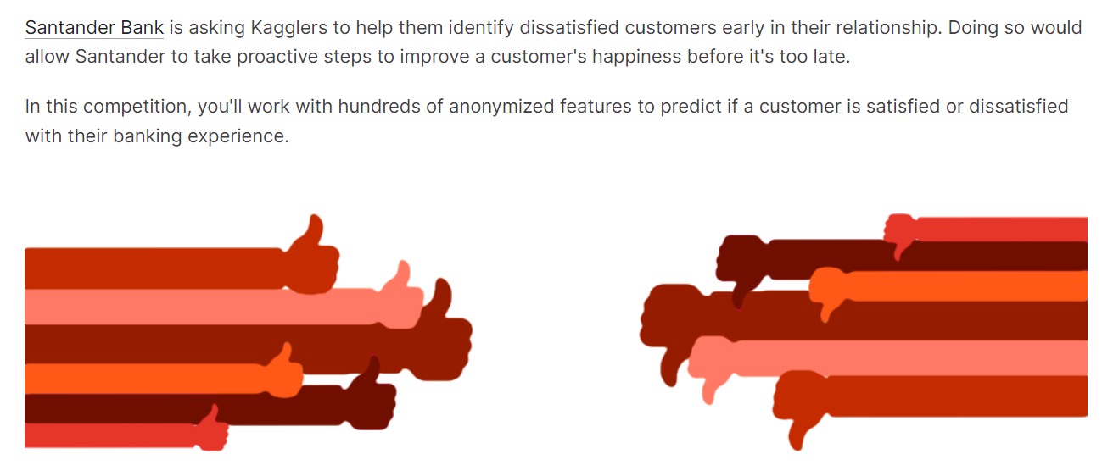

Slide 4
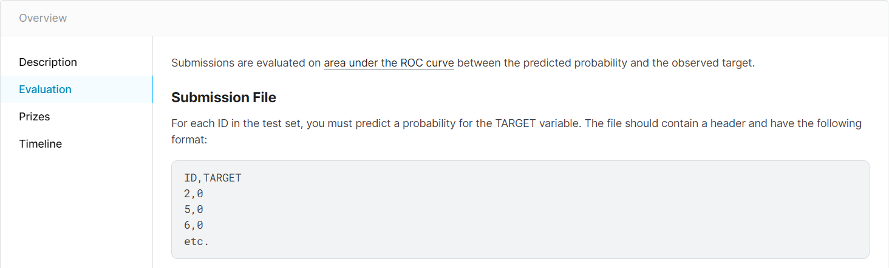

Slide 5
Data Explore

Slide 6
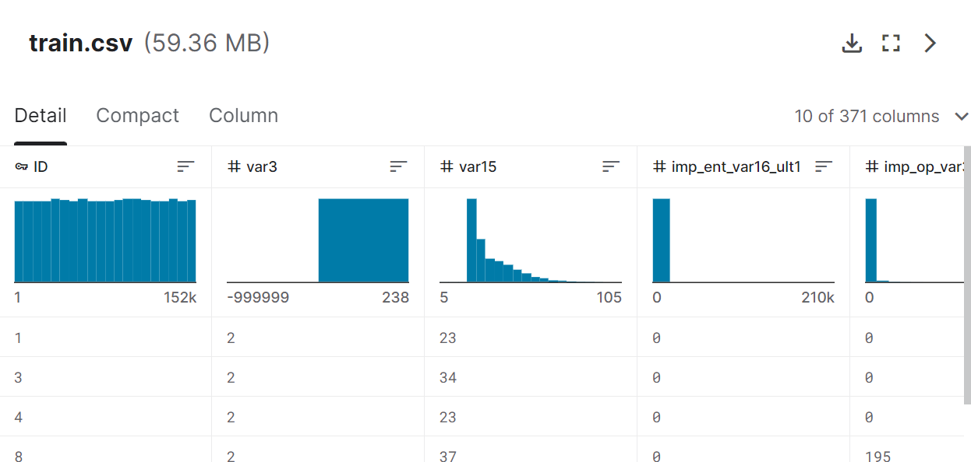

Slide 7
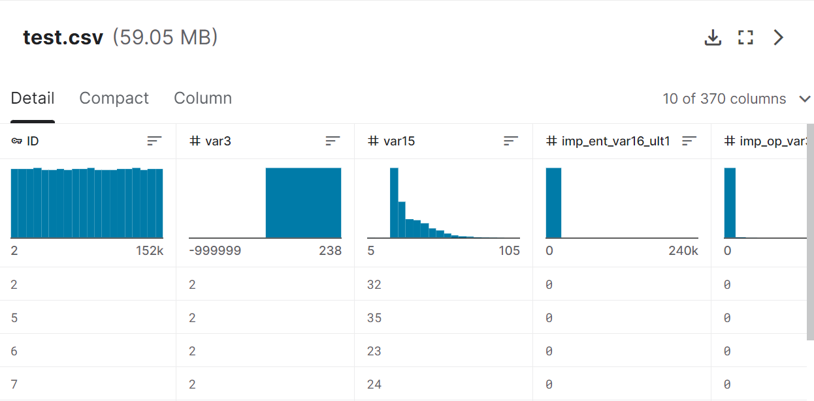

Slide 8
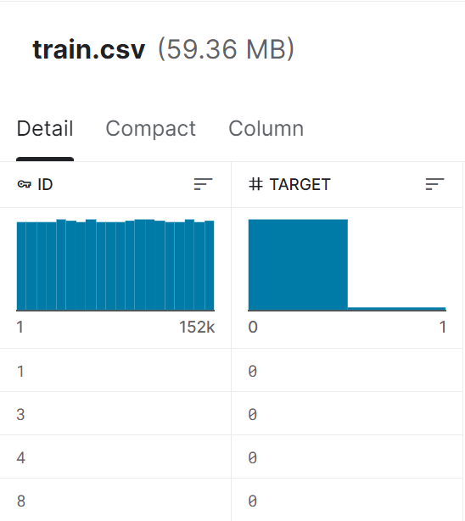
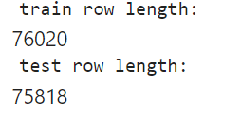

Slide 9
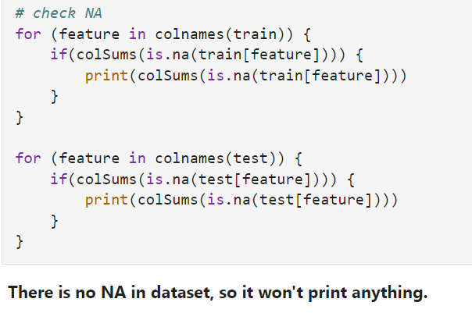

Slide 10
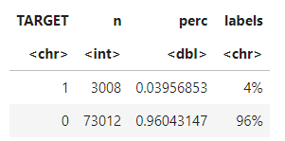
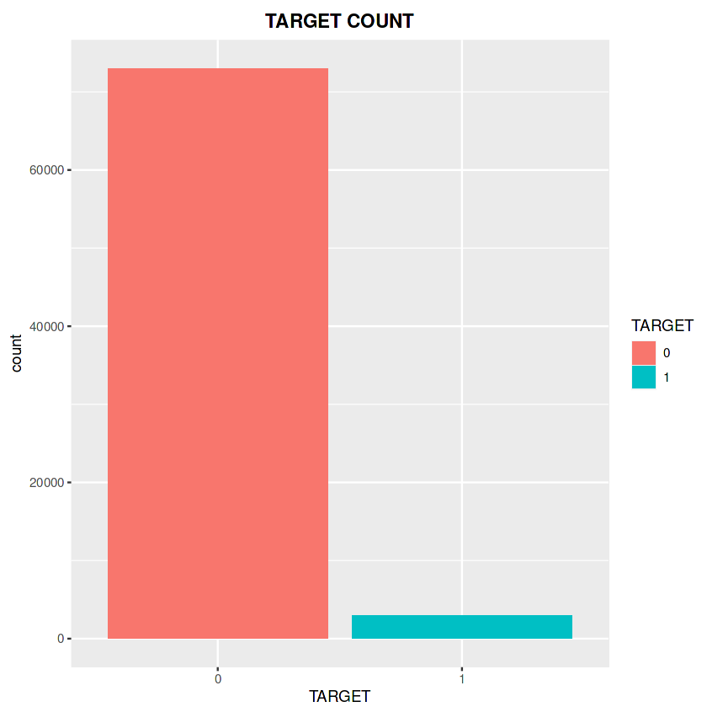
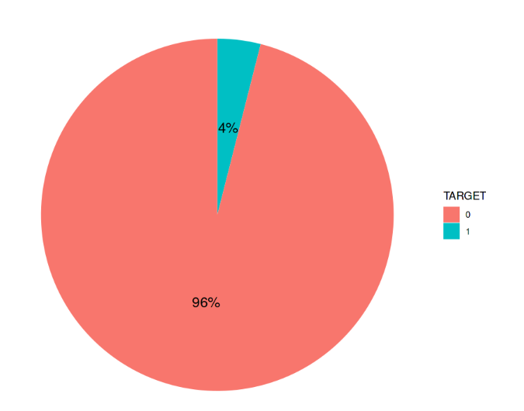
TARGET
The dataset is extremely unbalanced.

Slide 11
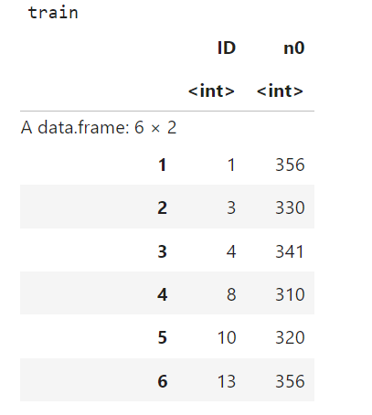
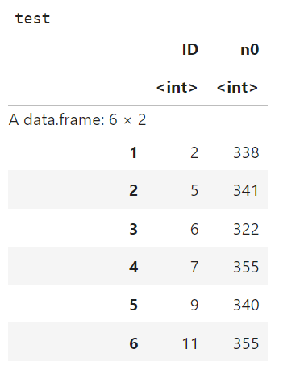

Slide 12
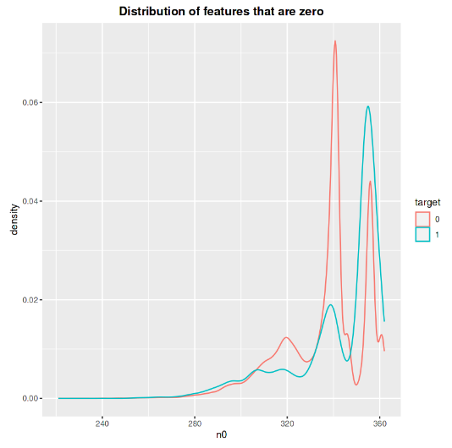
Unsatisfied customers have
slightly more features that are zero.

Slide 13


var3: nationality of the customer
-999999 means the nationality is unknown, replace it with 2(the most common value) in this column.

Slide 14
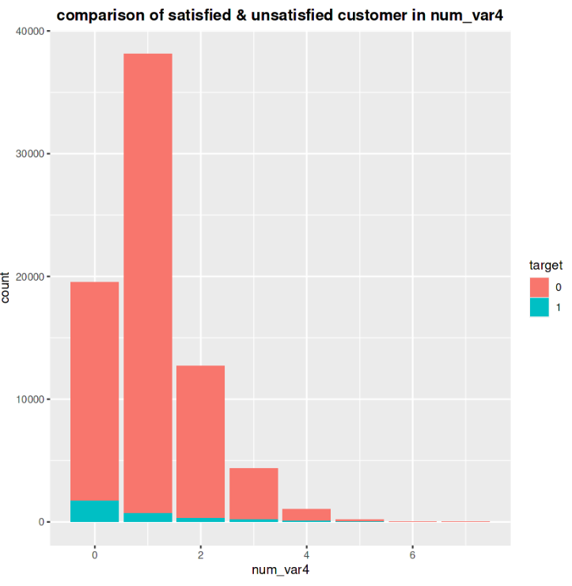
num_var4 : number of bank products
Most customers have 1 product.
Unsatisfied cosutomers have less products.

Slide 15
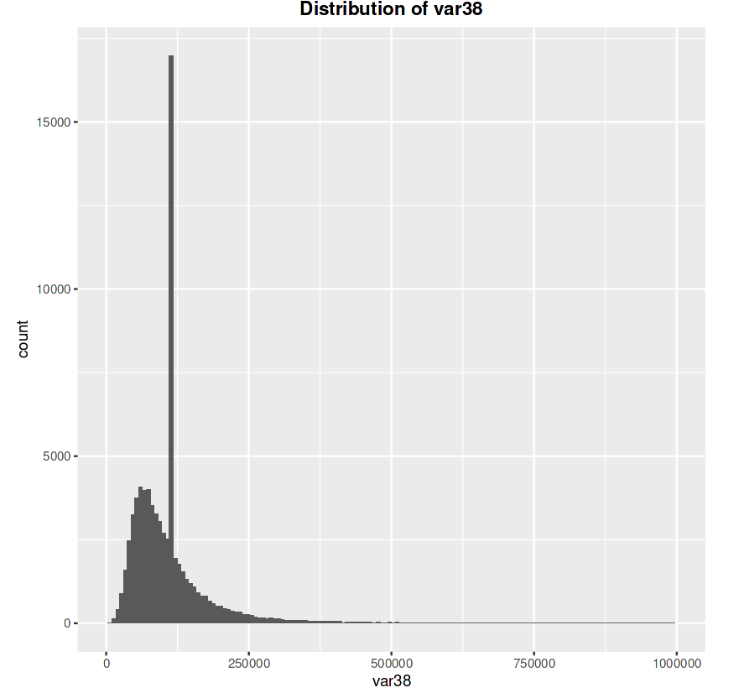
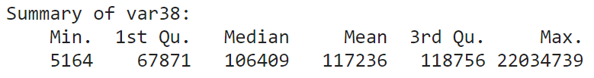

var38:
var38 is not normal distributed.

Slide 16
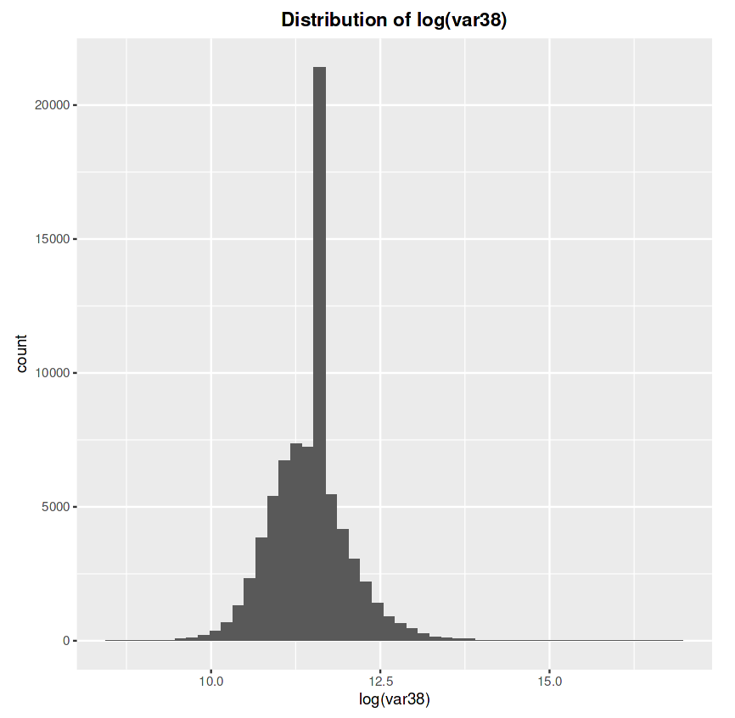
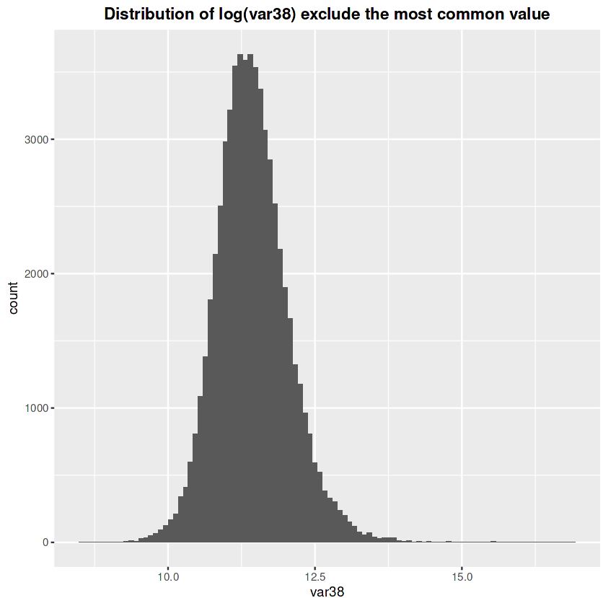
log(var38)
log(var38) become normal distributed after exclude the most common value.

Slide 17
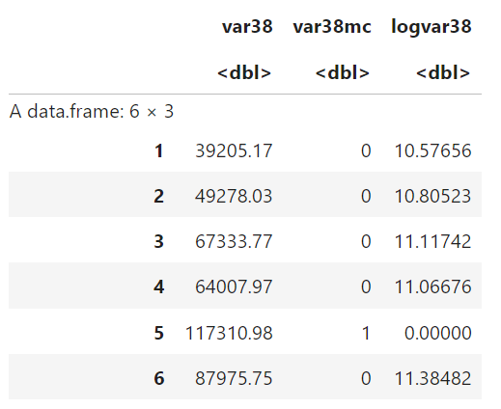

Slide 18

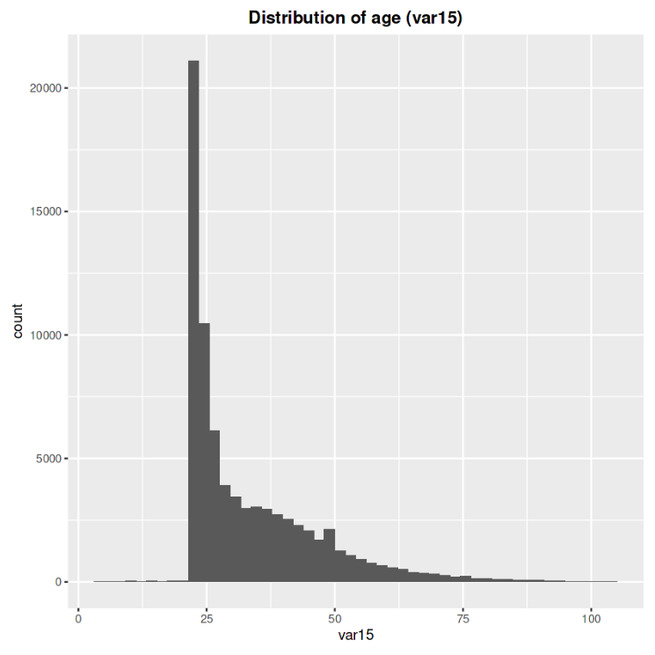
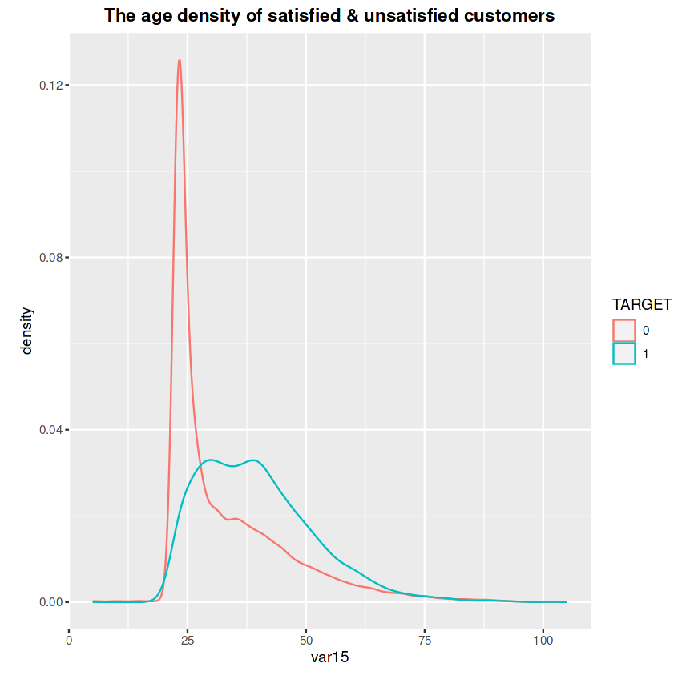
var15: the age of the customer
Unhappy customers are slightly older.

Slide 19
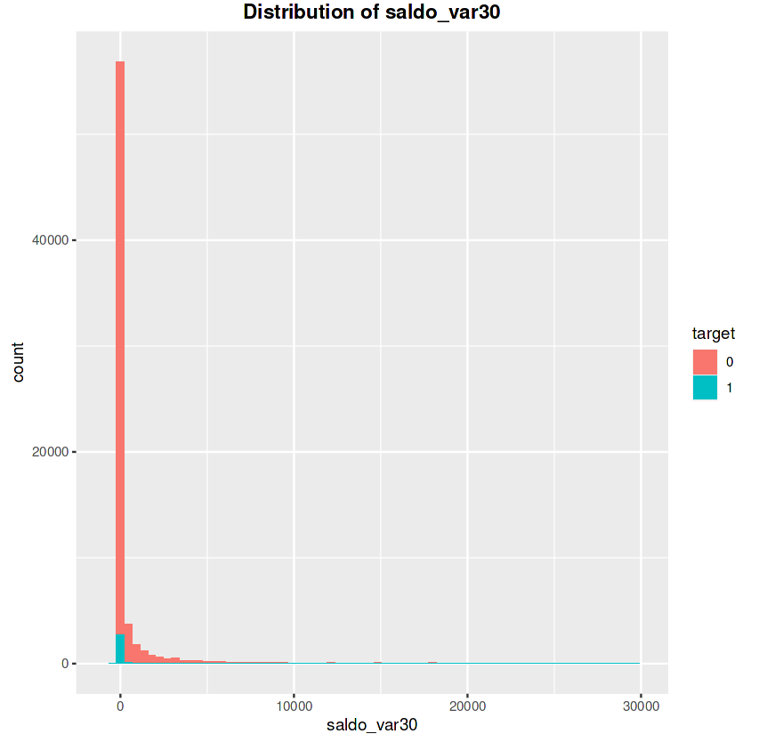
saldo_var30
Most of the unsatisfied customers have a saldo_var30 value equal to 0.

Slide 20
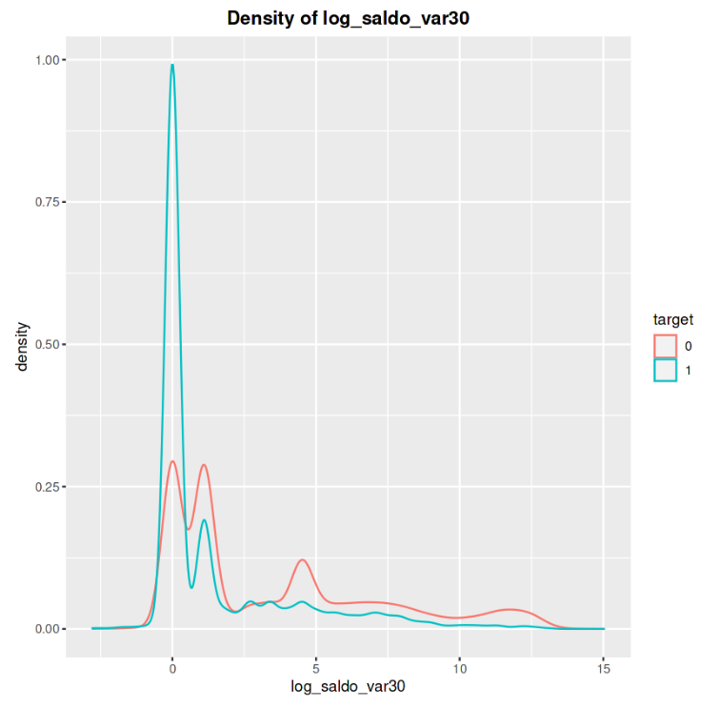
log_saldo_var30

Slide 21
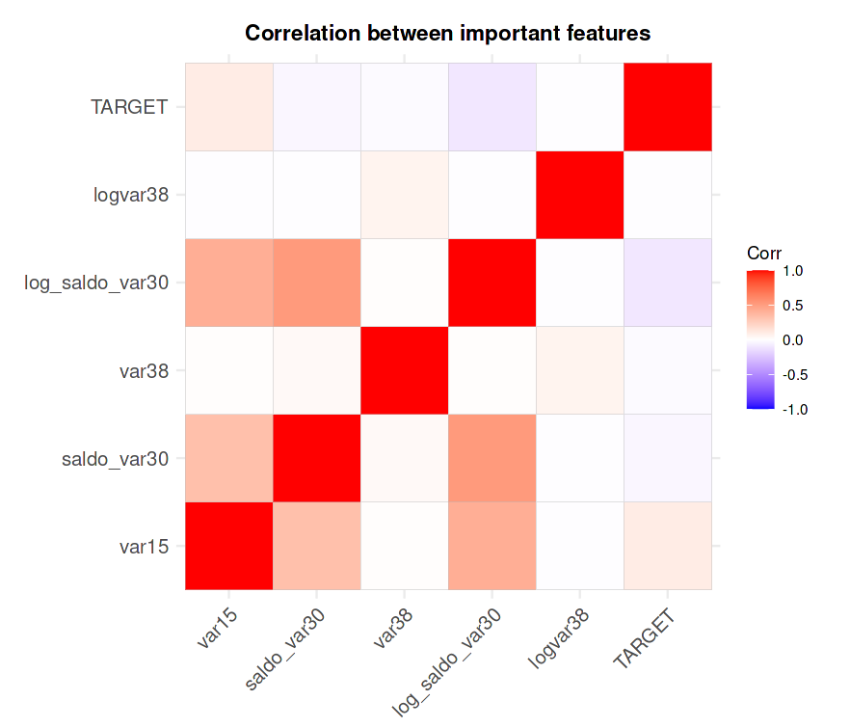
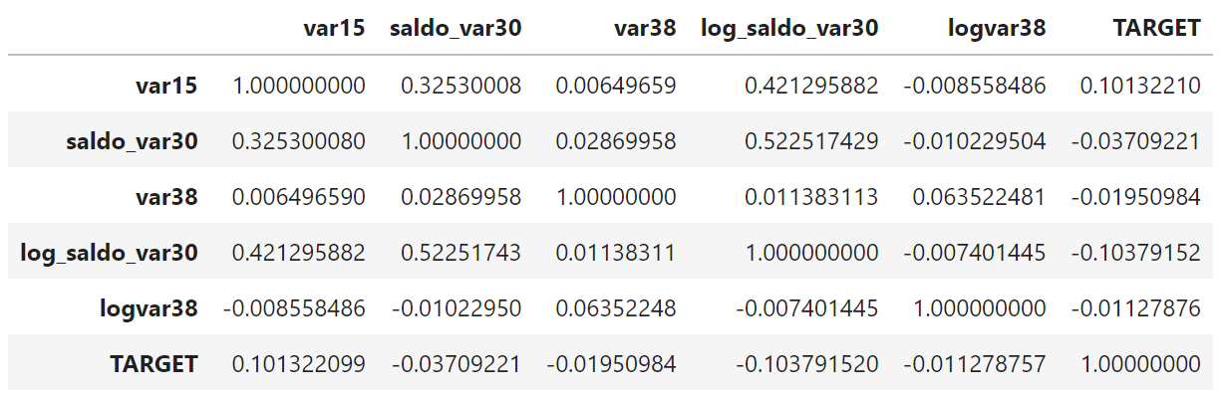
Correlation

Slide 22
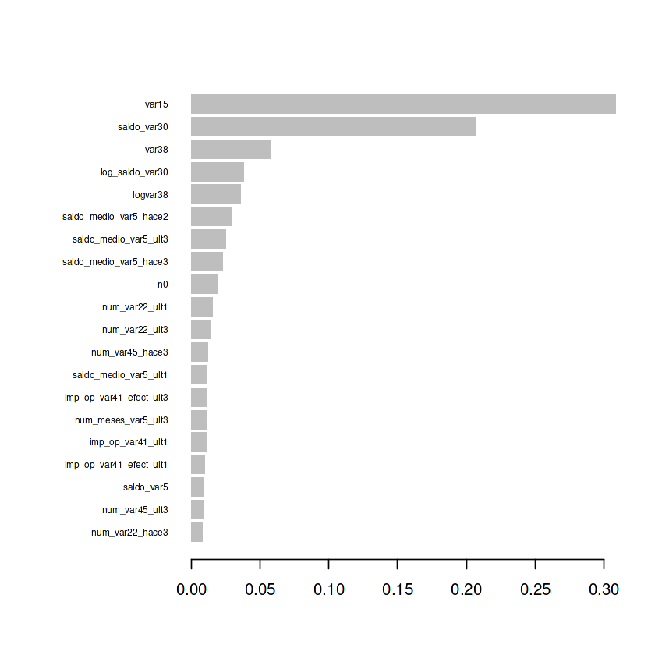

Slide 23
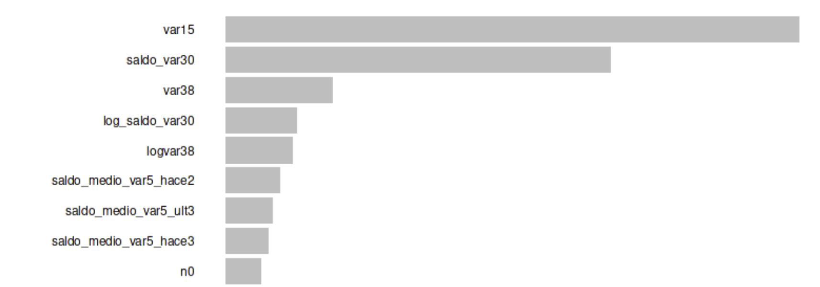

Slide 24
Models

Slide 25
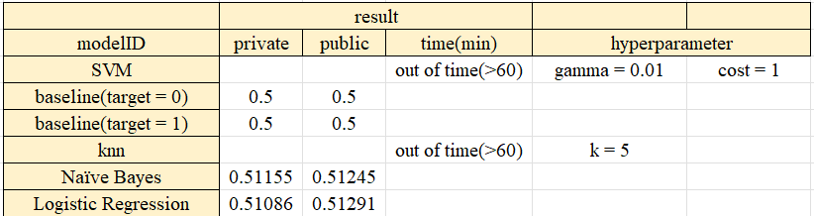
Model | private | public | Parameters
Null model with 0s | 0.5 | 0.5 | X
Null model with 1s | 0.5 | 0.5 | X
Naive Bayes | 0.51155 | 0.51245 | laplace = 0
Logistic Regression | 0.51086 | 0.51291 | family = gaussian
SVM | run time error (>60) |  | gamma = 0.01 | cost = 1
KNN | run time error (>60) |  | K = 5
Xgboost null model | 0.81965 | 0.83217 | objective = "binary:logistic"
Xgboost best model | 0.82568 | 0.83698 | See next page

Slide 26
Xgboost paras | Description
nrounds = 200 | 執行梯度下降時的遞迴次數
max_depth = 5 | 每棵樹的最大深度
eta = 0.05 | 梯度下降的學習速率
gamma = 0.01 | 節點分裂所需的最小損失函數下降值
colsample_bytree = 0.75 | 每次建樹可以使用多少比例的f
min_child_weight = 0 | 節點下的樣本數小於給定值時，停止分裂
subsample = 0.5 | 每棵樹隨機採樣的比例
*由caret 尋找的最佳參數

Slide 27
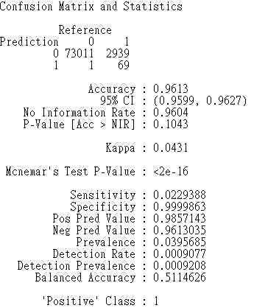
Xgboost model performance

Slide 28
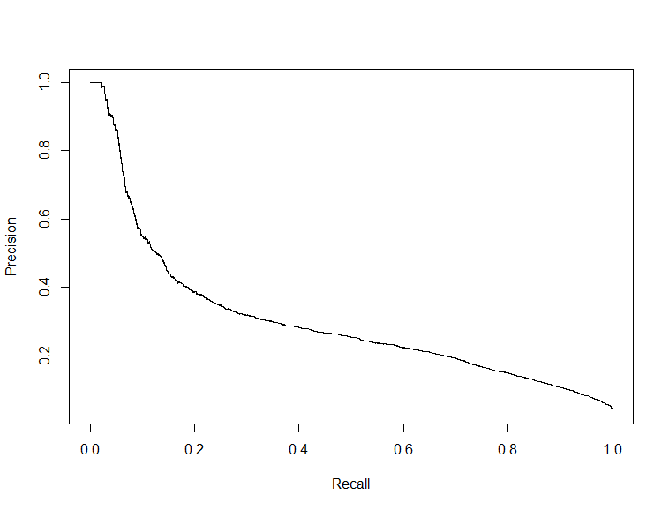
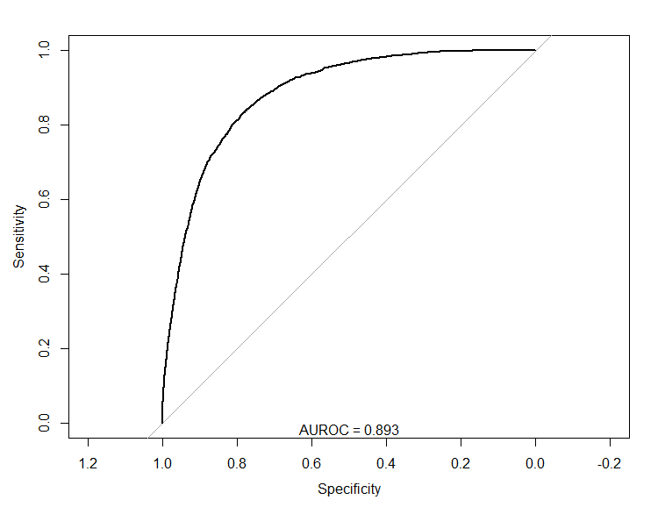
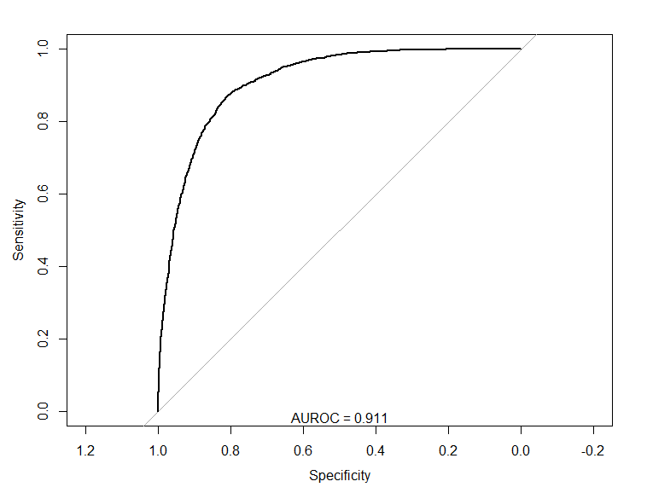
ROC curve
PR curve
AUPRC=0.3014435
AUROC = 0.8847

Slide 29
Undersampling

Slide 30
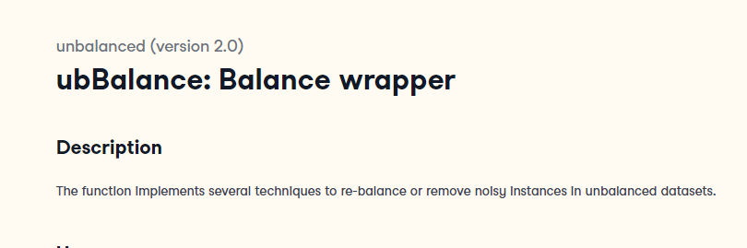

Slide 31
Undersampling
method | ubUnder | 各別生成2筆 1:1 以及 1:4 的資料，以下用data50和data20命名
Percentage | 50 & 20

Slide 32
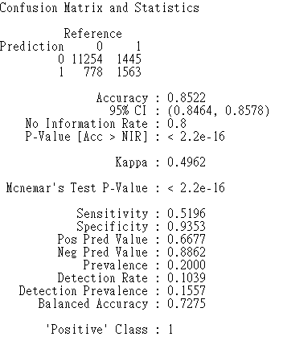
Xgboost Data20 performance
#paras equal to the best model on raw data

Slide 33
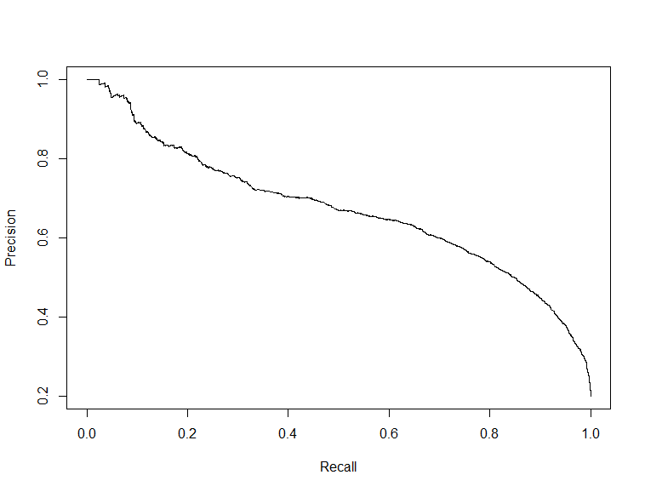

ROC curve
PR curve
AUROC=0.8928
AUPRC=0.6722689

Slide 34
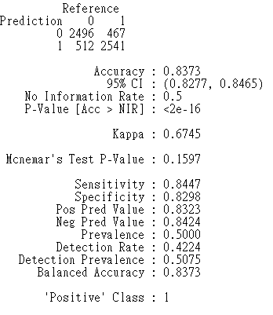
Xgboost Data50 performance
#paras equal to the best model on raw data

Slide 35
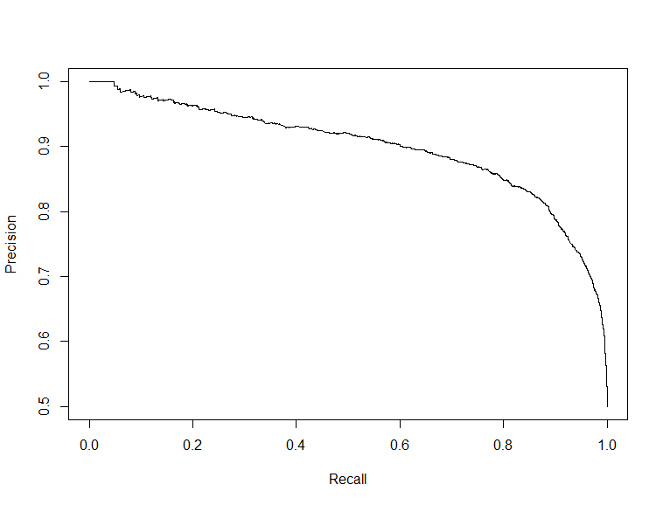
ROC curve
PR curve
AUPRC = 0.9107
AUPRC=0.8993

Slide 36
Xgboost Models Comparism
0.82403
0.83237
0.82403
0.83237
Model | private | public | AUROC | AUPRC | Accuracy
Raw data best model | 0.82657 | 0.83819 | 0.8847 | 0.3014 | 0.9163
1:4 data | 0.82314 | 0.83571 | 0.8928 | 0.6722 | 0.8522
1:1 data | 0.82403 | 0.83237 | 0.9107 | 0.8993 | 0.8373

Slide 37
Reference
https://www.kaggle.com/code/zfturbo/to-the-top-v3
https://www.kaggle.com/code/cast42/exploring-features
https://www.rdocumentation.org/packages/unbalanced/versions/2.0/topics/ubBalance

