Slide 1
Homework 4
Measurement

Slide 2
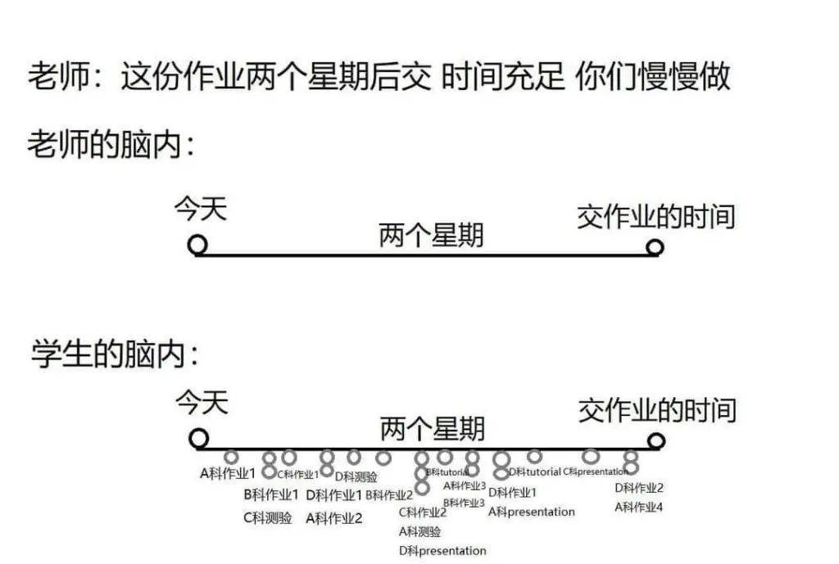

Slide 3
By Basic Properties of Determinant
Basic Property 1: 𝑑𝑒𝑡(𝐼)=1
Basic Property 2: Exchange rows only reverses the sign of det (do not change absolute value)
Basic Property 3: Determinant is “linear” for each row
(1) 行列式對於任一Row都是線性函數
(2) 交換兩Row改變正負號
(3) 兩Row相同則行列式為零
(4) det(I)=1

Slide 4

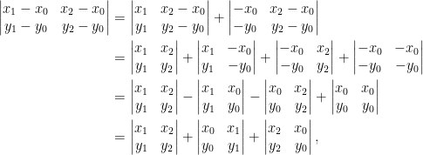

Triangle Area
Given a triangle T: (x0,y0), (x1,y1), (x2,y2)
The area of T is :

Slide 5
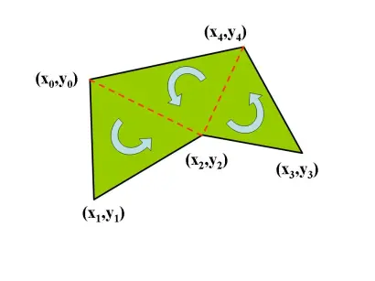
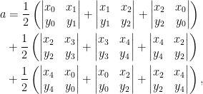
Polygon Area

Slide 6
Polygon Area

Slide 7
Homework 4
Modify the program download from https://drive.google.com/file/d/1zluRYgqSnB6jQphsDR37IOjdJzcich34/view?usp=sharing
Use C# language.

Slide 8
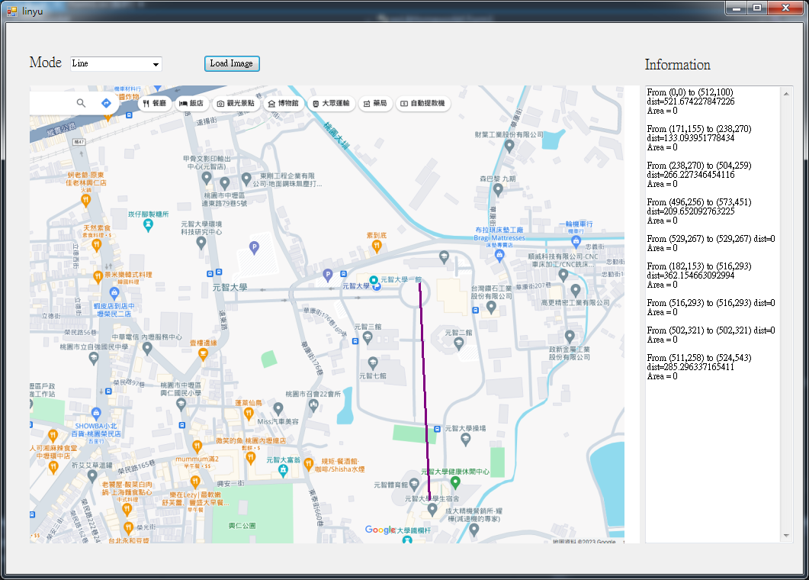

Slide 9
Homework 4
Input: none
Output: Report distance and area of the shape
Basic item
Line
Triangle
Rectangle
Pentagon
Bonus items
Polygon
Ellipse
Beautify the UI or other items worthy of bonus points
Due date: 2023/12/18

