Slide 1
CSS (2)
Abhijit A. M.
abhijit.comp@coep.ac.in
Credits: w3schools.com

Slide 2
Icons, Links, Lists, Tables

Slide 3
Using Icons
The simplest way to add an icon to your HTML page, is with an icon library, such as Font Awesome.
Add the name of the specified icon class to any inline HTML element (like <i> or <span>).

Slide 4

Font Awesome Icon library
<link rel="stylesheet" href="https://cdnjs.cloudflare.com/ajax/libs/font-awesome/4.7.0/css/font-awesome.min.css">
</head>
<body>
<i class="fa fa-cloud"></i>
<i class="fa fa-heart"></i>
<i class="fa fa-car"></i>
<i class="fa fa-file"></i>
<i class="fa fa-bars"></i>

Slide 5
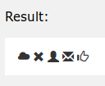
Bootstrap Icon library
<head>
<link rel="stylesheet" href="https://maxcdn.bootstrapcdn.com/bootstrap/3.3.7/css/bootstrap.min.css">
</head>
<body>
<i class="glyphicon glyphicon-cloud"></i>
<i class="glyphicon glyphicon-remove"></i>
<i class="glyphicon glyphicon-user"></i>
<i class="glyphicon glyphicon-envelope"></i>
<i class="glyphicon glyphicon-thumbs-up"></i>
</body>

Slide 6
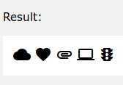
Google Icon library
<head>
<link rel="stylesheet" href="https://fonts.googleapis.com/icon?family=Material+Icons">
</head>
<body>
<i class="material-icons">cloud</i>
<i class="material-icons">favorite</i>
<i class="material-icons">attachment</i>
<i class="material-icons">computer</i>
<i class="material-icons">traffic</i>
</body>

Slide 7

Different link styles
Links can be styled differently depending on what state they are in.
The four links states are:
a:link - a normal, unvisited link
a:visited - a link the user has visited
a:hover - a link when the user mouses over it
a:active - a link the moment it is clicked

Slide 8


Link styling
a:link, a:visited {
background-color: #000666;
color: white;
padding: 14px 25px;
text-align: center;
text-decoration: none;
display: inline-block;
}
a:hover, a:active {
background-color: red;
}

Slide 9
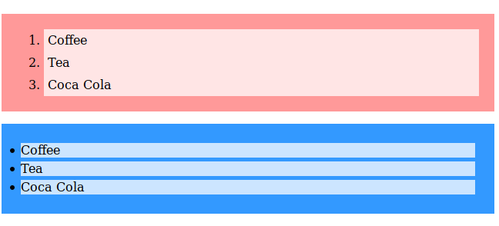
Lists styling
ol {
background: #ff9999;
padding: 20px;
}
ul {
background: #3399ff;
padding: 20px;
}
ol li {
background: #ffe5e5;
padding: 5px;
margin-left: 35px;
}
ul li {
background: #cce5ff;
margin: 5px;
}
<ol> <li>Coffee</li>
<li>Tea</li>
<li>Coca Cola</li> </ol>
<ul> <li>Coffee</li>
<li>Tea</li>
<li>Coca Cola</li> </ul>

Slide 10
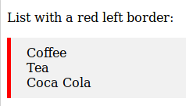
More list styling
ul {
border-left: 5px solid red;
background-color: #f1f1f1;
list-style-type: none;
padding: 10px 20px;
}
<p>List with a red left border:</p>
<ul> <li>Coffee</li>
<li>Tea</li>
<li>Coca Cola</li> </ul>

Slide 11









More list styling
ul.a {list-style-type: circle;}
ul.b {list-style-type: disc;}
ul.c {list-style-type: square;}
ol.d {list-style-type: armenian;}
ol.f {list-style-type: decimal;}
ol.n {list-style-type: lower-alpha;}
ol.s {list-style-type: upper-latin;}
ol.u {list-style-type: none;}
ol.v {list-style-type: inherit;}

Slide 12
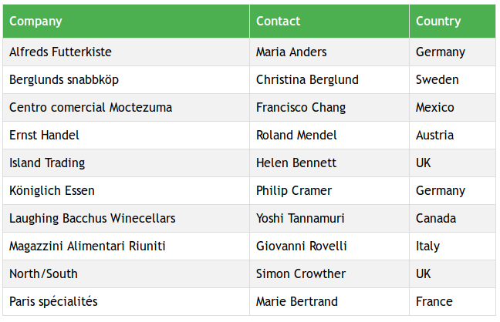
Tables: Observe this table

Slide 13
Tables: Observe this table
Header row formatted differently
Even rows shaded
Borders
  Collapsed, for all cells
Row color to change when mouse hovered

Slide 14
Tables: Observe this table
See table-demo.html
Try resizing the window
Note: table data and styling are totally separated

Slide 15
display

Slide 16
Layout: display
The display property is the most important CSS property for controlling layout.
Every HTML element has a default display value
Default display value for most elements is block or inline.

Slide 17

Block Level and Inline Elements
Block-level Elements
Starts on a new line
Takes up the full width available
Examples:
<div> <h1> - <h6>
<p> <form> <header>
<footer> <section>
Inline Elements
Does not start on a new line
Only takes up as much width as necessary.
Examples
<span>
<a>
<img>

Slide 18
display:none
display: none;
used to hide and show elements without deleting and recreating them.
The <script> element uses display: none; as default.

Slide 19


Overriding default display value
Changing an inline element to a block element, or vice versa
Useful for making the page look a specific way
Example
Making inline <li> elements for horizontal menus:
li {
display: inline;
}
li {
display: block;
}

Slide 20
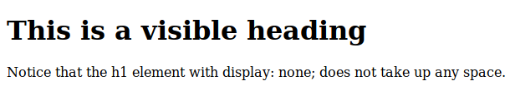
display:hidden or visibility:none
h1.hidden {
display: none;
}
The element will be hidden, and the page will be displayed as if the element is not there:
<h1>This is a visible heading</h1>
<h1 class="hidden">This is a hidden heading</h1>
<p>Notice that the h1 element with display: none; does not take up any space.</p>

Slide 21
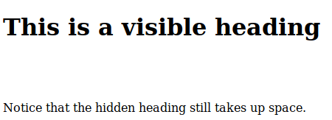
display:hidden or visibility:none
h1.hidden {
visibility: hidden;
}
The element will still take up the same space as before. The element will be hidden, but still affect the layout:
<h1>This is a visible heading</h1>
<h1 class="hidden">This is a hidden heading</h1>
<p>Notice that the hidden heading still takes up space.</p>

Slide 22
display Demos
display-hide-show-demo.html

Slide 23
width, position, overflow, overlap

Slide 24

Using width, max-width and margin: auto;
Setting the width of a block-level element will prevent it from stretching out to the edges of its container.
Try reducing the window size → browser adds scrollbar.
div.ex1 {
width: 500px;
margin: auto;
border: 3px solid #73AD21;
}

Slide 25

Using width, max-width and margin: auto;
max-width will improve the browser's handling of small windows.
Imp for making a site usable on small devices:
Try resizing browser window
See: css-demo/width-and-max-width.html
div.ex2 {
max-width: 500px;
margin: auto;
border: 3px solid #73AD21;
}

Slide 26
CSS Layout - The position Property
The position property specifies the type of positioning method used for an element (static, relative, fixed, absolute or sticky).
There are five different position values:
static
relative
fixed
absolute
sticky
See Demo: positions-fixed-relative-sticky-absolute-static.html
Deciding positions of various elements:
A non-trivial and challenging task
http://127.0.0.1/wst/lectures/css-demo/positions-fixed-relative-sticky-absolute-static.html

Slide 27
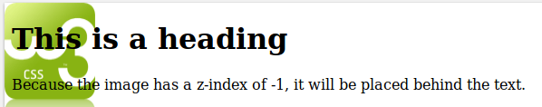
overlapping elements: z-index
img {
position: absolute;
left: 0px;
top: 0px;
z-index: -1;
}
<h1>This is a heading</h1>
<img src="w3css.gif" width="100" height="140">
<p>Because the image has a z-index of -1, it will be placed behind the text.</p>
http://127.0.0.1/wst/lectures/css-demo/image-text-positioning.html

Slide 28
overflow
The overflow property has the following values:
Value | Clipped? | Rendering
visible | No | Outside box
hidden | Yes | Invisible
scroll | Yes | Scrollbar Added
auto | Possibly | Scrollbar if needed

Slide 29
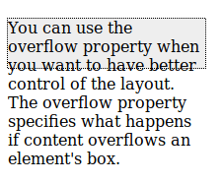
overflow: visible
div {
width: 200px;
height: 50px;
background-color: #eee;
overflow: visible;
border: 1px dotted black;
}

Slide 30

overflow: hidden
div {
width: 200px;
height: 50px;
background-color: #eee;
overflow: hidden;
border: 1px dotted black;
}

Slide 31
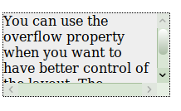
overflow: scroll
div {
width: 200px;
height: 50px;
background-color: #eee;
overflow: scroll;
border: 1px dotted black;
}

Slide 32

overflow: auto
div {
width: 200px;
height: 50px;
background-color: #eee;
overflow: auto;
border: 1px dotted black;
}
Also,
The overflow-x and overflow-y properties specifies whether to change the overflow of content just horizontally or vertically (or both):
overflow-x specifies what to do with the left/right edges of the content.
overflow-y specifies what to do with the top/bottom edges of the content.

Slide 33
float

Slide 34
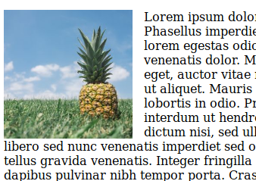
float
Possible values:
left - Element floats to the left of its container
right- Element floats to the right of its container
none - Element does not float (will be displayed just where it occurs in the text). This is default
inherit - Element inherits the float value of its parent
img {
float: left;
}

Slide 35
clear
Specifies what elements can float beside the cleared element and on which side.
Values
none - Allows floating elements on both sides. This is default
left - No floating elements allowed on the left side
right- No floating elements allowed on the right side
both - No floating elements allowed on either the left or the right side
inherit - The element inherits the clear value of its parent
div {
clear: left;
}

Slide 36
clear: example
.div2 {
border: 1px solid red;
}
.div1 {
float: left;
width: 100px;
height: 50px;
margin: 10px;
border: 3px solid #73AD21;
}
.div4 {
border: 1px solid red;
clear: left;
}
.div3 {
float: left;
width: 100px;
height: 50px;
margin: 10px;
border: 3px solid #73AD21;
}
<div class="div1">div1</div>
<div class="div2">div2 - Notice that div2 is after div1 in the HTML code. However, since div1 floats to the left, the text in div2 flows around div1.</div>
<h2>With clear</h2> <div class="div3">div3</div>
<div class="div4">div4 - Here, clear: left; moves div4 down below the floating div3. The value "left" clears elements floated to the left. You can also clear "right" and "both".</div>

Slide 37
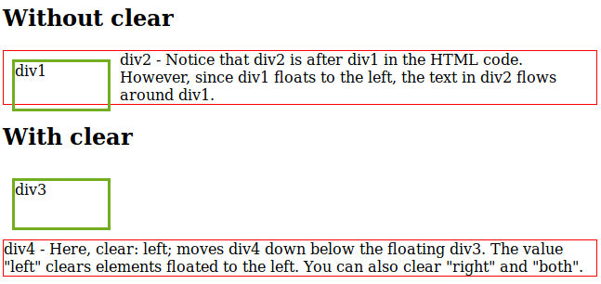
clear: example (illustration)

Slide 38
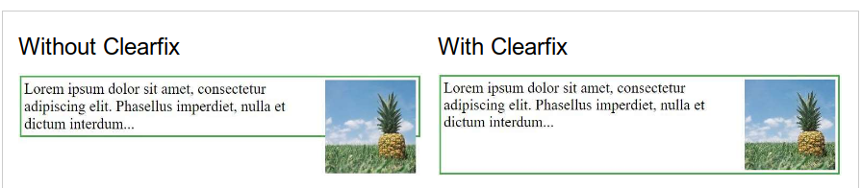
clearfix hack
If an element is taller than the element containing it, and it is floated, it will overflow outside of its container.
.clearfix {
overflow: auto;
}
→ Scrollbars are possible !

Slide 39
better clearfix hack
.clearfix::after {
content: "";
clear: both;
display: table;
}
Works much better, without scrollbars

Slide 40
web layout using ‘float’: HTML
<div class="header">
<h1>Chania</h1>
</div>
<div class="clearfix">
<div class="column menu">
<ul>
<li>The Flight</li>
<li>The City</li>
<li>The Island</li>
<li>The Food</li>
</ul>
</div>
<div class="column content">
<h1>The City</h1>
<p>Chania is the capital of the Chania region on the island of Crete. The city can be divided in two parts, the old town and the modern city.</p>
<p>You will learn more about web layout and responsive web pages in a later chapter.</p>
</div>
</div>
<div class="footer">
<p>Footer Text</p>
</div>

Slide 41
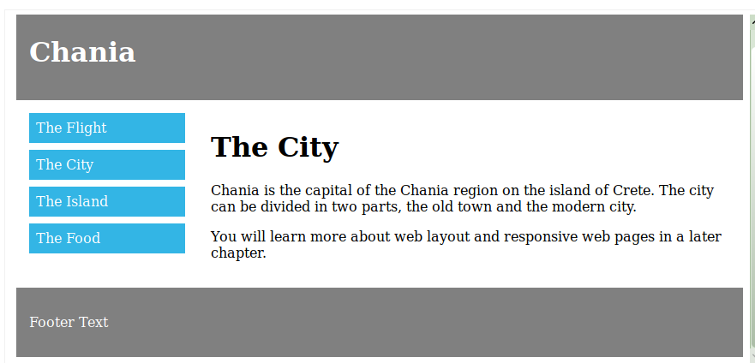
web layout using ‘float’
in HTML, everything is a div
CSS desides the display

Slide 42
web layout using ‘float’
.header, .footer {
background-color: grey;
color: white;
padding: 15px;
}
.column {
float: left;
padding: 15px;
}
.clearfix::after {
content: "";
clear: both;
display: table;
}
.menu {
width: 25%;
}
.content {
width: 75%;
}

Slide 43
web layout using ‘float’
* {
box-sizing: border-box;
}
.header, .footer {
background-color: grey;
color: white;
padding: 15px;
}
.column {
float: left;
padding: 15px;
}
.clearfix::after {
content: "";
clear: both;
display: table;
}
.menu {
width: 25%;
}
.content {
width: 75%;
}
.menu li {
padding: 8px;
margin-bottom: 8px;
background-color: #33b5e5;
color: #ffffff;
}
.menu li:hover {
background-color: #0099cc;
}

Slide 44
Auto resize using float:left
Auto resize of grid of boxes
On changing the browser window size
float: left + clear: left afterwards
See: http://127.0.0.1/wst/lectures/css-demo/resize-float-style.html

Slide 45
Auto resize using display:inline-block
.floating-box {
display: inline-block;
width: 150px;
height: 75px;
margin: 10px;
border: 3px solid #73AD21;
}

Slide 46
align, combinators,

Slide 47

Aligning Elements
To horizontally center a block element (like <div>), use margin: auto;
.center {
margin: auto;
width: 50%;
border: 3px solid green;
padding: 10px;
}
<div class="center">
<p> This one is centered </p>
</div>

Slide 48
center align text
To just center the text inside an element, use text-align: center;
Example
.center {
text-align: center;
border: 3px solid green;
}

Slide 49
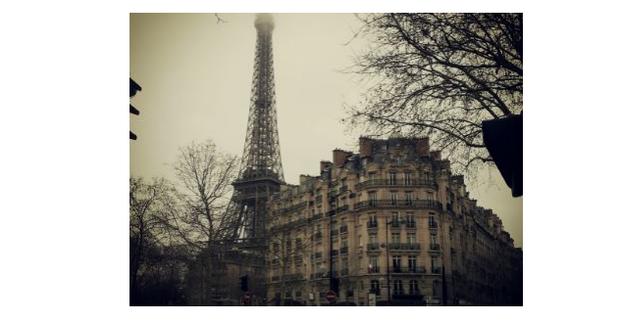
centering image
img {
display: block;
margin-left: auto;
margin-right: auto;
width: 40%;
}
set left and right margin to auto and make it into a block element

Slide 50
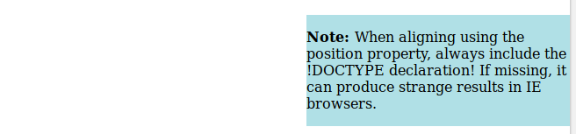
Align using position
body {
margin: 0;
padding: 0;
}
.container {
position: relative;
width: 100%;
}
.right {
position: absolute;
right: 0px;
width: 300px;
background-color: #b0e0e6;
}
Note: Absolute positioned elements are removed from the normal flow, and can overlap elements.
Tip: When aligning elements with position, always define margin and padding for the <body> element. This is to avoid visual differences in different browsers.

Slide 51
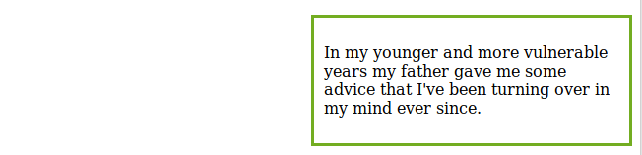
Align using float
.right {
float: right;
width: 300px;
border: 3px solid #73AD21;
padding: 10px;
}
<div class="right">
<p>In my younger and more vulnerable years my father gave me some advice that I've been turning over in my mind ever since.</p>
</div>
Tip: When aligning elements with float, always define margin and padding for the <body> element. This is to avoid visual differences in different browsers.

Slide 52

Align: horizontally and vertically
To center both vertically and horizontally, use padding and text-align: center:
.center {
padding: 70px 0;
border: 3px solid green;
text-align: center;
}

Slide 53
Align: other techniques
.center {
line-height: 200px; /* same as height ! */
height: 200px;
border: 3px solid green;
text-align: center;
}
/* If the text has multiple lines, add the following: */
.center p {
line-height: 1.5;
display: inline-block;
vertical-align: middle;
}
.center {
height: 200px;
position: relative;
border: 3px solid green;
}
.center p {
margin: 0;
position: absolute;
top: 50%;
left: 50%;
transform: translate(-50%, -50%);
}

Slide 54
CSS for “group of elements”

Slide 55
Combinators
descendant selector: The following example selects all <p> elements inside <div> elements:
div p {
background-color: yellow;
}
child selector : The following example selects all <p> elements that are immediate children of a <div> element:
div > p {
background-color: yellow;
}
adjacent sibling selector: The following example selects all <p> elements that are placed immediately after <div> elements:
div + p {
background-color: yellow;
}
general sibling selector: The following example selects all <p> elements that are siblings of <div> elements:
div ~ p {
background-color: yellow;
}

Slide 56
psuedo classes
A pseudo-class is used to define a special state of an element.
The syntax of pseudo-classes:
selector:pseudo-class {
property:value;
}
/* unvisited link */
a:link {
color: #FF0000;
}
Pseudo-classes can be combined with CSS classes:
a.highlight:hover {
color: #ff0000;
}
Hide and show using psuedo classes
p {
display: none;
background-color: yellow;
padding: 20px;
}
div:hover p {
display: block;
}
http://127.0.0.1/wst/lectures/css-demo/psuedo-class-show-hide.html

Slide 57
psuedo classes
In the following example, the selector matches any <p> element that is the first child of any element:
p:first-child {
color: blue;
}
In the following example, the selector matches the first <i> element in all <p> elements:
p i:first-child {
color: blue;
}
In the following example, the selector matches all <i> elements in <p> elements that are the first child of another element:
p:first-child i {
color: blue;
}

Slide 58
psuedo elements
A CSS pseudo-element is used to style specified parts of an element.
The syntax of pseudo-elements:
selector::pseudo-element {
property:value;
}
The following example formats the first line of the text in all <p> elements:
p::first-line {
color: #ff0000;
font-variant: small-caps;
}

Slide 59
psuedo elements
The following example formats the first letter of the text in all <p> elements:
Example
p::first-letter {
color: #ff0000;
font-size: xx-large;
}
Pseudo-elements can be combined with CSS classes:
Example
p.intro::first-letter {
color: #ff0000;
font-size:200%;
}

Slide 60
psuedo elements
The ::before (::after) pseudo-element can be used to insert some content before (after) the content of an element.
The following example inserts an image before the content of each <h1> element:
Example
h1::before {
content: url(smiley.gif);
}
The ::selection pseudo-element matches the portion of an element that is selected by a user.
The following example makes the selected text red on a yellow background:
Example
::selection {
color: red;
background: yellow;
}

Slide 61
opacity, nav bars

Slide 62
opacity
The opacity property specifies the opacity/transparency of an element.
img {
opacity: 0.5;
filter: alpha(opacity=50); /* For IE8 and earlier */
}
img:hover {
opacity: 1.0;
filter: alpha(opacity=100); /* For IE8 and earlier */
}
Wil change the image opacity on hover
https://www.w3schools.com/css/tryit.asp?filename=trycss_image_transparency

Slide 63
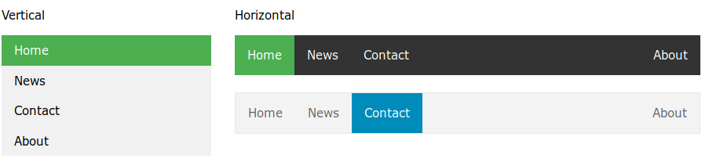
Navigation bars
Can create horizontal/vertical navigation bars using <ul> + CSS
http://127.0.0.1/wst/lectures/css-demo/horizontal-navbar.html
http://127.0.0.1/wst/lectures/css-demo/vertical-navbar.html

Slide 64
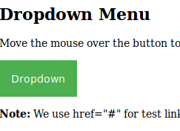
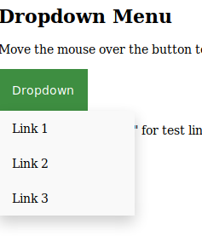
dropdown menu
All text inside divs
Use of
Positions: absolute/relative ; :hover psuedo class; display: block or inline-block or none;
z-index
http://127.0.0.1/wst/lectures/css-demo/dropdown-menu.html

Slide 65
attr selectors
The [attribute] selector is used to select elements with a specified attribute.
The following example selects all <a> elements with a target attribute:
a[target] {
background-color: yellow;
}
selects all <a> elements with a target="_blank" attribute:
a[target="_blank"] {
background-color: yellow;
}
selects all elements with a title attribute that contains a space-separated list of words, one of which is "flower":
[title~="flower"] {
border: 5px solid yellow;
}

Slide 66
attr selectors
selects all elements with a class attribute value that begins with "top" (whole word):
[class|="top"] {
background: yellow;
}
input[type="text"] {
width: 150px;
display: block;
margin-bottom: 10px;
background-color: yellow;
}
// useful in forms
input[type="button"] {
width: 120px;
margin-left: 35px;
display: block;
}

Slide 67
Responsive form with CSS
See the demo
http://127.0.0.1/wst/lectures/css-demo/responsive-form.html

Slide 68
CSS Counters
body {
counter-reset: section;
}
h2::before {
counter-increment: section;
content: "Section " counter(section) ": ";
}
See the demo
http://127.0.0.1/wst/lectures/css-demo/css-counters.html

Slide 69
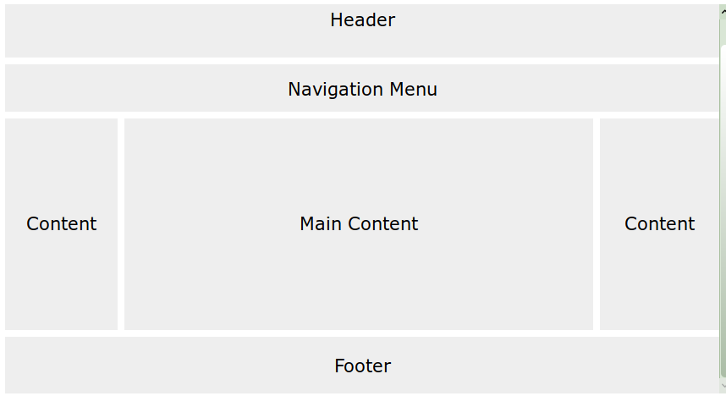
Typical Web layout with CSS

Slide 70
Typical Web layout with CSS
Content
The layout in this section, often depends on the target users. The most common layout is one (or combining them) of the following:
1-column (often used for mobile browsers)
2-column (often used for tablets and laptops)
3-column layout (only used for desktops)
http://127.0.0.1/wst/lectures/css-demo/website-layout.html

Slide 71
position: static
HTML elements are positioned static by default.
Static positioned elements are not affected by the top, bottom, left, and right properties.
An element with position: static; is not positioned in any special way; it is always positioned according to the normal flow of the page:
div.static {
position: static;
border: 3px solid #73AD21;
}

