Slide 1
jQuery
Abhijit A. M.
COEP

Slide 2
About jQuery
John Resig in 2006 developed it.
interaction between Javascript and HTML is emphasized
Simplify work. Do less coding.
Separate behaviour from structure
Separate style from structure
Eliminates cross browser problems

Slide 3
Example Jquery:
document.getElementById(“name”).setAttribute(“value”, value);
$(“#name”).value(value);
Example of jQuery code

Slide 4
jQuery can
select DOM elements
set properties
create/delete/modify DOM elements
define event behaviour(setting handlers)
AJAX
Everything that Javascript does
  but with much shorter code

Slide 5
ready() function
To ensure that their code runs after the browser finishes loading the document, many JavaScript programmers wrap their code in an onload function:
window.onload = function() {
alert( "welcome" );
};
Doesn't run until all images are finished downloading
jQuery solves this problem
$( document ).ready(function() {
// Your code here.
});

Slide 6
ready Function
Chronology of events
  Set up a basic HTML page and add jQuery
  jQuery:Create a “ready” function
  Call a function
5 ways to specify the ready function
  jquery(document).ready(function(){…};);
  jquery().ready(function(){…};)
  jquery(function(){…};)
  jquery(dofunc);
  $(dofunc);

Slide 7
jQuery selectors
$(selector)
selector:
$(‘#id’) id of element
$(‘p’) tag name
$(‘.class’) CSS class
$(‘p.class’) <p> elements having the CSS class
$(‘p:first’) $(‘p:last’) $(‘p:odd’) $(‘p:even’)
$(‘p:eq(2)’) gets the 2nd <p> element (1 based)
$(‘p’)[1] gets the 2nd <p> element (0 based)
$(‘p:nth-child(3)) gets the 3rd <p> element of the parent. n=even, odd too.

Slide 8
jQuery selectors
$(‘p:nth-child(5n+1)’) gets the 1st element after every 5th one
$(‘p a’) <a> elements, descended from a <p>
$(‘p>a’) <a> elements, direct child of a <p>
$(‘p+a’) <a> elements, directly following a <p>
$(‘p, a’) <p> and <a> elements
$(‘li:has(ul)’) <li> elements that have at least one <ul> descendent
$(‘:not(p)’) all elements but <p> elements
$(‘p:hidden’) only <p> elements that are hidden
$(‘p:empty’) <p> elements that have no child elements

Slide 9
jQuery function: each
function(index,element)
A function to run for each matched element.
index - The index position of the selector
element - The current element
  (the "this" selector can also be used)

Slide 10
jQuery functions
.each() iterate over the set
.size() number of elements in set
.end() reverts to the previous set
.get(n) get just the nth element (0 based)
.eq(n) get just the nth element (0 based) also .lt(n) & .gt(n)
.slice(n,m) gets only nth to (m-1)th elements
.not(‘p’) don’t include ‘p’ elements in set
.add(‘p’) add <p> elements to set
.remove() removes all the elements from the page DOM

Slide 11
jQuery functions
.empty() removes the contents of all the elements
.filter(fn/sel) selects elements where the func returns true or sel
.find(selector) selects elements meeting the selector criteria
.parent() returns the parent of each element in set
.children() returns all the children of each element in set
.next() gets next element of each element in set
.prev() gets previous element of each element in set
.siblings() gets all the siblings of the current element

Slide 12
jQuery functions formatting HTML/CSS/text
.css(property, value)
  $(‘p’).css(“background-color”, “blue”);
.html()
  $(“#name”).html(“<p> let’s go and play”);
.val() (form elements)
  $(“#myname).val(“abhijit”);
.text()
.addClass(‘class’)
.removeClass(‘class’)

Slide 13
The jQuery function
jQuery() = $()
  $(document) means jQuery(document)
$(‘selector’) Element selector expression
  $(“p”) selects all paragraphs
$(element) Specify element(s) directly
  $(document) selects the document
$(‘HTML’) HTML creation
$.function() Execute a jQuery function
  $.xyz() calls the xyz() function in jQuery
$.fn.myfunc(){} Create jQuery function
$(function) The “Ready” handler

Slide 14
DOM methods
$(‘#target’).before(‘<p>Inserted before #target</p>’);
$(‘#target’).after(‘<p>This is added after #target</p>’);
$(‘#target’).append(‘<p>Goes inside #target, at end</p>’);
$(‘#target’).wrap(‘<div></div>’);

Slide 15
Event handling
$(‘img’).bind(‘click’,function(event){alert(‘Howdy’;});
$(‘img’).bind(‘click’,imgclick(event));
  Allows unbinding the function
$(‘img’).unbind(‘click’,imgclick());
$(‘img’).unbind(‘click’);
$(‘img’).one(‘click’,imgclick(event));
  Only works once
$(‘img’).click(imgclick);
$(‘img’).toggle(click1, click2);
$(‘img’).hover(mouseover, mouseout);

Slide 16
this : properties
this
this.id
this.tagName
this.attr
this.src
this.classname
this.title
this.alt
this.value (for form elements)

Slide 17
event properties
event.target
  element triggering event
Event.target.id
  id of element triggering event
event.currentTarget
event.type
  type of event triggered
event.data
  second parm in the bind() func
Various mouse coordinate properties
Various keystroke related properties

Slide 18
Event methods
.stopPropagation()
  no bubbling
.preventDefault()
  no <a> link, no <form> submit
.trigger(eventType)
  does not actually trigger the event, but calls the appropriate function specified as the one tied to the eventType
.click(), blur(), focus(), select(), submit()
  With no parameter, invokes the event handlers, like trigger does, for all the elements in the wrapped set

Slide 19
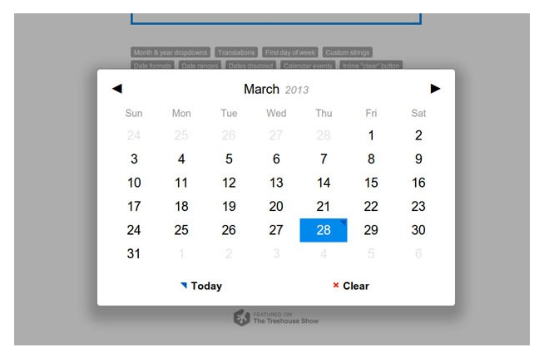
jQuery plugins
pickaDate: date picker

Slide 20
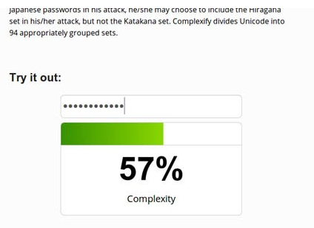
jQuery plugins
Complexity: check password complexity

Slide 21
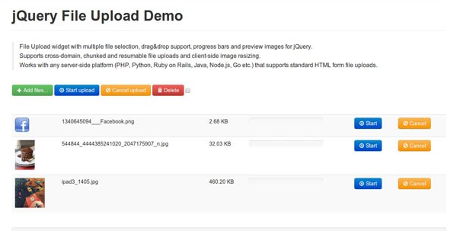
jQuery plugins
file upload

Slide 22
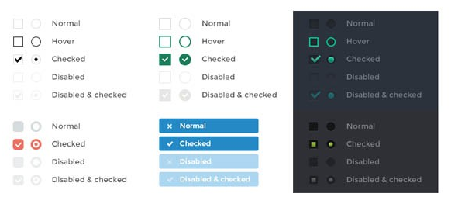
jQuery plugins
icheck: form controls

Slide 23
jQuery plugins

Slide 24
jQuery plugins

Slide 25
jQuery plugins

Slide 26
jQuery plugins

Slide 27
jQuery plugins

Slide 28
jQuery plugins

