Slide 1
Moodle and
Moodle Development
Abhijit A M
abhijit13@gmail.com

Slide 2
Purpose
Introduce key concepts for understanding moodle code as a developer

Slide 3
Key Features
The way the application is divided into plugins;
The permission system, which controls which users can perform which actions in different parts of the system;
The way output is generated, so that different themes (skins) can be used to give different appearances, and so that the interface can be localised.
The database abstraction layer.
Notes:
Credit: http://www.aosabook.org/en/moodle.html

Slide 4
URLs
http://127.0.0.1/moodle/admin/roles/define.php?action=view&roleid=5
http://moodle.coep.org.in/moodle/course/view.php?id=342#section-5
Look at the URL and start reading code there.
URLs are permanent.
The URLs do not change if the course is renamed, or if a moderator moves a discussion to a different forum

Slide 5
User
Using a web browser
HTTP
Moodle
Three tier architecture
Not strongly enforced
UI
PHP function calls
Libraries
PHP function calls
DB libs
File libs
SQL
DB
Files
moodledata

Slide 6
Core UI Libs (formslib, commenting, YUI, …)
Forum UI
Quiz UI
…
Core UI
roles, categories,
courses, users, …
Plugins
Moodle core
Core libraries (for handling roles, categories, courses, users, …)
Plugins implement specific functionality.
They slice through all three layers.
They use the facilities provided by Moodle core.
Forum lib
Quiz lib
…
DB libs
File libs
Core data
Forum
data
Quiz
data

Slide 7
Plugins
Easier for people to customise Moodle
Moodle has a relatively fat core
Activity module plugin would be very different from a new Authentication plugin or a new Question type
To see list of plugins:
define('CLI_SCRIPT', true);
print_object(get_plugin_types());

Slide 8
Types of plugin
Moodle has many different types of plugin, each designed for a specific purpose.
Activity modules
Admin reports
Assignment types
Authentication plugins
Blocks
Content editors
Course formats
Course reports
Course importers
Database fields
Database presets
Enrolment plugins
Filters
Gradebook report
Gradebook export
Gradebook import
Message senders
Mnet services
Plagiarism detection plugins
Portfolio plugins
Question types
Question import/export formats
Quiz reports
Repository plugins
Resource types
Search engine adapters
Themes
User profile fields
Web services
Workshop allocators
Workshop forms
Workshop evaluators

Slide 9
List of Plugins
[availability] => /var/www/html/moodle/availability/condition
[qtype] => /var/www/html/moodle/question/type
[mod] => /var/www/html/moodle/mod
[auth] => /var/www/html/moodle/auth
[calendartype] => /var/www/html/moodle/calendar/type
[enrol] => /var/www/html/moodle/enrol
[message] => /var/www/html/moodle/message/output
[block] => /var/www/html/moodle/blocks
[filter] => /var/www/html/moodle/filter
[editor] => /var/www/html/moodle/lib/editor
[format] => /var/www/html/moodle/course/format
[profilefield] => /var/www/html/moodle/user/profile/field
[report] => /var/www/html/moodle/report
[coursereport] => /var/www/html/moodle/course/report
[gradeexport] => /var/www/html/moodle/grade/export
[gradeimport] => /var/www/html/moodle/grade/import
[gradereport] => /var/www/html/moodle/grade/report
[gradingform] => /var/www/html/moodle/grade/grading/form
[mnetservice] => /var/www/html/moodle/mnet/service
[webservice] => /var/www/html/moodle/webservice
[repository] => /var/www/html/moodle/repository
[portfolio] => /var/www/html/moodle/portfolio
[qbehaviour] => /var/www/html/moodle/question/behaviour
[qformat] => /var/www/html/moodle/question/format
[plagiarism] => /var/www/html/moodle/plagiarism
[tool] => /var/www/html/moodle/admin/tool
[cachestore] => /var/www/html/moodle/cache/stores
[cachelock] => /var/www/html/moodle/cache/locks
[theme] => /var/www/html/moodle/theme
[assignsubmission] => /var/www/html/moodle/mod/assign/submission
[assignfeedback] => /var/www/html/moodle/mod/assign/feedback
[assignment] => /var/www/html/moodle/mod/assignment/type
[booktool] => /var/www/html/moodle/mod/book/tool
[datafield] => /var/www/html/moodle/mod/data/field
[datapreset] => /var/www/html/moodle/mod/data/preset
[ltisource] => /var/www/html/moodle/mod/lti/source
[ltiservice] => /var/www/html/moodle/mod/lti/service
[quiz] => /var/www/html/moodle/mod/quiz/report
[quizaccess] => /var/www/html/moodle/mod/quiz/accessrule
[scormreport] => /var/www/html/moodle/mod/scorm/report
[workshopform] => /var/www/html/moodle/mod/workshop/form
[workshopallocation] => /var/www/html/moodle/mod/workshop/allocation
[workshopeval] => /var/www/html/moodle/mod/workshop/eval
[atto] => /var/www/html/moodle/lib/editor/atto/plugins
[tinymce] => /var/www/html/moodle/lib/editor/tinymce/plugins
[logstore] => /var/www/html/moodle/admin/tool/log/store
[local] => /var/www/html/moodle/local

Slide 10
Plugins and file names
Plugin type | Plugin name | Frankenstyle | Folder
mod (Activity module) | forum | mod_forum | mod/forum
mod (Activity module) | quiz | mod_quiz | mod/quiz
block (Side-block) | navigation | block_navigation | blocks/navigation
qtype (Question type) | shortanswer | qtype_shortanswer | question/type/shortanswer
quiz (Quiz report) | statistics | quiz_statistics | mod/quiz/report/statistics

Slide 11
Key Terms to be Understood
User
Context
Role
Capability

Slide 12
Context
Roughly, Context = Place
  System, User, Category, Course, Activity Module, Block, Forums, Quizzes, Assignments, etc.
A context is a space in Moodle where roles can be assigned.
  For example, a Moodle site is one context and that contains a number of other contexts within it.
  A category is a context, within a site context, that contains courses and sub-categories that have a context of their own.
  A course may hold, within its own context, an activity, or a Question bank's question category, which are also contexts.
  A context might contain other contexts and Roles can be assigned to each context.

Slide 13
Context
Contexts have hierarchy
  System includes all
  Course includes Assignment
Each page that you visit can be said to have one of these contexts
  If you are on assignment page, you are in assignment context and also course context
A student in the context of Course A, will initially be considered a student in a Quiz context that is located in Course A.

Slide 14
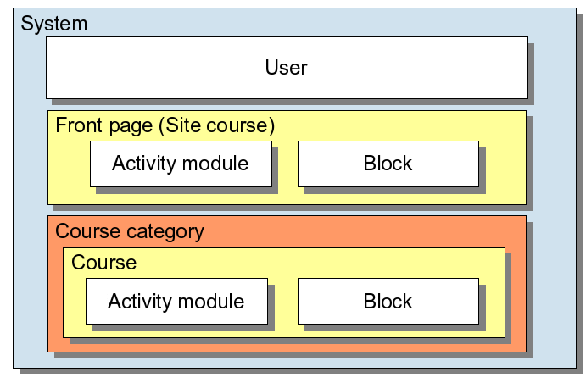
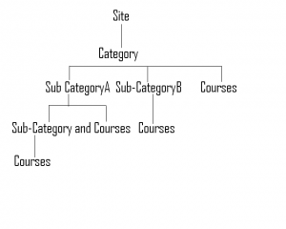
Context

Slide 15
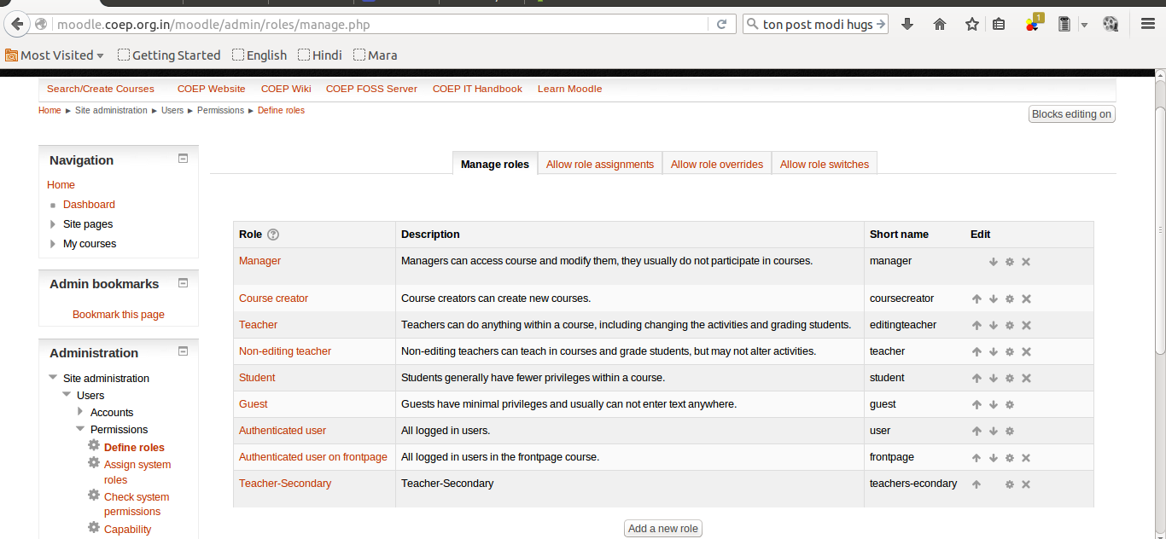
Roles
http://moodle.coep.org.in/moodle/admin/roles/manage.php

Slide 16
Roles
A role is really just a named set of permissions
Within a particular course, you may be a Student and in another course you may be a teacher. (same user, different roles)
After login you will have the "Authenticated user" role in the System context: This role will apply everywhere. You will have permissions of an ‘authenticated user’ on each page.

Slide 17
Capability
Each bit of functionality that a user may or may not have is called a capability.
db/access.php
<?php
$capabilities = array('local/greet:begreeted' => array(
'captype' => 'read',
'contextlevel' => CONTEXT_SYSTEM,
'archetypes' => array('guest' => CAP_ALLOW, 'user' => CAP_ALLOW)
));

Slide 18
Permissions
A role defines a permission for each capability
  For example the Teacher role will probably ALLOW moodle/course:manage, but the Student role will not. However, both Student and Teacher will allow mod/forum:startdiscussion.
The roles are normally defined globally, but they can be re-defined in each context
  For example, one particular wiki can be made read-only to students by overriding the permission for the mod/wiki:edit capability for the Student role in that wiki (Module) context, to PREVENT.
http://www.aosabook.org/en/moodle.html

Slide 19
Permissions
There are four Permissions:
  NOT SET/INHERIT (default)
  ALLOW
  PREVENT
  PROHIBIT
In a given context, a role will have one of these four permissions for each capability. One difference between PROHIBIT and PREVENT is that a PROHIBIT cannot be overridden in sub-contexts.
http://www.aosabook.org/en/moodle.html

Slide 20
Context
(Site OU VLE)
Role
(Logged-in)
Paul is logged in to the VLE
Just being logged-in does not let you attempt quizzes
Context
(Category OUBS)
Paul is a student in PM100
Capability
(Attempt quiz)
✓
Context
(Course PM100)
Role
(Student)
User
(Paul)
So: Paul can do this quiz
Context
(Activity Quiz 1)
Being a Student does let you attempt quizzes
Is Paul allowed to attempt Quiz 1?
http://www.slideshare.net/tjh1000/a-basic-introduciton-to-the-moodle-architecture-5442122?from_action=save

Slide 21
config.php
<?php // Moodle configuration file
unset($CFG);
global $CFG;
$CFG = new stdClass();
$CFG->dbtype = 'mysqli';
$CFG->dblibrary = 'native';
$CFG->dbhost = 'localhost';
$CFG->dbname = 'moodle';
$CFG->dbuser = 'root';
$CFG->dbpass = 'root';
$CFG->prefix = 'mdl_';
$CFG->dboptions = array (
'dbpersist' => 0,
'dbport' => '',
'dbsocket' => '',
);
$CFG->wwwroot = 'http://127.0.0.1/moodle';
$CFG->dataroot = '/var/www/moodledata';
$CFG->admin = 'admin';
$CFG->directorypermissions = 0777;
require_once(dirname(__FILE__) . '/lib/setup.php');

Slide 22
Agile Development

Slide 23
Set of software development methods in which requirements and solutions evolve through collaboration between self-organizing, cross-functional teams
https://en.wikipedia.org/wiki/Agile_software_development

Slide 24
Agile Manifesto,
came out of the DSDM Consortium in 1994, although its roots go back to the mid 1980s at DuPont and works by James Martin[4] and James Kerr et al.
value Individuals and interactions over Processes and tools, Working software over Comprehensive documentation, Customer collaboration over Contract negotiation, and Responding to change over Following a plan.

Slide 25
Agile Development
Individuals and interactions: self-organization and motivation are important, as are interactions like co-location and pair programming.
Working software: working software is more useful and welcome than just presenting documents to clients in meetings.
Customer collaboration: requirements cannot be fully collected at the beginning of the software development cycle, therefore continuous customer or stakeholder involvement is very important.
Responding to change: agile methods are focused on quick responses to change and continuous development.

Slide 26
10 Principles of Agile
Customer satisfaction by early and continuous delivery of valuable software
Welcome changing requirements, even in late development
Working software is delivered frequently (weeks rather than months)
Close, daily cooperation between business people and developers
Projects are built around motivated individuals, who should be trusted
Face-to-face conversation is the best form of communication (co-location)
Working software is the principal measure of progress
Sustainable development, able to maintain a constant pace
Continuous attention to technical excellence and good design
Simplicity—the art of maximizing the amount of work not done—is essential

Slide 27
Scrum – An Agile Methodology
Used by Moodle Hq

Slide 28
Scrum
a flexible, holistic product development strategy where a development team works as a unit to reach a common goal
https://en.wikipedia.org/wiki/Scrum_%28software_development%29

Slide 29
Scrum
enables teams to self-organize by encouraging physical co-location or close online collaboration of all team members, as well as daily face-to-face communication among all team members and disciplines in the project.

Slide 30
Scrum
empirical approach—accepting that the problem cannot be fully understood or defined, focusing instead on maximizing the team's ability to deliver quickly, to respond to emerging requirements and to adapt to evolving technologies and changes in market conditions

Slide 31
Scrum – 3 Roles
Product owner
  represents the stakeholders and is the voice of the customer
  Main job is communication as the customer
Development team
  3 to 9. Actual work.
  Delivers at end of each Scrum cycle
Scrum Master
  Not a traditional team lead but a facilitator or servent-leader
  Helping, coaching, promoting self-organization, educating scrum principles

Slide 32

Scrum Framework
https://en.wikipedia.org/wiki/File:Scrum_Framework.png

Slide 33
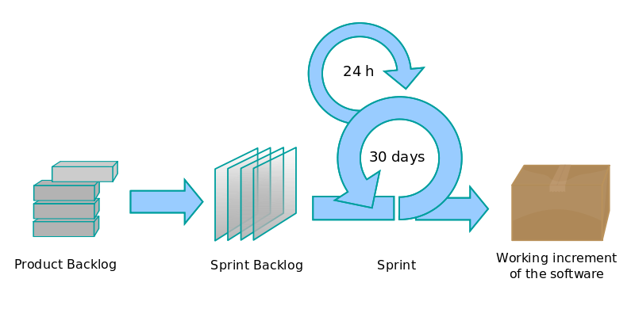
Scrum Process
https://en.wikipedia.org/wiki/File:Scrum_process.svg

Slide 34
Scrum: Review and retrospective
sprint review – work done and not done, presenting to stakeholders (2 hours for 2 week sprint)
Retrospective – reflection on past sprint, further actions

Slide 35
Scrum of Scrums
technique to scale scrum up for multiple teams working on the same product, allowing teams to discuss progress on their interdependencies, focusing on how to coordinate delivering software
https://en.wikipedia.org/wiki/Scrum_%28software_development%29

Slide 36
Terminology
Sprint burn-down chart
Daily progress for a sprint over the sprint's length.
Release burn-down chart
Feature level progress of completed product backlog items in the product backlog.
Product backlog (PBL) list
A prioritized list of high-level requirements.
Sprint backlog (SBL) list
A prioritized list of tasks to complete during the sprint.

Slide 37
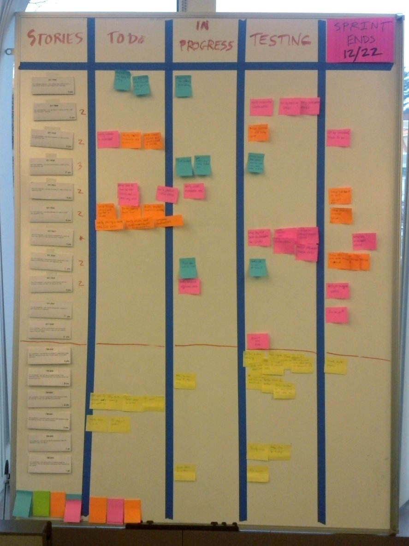
Scrum
Task
Board
https://upload.wikimedia.org/wikipedia/commons/1/1b/Scrum_task_board.jpg

Slide 38
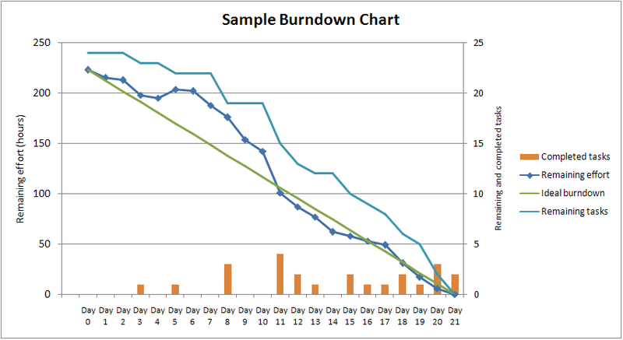

Slide 44
Acknowledgements:

