Slide 1
Brief introduction to web technologies

Slide 2
PHP: “PHP: Hypertext Preprocessor”
PHP files can contain text, HTML, CSS, JavaScript, and PHP code
PHP code are executed on the server, and the result is returned to the browser as plain HTML

Slide 3
PHP Can
generate dynamic page content
create, open, read, write, delete, and close files on the server
collect form data
send and receive cookies
add, delete, modify data in your database
be used to control user-access
encrypt data
Output images, PDF files, and even Flash movies.
Output any text, such as XHTML and XML.

Slide 4
PHP: Features
Data types: string, integer, float, boolean, array, object, NULL, resource
If-else, switch, for, while
Classes and objects; Functions , Arrays
File handling on server
Cookies, Sesisons, Exception handling
Globals: $_POST, $_COOKIE, etc.
  Get information sent by browser, server specific info

Slide 5
Document Object Model (DOM)

Slide 6
DOM
Browser creates the model
Javascript can interact with browser to
  Read
  Delete
  Add
  Modify
Entire page can be created in javascript

Slide 7
Javascript
Interpreted language
Runs in browser
Javascript code is sent by web server to the browser
  Normally along with the HTML code

Slide 8
Javascript
JavaScript Can Change HTML Content
  document.getElementById("demo").innerHTML = "Hello JavaScript";
JavaScript Can Change HTML Attributes
  document.getElementById('myImage').src='pic_bulboff.gif'
JavaScript Can Change HTML Styles (CSS)
  document.getElementById("demo").style.fontSize = "35px";

Slide 9
Javascript
JavaScript Can Hide HTML Elements
  document.getElementById("demo").style.display = "none";
JavaScript Can Show HTML Elements
  document.getElementById("demo").style.display = "block";

Slide 10
Javascript
JavaScript can "display" data in different ways:
  Writing into an HTML element, using innerHTML.
  Writing into the HTML output using document.write().
  Writing into an alert box, using window.alert().
  Writing into the browser console, using console.log().

Slide 11
Javascript + DOM
With the Document object model, JavaScript gets all the power it needs to create dynamic HTML:
  JavaScript can change all the HTML elements in the page
  JavaScript can change all the HTML attributes in the page
  JavaScript can change all the CSS styles in the page
  JavaScript can remove existing HTML elements and attributes
  JavaScript can add new HTML elements and attributes
  JavaScript can react to all existing HTML events in the page
  JavaScript can create new HTML events in the page

Slide 12
Javascript: Features
Arrays, Strings, Numbers, Objects
Dynamically Typed
Switch, if-else, while, for
Functions
No ‘class’

Slide 13
Events, Event driven code
HTML events are "things" that happen to HTML elements.
  JavaScript can "react" on these events.
Here are some examples of HTML events:
  An HTML web page has finished loading
  An HTML input field was changed
  An HTML button was clicked

Slide 14
Events, Event driven code
<button onclick="document.getElementById('demo').innerHTML = Date()">The time is?</button>
<button onclick="alert(‘hi’)">The hi button</button>

Slide 15
JSON
JSON: JavaScript Object Notation.
Sending Data
  If you have data stored in a JavaScript object, you can convert the object into JSON, and send it to a server:
  Example
    var myObj = { "name":"John", "age":31, "city":"New York" };
    var myJSON = JSON.stringify(myObj);
    window.location = "demo_json.php?x=" + myJSON;

Slide 16
JSON
Receiving Data
If you receive data in JSON format, you can convert it into a JavaScript object:
Example
  var myJSON = '{ "name":"John", "age":31, "city":"New York" }';
  var myObj = JSON.parse(myJSON);
  document.getElementById("demo").innerHTML = myObj.name;

Slide 17
JSON + PHP
<?php
$myObj->name = "John";
$myObj->age = 30;
$myObj->city = "New York";
$myJSON = json_encode($myObj);
echo $myJSON;
?>

Slide 18
AJAX
Asynchronous Javascript And XML
Read data from a web server - after the page has loaded
Update a web page without reloading the page
Send data to a web server - in the background

Slide 19
AJAX
AJAX just uses a combination of:
  A browser built-in XMLHttpRequest object (to request data from a web server)
  JavaScript and HTML DOM (to display or use the data)

Slide 20
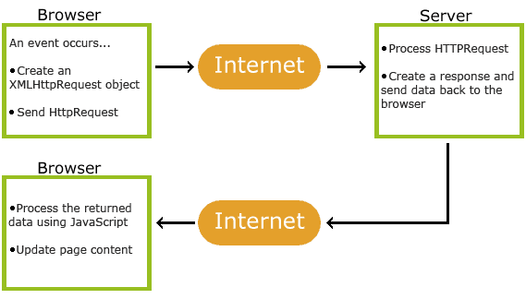
How Ajax Works

