Slide 1
The timetable problem and Taasika Software
Abhijit A. M.
College of Engineering Pune (COEP)
abhijit.comp@coep.ac.in

Slide 2
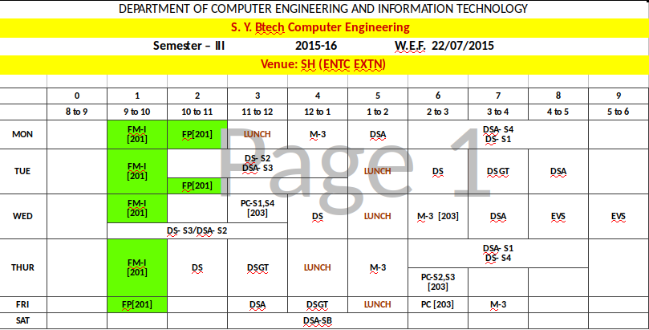
Timetable for a class
Day Time Venue Subject Teacher?

Slide 3
What is a timetable?
A collection of day + slot wise schedules
Schedule: Teacher + Subject + Group of Students + Venue at a given day + slot
Group of Students
  Class
  Batch (Subset of Class)

Slide 4
What is a timetable?
Many views of the same timetable
Suppose: Lecture of DSA for SY Comp. Engg. On Monday at 11 AM in room AC-203, by Abhijit
  Has to be reflected in
    SYCE’s timetable
    Abhijit’s own timetable
    Room AC-203’s timetable
  Monday 11-AM on all of them
  No clashes

Slide 5
Timetable for a class

Slide 6
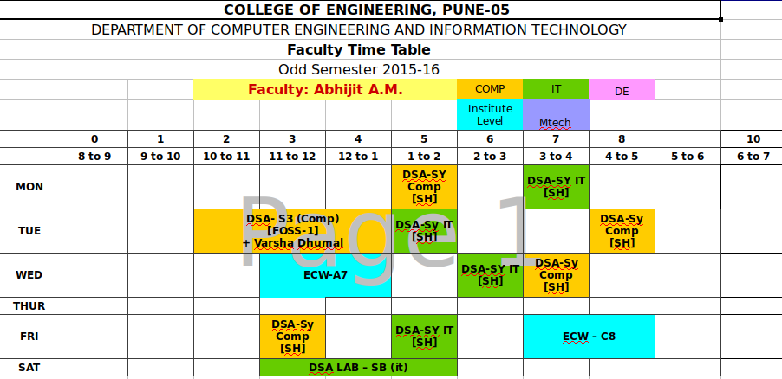
Teacher’s timetable

Slide 7
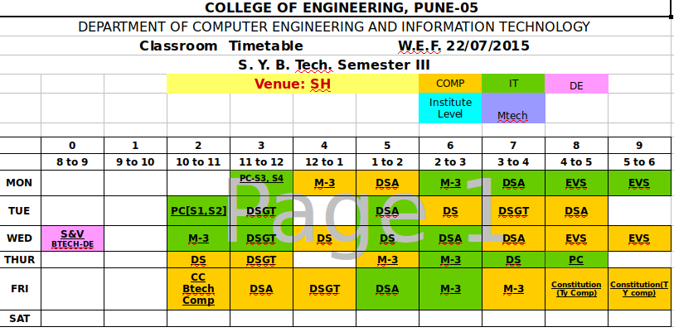
Room’s timetable

Slide 8
The trouble with the spreadsheet approach
Each entry to be made thrice
  Mistakes can happen
Need to manually count no. of entries per subject
  Takes hours
Moving of entries is quite dangerous
  Mistakes are likely to happen
Overall it takes 6-8 hours to just cross check all entries are correct

Slide 9
Specification of the problem

Slide 10
Specification of the problem
Configuration
Higher level configuration
  No. of days : 5 or 6
  No. of slots per day : 8, 9, 10, etc.
  Day starts at (8AM, 7 AM, 9 AM, etc.)
    This is used in labeling the slots e.g. 8AM
  Each slot duration: 1 hour, 50 minutes, etc.
    This is used in labeling the slots, e.g. 8AM-9AM

Slide 11
Specification of the problem
Configuration for ONE dept: Primary Data
List of teachers
  Min and Max load per teacher
    E.g. Abhijit has load of 16 to 24 hours
List of classes
  SYCE, TYIT, etc.
List of Batches per class
  SYCE-S1, SYCE-S2, etc. for SYCE
List of Rooms + their capacity
  E.g. AC-202, 100 capacity
List of subjects
  No. of slots per entry (1 hour, 2 hour, etc.)
    E.g. DSA, 3 Entries of 1 hour each
  No. of entries in a week
  Whether subject is taught to a class or a batch
    Labs, Electives are offered to batches

Slide 12
Specification of the problem: Configuration
Required “schedules” list; Mappings
Subjects → Class → Teacher Mapping
  Abhijit teachers DSA to SYCE
  This means there will be 3 entries of 1 hours each on SYCE timetable, and also Abhijit’s timetable
Subject → Batch → Teacher Mapping
  The subjects taught in batches can have different teachers per batch
    S1 lab handled by Abhijit, S2 by Vibhvari
  Each mapping to be specified separately

Slide 13
Specification of the problem: Configuration: Overlaps
Overlapping batches information
  S1, S2, S3, S4 can overlap with each other
Additional complication: Cross-class batches to be combined
  Electives are taught in batches, but same elective offered to TYCE and TYIT (e.g. this course!)
  Same entry in TYCE and TYIT timetable !
  “Must Overlap” batches

Slide 14
Output
A timetable with all the required schedules in place
PDF format timetable
  Teacherwise, roomwise, classwise Must
  Batch wise, subjectwise is also desired
XLS format timetable
Other formats also desired

Slide 15
Hard Constraints
Requirements from a timetable solution
No clashes: On a given day + slot
  One teacher in only one place
  One student in only one place
    As a part of class or batch
    If batch is scheduled, then class can’t be and vice-versa
  One room engaging in only one activity
Break for a all students during specified lunch hours
Some fixed slots (e.g. institute level fixed slots, ILOE)

Slide 16
Hard Constraints/Checks
Requirements from a timetable solution
Various timetables should have no discrepancy
  Teacherwise, classwise, roomwise must be in sync
Room capacity should be checked with class/batch capacity

Slide 17
Soft Constraints
Requirements from a timetable solution
Not more than one break for students
  Sometimes may want more than one break
Teachers requirements
  should get a break after 2/3 hours
  Fit the schedule per day in 7 or 8 hours
  Lunch break
No 2 lectures of the same subject on same day
  Sometimes need to have 2 continuous!

Slide 18
Soft Constraints
Requirements from a timetable solution
Teacher’s min/max workload hours should be checked
  Warnings may be issued
Spread of timetable for a class should be minimum per day
  3 hours on Monday and 9 on Tuesday to be avoided
  Sometimes this is desired, sometimes undesired
Teachers to get a day free

Slide 19
Checks to be done
Requirements from a timetable solution
All required entries done or not
  3 lectures for DSA → 2 or 4 will not do

Slide 20
Class and Batches
Simple Scenario
A class divided into
4 batches: S1, S2, S3, S4
  A partition
When class is running, none of the batches can be busy
When one batch is busy, another batch can be busy in something else
  But class can’t be busy now
S1
S2
S3
S4

Slide 21
Class and Batches
Realistic scenario
A class divided into
1) 4 batches: S1, S2, S3, S4
  A partition
2) Another set of 3 batches: B1, B2, B2
  A partition
2) S_{j} can overlap B_{k}
S1
B1
S2
B2
S3
S4
B3

Slide 22
Class and Batches
Realistic scenario
In the schedule
  S_{i} can overlap with S_{j} in any day + slot provided
    Teacher and room are different
  B_{x} can overlap with B_{y}
  S_{n} can’t overlap with B_{m}
S1
B1
S2
B2
S3
S4
B3

Slide 23
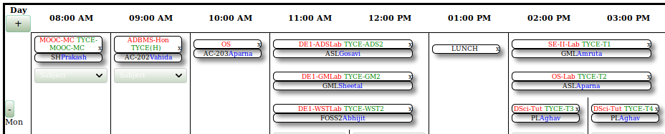
Class and Batches
Realistic scenario
In this timetable
  TYCE-T1, TYCE-T2, TYCE-T3, TYCE-T4 is one set of overlapping batches
  TYCE-ADS2, TYCE-GM2, TYCE-WST2 is another set off overlapping batches
    Typically elective courses in CE/IT Dept at COEP

Slide 24
Further Requirements
Save current timetable
  Current instance of the timetable
  All schedules + configuration data
Revert back to a snapshot, work on it
Save as a new snapshot

Slide 25
The Taasika Software

Slide 26
Taasika Approach
Semi automated timetable software
Schedule entry on class/teacher/room automatically makes other entries
  Basically the database stored only one entry, different views are shown
Does not allow hard constraint violation
  Wrong approach: Allow violation and then show error
  An entry can’t be made in a slot if teacher/students/room is busy

Slide 27
Using Taasika
Install
  Automated, web based; Create default config during installation
Add teachers, rooms, subjects, classes, batches, Mappings
Start making timetable, keep making entries
  Save snapshots as desired, add more configuration data if needed
Export timetable any point in time

Slide 28
3 Tier architecture of Web Applications

Slide 29
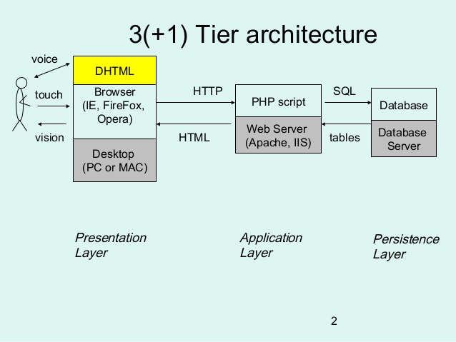
3 Tier architecture of web applications

Slide 30
Key concepts of 3 tier architecture
Database stores all ‘data’
The PHP scripts
  Read data from database
  Emit HTML, Javascript
  Send to browser
Browser runs HTML + javascript
  Can send a request back to webserver
Demo

Slide 31
Possibilities
Persistence Layer: Database
  Can be anything: mysql, postgres, etc.
Application layer
  Can be Apache/Tomcat/Nginx, etc. +
  PHP, Python, Perl, Java, etc.
Presentation Layer
  Can be any browser

Slide 32
Taasika Architecture
Typical 3 tier architecture

Slide 33
Key concept
For every schedule
  Day + slot + teacher + class/batch + room + subject
Make only one database entry
Show different views of the same database
  Classwise/batchwise/teacherwise/roomwise
  Subjectwise?

Slide 34
Some considerations
Design made considering some possible needs of other departments as well
Some parts of the design are not ‘implemented’ yet
  They exist only conceptually

Slide 35
Taasika Database Design

Slide 36
Dept, Config and Snapshot
Dept
Config
Config
Snapshot
Snapshot

Slide 37
Dept, Config, Snapshot
Dept: Name, shortName
Configuration:
  No. of slots
  Day starts at
  Each Slot duration
Snapshot
  Name
  Which config?

Slide 38
User
Fields
  Id
  Password
Unused as of now
Future extension of Taasika
  Logins, different views to different people

Slide 39
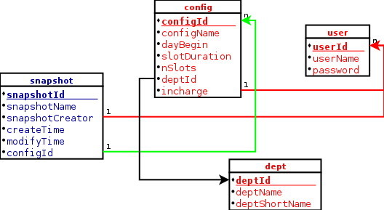
User, dept, config, snapshot

Slide 40
Inside a snapshot
List of teachers, classes, rooms, subjects, batches
Mappings
  Subject-Class-Teacher
  Subject-Batch-Teacher
Overlaps information
  Batches may/must overlap

Slide 41
Teachers, Classes, Batches
Teacher
  Name
  Short Name
  Min Hrs
  Max Hrs
Class
  Name
  Short Name
  Strength
    Needed to be checked against the room
Batch
  Name
  Strength

Slide 42
Subjects, Room
Room
  Name
  Short Name
  Strength
    To be compared against batch/class strength
Subject
  Name
  Short Name
  No. of slots + Length of each slot
  Whether offered to batch or class
    No distinction between theory/lab
    Typically lab and electives are taught to ‘batches’

Slide 43
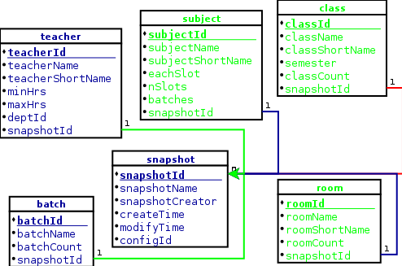
Class, batch, subject, room, teacher

Slide 44
Batch-Class Relation
Batch and Class two different tables
  Batch can exist independently of class
  Not useful for CE/IT dept
  Still designed like this for possible future uses
Batch-Class table
  batchID + classId
  Batch belongs to which class

Slide 45
Overlapping Batches
Practically we have a set of batches which can overlap
  E.g. S1, S2, S3, S4 can overlap
How to specify in a tabular form?
  One way: Pairs of overlapping batches
    S1, S2 S1, S3 S1, S4
    This much should be sufficient, but after entering S3’s entry, how to find the info that S4 and S2 can overlap with it?
  Actual entries: all possible pairs
    S1, S2 S1, S3 S1, S4 S2, S1 S2, S3 S2, S4 S3, S1 S3,S2 S3,S4 S4, S1 S4,S 2 S4, S3

Slide 46
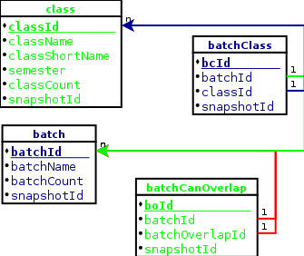
Batch-Class, Overlapping batches

Slide 47
Mappings: the ‘real’ tasks
Primary data: classes, subjects, rooms, batches, teachers
  Not meaningful in themselves
Subject-Class-Teacher(SCT) mapping
  Tells that DSA will be taught to SYCE by Abhijit
  From subjects table we can see that DSA has 3 lectures
  So in timetable 3 entries of DSA-SYCE-Abhijit are needed in some suitable room

Slide 48
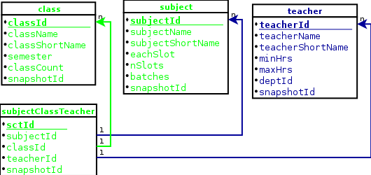
Mappings: Subject – Class – Teacher (SCT)

Slide 49
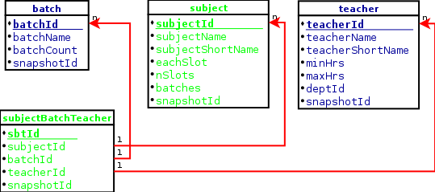
Mappings: Subject – Batch – Teacher (SBT)

Slide 50
“Must” overlapping schedules
For example
  WST lecture for a subset of class-TYCE and subset of class-TYIT students together
Solution
  Obviously the ‘subset’ becomes a batch
  Two SBT mappings
    TYCE-WST-Batch + Abhijit + WST
    TYIT-WST-Batch + Abhijit + WST
OverlappingSBT table
  sbtID of the above two
  Possible only if teacher + subject are same

Slide 51
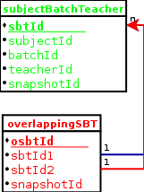
Overlapping SBT

Slide 52
Fixed Entries / Labels
How to make an entry for “LUNCH”?
Entries indicating class busy, but not occupying in classroom
  E.g. Minor slot, ILOE slot
Solution:
  Attribute ‘isFixed’ in timeTable table
  FixedEntry table storing the text

Slide 53
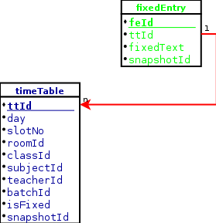
TimeTable and fixed Entry
IsFixed = 1

Slide 54
Need for database ‘views’
This is how the ‘timeTable’ looks
| ttId | day | slotNo | roomId | classId | subjectId | teacherId | batchId | isFixed | snapshotId |
| 6355 | 5 | 8 | NULL | 44 | NULL | NULL | NULL | 1 | 3 |
| 6356 | 2 | 8 | 58 | 44 | 236 | 127 | 243 | 0 | 3 |
| 6357 | 2 | 8 | 84 | 44 | 236 | 143 | 244 | 0 | 3 |
| 6358 | 2 | 8 | 82 | 44 | 236 | 144 | 245 | 0 | 3 |
| 6359 | 1 | 8 | 58 | 31 | 236 | 127 | 240 | 0 | 3 |

Slide 55
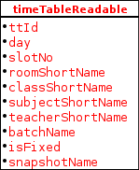
Views: ‘Readable’ tables
Debugging becomes easier, as reading ‘numeric’ data is cumbersome
teacherReadable batchCanOverlapReadable batchClassReadable subjectBatchTeacherReadable overlappingSBTReadable subjectClassTeacherReadable classRoomReadable batchRoomReadable subjectRoomReadable

Slide 56
Readable timetable
6355 | 5 | 8 | NULL | SYIT | NULL | NULL | NULL | 1 | sy-ty1 |
6356 | 2 | 8 | AC-202 | SYIT | ODEMCTut | Maths1 | SYIT-O1 | 0 | sy-ty1 |
6357 | 2 | 8 | AC-102(Math) | SYIT | ODEMCTut | Maths2 | SYIT-O2 | 0 | sy-ty1 |
6358 | 2 | 8 | AC-101(FY) | SYIT | ODEMCTut | Maths3 | SYIT-O3 | 0 | sy-ty1 |
6359 | 1 | 8 | AC-202 | SYCE | ODEMCTut | Maths1 | SYCE-O1 | 0 | sy-ty1 |

Slide 57
View creation queries
CREATE VIEW teacherReadable
AS
SELECT t.teacherId, t.teacherName, t.teacherShortName, t.minHrs, t.maxHrs, d.deptShortName, s.snapshotName
FROM teacher t, dept d, snapshot s
WHERE t.deptId = d.deptId AND
t.snapshotId = s.snapshotId
ORDER BY snapshotName, teacherShortName;

