Slide 1
Fanfiction Forum Database
Ruochen(Villa) Liu, Yiming Zhu

Slide 2
Introduction to Our Project
Deals with a Fanfiction Forum database
Allows users to log in or register
Allows users to manage books and comments - able to Create, Read, Update, and Delete tuples

Slide 3
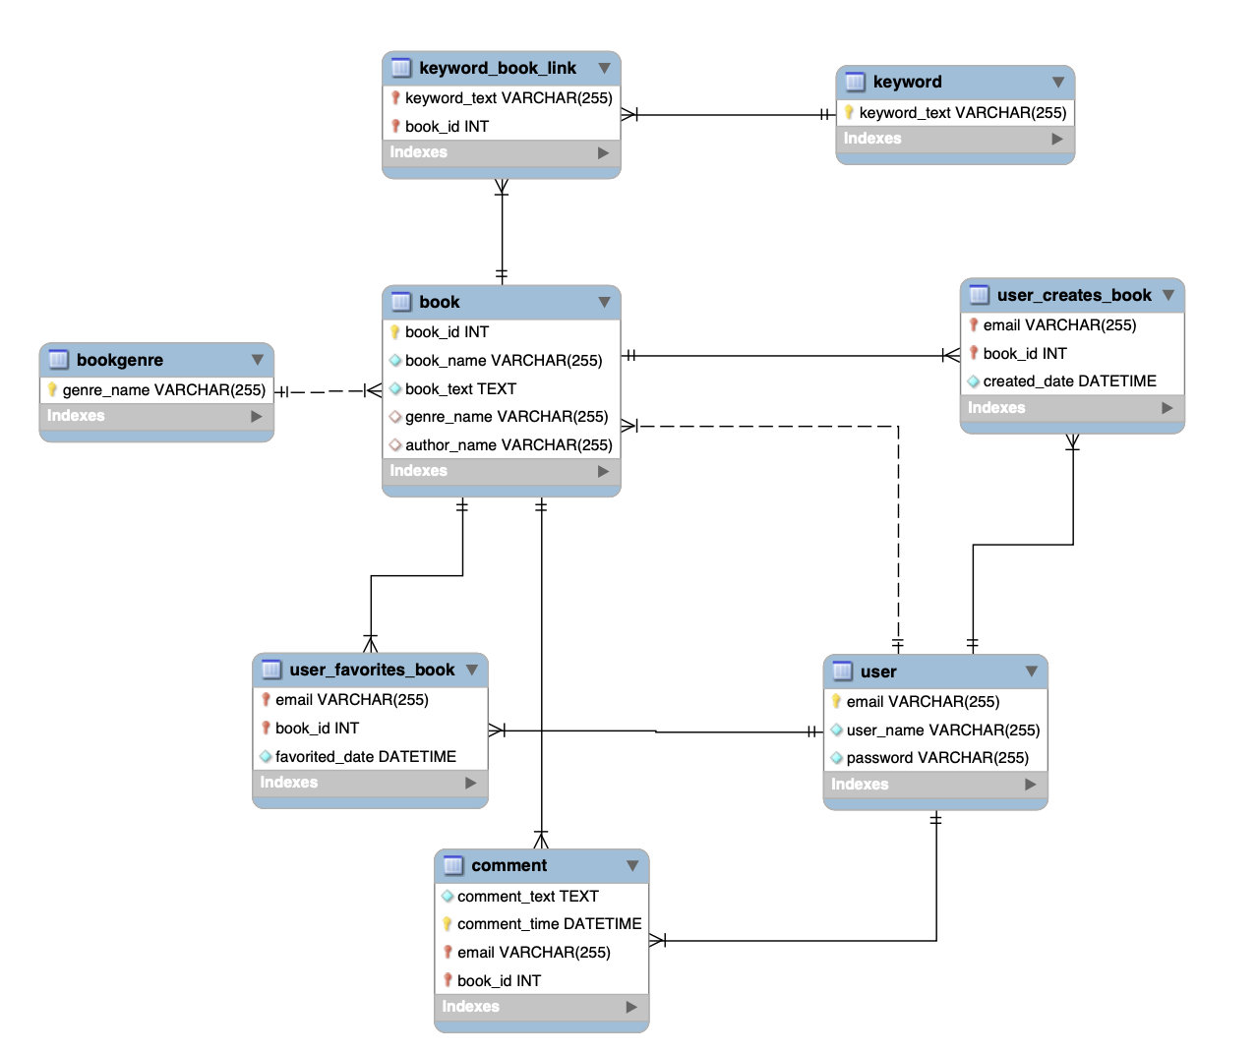
Schema

Slide 4
Technologies Used
MySQL workbench for creating database schema and objects
Python pymysql library to connect to the MySQL database
User interface to interact with the database through command line arguments

Slide 5
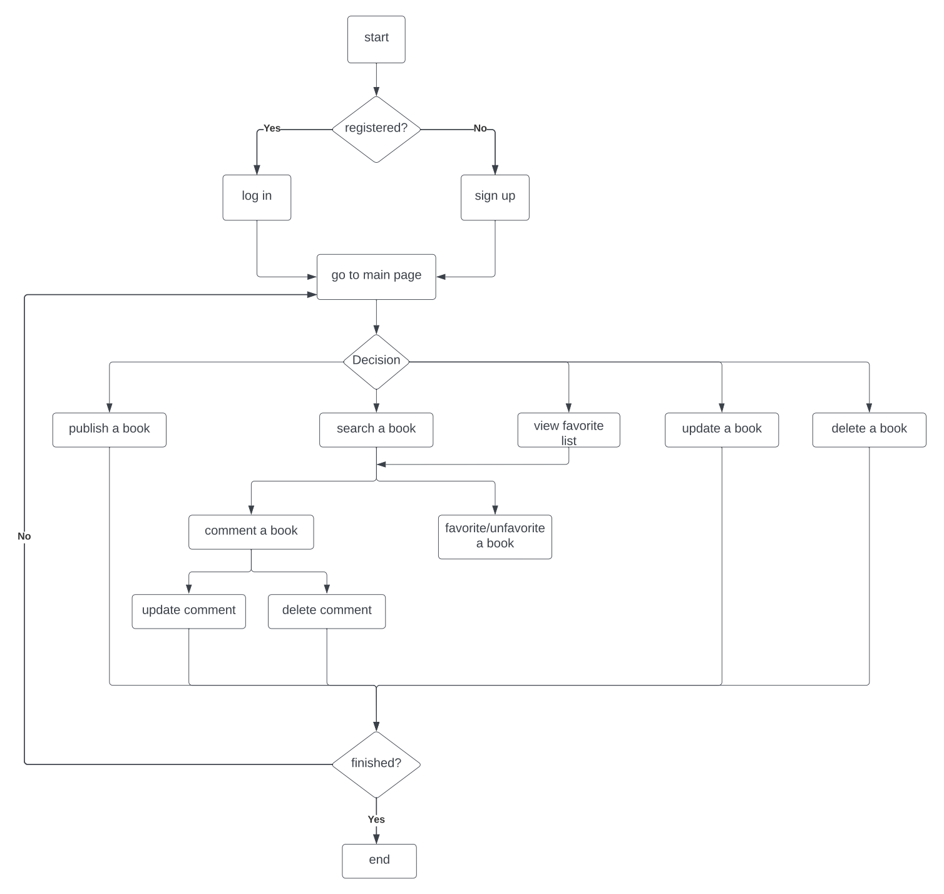
Workflow

Slide 6
Functionality and Utility
First a welcome message is displayed, user login or register
Main menu: 1) Search a book 2) View favorite list 3) Publish a book 4)Update a book 5) Delete a book
For 1) and 2), we determine one exact book by:
1) Search a book: search by book name/keyword/book genre
2) View favorite list: choose one from user’s list
Based on the choice of book:
users can like/unlike that book
users can comment on that book -> also can update/delete that comment

Slide 7
Application Demonstration
Switch to application

Slide 8
Future Improvements
Create more CRUD operations
Add more functionalities
Expand to include Admin role
Create a more user friendly web application for the front end

