Slide 1

Fresher Program Project name IPOS UIC
Group Member
Do Kim Thanh
Ngo Ha Gia Bao

Slide 2


Technology

Slide 3
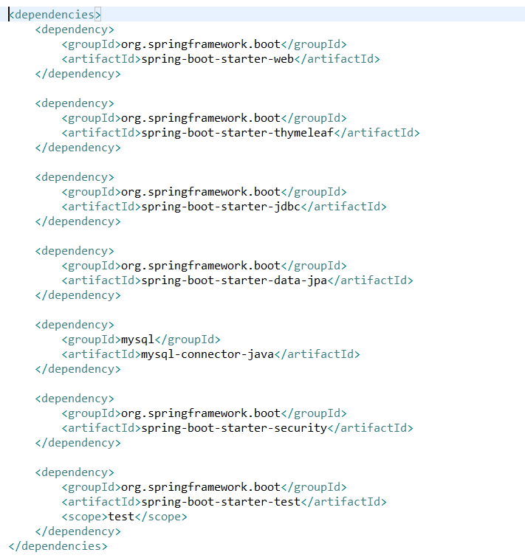
Notes:
Các công nghệ sử dụng: web, thymeleaf, jdbc,..

Slide 4
What is Spring boot?
Spring Boot is a project built on the top of the Spring framework. It provides a simpler and faster way to set up, configure, and run both simple and web-based applications.
Notes:
Notable features
Auto-configuration: It sets up your application based on the surrounding environment, as well as hints what the developers provide.
Standalone: Literally, it's completely standalone. Hence, you don’t need to deploy your application to a web server or any special environment. Your only task is to click on the button or give out the run command, and it will start.
Opinionated: This means that the framework chooses how to things for itself. This is the point where a lot of people says "wait a minute, I do not want to participate in it." Here I encourage you to wait for a second and hold your judgment for now, because, actually, it can be a good thing.

Slide 5
Objective
Mini Social Network

Slide 6
Requirement
Requirement:
· Register and Login
· Create a new post
· View posts created by others users
· Search posts by hashtags
· Like a post
· Delete a post

Slide 7
What have done
· Register and Login
· Create a new post
· View posts created by others users
· Delete a post

Slide 8
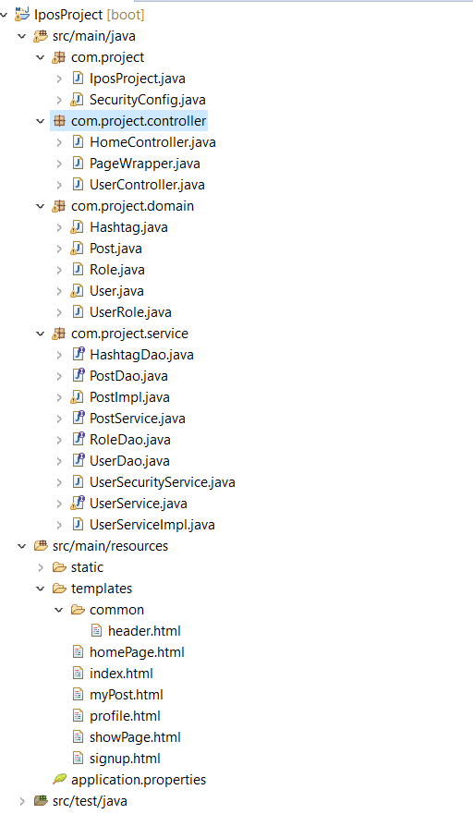
Structure

Slide 9
Demo

Slide 10

Q&A

Slide 11
Thank you
for listening

