Slide 1

Rapid Prototyping Practice Using OOP Ludo game
By-
Nikita Tipule 111903051
Nikhil Repale 111903050
Harshal Chavan 111903036

Slide 2
Concepts Used
Language: C++
Graphics library: For user interface
Concepts of object oriented programming (classes and objects)

Slide 3
Phases
Implementation of basic layout (UI)
Implementation of code for filling layout with colors
Implementation of code for movement and path of pawns

Slide 4
Structures Used
struct pawns
{
int pos;
int status;
int sum;
}
pos: To store the position of pawn
status : To check the pawn is in home or not
sum : Count steps of pawn
struct user
{
struct pawns g[4];
int def;
int color;
int win;
}
g[4] : Create 4 pawns
def : Starting position
Color : To store color of pawns
win: Indicates number of pawns in home

Slide 5
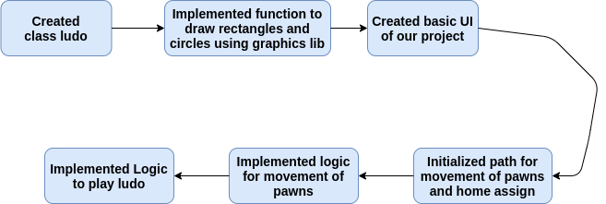

Flow of Project

Slide 6
Functionalities
It is a multiplayer game
It has nice user interface
Also animations are there

Slide 7
THANK YOU

