Slide 1
Internship Summary:
Realised By: Khalil Krifa
Company: Huawei
Mentor : Med Ali Abdelkader
July2026-August2026
Notes:
Ten minutes. The story: routers announce their own failures hours in advance, nobody reads it, and we built the thing that does.

Slide 2
PART ONE:
Before the project:
learning the network
Six weeks of study before a line of code — because you cannot predict a network failure without first understanding the network.
Mobile networks
Routing protocols
MPLS & VPNs
Data centres
Huawei VRP
2G → 5G
IGP, BGP
labels, VRF
spine-leaf
hands-on CLI
Notes:
Ten minutes. The story: routers announce their own failures hours in advance, nobody reads it, and we built the thing that does.

Slide 3
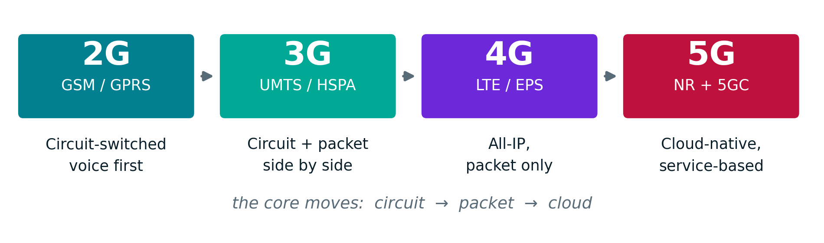
MOBILE NETWORKS:
Four generations, one direction of travel
Voice stops being special
Radio intelligence keeps moving
Control and user planes separate
2G reserved a dedicated circuit per call. By 4G voice is just data over IMS.
Centralised in the BSC/RNC, flattened into the eNodeB, then split again into CU/DU/RU.
In 5G the user-plane function can sit at the edge, close to the subscriber.

Slide 4
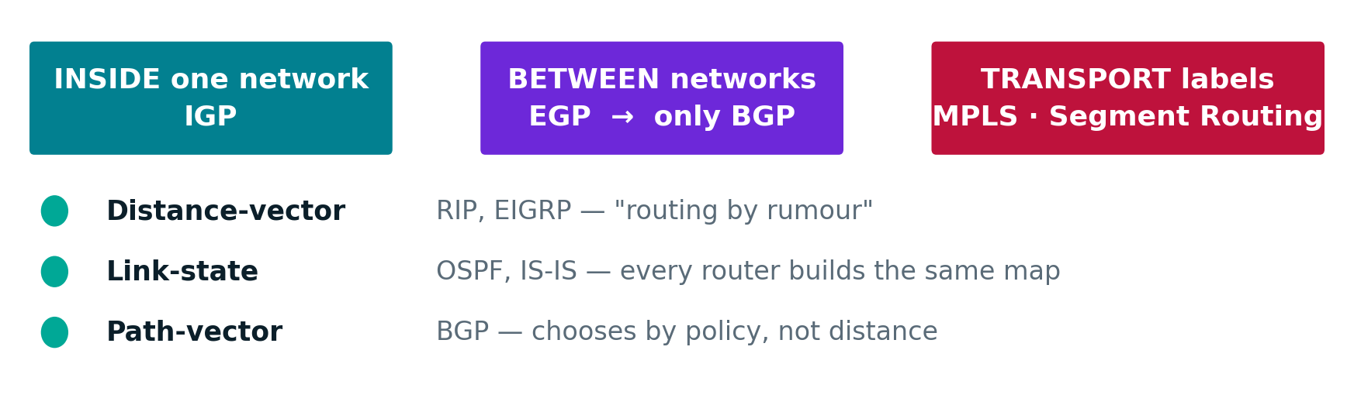
ROUTING PROTOCOLS:
How routers agree on where to send a packet
What an operator actually runs
IS-IS or OSPF inside the network for reachability, BGP at the edges for policy, and MPLS or Segment Routing underneath to steer traffic along chosen paths.

Slide 5
MPLS, SEGMENT ROUTING & VPNs:
Carrying many customers over one network
Classic routing reads the destination IP at every hop. MPLS attaches a label once, and every router afterwards just follows the label — faster, and the path can be chosen in advance. Segment Routing goes further and writes the whole route into the packet, removing the need for a separate label-distribution protocol.
VRF
RD
RT
A virtual router inside a physical one. Two customers can both use 192.168.1.0/24 without ever seeing each other.
A tag that makes each customer's overlapping address unique while it crosses the operator's core.
The shipping label. It tells the receiving router which customer's table the route belongs in.
Together these are MPLS L3VPN — how one physical network carries hundreds of separate corporate networks that never see each other.

Slide 6
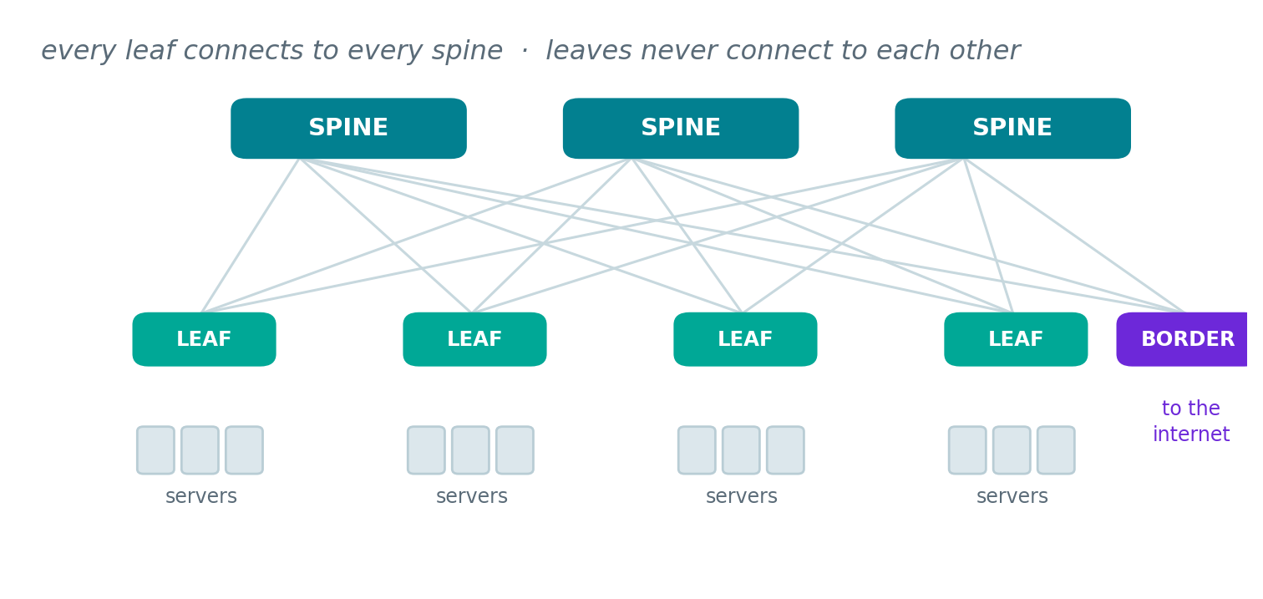
DATA CENTRE ARCHITECTURE:
One question: how do you connect 100 racks?
Spine and leaf
You cannot cable every switch to every other — 100 switches would need ~5,000 links. A middle layer solves it in two hops.
VXLAN
Wraps an Ethernet frame inside an IP packet, so a VM can move between racks and keep its address.
BGP EVPN
Instead of flooding to find where a machine lives, every leaf announces what is behind it in advance.
This matters for the project: an operator's 4G and 5G core is no longer dedicated hardware — it is software running on servers in exactly this kind of fabric.

Slide 7
HANDS-ON:
From theory to the command line
1
Huawei VRP
Where it led
The operating system on Huawei routers and switches. Learned the view hierarchy — user, system, interface, protocol — and the habits that differ from Cisco: display instead of show, undo instead of no.
Studying Huawei's own documentation is what made the project possible. The alarm reference that the model is built on — every alarm's meaning, its probable causes and its repair procedure — is the same vendor documentation used to learn the platform.
2
Configuration practice
Device setup, AAA and remote access, interface addressing, VLANs, and OSPF, built and tested in eNSP against the HCIA-Datacom syllabus.
1,973 alarm definitions came from there.
Also studied: HVPN — Huawei's hierarchical L3VPN, where access, aggregation and core routers each carry only the routes they need.

Slide 8
Part Two :
Project :
RouterGuardian
Predicting router failures from Huawei alarm logs and turning each prediction into an action.
Notes:
Ten minutes. The story: routers announce their own failures hours in advance, nobody reads it, and we built the thing that does.

Slide 9
THE PROBLEM:
A router tells you it is failing.
But Nobody is reading.
1
Thousands of alarms a day
The cost
A medium network floods the operations centre. Almost all of it is noise.
When a router fails, everything downstream of it loses service.
2
Failures announce themselves
Degrading hardware raises alarms with rising frequency for hours beforehand.
A core router can carry 40+
devices beneath it.
3
The team reacts after the fact
By the time a Critical alarm fires, service is already gone.
Notes:
Set up the gap: the information exists, it is just unread. That gap is the opportunity.

Slide 10
WHAT WE BUILT:
Read the last 24 hours. Predict the next 12. Act on it.
RouterGuardian scores every router in the network, and every prediction is routed to the action that actually fixes it.
HARDWARE FAULT
SOFTWARE FAULT
Alert the on-call team
Attempt scripted remediation
A board, an optic, a fan. No script can fix it, a human is paged, with the alarms, the reasons and the vendor's repair procedure.
A stuck process, a dropped session. The system tries the fix automatically and tells the team it is doing so.
The split matters: it is the difference between waking someone at 3am and not having to.
Notes:
One sentence for the whole project. The two-way split is what makes it operational rather than academic.

Slide 11
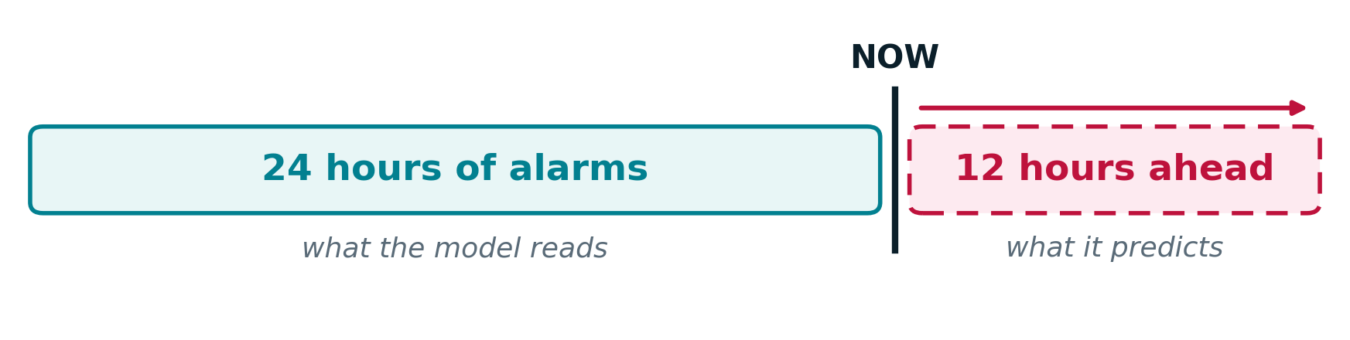
THE DATA:
Real vendor documentation, a simulated network
1,973
48,627
120
Huawei alarm
definitions extracted
alarm events
generated
devices over
182 days
No operator log was available, so the event stream is synthetic : built from real alarm names, severities and repair procedures.
Every result in this deck is measured on that data, and we are explicit about what it proves.
Notes:
Be upfront about the synthetic data here, once, early. It buys credibility for everything after it.

Slide 12
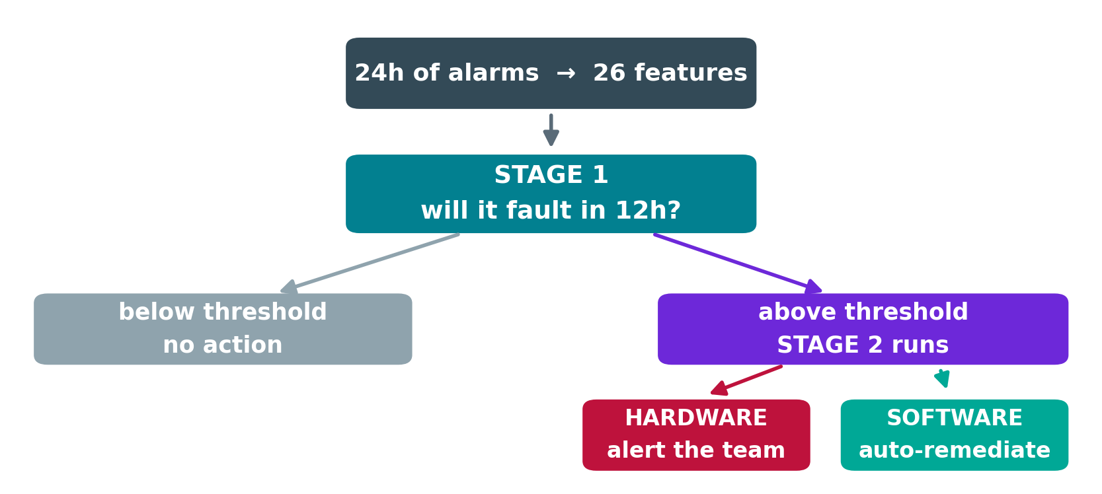
THE MODEL:
Two questions, asked in order
Why two stages
Fault windows are rare : one model would drown the signal.
Each stage gets its own operating point.
It matches how the team actually decides.
26 features per window: alarm volume, type mix, severity, how fast activity is accelerating, and the router's own fault history.
Notes:
Stage 2 only ever runs on what Stage 1 flagged. That is why fault type is blank for healthy routers.

Slide 13
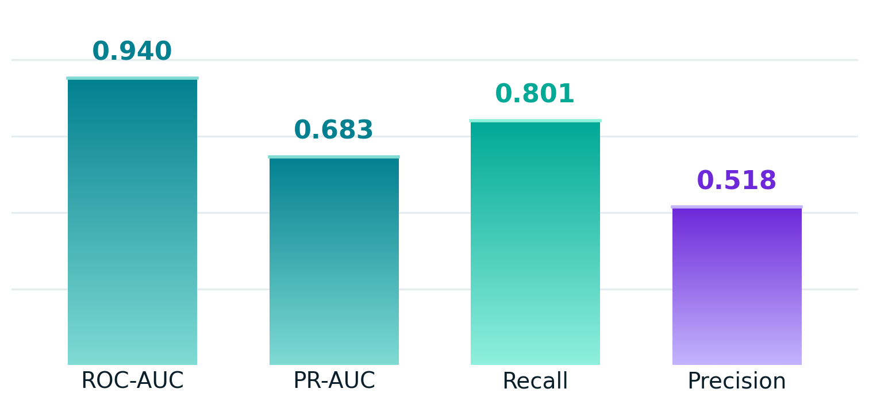
RESULTS:
Four out of five failures caught before they happen
At the deployed threshold
80%
of real failures are predicted before they occur
The trade we chose
About half of the alerts are false. Missing an outage costs more than an engineer checking a healthy router.
Measured on a time-separated held-out split : the model is tested only on windows from later than anything it trained on.
Notes:
If asked about precision: it is a deliberate recall-first operating point, and the threshold is a business decision the operator can move.

Slide 14
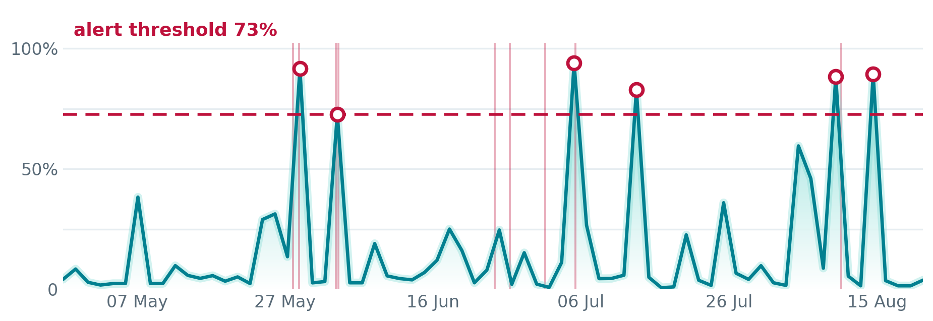
DOES IT ACTUALLY WORK:
The risk curve rises into the real failures
One router, four months. The model is re-scored at each point using only the alarms it had at that moment. Pale vertical lines are failures that really happened; the ringed peaks are where an alert would have fired.
Notes:
This is the strongest slide. The spikes line up with the real episodes and it was not constructed to — it is a replay.

Slide 15
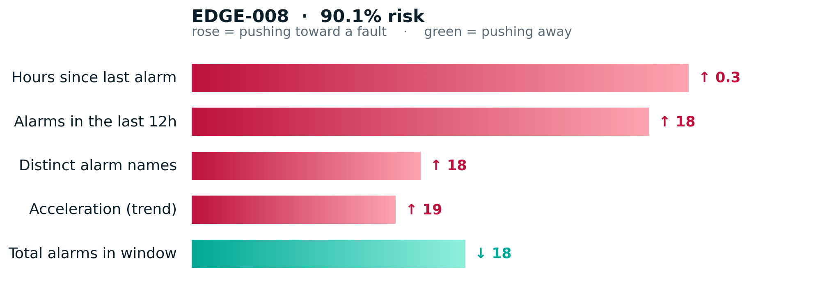
EXPLAINABILITY:
Every score comes with its reasons
Not a black box
Each prediction carries exact TreeSHAP contributions : how far every feature moved this router away from the fleet average.
An engineer can see why this router and not its neighbour which is what makes the alert actionable at 3am.
Notes:
Judges often ask about interpretability. This is the answer, and it is exact rather than approximate.

Slide 16
FROM PREDICTION TO ACTION:
The prediction leaves the screen
1
2
3
Automatic alert
Troubleshooting assistant
Root-cause comparison
The on-call team is emailed the moment a hardware fault is predicted , with the alarms behind it, the model's reasons, the blast radius, and Huawei's documented repair procedure.
A link in the email opens a conversation grounded in that incident. It answers what to do first, how urgent it is and why the router was flagged — from the stored facts, never invented.
Two routers side by side: location, physical environment, hardware age and topology. It says which of them plausibly explains the risk gap, and which is ruled out.
A prediction nobody sees is worth nothing. This is the half that makes it a system rather than a model.
Notes:
Emphasise: the email is a work order, not a notification. It contains everything needed to act.

Slide 17
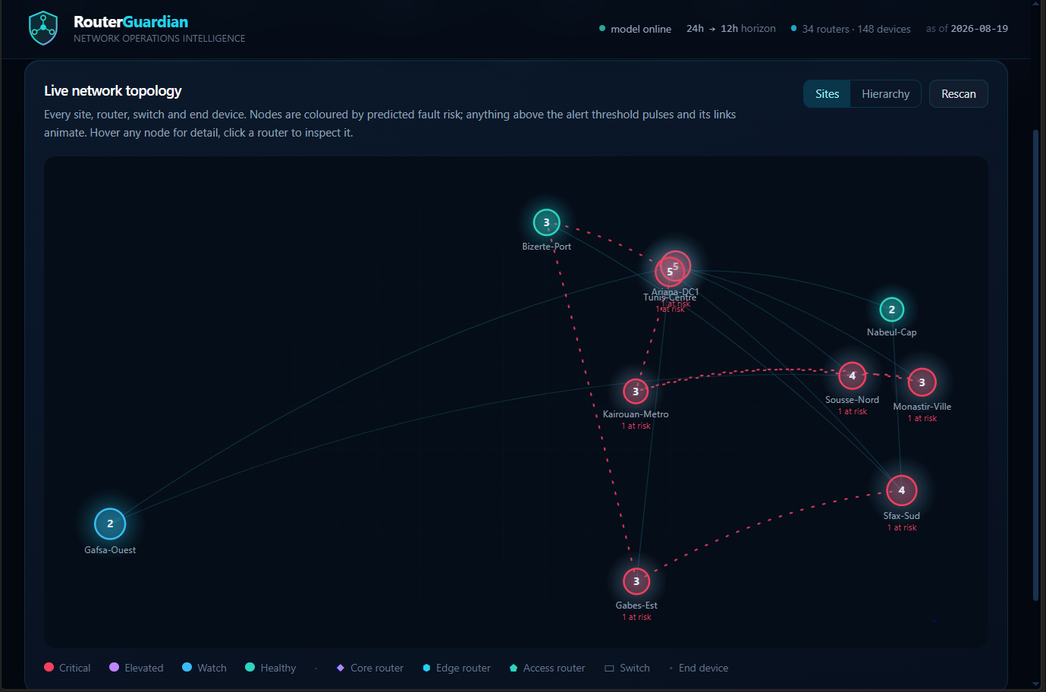
THE APPLICATION:
Built to be used, not demonstrated
[ paste a screenshot of the Fleet or Overview tab here ]
Live topology, coloured by predicted risk
Every router ranked, with blast radius
Risk replay per router over months
Alert outbox and CSV export
Notes:
Keep this short — if there is a live demo, this is where it goes instead.

Slide 18
HONEST LIMITS:
What real data would change
Results would become evidence
Today the model is tested on data built alongside it. Real logs turn a coherent method into an empirical result.
Scores would drop, and that is fine
Real precursors are noisier. A model catching half of the failures still beats discovering all of them afterwards.
Impact would become real
The topology is synthesised. With a real inventory, ranking by risk times customers affected is what an operations centre actually wants.
The method and the system are real. Only the evidence is synthetic and swapping in real logs exercises the same pipeline end to end.
Notes:
Volunteer the limitation before the panel finds it. Then show you know exactly what the next step is.

Slide 19
IN SUMMARY:
From an unread alarm stream
to an actionable prediction.
1,973
0.940
12h
2
real Huawei alarm
definitions
ROC-AUC,
80% recall
warning before
a failure
remediation paths,
automatic
Thank you
Your questions are welcomed.
Notes:
Close on the 12 hours. That is the number the panel should remember.

