Slide 1
Lane Estimation Using GPS Probe Data
for OSM Imputation
Machine Learning Approach for Lane Count Prediction & Map Enhancement
Apoorv Mishra | Rutgers Business School | Fall 2025

Slide 2
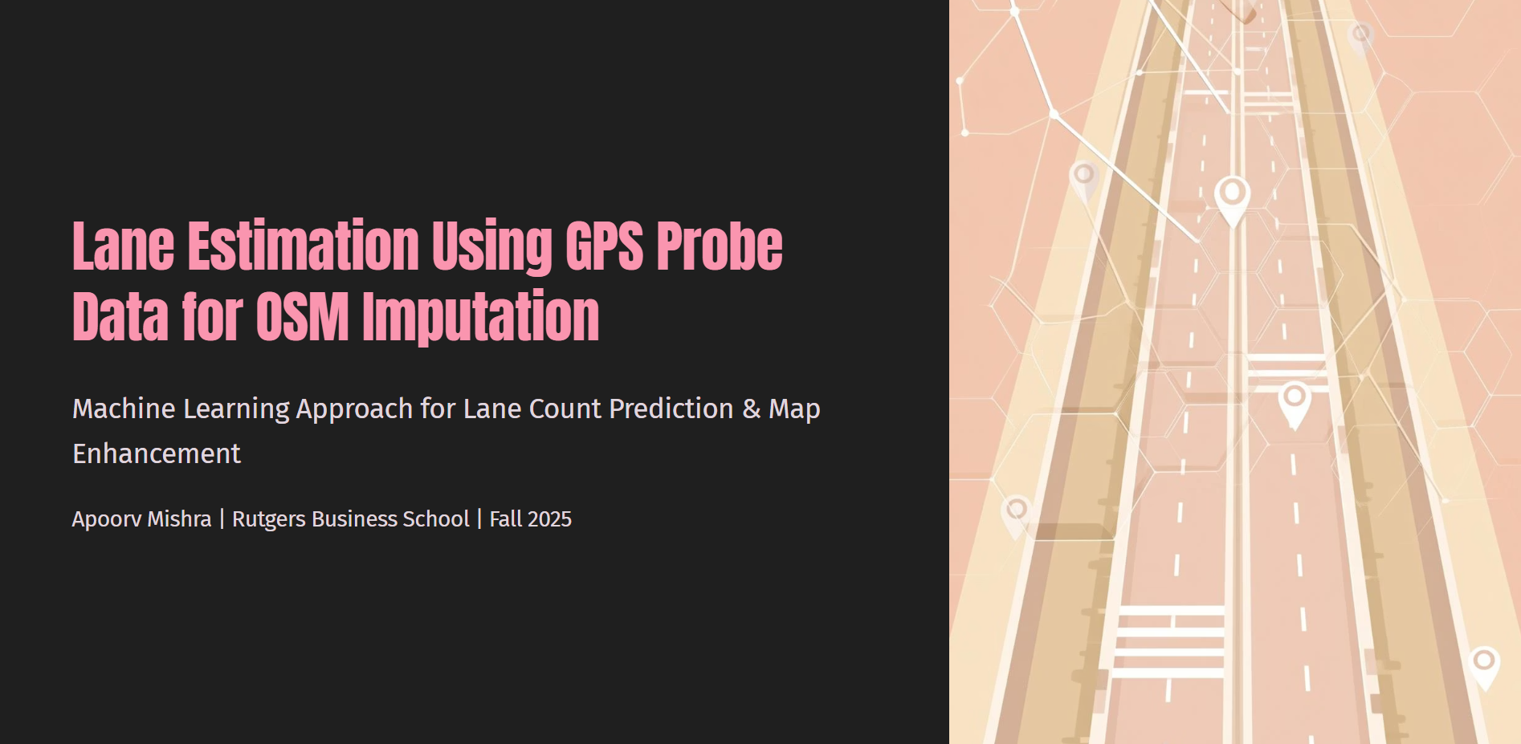

Slide 3
The Challenge: Bridging the Gap in Lane Data
OpenStreetMap often lacks comprehensive or accurate lane count information
• Missing Tags: Many road segments within OSM are missing crucial lane count attributes
• Incorrect Data: Existing lane data can be inaccurate, leading to mapping inconsistencies
• Navigation Impact: GPS navigation systems rely on accurate lane data for routing
• Traffic Simulation: Urban planners need lane data for traffic modeling
• Autonomous Vehicles: Self-driving cars require precise lane information for safe navigation

Slide 4
Project Objective: Automated Lane Count Prediction
Leveraging machine learning to predict lane counts and enhance OSM data
• GPS Probe Traces: Utilize raw GPS data from vehicles driving on roads
• Feature Extraction: Transform GPS traces into meaningful distribution features
• Machine Learning: Apply classification models (Random Forest, XGBoost) for prediction
• Lane Prediction: Output estimated lane counts for road segments
• Validation: Compare predictions against official Florida DOT ground truth data

Slide 5
Core Insight: GPS Clustering Reveals Lane Structure
GPS probe distribution patterns indicate the number of lanes
• Lane-Dependent Clustering: Vehicles naturally cluster within their respective lanes
• Lateral Distribution: Analyzing the spread across road width reveals distinct peaks
• Peak = Lane: Each peak in the GPS distribution corresponds to a lane position
• More Lanes = More Peaks: Roads with more lanes show wider spread with more peaks
• Key Quote: "Cars leave quantifiable digital footprints that reveal road infrastructure"

Slide 6
Datasets Overview: Fueling the Prediction Model
Three distinct datasets for training, validation, and feature enhancement
• Dataset 1 - LA GPS Probe (Training): 329,787 filtered road segments with GPS distributions
• Dataset 2 - Florida DOT Lanes (Validation): 86,880 segments with official lane counts
• Dataset 3 - Florida DOT AADT (Feature): 20,289 segments with traffic volume data
• Total Data Points: 600,000+ road segments analyzed across multiple states
• Data Quality: Rigorous filtering ensures high-quality, representative training data

Slide 7
Dataset 1: LA GPS Probe Data Details
Primary training dataset with crowdsourced GPS probe traces
• Source: Crowdsourced GPS traces from smartphones, fleet vehicles, navigation systems
• File: la_link_dist_vs_lanes_estimation_dataset_v1.parquet
• Filtering: total_count > 1,000 GPS points (ensures sufficient data density)
• Lane Range: lanes_int ≤ 7 (focusing on common road configurations)
• Target Variable: lanes_int (ground truth lane count)
• Final Size: 329,787 road segments after quality filtering

Slide 8
Feature Engineering: The 40 GPS Bins
Capturing lateral distribution of GPS points across road width
• Road Width Discretization: Divide road width into 40 equal slices (bins)
• Bin 0 = Leftmost edge, Bin 39 = Rightmost edge of road
• GPS Point Ratio: Each bin = percentage of GPS points in that slice (sums to 1.0)
• Peak Identification: Peaks in distribution indicate lane positions
• Additional Feature: 'oneway' flag for one-way road indicator
• Total Features: 41 (40 GPS bins + 1 oneway flag)

Slide 9
Model Comparison: Finding the Best Performer
Evaluating multiple ML models for lane count prediction
• Random Forest: 90.11% accuracy - WINNER ⭐
• XGBoost: 85.0% accuracy - Good performance
• LightGBM: 84.56% accuracy - Fast training
• GMM (Unsupervised): 22.0% accuracy - Not effective
•
• Random Forest won due to its ability to handle non-linear relationships and robustness

Slide 10
Random Forest: Configuration for Optimal Results
Meticulously configured for maximum predictive accuracy
• n_estimators = 200: Robust ensemble of 200 decision trees
• class_weight = 'balanced_subsample': Addresses class imbalance in lane counts
• max_depth = None: Trees grow until leaves are pure
• Feature Set: 40 GPS bins + oneway flag = 41 total features
• Train/Test Split: 80/20 stratified by lane count
• Training Size: 263,829 records | Test Size: 65,958 records

Slide 11
Main Results: High Accuracy Achieved
Random Forest model achieved exceptional accuracy
• Overall Accuracy: 90.11% - Direct match to ground truth
• Within ±1 Lane: 99.0% - Highly reliable for practical applications
•
• Error Distribution:
• • Correct (0 error): 59,438 predictions (90.1%)
• • Off by 1 lane: 5,858 predictions (8.9%)
• • Off by 2 lanes: 655 predictions (1.0%)
• • Off by 3+ lanes: 7 predictions (0.0%)

Slide 12
Error Analysis: Where the Model Struggles
Understanding prediction errors to guide improvements
• High Error Lanes: 1-lane (27.5% error) and 3-lane (27.4% error) roads
• Low Error Lanes: 2-lane roads have only 2.8% error rate
•
• Most Common Mistakes:
• • 3 lanes → Predicted as 2 lanes: 1,944 times
• • 1 lane → Predicted as 2 lanes: 881 times
• • 5 lanes → Predicted as 4 lanes: 798 times
•
• Insight: Adjacent lane counts get confused due to similar GPS patterns

Slide 13
Key Discovery: AADT Correlates with Lane Count
Traffic volume (AADT) shows strong predictive power
• AADT = Annual Average Daily Traffic (vehicles per day)
•
• Traffic Volume by Lane Count:
• • 1 lane: 13,249 vehicles/day
• • 2 lanes: 20,390 vehicles/day
• • 3 lanes: 52,711 vehicles/day (2.5x jump from 2 lanes!)
• • 4 lanes: 79,403 vehicles/day
• • 5 lanes: 142,727 vehicles/day
•
• AADT alone achieves 43% accuracy with just 1 feature!

Slide 14
Proposed Improvement: Adding AADT Feature
Combining GPS distribution with traffic volume
• Current Model: 41 features (40 GPS + oneway) → 90.11% accuracy
• Enhanced Model: 42 features (40 GPS + oneway + AADT) → Expected 93-95%
•
• Why AADT Helps:
• • Distinguishes 2-lane vs 3-lane roads (20K vs 53K vehicles/day)
• • Provides additional signal when GPS pattern is unclear
• • Compensates for low GPS density roads
• • Helps break ties between adjacent lane predictions

Slide 15
Conclusion & Future Work
Summary of achievements and next steps
• ACHIEVED: 90.11% accuracy using GPS probe distribution features
• ACHIEVED: 99% of predictions within ±1 lane of true value
• DISCOVERED: AADT can improve accuracy to 93-95%
• VALIDATED: Against Florida DOT ground truth (86,880 road segments)
•
• Future Work:
• • Integrate AADT feature into production model
• • Test on additional states and regions
• • Deploy for large-scale OSM lane data imputation

Slide 16
Thank You!
Questions?

