Slide 1
DNN_04
Convolutional Neural Network

Slide 2
History
Coined by Yann lecun(LeNet) , Inspired by paper published in early 70 on mammalian visual cortex (Hubel and Wiesel)
Human visual system works in hierarchical fashion , one neuron passing information to other neuron
Collection of neuron is called cluster (having names like V1,V2 etc) which we generally called as layers in CNN
Each set of cluster detects some particular kind of features which keeps on fine tune going deeper in the clusters or we can say layers in terms of CNN

Slide 3
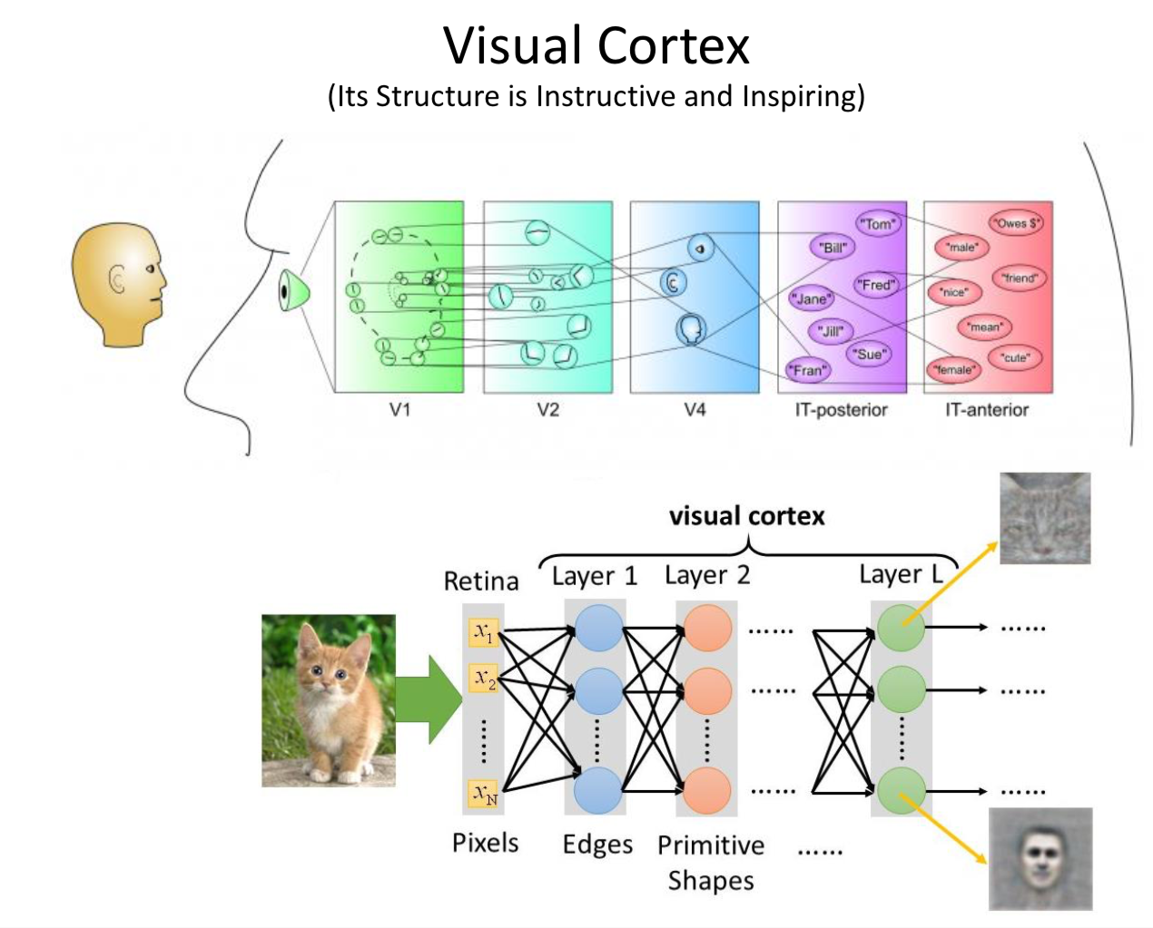
Key points taken from Hubel Paper by Lecun
Local connection
Layered/Hierarchical architecture
Spatial invariant

Slide 4
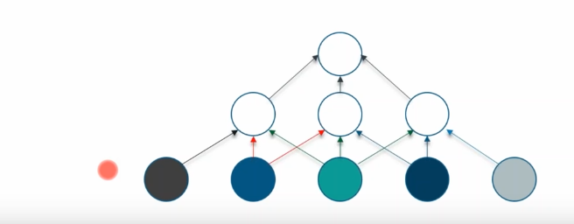
Introduction
CNN is type of NN which is majorly used in image recognition task
It is different from MLP because in CNN input is multidimensional image while in case of MLP it is just a vector of features or input
In CNN each neuron is only connected to some neuron of earlier layer which makes no of neurons lesser and network faster

Slide 5
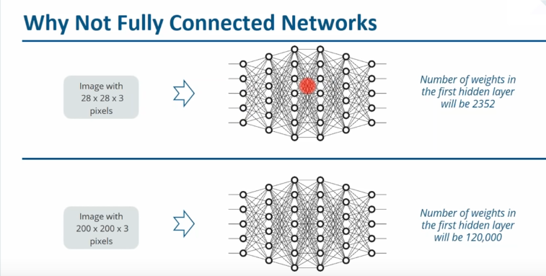
Need of CNN , why we can’t use MLP ??

Slide 6
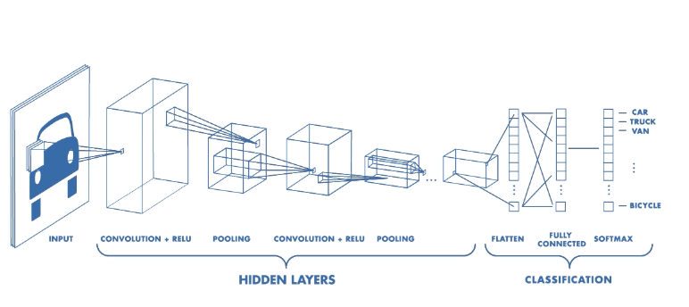
CNN Architecture

Slide 7
Lets breakdown the layers and some terms !!
Convolution
Relu
Pooling
Padding
Stride
Dropout
Flatten
Fully connected
Convolutional Block : Convolution + relu + pooling

Slide 8
Convolution
Convolution operation generates weighted average image of all the pixels falling under kernel/filter
What is kernel / filter :)
Filter is generally a collection of kernels for each different channel(RGB) but used interchangeably many times
Output of all 3 channels from kernel is combined to form a single channel image
Depth of Output depends over the number of filters used in current layer

Slide 9
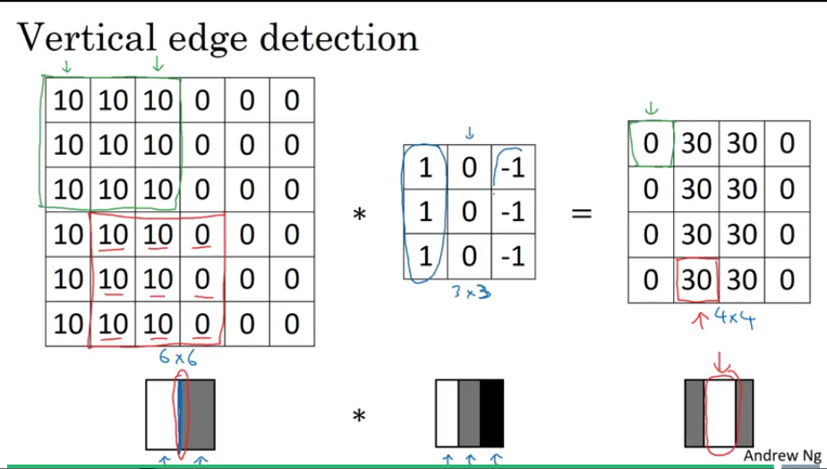
Convolution in 2D

Slide 10
Convolution Visualization for 3D

Slide 11
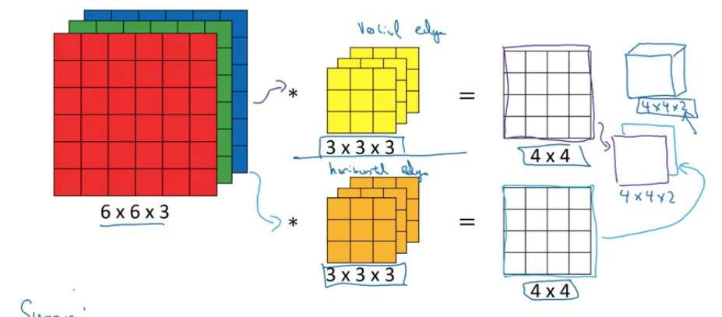
Convolution with multiple filters

Slide 12
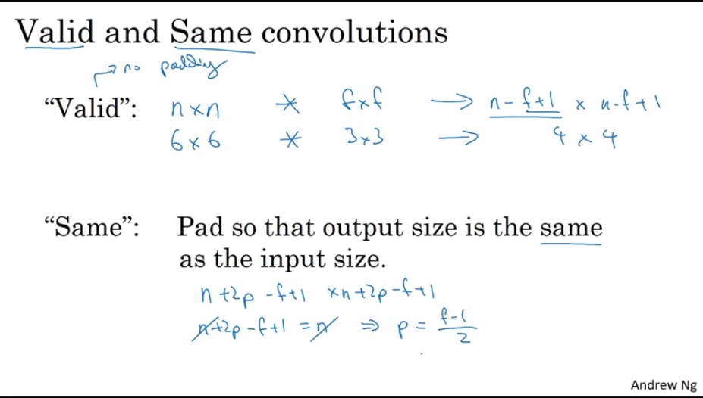

Slide 13
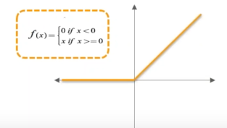
Benefits of Convolution
It drops the redundant information from the image and keeps only the useful information like (edges , corners , eyes , face etc.)
Relu (Activation Function)
It is used to drop the negative values and replace them with 0
If not replaced those values with zero , sum of all values will become zero
It helps in activating all those neurons when values are above 0

Slide 14
Padding
In above convolution example we are dropping the features of edges as size of output is reducing from 5*5 =>3*3 , which is not a good idea
So , to overcome this problem we apply padding on the edges of the image and then apply the convolution operation so that size of output image remains same and no information from the edge is dropped

Slide 15
Where the size of image is reducing ??
Convolution operation stride &
Pooling layer is responsible for reducing the input image size
Stride :
Stride is by what amount we are moving our kernel over the image
If stride is 1 , we are moving 1 pixel apart if its 2 we are moving 2 pixel part
Higher stride will also reduce the size of output

Slide 16
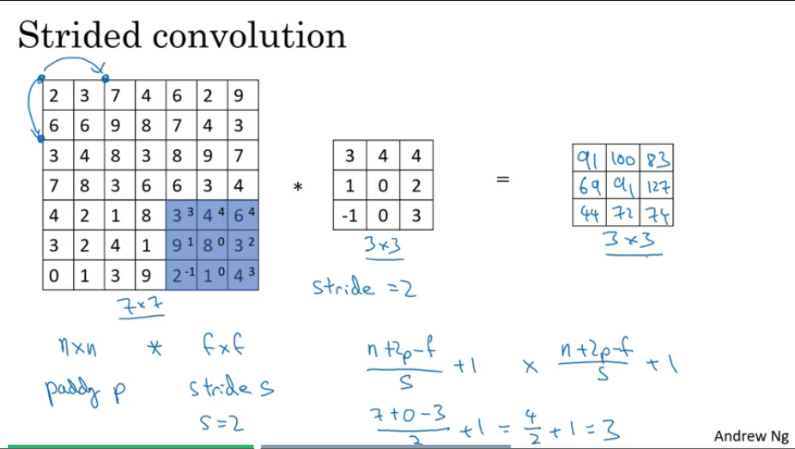

Slide 17
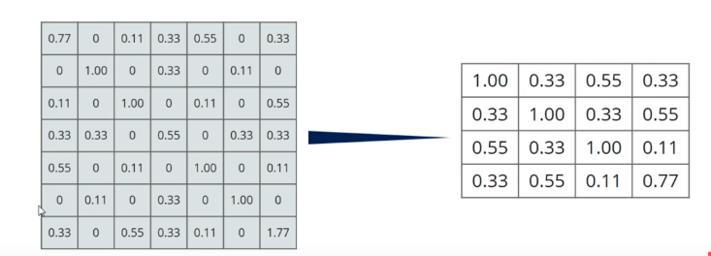
Pooling Layer
Take a window of size 2*2 or 3*3
Move the window over the output generated from (convolution + Relu)
Take the maximum value falling in that window and move further across the filter
Pooling types :
Max Pooling
Avg Pooling
Ultimate objective of pooling is to reduce the size of the image by dropping the extra features and keeping only the useful features (7*7) => (4*4)

Slide 18
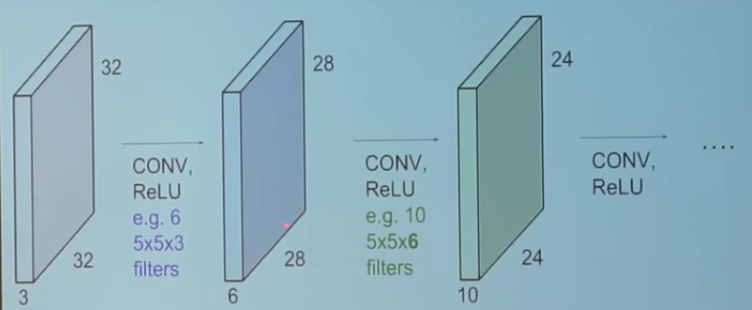
Convolution Blocks
Convolution block is nothing just the combination of (convolution , relu and poling layer )

Slide 19
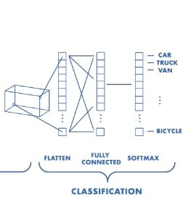
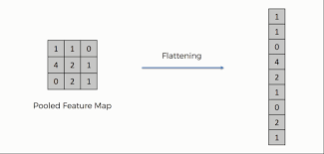
Flatten & Fully Connected
we convert the output from the final shrink filters into a single list
Fully connected layer is introduced after converting those features in the list
FC layer is useful here because we have reduced our features to very small number and it can help in activating the neurons to predict the output (just MLP)

Slide 20
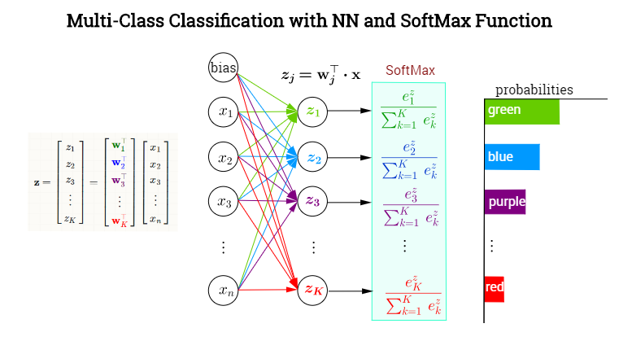
Prediction
Softmax is used at output layer to predict the probabilities of all the classes just like in MLP

Slide 21
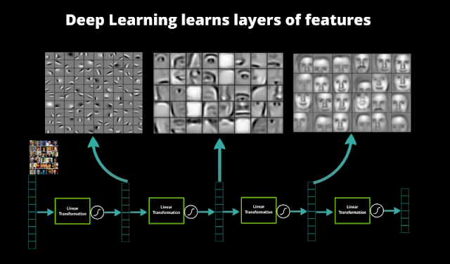
CNN Features at Different Layers
Initial layers learn the low level features (edges , coreners)
Deeper layers learn the high level and complex features (eyes,nose,ear etc)

Slide 22
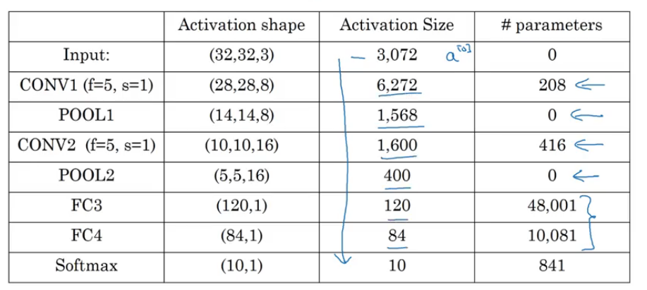
CNN Summary

Slide 23
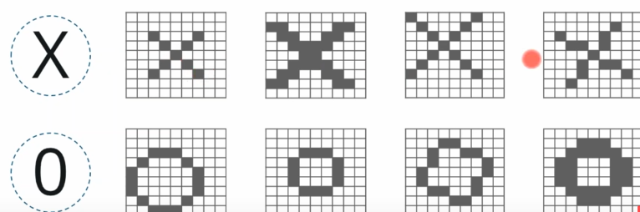
CNN Binary Classifier Walkthrough
Binary classifier to predict whether its 0/X
Problem is there can be many variations of X and 0 and we have to handle all of those variations

Slide 24
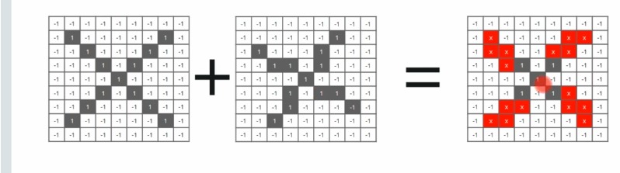
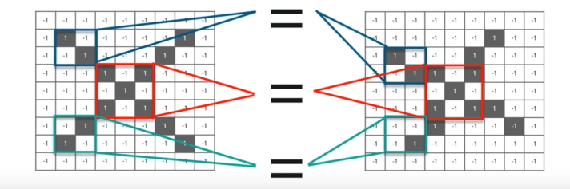
Normal Classification vs CNN classification

Slide 25
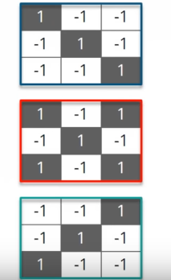
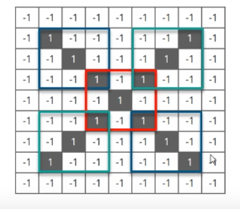
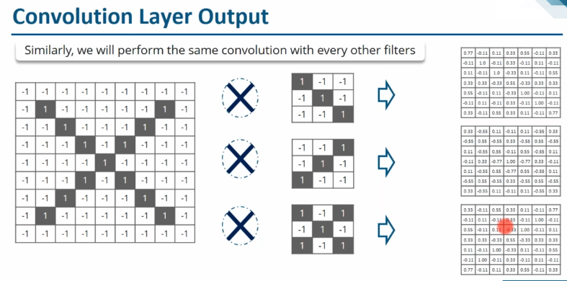
It will start looking for those features and if those features matches then particular class will be classified correctly
Convolution o/p after running all the filters

Slide 26
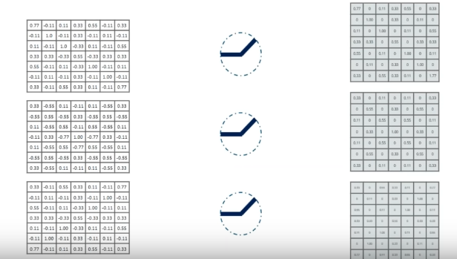
Relu Output

Slide 27
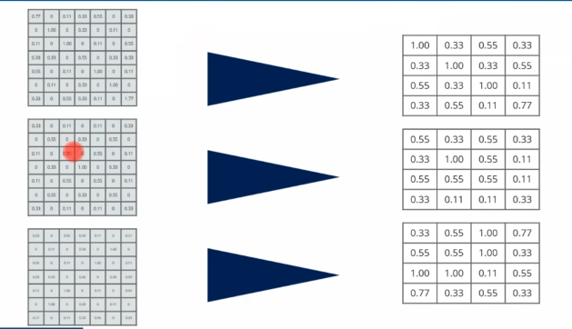
Pooling Output

Slide 28
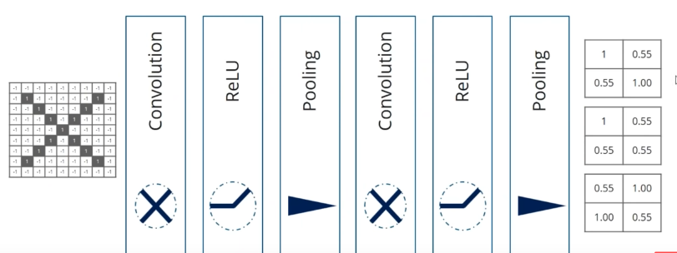
Adding Blocks of convolution
By adding blocks of (convolution + relu + pooling) , final output features reduce even more

Slide 29
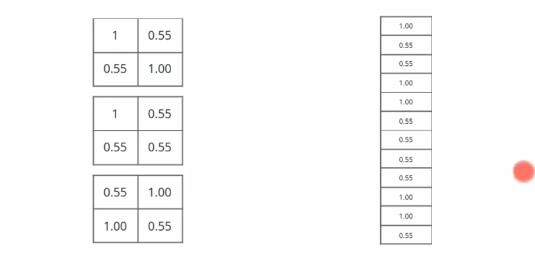
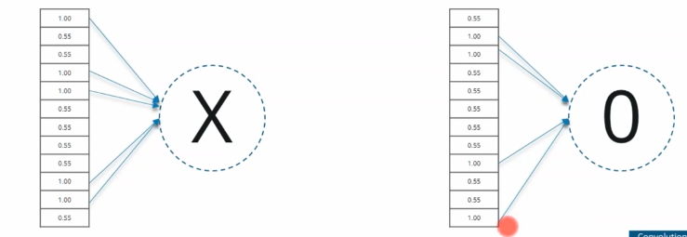
CNN Prediction
After FC layer in output layer only some of the neurons will shoot up to predict any particular class and some other neurons will shoot up to predict some other class and on the basis of those neurons we can classify any image
Below images shows the output of flatten and output layer

Slide 30
CNN Visualization Links
CNN Flow by karpathy
https://cs.stanford.edu/people/karpathy/convnetjs/demo/mnist.html
Convolution Feature Mapping in 2D and 3D
http://scs.ryerson.ca/~aharley/vis/conv/flat.html (2D)
http://scs.ryerson.ca/~aharley/vis/conv/ (3D)
CNN Prediction
https://www.youtube.com/watch?v=f0t-OCG79-U (blocks visualization)

