Slide 1
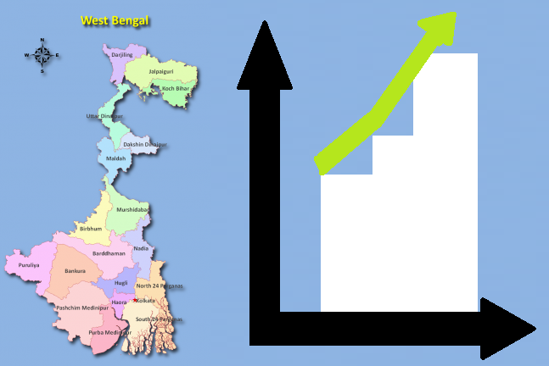


Ministers & Policy Makers
Cloud Based Solution
Decisions
& Policy Updates
Predictive Analytics, to Support Next Level Decision Making
Artificial Intelligence
Machine Learning (Supervised & Unsupervised), Statistical Modelling
Choropleth Reporting
Executive Reporting
Product
Manager PMO
Data Analytics
User Stories
System Integration
UAT Admin Team
Feature
Approval
www.ssy.wblabour.gov.in
Beneficiaries
1 Crore + Unorganized
Workers
(HTML, CSS, jquery, Bootstrap)
CICD
Pipeline
Social
Media
Integration
Agile Scrum Dev Team
SQL Database
Cyber
Security
(End to End)
PF
ESI
Death
Existing Disparate Systems

