Slide 1



“Information is the oil of the 21st century, and analytics is the combustion engine”
- Peter Sondergaard
SVP, Gartner

Slide 2

Significance of Analytics
Initiation
Data Collection
Analytics
Predictable
Outcomes
Decision Making
& Improvements
Implementation
Iterative
Improvement
Cycle
Digital Transformation Maturity
Analytics
Metrics Data
Collection
Timeline

Slide 3
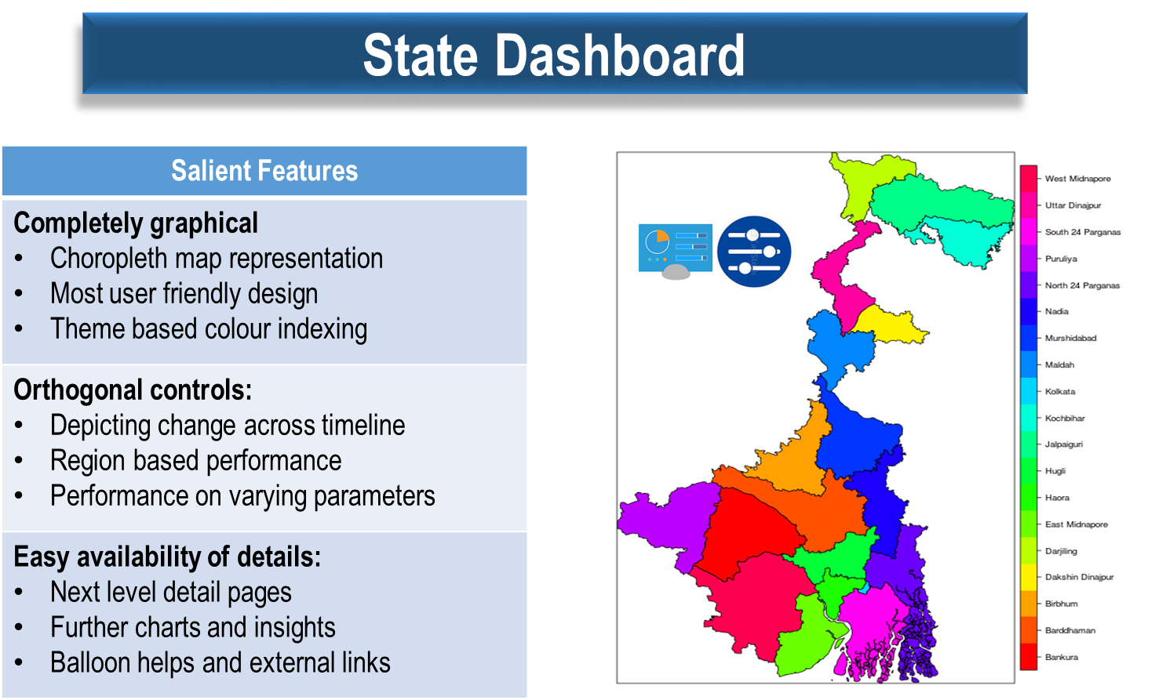

Slide 4
Deep Insight
Medical
Values
Surgery
Death
Natural Death
Surgery
Natural
Death
Death
Medical
Natural
Surgery
12
12
12
Accidental
Premature
10
OPD
Accidental
Premature
10
OPD
Accidental
Premature
10

Slide 5
Deep Insight
Administrative Unit wise:
Gender
Age
Religion
Social Category
Married/Unmarried
Family Size
Benefit Preference, Quantum, Quality
Worker Type
Hence customised policies.

Slide 6
Thank You

