Slide 1

ROOMMATE FINDER
Project By : Hariom Badarkhe
Mis no. : 112103017

Slide 2

TABLE OF CONTENTS-
Introduction
User Interface
Operations
Matching Algorithm
Conclusion

Slide 3

Introduction-
Welcome to Roommate Finder, a revolutionary solution designed to make finding the perfect roommate.
As college students venture into their first year, they often find it challenging to connect with roommates who share common qualities and interests.
In an unfamiliar city, students may struggle to find roommates who align with their preferences, hobbies, and daily routines.
To address this issue, I have developed the Roommate Finder, an innovative platform that utilizes advanced algorithms to match students with their ideal roommates
This Photo by Unknown author is licensed under CC BY-SA-NC.

Slide 4
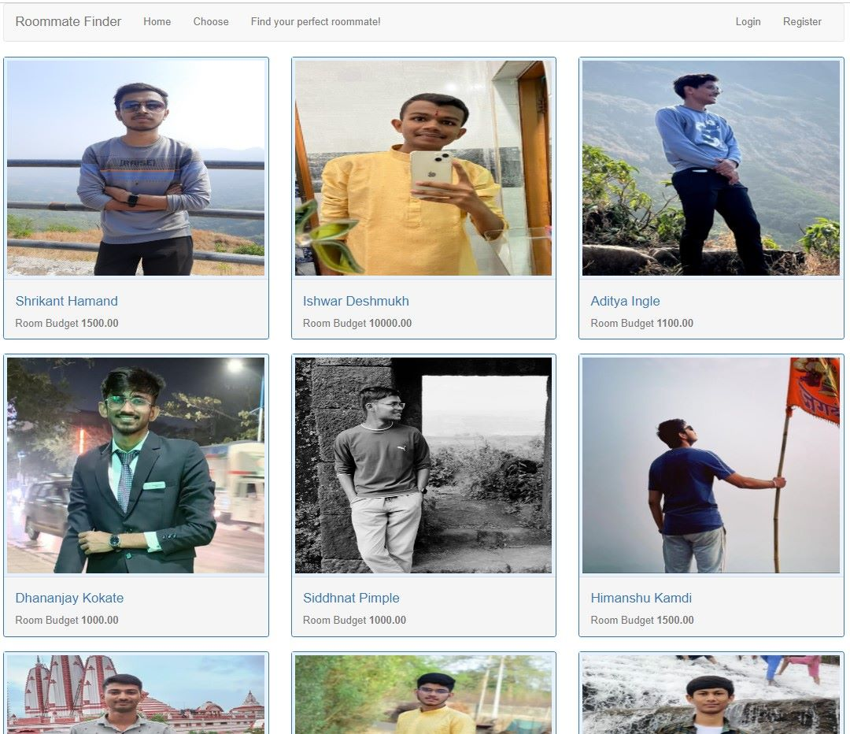
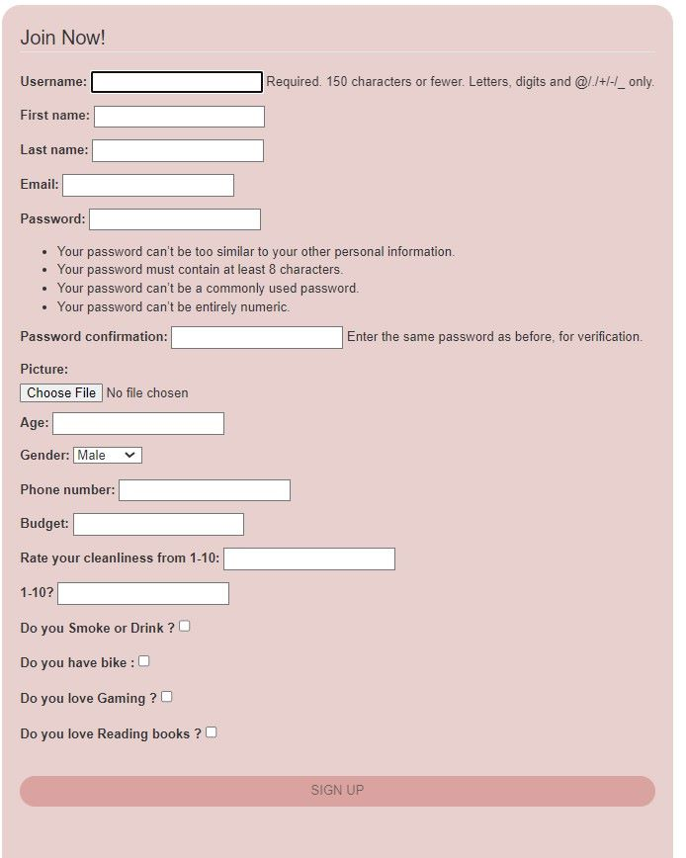

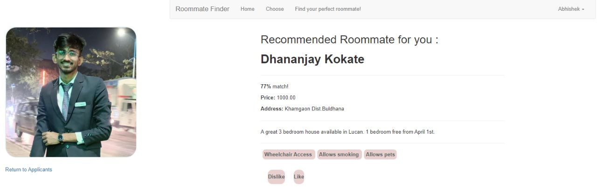
User Interface-

Slide 5

Operations-
User can register/Sign Up for Creating Profile .
He/She can add their interests and some info and make their new profile.
By clicking on "Find Perfect Roommate" , you will get a roommate recommendation
By clicking on choose option he/she can see other's profiles too.
There is an option for profile visiting and logout also.

Slide 6
Matching Algorithm
Find the Roommate with the minimum total difference in the interests (i.e., the most similar Roommate) from the dictionary "d".
Fetch the offers made by the user for the most similar Roommate from the database
Calculate the percentage of similarity between the most similar Roommate and the user's preferences.

Slide 7

Conclusion :
Recapping the benefits of using the Roommate Finder :
Increased chances of finding compatible roommates.
2. Improved living experience in a new city
3. Enhanced Safety and Security.

Slide 8

This Photo by Unknown author is licensed under CC BY-SA.

