Slide 1


BISM7208 DIGITAL TRANSFORMATION HACKATHON
BEACON.
Scan it. Show up. Get recognised.
Connecting young people to safer, more accessible and rewarding after-school experiences.
A proposed school-community platform on Microsoft 365

Slide 2
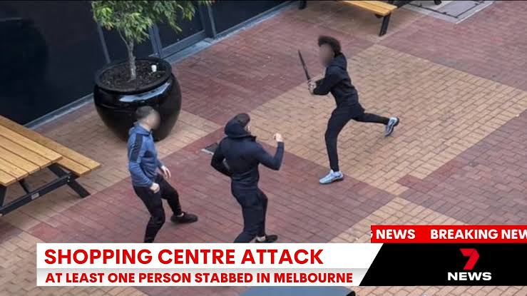
THE PROBLEM
BEACON
THE CHALLENGE ISN'T JUST FINDING ACTIVITIES
10,056
Young alleged offenders
Queensland, 2024-25 Ages 10 - 17
Down 8.8% from the previous year
45%
Safe-space access concern
Said there weren’t enough places to meet friends, or were unsure
QFCC survey Ages 13 - 18
Beacon’s actionable problem: barriers to safe, suitable after-school participation.

Slide 3
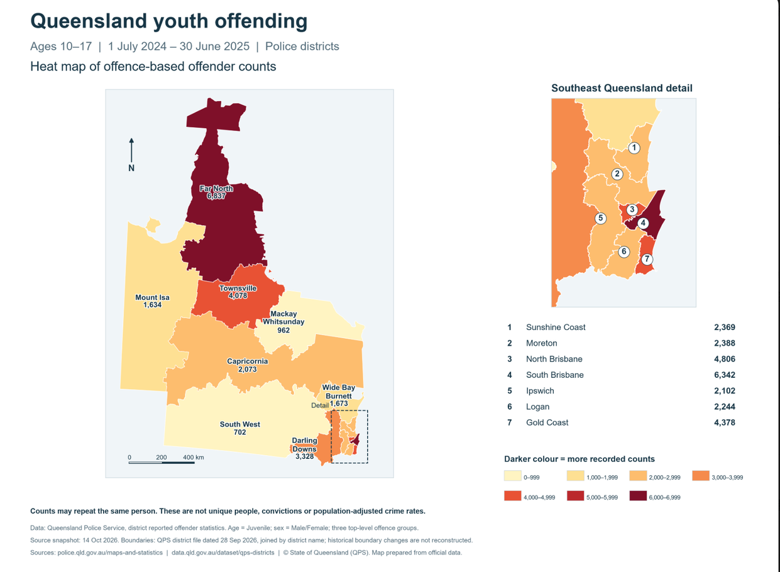
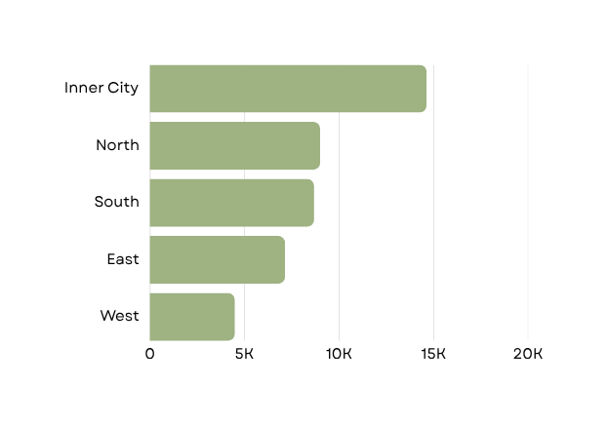
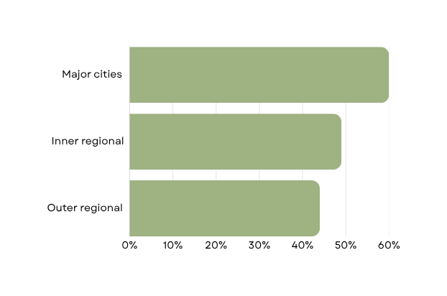
GEOGRAPHIC EVIDENCE
QUEENSLAND
Safe-space access differs by remoteness.
Safe-space availability
Young people reporting enough safe spaces
Brisbane recorded-offence rates
Source : QFCC (n.d., p. 3) · 2020 survey
QGSO (2026), Table 8 · Scale 0–20,000
Notes:
3

Slide 4


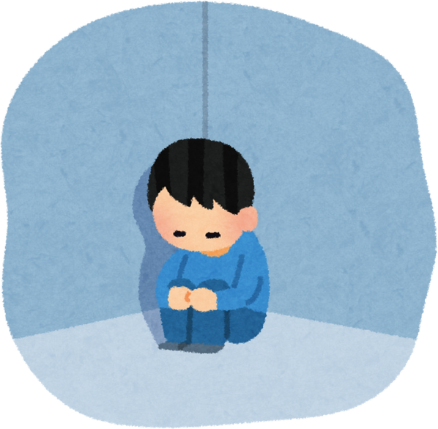
WHY IT EXISTS
THE PARTICIPATION JOURNEY
BARRIERS KEEP YOUNG PEOPLE FROM PARTICIPATING
BARRIERS
POTENTIAL EFFECT
THEORETICAL RISK
Hard to discover
Lower participation in supervised activities.
Greater exposure to disengagement and risky situations
Cost and transport
Attending alone
Perceived safety
More unstructured time without trusted adults
Limited activity choice
Sources: ASC (n.d.-a); QFCC (n.d.); Osgood et al. (1996)
Notes:
4

Slide 5

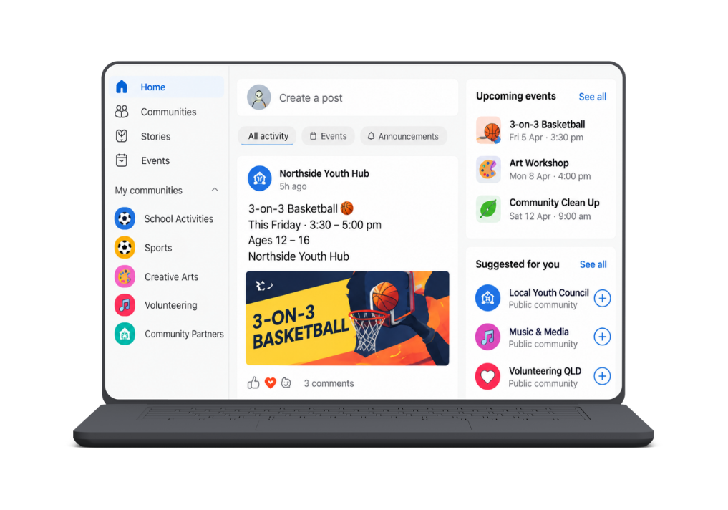
THE TECHNOLOGY
BEACON
School-managed communities
Events and activities in one place
VIVA ENGAGE
The front door to after-school opportunities.
A familiar , school-managed space where students can discover activities, connect with peers and stay informed.
Discover
See upcoming activites, events and opportuniities in one place
Connect
Engage with peers, school groups and community organisations.
Stay informed
Get updates and reminders through a familiar Microsoft 365 experience.
Safe and trusted
Moderated by schools, with approved hosts and content
Familiar Microsoft 365 experience

Slide 6

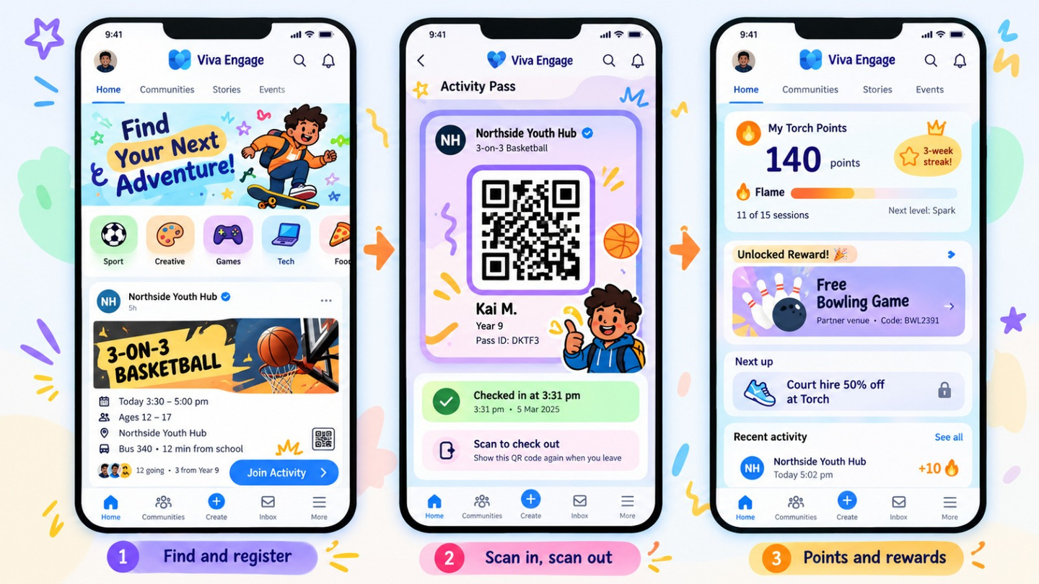
HOW IT WORKS
BEACON
ONE AFTERNOON. A REASON TO SHOW UP AGAIN.
01 / DISCOVER
02 / PARTICIPATE
03 / RETURN
Microsoft (n.d.-e).
Notes:
5

Slide 7




HOW IT WORKS
BEACON
THE REWARD PATHWAY
SAME DAY
+10 Torch Points
Verified session
SAME WEEK
Local voucher
Return incentive
EACH TERM
Group rewards
Consistent participation
LONG TERM
Youth Champion
Leadership opportunity
Microsoft (n.d.-e).
Notes:
5

Slide 8



THE TECHNOLOGY
MICROSOFT
Built on technology schools already use.
One connected Microsoft ecosystem. Three jobs to solve.
1. DISCOVER
The front door
Viva Engage
Microsoft Teams
Find activities through school-managed Microsoft 365
2. PARTICIPATE
The engine
Power Apps
+ Dataverse
Power Automate
+ Pages
Register, verify attendance and award points
3. GOVERN
The oversight
Power BI + Purview
Copilot Studio (proposed)
Aggregate reporting, moderation and guided support
Existing school sign-in + configurable tools + measurable participation
Microsoft (n.d.-a, n.d.-c–f); Queensland Department of Education (2026).

Slide 9





STRATEGIC POSITIONING
BEACON - STRATEGIC POSITIONING
BEACON CONNECTS WHAT OTHERS DELIVER SEPARATELY.
STP STRATEGY
S · SEGMENTATION
Young people aged 12–16, segmented by location, interests and participation barriers
T · TARGETING
Five-school pilot catchment, prioritising students facing access and engagement barriers
P · POSITIONING
School-linked activity discovery with verified attendance and participation rewards
HIGH SCHOOL-LINKED ENGAGEMENT
BEACON
NARROWER
DISCOVERY
BROADER
DISCOVERY
PROPOSED DIFFERENTIATION
    Cross-provider activity discovery
    Trusted school connection
    Rewards for consistent attendance
    Verified engagement reporting
LOW SCHOOL-LINKED ENGAGEMENT
Beacon Competitor Analysis. Illustrative positioning.

Slide 10
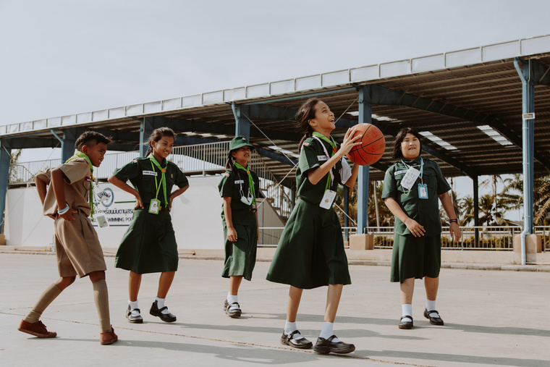
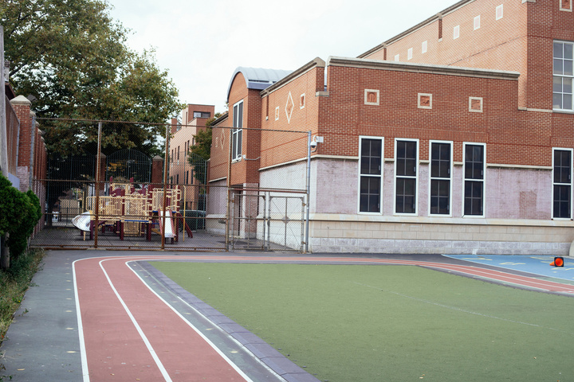
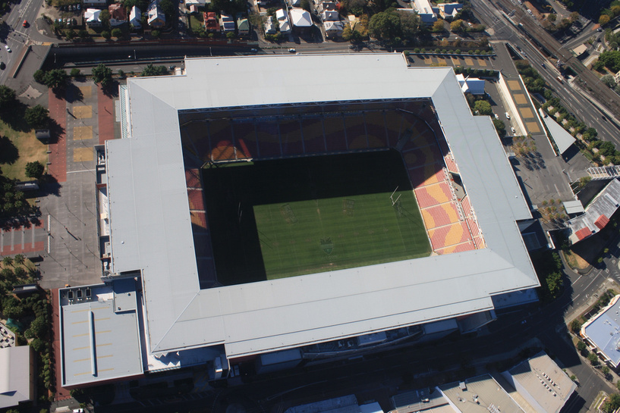
VALUE PROPOSITION CANVAS
STUDENTS AGED 12 - 16
SCHOOLS
LOCAL COUNCILS &2032 PARTNERS
NEED
Safe, enjoyable activities after school.
BEACON OFFERS
Verified activity feed, Beacon Pass, Torch Points and Youth Champions.
VALUE CREATED
makes the first visit easier and gives students a reason to come back.
NEED
Support wellbeing, manage safeguarding and show outcomes.
BEACON OFFERS
School-linked activites, approval worksflows, verified attendance.
VALUE CREATED
Extends support beyond the school gate with visible outcomes.
NEED
Support community impact & show measurable legacy.
BEACON OFFERS
Partner activity portal, moderated listing & impact reporting.
VALUE CREATED
Turns community legacy into evidence and not just sponsorship.
From first visits, to school-supported participation, to community impact -Beacon aligns value across all the three groups.
Australian Sports Commission (n.d.); Queensland Family and Child Commission (n.d.); Strategyzer (n.d.).

Slide 11
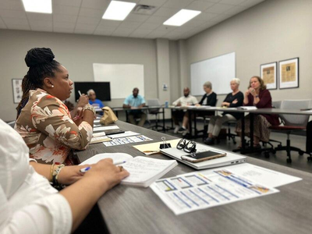
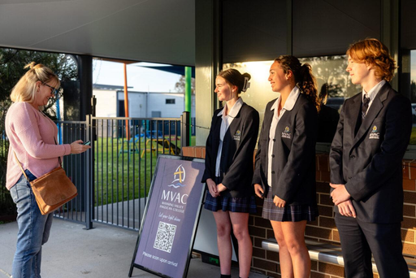
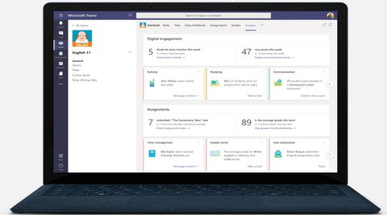
BUSINESS MODEL CANVAS
HOW WE DELIVER
A TRUSTED NETWORK MAKES BEACON POSSIBLE.
Key Partners
Who enables participation?
Schools and Department of Education
Councils, PCYC and local providers
Microsoft and evaluation partners
Key Activities
What must Beacon do?
Approve and coordinate activities
Verify sessions and moderate
Manage rewards and impact reports
Key Resources
What supports delivery?
Microsoft platform and
data systems
Verified venue and activity network
Coordinators and moderators
Partners supply opportunities. Beacon coordinates safe, verified participation.
Osterwalder & Pigneur (2010)

Slide 12
BUSINESS MODEL CANVAS
WHO WE SERVE
DIFFERENT STAKEHOLDERS. ONE CONNECTED PLATFORM.
STAKEHOLDER
STAKEHOLDER
STAKEHOLDER
STAKEHOLDER
Students Safe activites and rewards Viva Engage/Teams Youth Champions
Schools Wellbeing engagement evidence School Well being teams School coordinator
Councils Reach & participation data partner portal Impact reporting
Local Venues Community participation Venue portal/QR Partner support
2032 partners Measurable youth legacy partnership outreach Legacy reports
Osterwalder & Pigneur (2010); Stakeholder arrangements are proposed.
Students participate free. Schools and councils are the modelled payers; partners supply activities and potential in-kind value.

Slide 13
COST STRUCTURE
BEACON
EVERY LINE IS A QUANTITY MULTIPLIED BY A PRICE.
Staff
$100,620 loaded × 0.6 FTE
$60,372
Platform build
50 developer days × $1,200
$60,000
Contingency
10% of $164,376
$16,438
Evaluation
100 hours × $150
$15,000
Licences, net
$24,328 gross − 50% Microsoft credit
$12,164
Co-design and comms
5 schools × $2,000
$10,000
Legal and privacy
PIA $3,500 + agreements $2,500
$6,000
Rewards
$2,100 face value × 40%
$840
Total Year 1 cash cost $180,814
Beacon Financial Model v3, Base scenario.

Slide 14
REVENUE STREAMS
YEAR 1 - 5 SCHOOL PILOT
SCHOOLS AND COUNCILS COVER 40%
THE REST BUILDS IT ONCE.
$ 40,000
22% of cost
$ 30,000
17% of cost
$ 110,814
61% of cost
EARNED REVENUE $ 70,000
TOTAL COST TO COVER $ 180,814
01 SCHOOL SUBSCRIPTIONS
$40,000
5 schools × 800 students × $10
An annual whole-school licence, $8,000 a school , inside a wellbeing budget line, no new approval needed.
02 COUNCIL CO - FUNDING
$30,000
1 catchment × $30,000
The council buys the catchment dashboard: where young people go after 3pm, and which facilities sit idle.
03 BUILD - YEAR FUNDING
$110,814
$180,814 − $70,000
80% of this is one-off: platform build, evaluation and legal. Only $21,714 is operating shortfall.
IN KIND, ON TOP
Year 1 shortfall $21,714, at five schools
Running costs covered at 12 schools · each one beyond adds surplus of $6,237
FOR SCALE
$1.3 million — to detain one young person for a year
$124,000 — our entire three-year public need

Slide 15
Scan it. Show up. Get recognised.
BEACON · THANK YOU

Slide 16
REFERENCE LIST
Australian Sports Commission. (n.d.-a). Barriers and motivation. https://www.ausport.gov.au/youth_participation/barriers_and_motivation
Australian Sports Commission. (n.d.-b). Cost (direct financial and time). https://www.ausport.gov.au/clearinghouse/evidence/children-and-youth-in-sport/factors/cost
Brisbane City Council. (n.d.). Events — Chill Out [Data set]. Retrieved October 19, 2026, from https://data.brisbane.qld.gov.au/explore/dataset/chill-out-events/calendar/
Clipboard. (n.d.). Clipboard extracurricular management system. https://www.clipboard.app/
Cohen, L. E., & Felson, M. (1979). Social change and crime rate trends: A routine activity approach. American Sociological Review, 44(4), 588–608. https://doi.org/10.2307/2094589
Commonwealth Bank of Australia. (2026, April 16). Commonwealth Bank confirmed as Founding Partner and Official Bank for Brisbane 2032 Olympic and Paralympic Games [Media release]. https://www.commbank.com.au/articles/newsroom/2026/04/brisbane-2032.html
Durlak, J. A., Weissberg, R. P., & Pachan, M. (2010). A meta-analysis of after-school programs that seek to promote personal and social skills in children and adolescents. American Journal of Community Psychology, 45(3–4), 294–309. https://doi.org/10.1007/s10464-010-9300-6
Hirschi, T. (1969). Causes of delinquency. University of California Press.
Microsoft. (n.d.-a). Barcode reader control in Power Apps. Microsoft Learn. https://learn.microsoft.com/en-us/power-apps/maker/canvas-apps/controls/control-barcodereader
Microsoft. (n.d.-b). Manage communication compliance policies. Microsoft Learn. https://learn.microsoft.com/en-us/purview/communication-compliance-policies
Microsoft. (n.d.-c). Microsoft 365 Education service description. Microsoft Learn. https://learn.microsoft.com/en-us/office365/servicedescriptions/office-365-platform-service-description/microsoft-365-education
Microsoft. (n.d.-d). Microsoft Viva. Microsoft Learn. https://learn.microsoft.com/en-us/viva/
Microsoft. (n.d.-e). Microsoft Viva Engage. https://www.microsoft.com/en/microsoft-viva/engage
Microsoft. (n.d.-f). Viva Engage. Microsoft Learn. https://learn.microsoft.com/en-us/connectors/yammer/

Slide 17
REFERENCE LIST
National Institute of Justice. (2018, October 2). Practice profile: After-school programs. CrimeSolutions. https://crimesolutions.ojp.gov/ratedpractices/after-school-programs
Osgood, D. W., Wilson, J. K., O'Malley, P. M., Bachman, J. G., & Johnston, L. D. (1996). Routine activities and individual deviant behavior. American Sociological Review, 61(4), 635–655. https://doi.org/10.2307/2096397
Osterwalder, A., & Pigneur, Y. (2010). Business model generation: A handbook for visionaries, game changers, and challengers. John Wiley & Sons.
PCYC Queensland. (n.d.). Our programs. https://www.pcyc.org.au/our-programs/
Productivity Commission. (2026). Report on Government Services 2026: Section 17, Youth justice services. https://www.pc.gov.au/ongoing/report-on-government-services/community-services/youth-justice/
Queensland Department of Education. (2026, April 30). Internet at school. https://education.qld.gov.au/parents/school-information/internetAtSchool
Queensland Family and Child Commission. (2022). Safe spaces: Growing Up in Queensland 2022. https://www.qfcc.qld.gov.au/sites/default/files/report-growing-up-in-queensland-2022.pdf
Queensland Government. (2023, November 10). 20 year plan makes most of Games [Ministerial media statement]. https://statements.qld.gov.au/statements/99127
Queensland Government Statistician's Office. (2026). Crime report, Queensland, 2024–25. Queensland Treasury. https://www.qgso.qld.gov.au/issues/7856/crime-report-qld-2024-25.pdf
Sentral. (n.d.). Sentral Activities. https://info.sentral.com.au/product-spotlight-activities
Strategyzer. (n.d.). The Value Proposition Canvas. https://www.strategyzer.com/library/the-value-proposition-canvas
Taheri, S. A., & Welsh, B. C. (2016). After-school programs for delinquency prevention: A systematic review and meta-analysis. Youth Violence and Juvenile Justice, 14(3), 272–290. https://doi.org/10.1177/1541204014567542

