Slide 1


BISM7208 DIGITAL TRANSFORMATION HACKATHON
BEACON.
Scan it. Show up. Get recognised.
Connecting young people to safer, more accessible and rewarding after-school experiences.
A proposed school-community platform on Microsoft 365

Slide 2
THE PROBLEM
BEACON
THE CHALLENGE ISN'T JUST FINDING ACTIVITIES
10,056
Young alleged offenders
Queensland, 2024-25 Ages 10 - 17
Down 8.8% from the previous year
45%
Safe-space access concern
Said there weren’t enough places to meet friends, or were unsure
QFCC survey Ages 13 - 18
Beacon’s actionable problem: barriers to safe, suitable after-school participation.

Slide 3
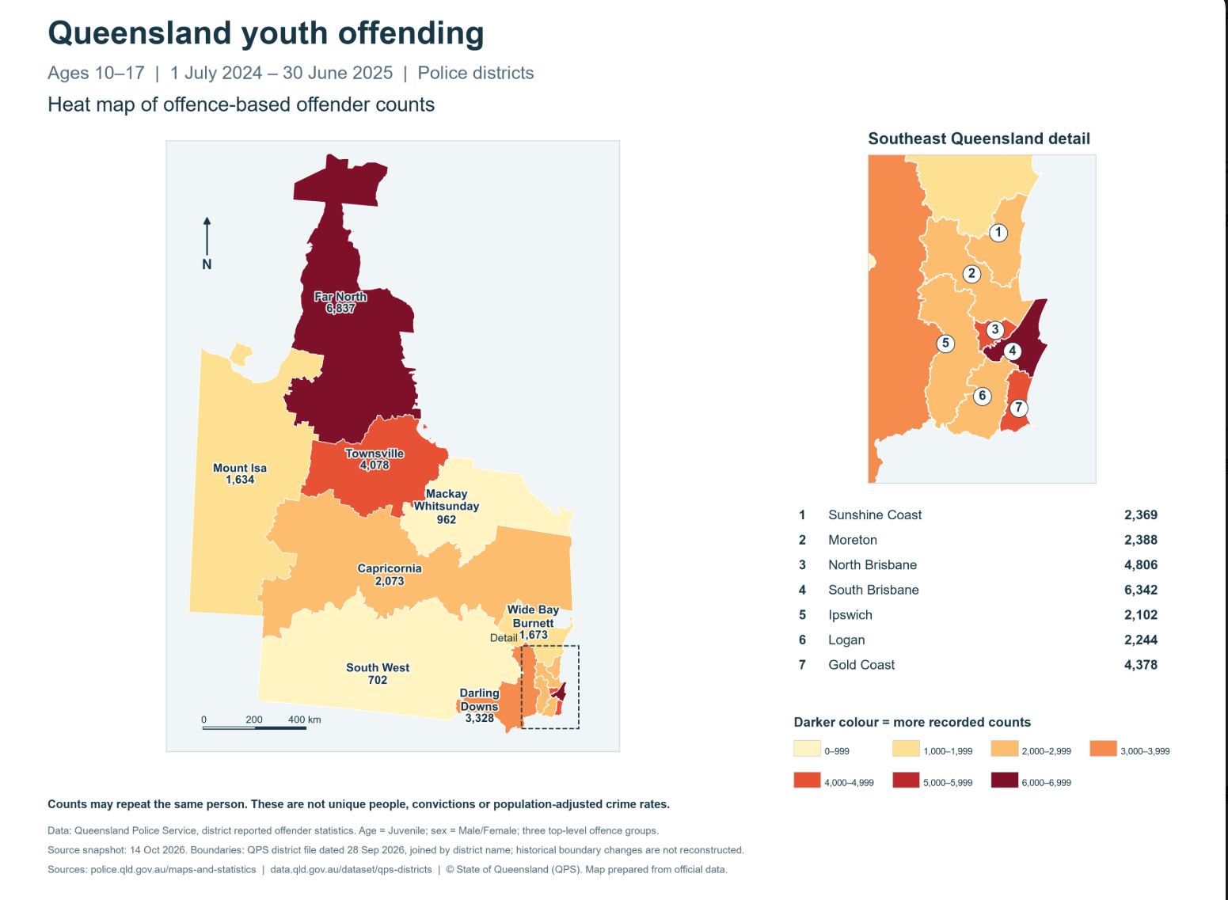
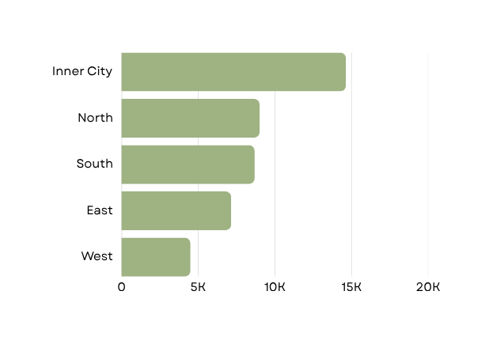
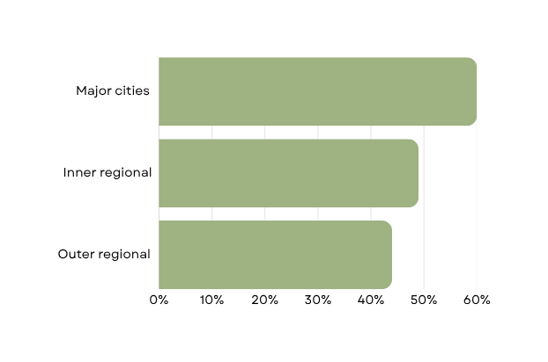
GEOGRAPHIC EVIDENCE
QUEENSLAND
Safe-space access differs by remoteness.
Safe-space availability
Young people reporting enough safe spaces
Brisbane recorded-offence rates
Source : QFCC (n.d., p. 3) · 2020 survey
QGSO (2026), Table 8 · Scale 0–20,000

Slide 4
WHY IT EXISTS
THE PARTICIPATION JOURNEY
BARRIERS KEEP YOUNG PEOPLE FROM PARTICIPATING
BARRIERS
POTENTIAL EFFECT
THEORETICAL RISK
Hard to discover
Lower participation in supervised activities.
Greater exposure to disengagement and risky situations
Cost and transport
Attending alone
More unstructured time without trusted adults
Perceived safety
Limited activity choice
Sources: ASC (n.d.-a); QFCC (n.d.); Osgood et al. (1996)

Slide 5
WHY IT PERSISTS
EVIDENCE-LED DESIGN
TWO THEORIES EXPLAIN WHY SUPERVISION AND BELONGING MATTER
Routine Activity Theory
Social settings and the absence of capable guardians can shape opportunities for offending.
Social Bond Theory
Attachment, involvement and social connections can strengthen bonds with conventional society.
Design implication:
Approved sessions with trusted adult hosts.
Cohen & Felson (1979);
Osgood et al. (1996)
Design implication:
Peer belonging, regular participation and youth leadership.
Hirschi (1969)
The three after-school programme research findings
d = 0.19
Positive social behaviour
Not significant
Average delinquency effect
d = 0.14
School bonding
Durlak et al. (2010), via NIJ (2018); Taheri & Welsh (2016).

Slide 6



THE TECHNOLOGY
MICROSOFT 365.
Built on technology schools already use.
One connected Microsoft ecosystem. Three jobs to solve.
1. DISCOVER
The front door
Viva Engage
Microsoft Teams
Find activities through school-managed Microsoft 365
2. PARTICIPATE
The engine
Power Apps
+ Dataverse
Power Automate
+ Pages
Register, verify attendance and award points
3. GOVERN
The oversight
Power BI + Purview
Copilot Studio (proposed)
Aggregate reporting, moderation and guided support
Existing school sign-in + configurable tools + measurable participation
Microsoft (n.d.-a, n.d.-c–f); Queensland Department of Education (2026); Team 5 (2026b).

Slide 7

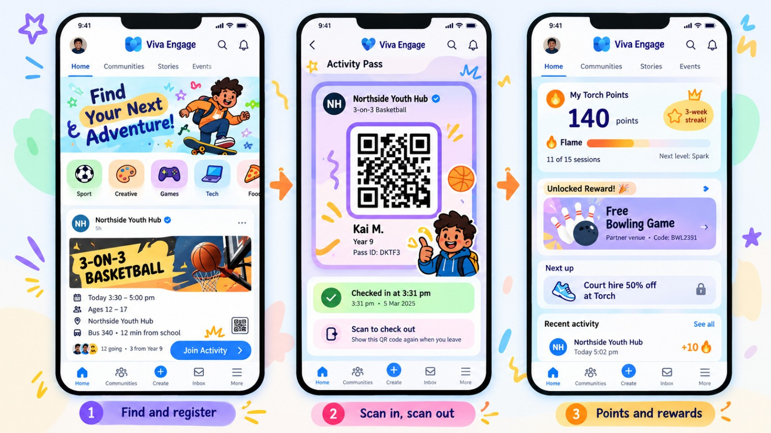
HOW IT WORKS
BEACON
ONE AFTERNOON. A REASON TO SHOW UP AGAIN.
THE REWARD PATHWAY
SAME DAY
+10 Torch Points
Verified session
SAME WEEK
Local voucher
Return incentive
EACH TERM
Group rewards
Consistent participation
LONG TERM
Youth Champion
Leadership opportunity
01 / DISCOVER
02 / PARTICIPATE
03 / RETURN
Microsoft (n.d.-e); Team 5 (2026b).

Slide 8




COMPETITIVE LANDSCAPE
BEACON
WE DON'T REPLACE THE ECOSYSTEM. WE CONNECT IT.
YOUTH & COMMUNITY ACTIVITIES
SCHOOL ACTIVITY MANAGEMENT
PCYC Queensland
Supervised youth programs
Potential partner
Brisbane City Council
Youth spaces and events
Potential partner
Clipboard
Extracurricular administration
Complement
Sentral
Activities and attendance
Complement
BEACON'S PROPOSED POSITION
The connection layer.
  Discover activities across providers
  Verify completed attendance
  Reward repeat participation
  Report aggregate engagement
The biggest alternative may be not participating at all.
PCYC Queensland (n.d.); Brisbane City Council (n.d.); Clipboard (n.d.); Sentral (n.d.).

Slide 9

VALUE PROPOSITION CANVAS
STUDENTS AGED 12 - 16
MAKE THE FIRST VISIT EASIER. MAKE THE NEXT ONE WORTH IT.
Customer profile
JOBS
Have fun after school, spend time with friends and explore interests.
PAINS
Cost, travel, attending alone and uncertainty about safety or welcome.
GAINS
Friendships, skills, confidence and recognition.
Beacon value map
PRODUCTS & SERVICES
Verified activity feed, Beacon Pass, Torch Points and Youth Champions.
PAIN RELIEVERS
Clear activity details, approved hosts, friend invitations and proposed first-visit offers.
GAIN CREATORS
Attendance streaks, partner rewards, leadership and belonging.
From “Will I fit in?” to “I have a reason to come back.”
Australian Sports Commission (n.d.); Queensland Family and Child Commission (n.d.); Strategyzer (n.d.); Team 5 (2026b).

Slide 10
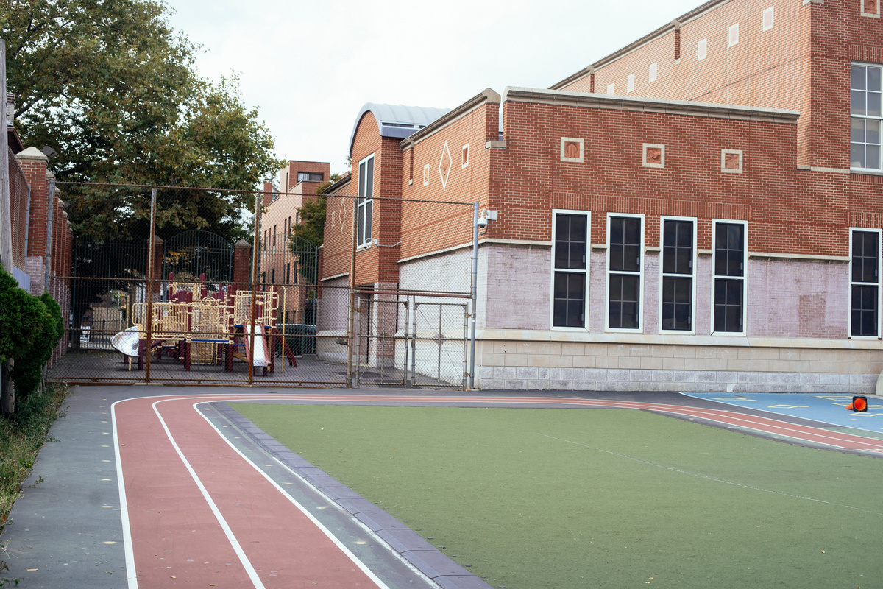
VALUE PROPOSITION CANVAS: HIGH SCHOOLS
SCHOOLS
WELLBEING SUPPORT SHOULDN'T END AT THE SCHOOL GATE.
What schools need
What Beacon proposes
JOBS
Support wellbeing and
account for program
spending.
PRODUCTS & SERVICES
School-linked activities, partner coordination and engagement dashboards.
PAINS
Limited staff capacity, external-provider coordination and safeguarding obligations.
PAIN RELIEVERS
Approval workflows, moderation and verified attendance records.
GAINS
Visible engagement outcomes and stronger community relationships.
GAIN CREATORS
Term reports, first-visit measures and repeat-attendance insights.
Strategyzer (n.d.); Team 5 (2026b, 2026c).

Slide 11
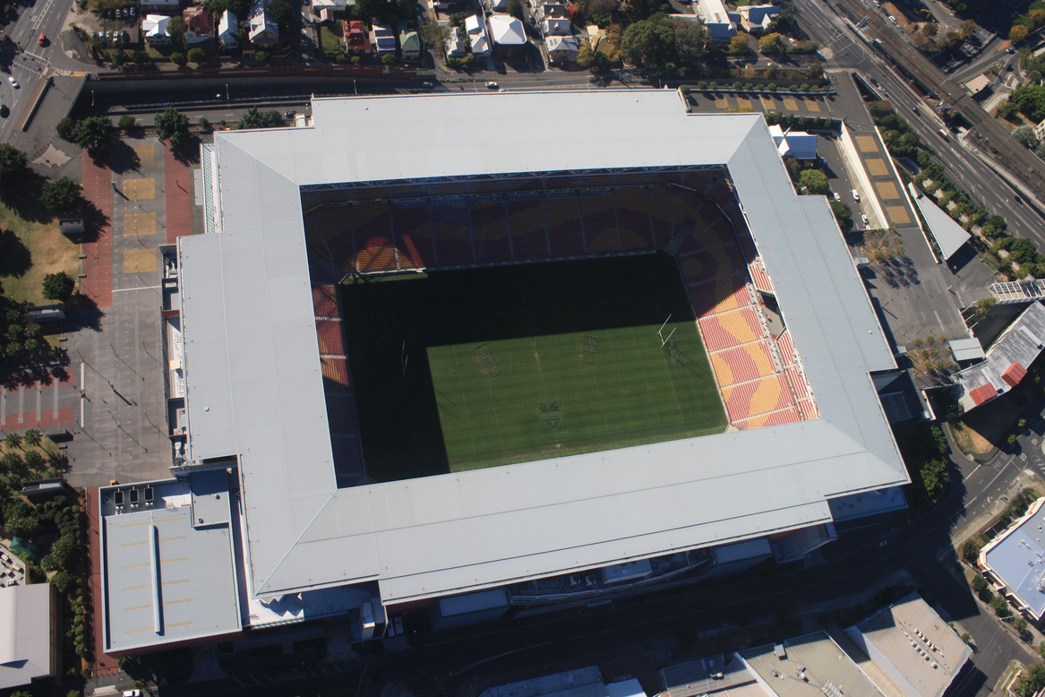
VALUE PROPOSITION CANVAS: BRISBANE 2032 PARTNERS
BRISBANE 2032 PARTNERS
MAKE THE 2032 LEGACY MEASURABLE TODAY.
Partner customer profile
Beacon value map
JOBS
Contribute to community legacy and report meaningful impact.
PAINS
Difficult impact measurement and sensitivity around marketing to minors.
GAINS
Demonstrable participation, trusted engagement and longer-term legacy.
PRODUCTS & SERVICES
Partner activity portal and aggregate impact dashboard.
PAIN RELIEVERS
Moderated listings, limited branding and no individual student data shared.
GAIN CREATORS
Participation reports, youth leadership stories and community outcomes.
A community legacy supported by evidence, not just sponsorship logos.
Prospective partners only. No Beacon sponsorship or funding commitment secured.
Commonwealth Bank of Australia (2026); Queensland Government (2023); Strategyzer (n.d.); Team 5 (2026b, 2026c).

Slide 12
STRATEGIC POSITIONING
BEACON · STRATEGIC POSITIONING
BEACON CONNECTS WHAT OTHERS DELIVER SEPARATELY.
STP STRATEGY
S · SEGMENTATION
Young people aged 12–16, segmented by location, interests and participation barriers
T · TARGETING
Five-school pilot catchment, prioritising students facing access and engagement barriers
P · POSITIONING
School-linked activity discovery with verified attendance and participation rewards
HIGH SCHOOL-LINKED ENGAGEMENT
BEACON
NARROWER
DISCOVERY
BROADER
DISCOVERY
PROPOSED DIFFERENTIATION
  Cross-provider activity discovery
  Trusted school connection
  Rewards for consistent attendance
  Verified engagement reporting
LOW SCHOOL-LINKED ENGAGEMENT
Team 5 (2026a), Beacon Competitor Analysis. Illustrative positioning.

Slide 13
BUSINESS MODEL CANVAS
HOW WE DELIVER
A TRUSTED NETWORK MAKES BEACON POSSIBLE.
Key Partners
Who enables participation?
  Schools and Department of Education
  Councils, PCYC and local providers
  Microsoft and evaluation partners
Key Activities
What must Beacon do?
  Approve and coordinate activities
  Verify sessions and moderate
  Manage rewards and impact reports
Key Resources
What supports delivery?
  Microsoft platform and
data systems
  Verified venue and activity network
  Coordinators and moderators
Partners supply opportunities. Beacon coordinates safe, verified participation.
Osterwalder & Pigneur (2010); Team 5 (2026b).

Slide 14
BUSINESS MODEL CANVAS
WHO WE SERVE
DIFFERENT STAKEHOLDERS. ONE CONNECTED PLATFORM.
CUSTOMER | VALUE | CHANNEL | RELATIONSHIP
Students | Safe activities and rewards | Viva Engage / Teams | Youth Champions
Schools | Wellbeing engagement evidence | School wellbeing teams | School coordinator
Councils | Reach and participation data | Partner portal | Impact reporting
Local venues | Community participation | Venue portal / QR | Partner support
2032 partners | Measurable youth legacy | Partnership outreach | Legacy reports
Students participate free. Schools and councils are the modelled payers; partners supply activities and potential in-kind value.
Osterwalder & Pigneur (2010); Team 5 (2026b, 2026c). Stakeholder arrangements are proposed.

Slide 15
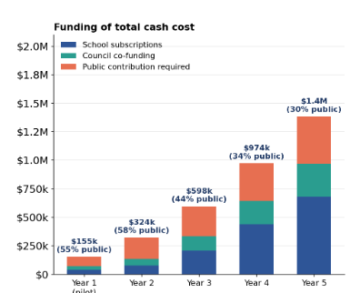
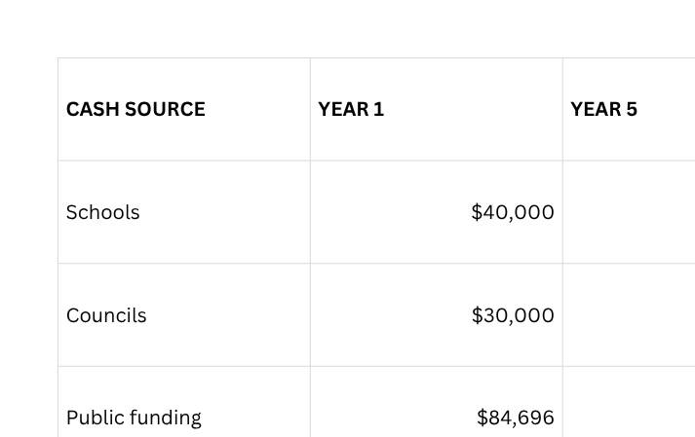
BUSINESS MODEL CANVAS
REVENUE STREAMS
SCHOOLS AND COUNCILS FUND A GROWING SHARE OF BEACON.
Earned revenue covers 45% of costs in Year 1 → 70% by Year 5.
Team 5 (2026c), Financial Model v3, Base scenario, AUD ex GST.

Slide 16
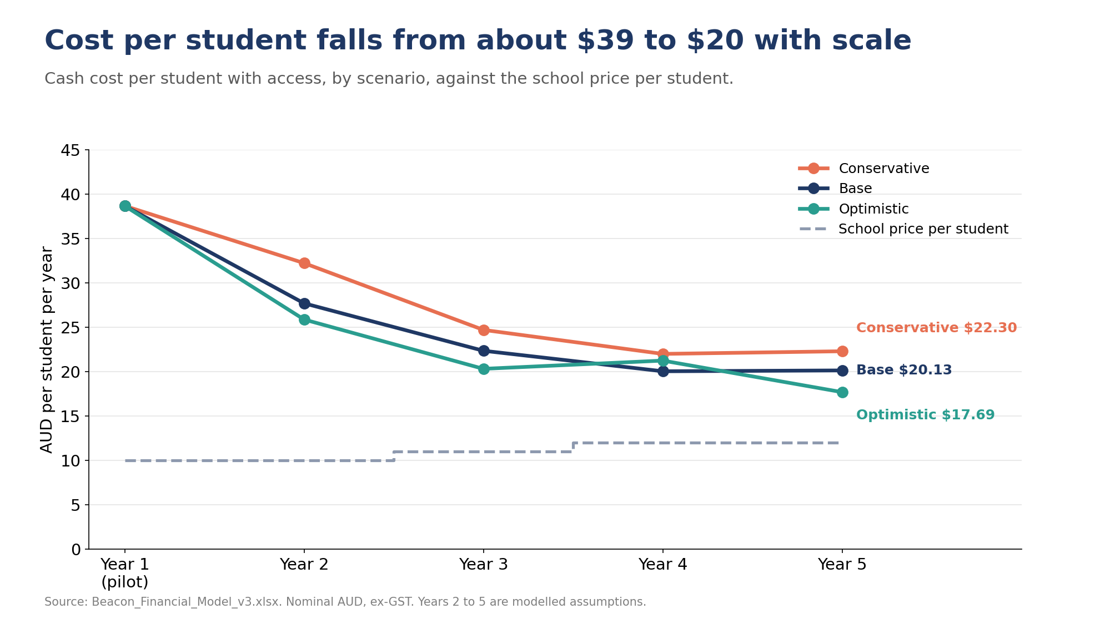
COST STRUCTURE
BEACON
WHERE THE MONEY GOES
Cash costs | Year 1
Staff | $55,000
Licences | $13,856
Platform | $60,000
Other delivery | $25,000
Rewards | $840
Contingency | $0
Total | $154,696
Cost per student with access falls from approximately $39 to $20.
Team 5 (2026c), Beacon Financial Model v3, Base scenario.

Slide 17
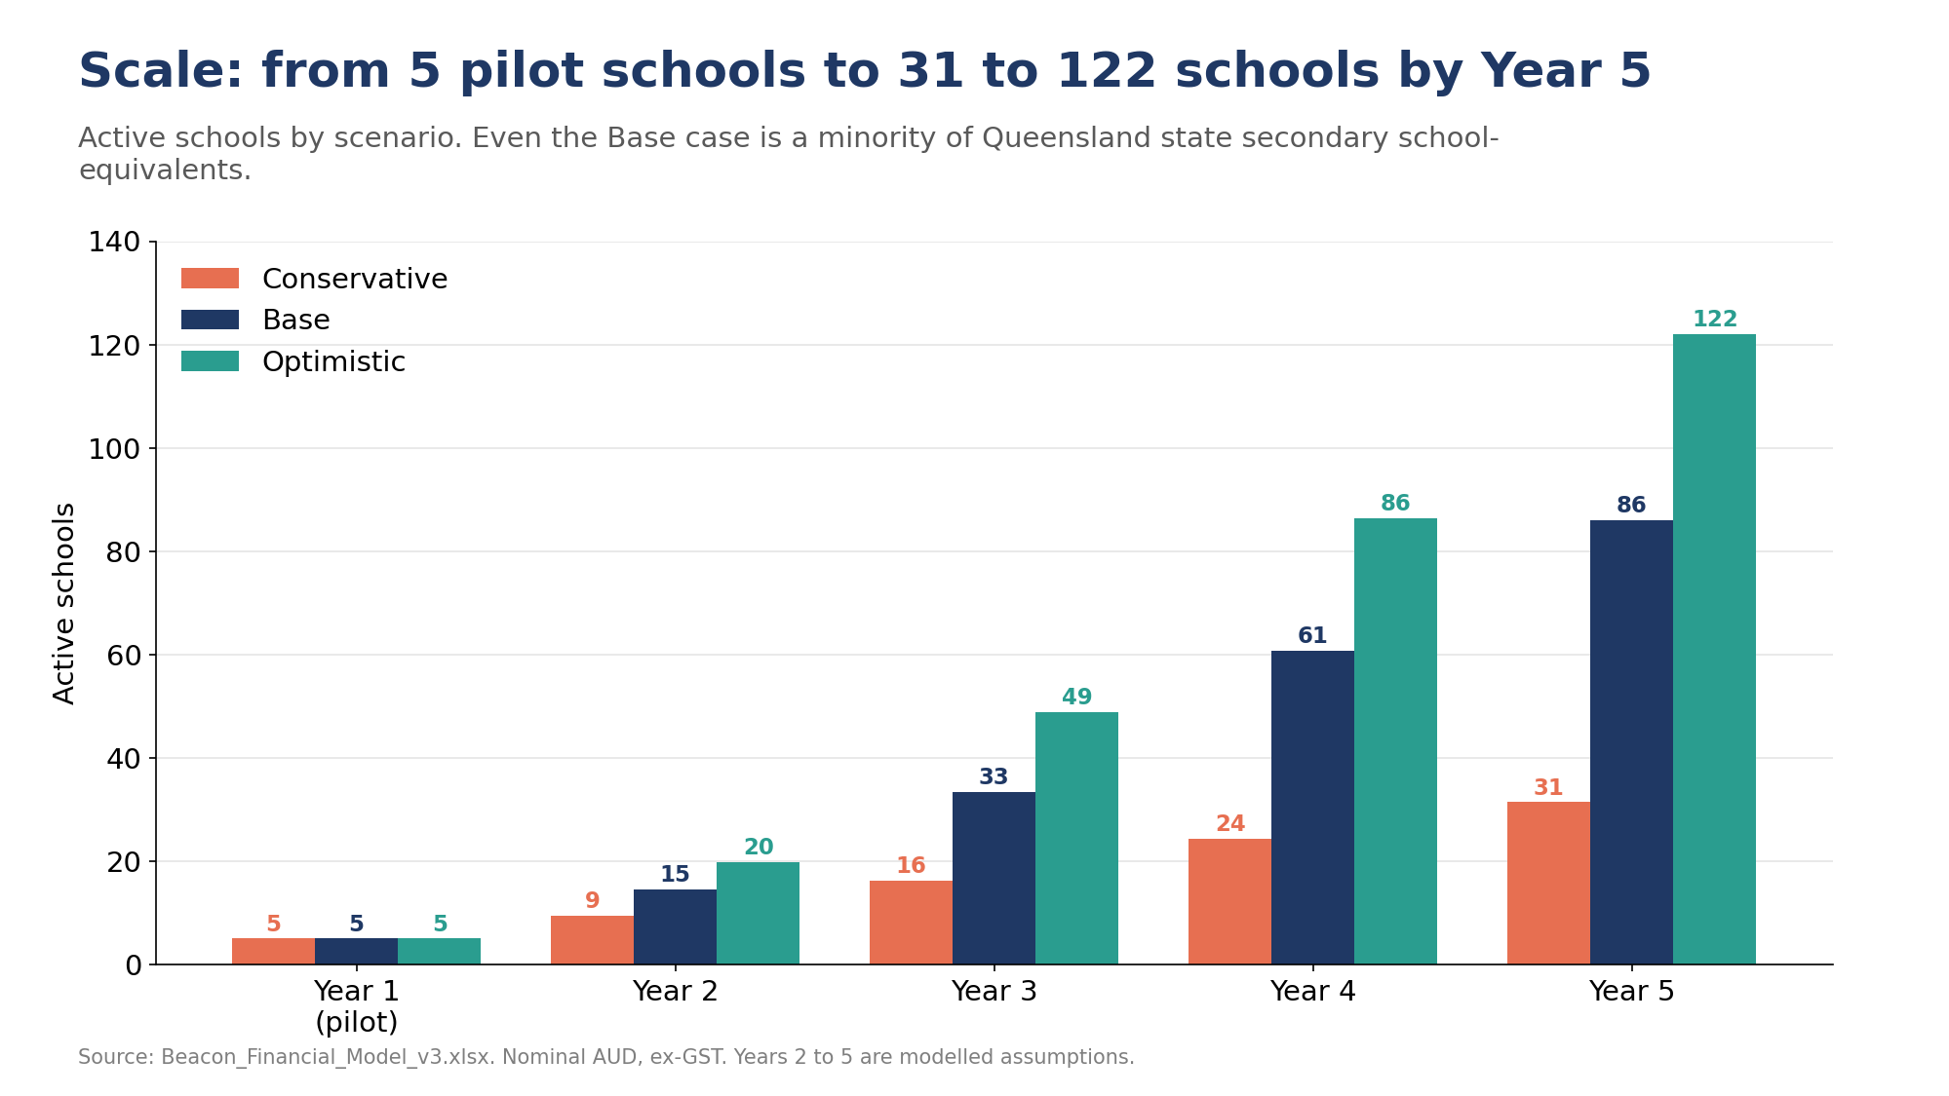
RISK & MITIGATION
BEACON
WHAT WE'D TEST BEFORE SCALING
Risk | Mitigation
Low retention | Track four-week return; test rewards
School fees | Validate willingness to pay
Venue support | Secure agreements and backup offers
Child safety | Screen hosts; consent and moderation
Microsoft access | Confirm licences and permissions
Competition | Build trusted provider relationships
Scale only after confirming demand, safety, technology access and funding.
Team 5 (2026b, 2026c), Beacon Financial Model v3 and proposed risk mitigations.

Slide 18
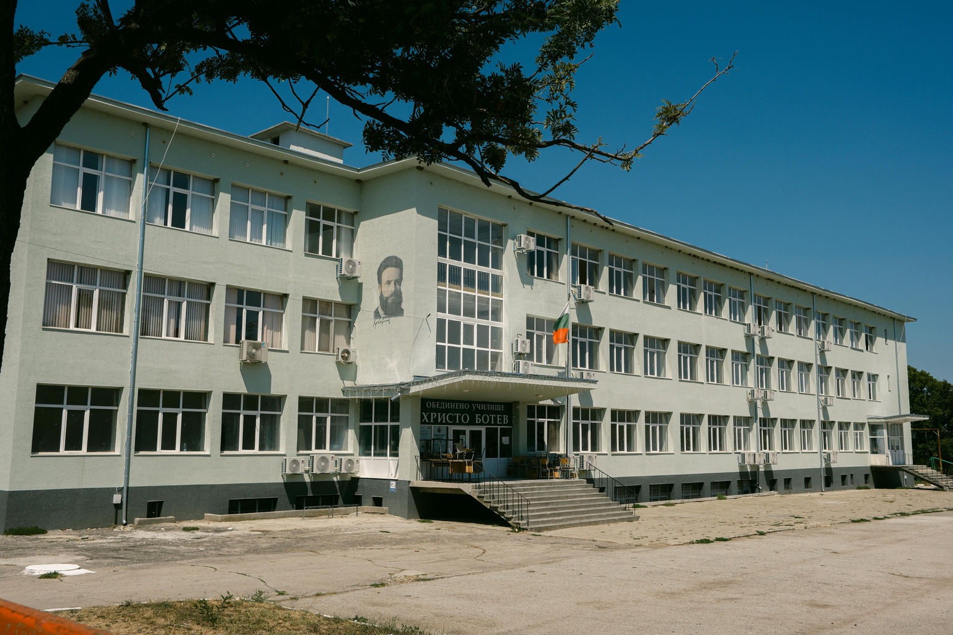
THE PILOT & OUR ASK
FIVE SCHOOLS. ONE OPPORTUNITY TO PROVE BEACON WORKS.
REQUIRED PUBLIC FUNDING
$84,696
For scale: the pilot's public ask is equivalent to approximately 24 days of youth detention for one child, using a rounded national average of $3,600 per day.
5
Pilot schools
4,000
Students with access
12
Months
Funding sought from the Queensland Department of Education or Youth Justice early-intervention funding. No commitment in place.
Microsoft support requested: $13,856 in licence credits, plus platform enablement.
THE PROBLEM THE SOLUTION THE EVIDENCE TO BUILD
Participation barriers Verified activities and rewards Attendance and retention
Team 5 (2026c), Beacon Financial Model v3; Productivity Commission (2026, Section 17). National cost benchmark; no prevention outcome assumed.

Slide 19
Scan it. Show up. Get recognised.
BEACON · THANK YOU

