Slide 1

Data Engineer Salary Predict
In our Data Science course this semester, we were particularly intrigued by the current landscape of data science-related careers, specifically focusing on compensation trends. To satisfy our curiosity and academic requirements, we decided to explore a relevant dataset found on Kaggle: "Data Engineer Salary in 2024."
Date: June 6, 2024

Slide 2
Contributors
陳文遠 112971012
王世儒 112971006
任芝萱 112971020
Data preprocessing
Model training
Shiny app developing

Slide 3

About the Dataset
1
Insights into Data Engineer Salaries
2
Analyzing Trends and Patterns
This dataset provides insights into data engineer salaries and employment attributes for the year 2024. It includes information such as salary, job title, experience level, employment type, employee residence, remote work ratio, company location, and company size.
The dataset allows for analysis of salary trends, employment patterns, and geographic variations in data engineering roles. It can be used by researchers, analysts, and organizations to understand the evolving landscape of data engineering employment and compensation.
3
Feature Description
The dataset includes features such as experience level, employment type, job title, salary, employee residence, remote work ratio, company location, and company size.

Slide 4
Exploratory Data Analysis
Boxplot
Visualize the distribution of salaries across different categorical features, such as experience level, employment type, and company size.
Histogram
Examine the frequency distribution of salaries, both in their original scale and after a log transformation.
1
2
3
Barplot
Analyze the average salaries or counts for each category, ordered by descending value.

Slide 5
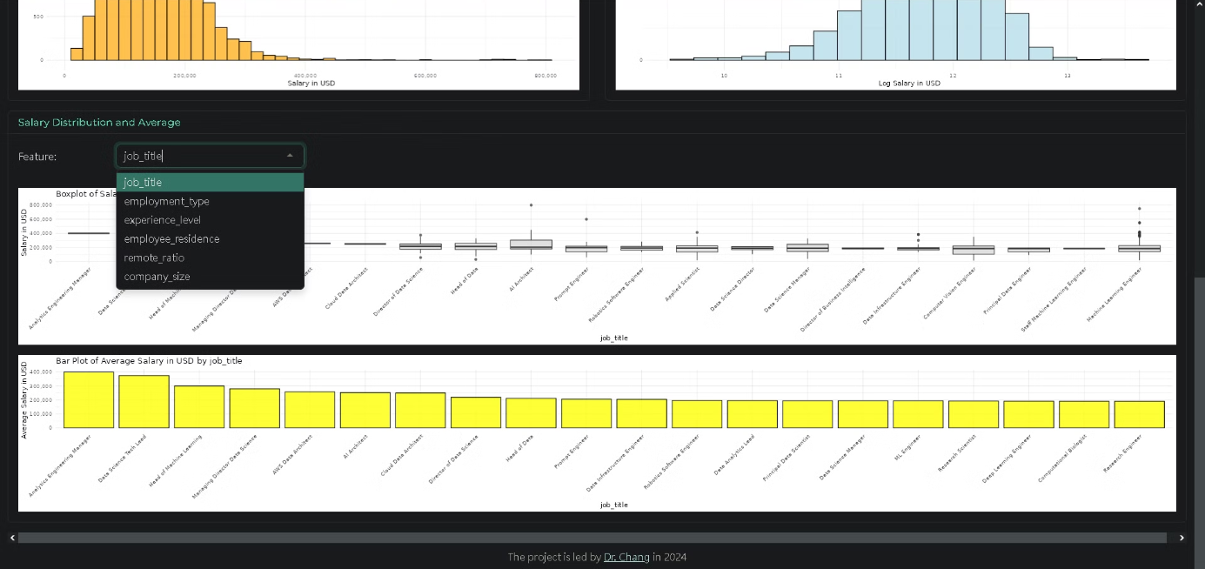
Dashboard

Slide 6
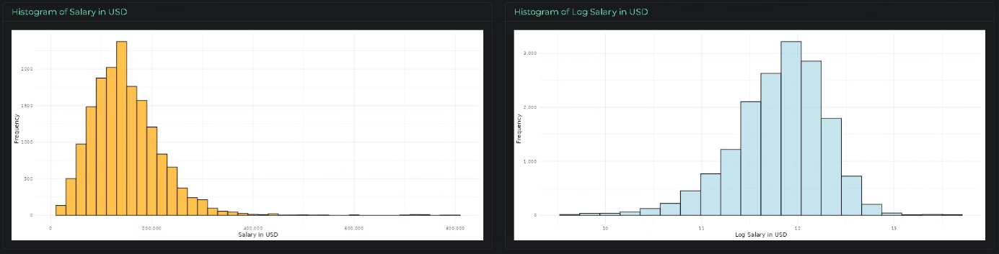
Histogram of Salary

Slide 7
Data Preprocessing
Handling Missing Values
Outlier Detection and Removal
Identify and address any missing or null values in the dataset, ensuring a complete and clean dataset for analysis.
Detect and handle any outliers in the salary data, using techniques such as the interquartile range (IQR) method to identify and replace extreme values.
Encoding Categorical Features
Train-Test Split
Convert categorical features, such as experience level, employment type, and company size, into numerical representations using techniques like ordinal and target encoding.
Split the dataset into training and testing sets, reserving a portion of the data for model evaluation and ensuring the robustness of the final model.

Slide 8
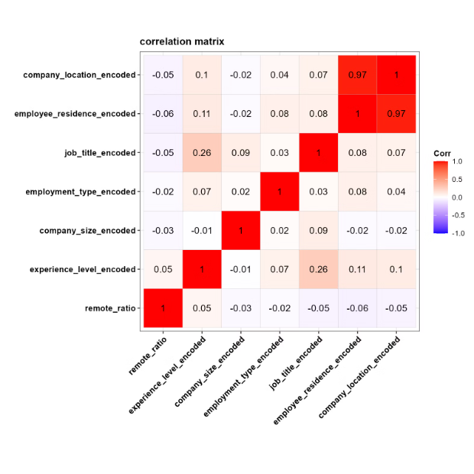
Correlation Matrix for the features
We use target encoding to calculate the mean of signedlog10(salary_in_usd) for each feature.
After target encoding, we use ggcorrplot to generate the correlation matrix for the features.
After comparing the correlation between each feature, we found that there is a high correlation coefficient of 0.97 between two variables. Therefore, we have decided to remove "company_location_encoded".

Slide 9




Model Training and Results
Random Forest
Gradient Boosting
Cross-Validation
Grid Search
Utilize the random forest algorithm to build an ensemble model for predicting the transformed salary target variable.
Employ gradient boosting techniques to further enhance the predictive performance of the ensemble model.
Implement 5-fold cross-validation to ensure the robustness and generalization of the final model.
Utilize grid search to optimize the hyperparameters of the individual models within the ensemble.

Slide 10
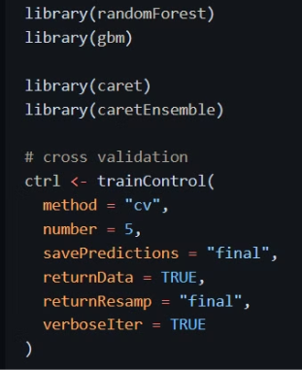
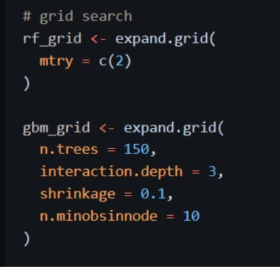
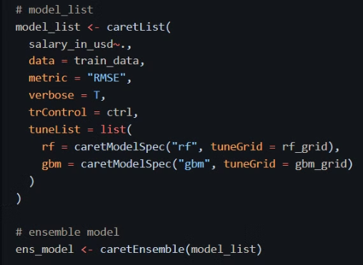
Model code
cross validation
grid search
ensemble

Slide 11
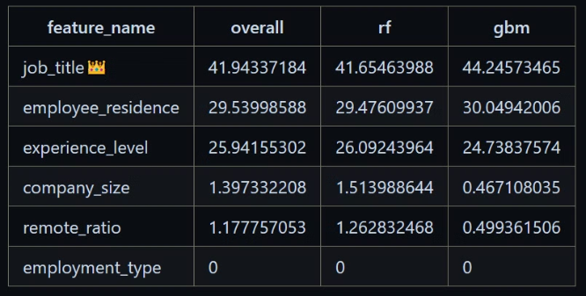
Feature Importance
Job Title
The job title feature is identified as the most important predictor of data engineer salaries, indicating its crucial role in determining compensation levels.
Employee Residence
The employee's country of residence also emerges as a significant factor in influencing data engineer salaries, reflecting geographic variations in compensation.
Experience Level
The experience level of the data engineer, categorized as entry-level, mid-level, or senior, is another important determinant of salary.

Slide 12
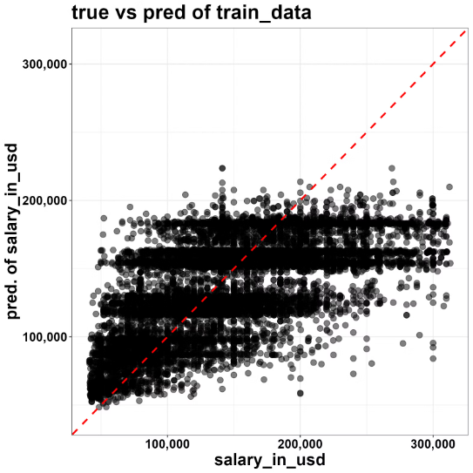
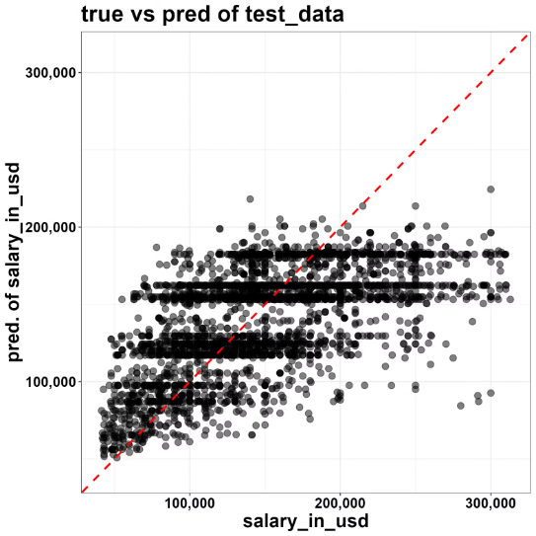
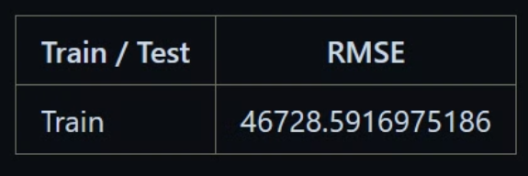
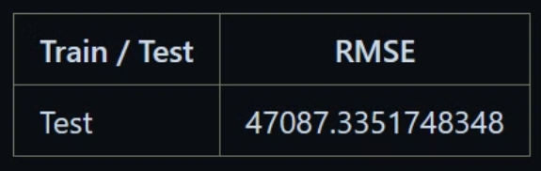
Measurement

Slide 13
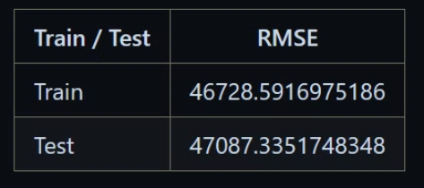
Compare with other results on Kaggle
Our Performance👑
AIML salaries 2022-2024 AutoViz+CatBoost+SHAP
Neural Network Regression Models
RMSE score for train
test RMSE: 57857.07162184822
51.4 kUSD/year,
and for test 52.0 kUSD/year

Slide 14



Conclusion
Results
Improvement
The accuracy of our model is already significantly better than other results on Kaggle, indicating the effectiveness of our ensemble approach and feature engineering efforts.
While the current results are passable, we believe that with additional data or features, we can further optimize the model to achieve even better predictive performance that meets industry standards.

