Slide 1
概率语言模型-n-gram
Lesson-09

Slide 2
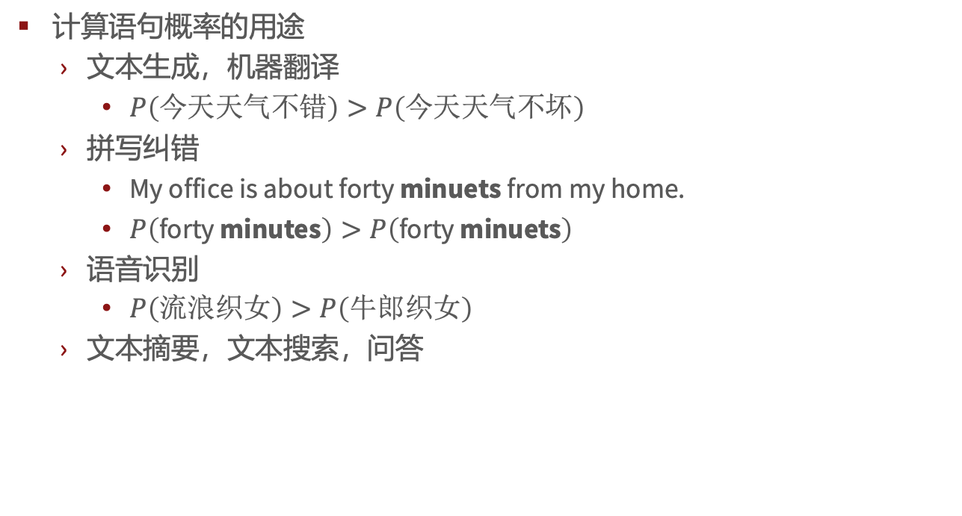
概率语言模型(Probabilistic language models)
计算语句概率的用途
文本生成，机器翻译
$P\left(今天天气不错\right)>P\left(今天天气不坏\right)$
拼写纠错
My office is about forty minuets from my home.
$P\left(\text{forty} \text{minut}\text{e}\text{s}\right)>P\left(\text{forty} \text{minuets}\right)$
语音识别
$P\left(流浪织女\right)>P\left(牛郎织女\right)$
文本摘要，文本搜索，问答

Slide 3

概率语言模型
目标：计算一句话或一段文本的概率？
$$P\left(W\right)=P\left(w_{1},w_{2},w_{3},…,w_{n}\right)$$
或者计算下一个词的概率：
$$P\left({w_{4}|w}_{1},w_{2},w_{3}\right)$$
上述两种概率的模型就称为语言模型（language model, LM)
$P\left(W\right)$ or $P\left(w_{n}|w_{1},w_{2},…,w_{n−1} \right)$

Slide 4
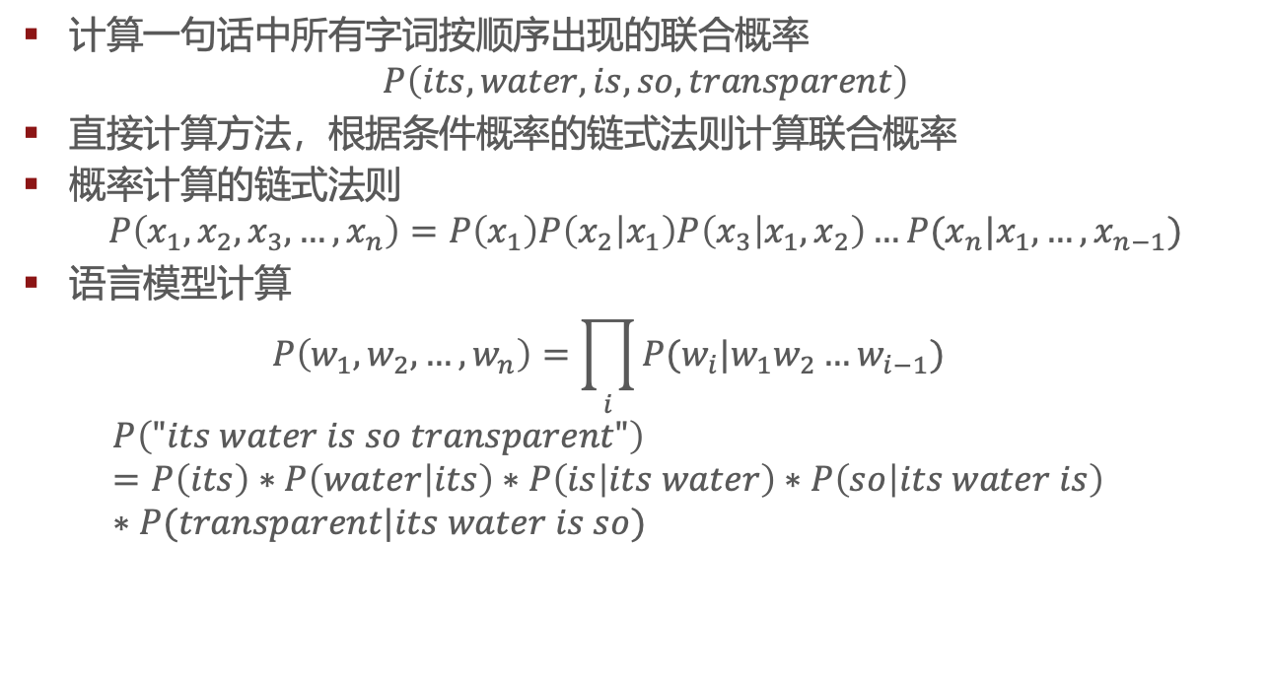
如何计算$P(W)$
计算一句话中所有字词按顺序出现的联合概率
$$P\left(its,water,is,so,transparent\right)$$
直接计算方法，根据条件概率的链式法则计算联合概率
概率计算的链式法则
$$P\left(x_{1},x_{2},x_{3},…,x_{n}\right)=P\left(x_{1}\right)P\left(x_{2} | x_{1}\right)P\left(x_{3} | x_{1},x_{2}\right)…P(x_{n}|x_{1},…,x_{n−1})$$
语言模型计算
$$P\left(w_{1},w_{2},…,w_{n}\right)=\prod_{i}{P(w_{i}|w_{1}w_{2}…w_{i−1})}$$
$$P\left("its water is so transparent"\right)=P\left(its\right)∗P\left(water | its\right)∗P\left(is | its water\right)∗P\left(so | its water is\right)∗P(transparent|its water is so)$$

Slide 5
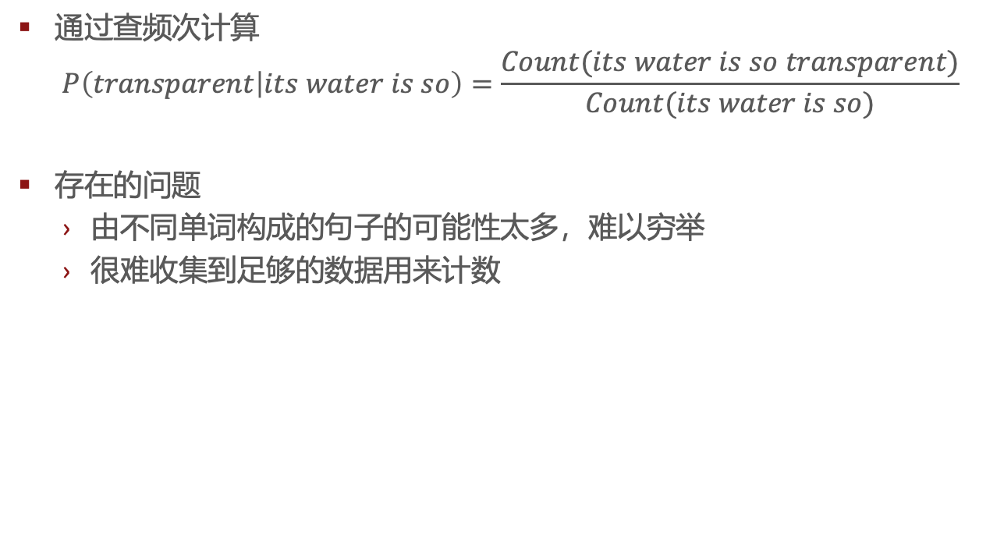
如何计算$P(W)$
通过查频次计算
$$P\left(transparent | its water is so\right)=\frac{Count(its water is so transparent)}{Count(its water is so)}$$
存在的问题
由不同单词构成的句子的可能性太多，难以穷举
很难收集到足够的数据用来计数

Slide 6
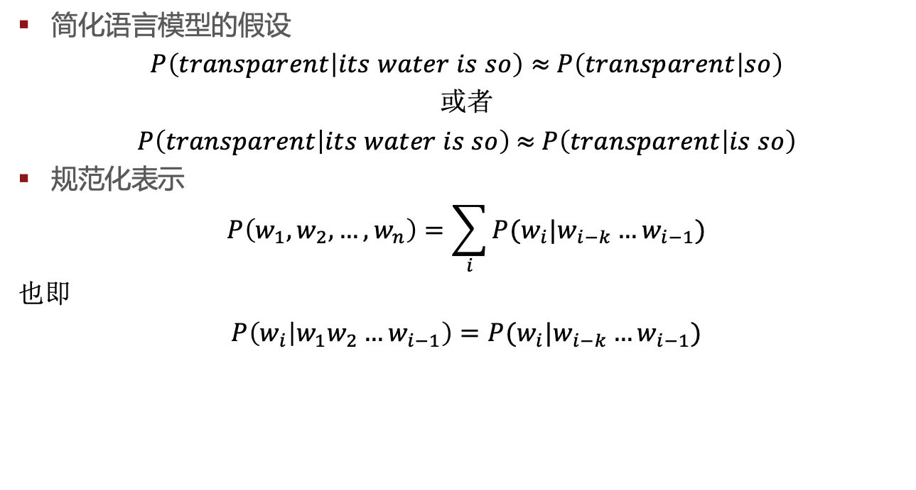
马尔可夫假设
简化语言模型的假设
$P\left(transparent | its water is so\right)≈$ $P\left(transparent | so\right)$
或者
$P\left(transparent | its water is so\right)$ $≈$ $P\left(transparent | is so\right)$
规范化表示
$$P\left(w_{1},w_{2},…,w_{n}\right)=\sum_{i}{P(w_{i}|w_{i−k}…w_{i−1})}$$
也即
$P\left(w_{i} | w_{1}w_{2}…w_{i−1}\right)=P(w_{i}|w_{i−k}…w_{i−1}$)

Slide 7
基于马尔可夫假设的最简单的模型——unigram model
基于一个unigram model生成的若干语句
fifth, an, of, futures, the, an, incorporated, a, a, the, inflation, most, dollars, quarter, in, is, mass
thrift, did, eighty, said, hard, 'm, july, bullish
that, or, limited, the

Slide 8
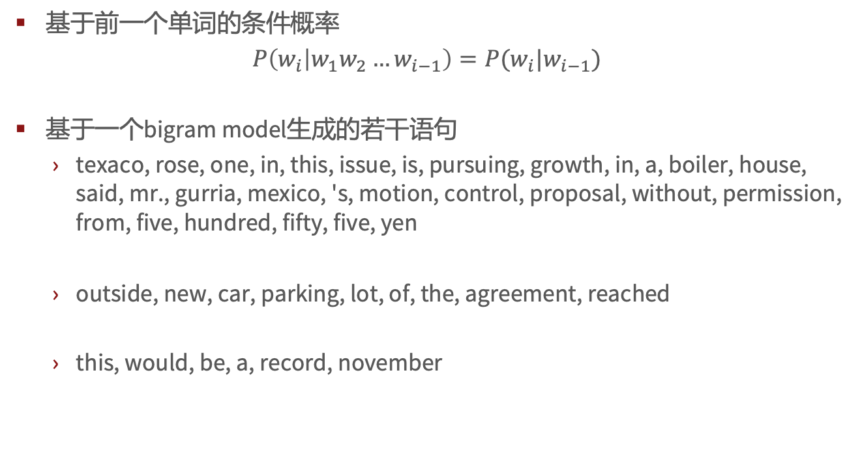
Bigram model
基于前一个单词的条件概率
$P\left(w_{i} | w_{1}w_{2}…w_{i−1}\right)=P(w_{i}|w_{i−1}$)
基于一个bigram model生成的若干语句
texaco, rose, one, in, this, issue, is, pursuing, growth, in, a, boiler, house, said, mr., gurria, mexico, 's, motion, control, proposal, without, permission, from, five, hundred, fifty, five, yen
outside, new, car, parking, lot, of, the, agreement, reached
this, would, be, a, record, november

Slide 9
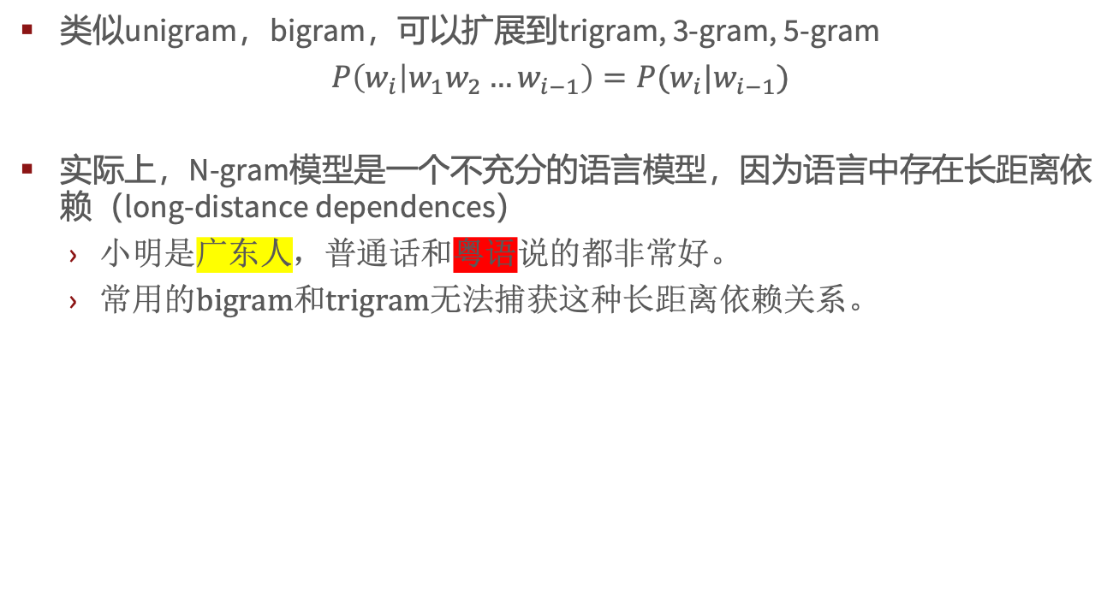
N-gram模型
类似unigram，bigram，可以扩展到trigram, 3-gram, 5-gram
$P\left(w_{i} | w_{1}w_{2}…w_{i−1}\right)=P(w_{i}|w_{i−1}$)
实际上，N-gram模型是一个不充分的语言模型，因为语言中存在长距离依赖（long-distance dependences）
小明是广东人，普通话和粤语说的都非常好。
常用的bigram和trigram无法捕获这种长距离依赖关系。

Slide 10
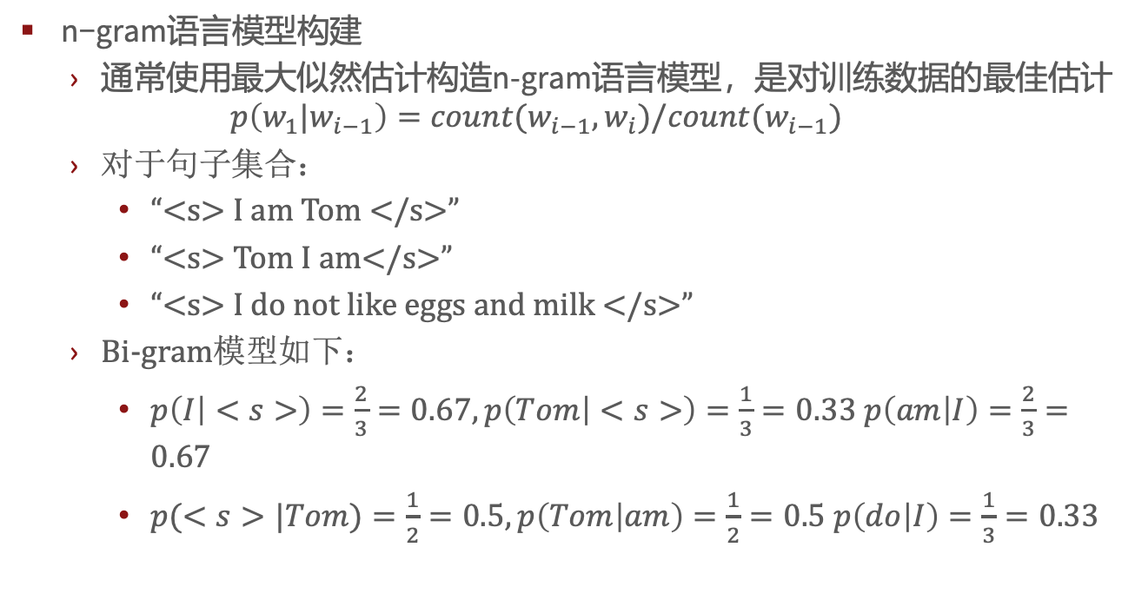
计算N-grams的概率
n−gram语言模型构建
$通常$使用最大似然估计构造n-gram语言模型，是对训练数据的最佳估计
$$p\left(w_{1}|w_{i−1}\right)=count(w_{i−1},w_{i})/count(w_{i−1})$$
对于句子集合：
“<s> I am Tom </s>”
“<s> Tom I am</s>”
“<s> I do not like eggs and milk </s>”
Bi-gram模型如下：
$p\left(I | <s>\right)=\frac{2}{3}=0.67, p\left(Tom | <s>\right)=\frac{1}{3}=0.33 p\left(am | I\right)=\frac{2}{3}=0.67$
$p(<s>|Tom)=\frac{1}{2}=0.5, p\left(Tom | am\right)=\frac{1}{2}=0.5 p\left(do | I\right)=\frac{1}{3}=0.33$

Slide 11
Berkeley Restaurant Project sentences
语料库示例
can you tell me about any good cantonese restaurants close by
mid priced thai food is what i’m looking for
tell me about chez panisse
can you give me a listing of the kinds of food that are available
i’m looking for a good place to eat breakfast
when is caffe venezia open during the day

Slide 12
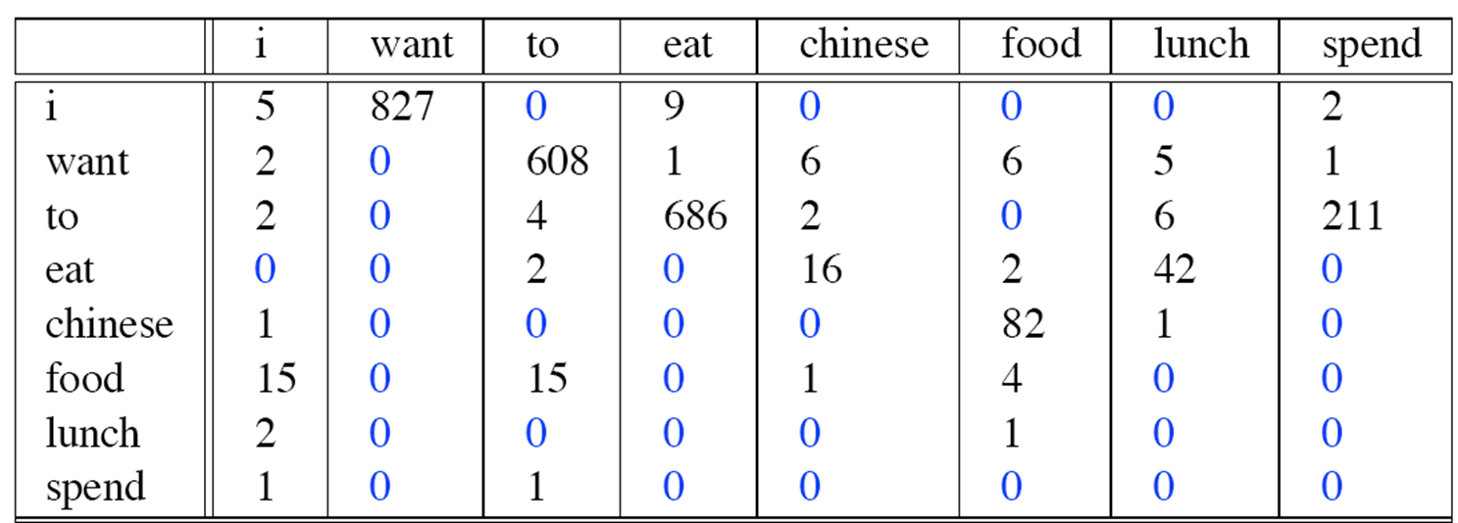
粗略的bi-gram计数
从9222个语句中抽取bi-gram，bi-gram计数表部分数据如下：

Slide 13
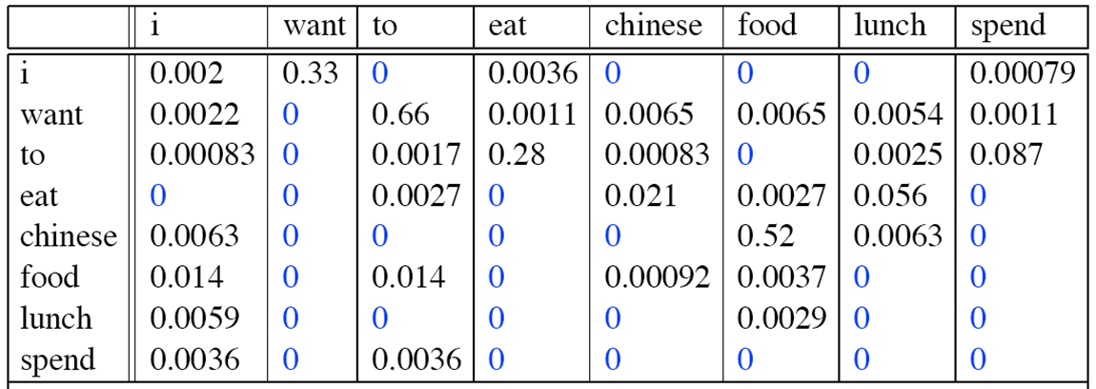

bi-gram模型计算
Unigrams部分如果如下：
$Bi$grams结果如下：

Slide 14
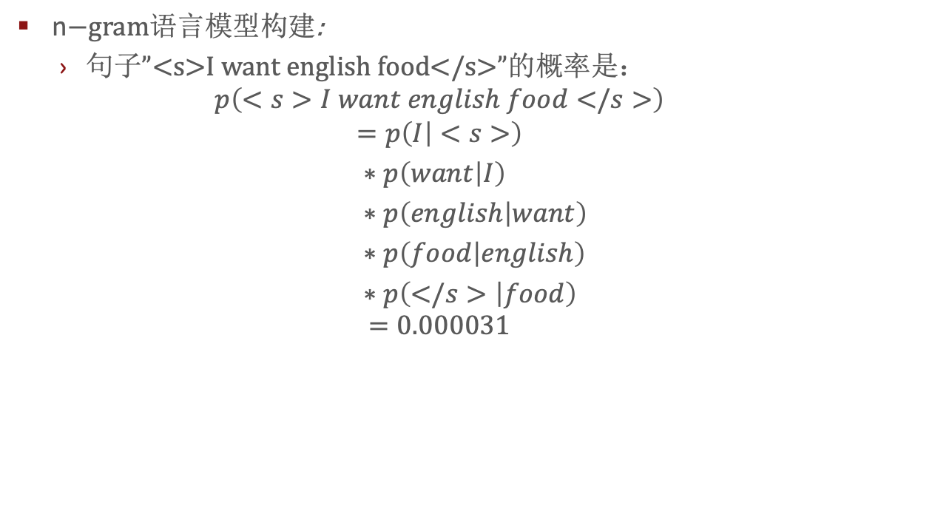
N-gram
n$−gram语言模型构建$:
句子”<s>I want english food</s>”的概率是：
$$p\left(<s>I want english food</s>\right)$$
$$=p\left(I | <s>\right)$$
$∗p\left(want | I\right)$
$∗p\left(english | want\right)$
$∗p\left(food | english\right)$
$∗p\left(</s> | food\right)$ $$=0.000031$$

Slide 15

N-gram
n$−gram语言模型构建$:
P$\left(english | want\right)$=0.0011
P$\left(chinese | want\right)$=0.0065
P$\left(to | want\right)$=0.66
P$\left(eat | to\right)$=0.28
P$\left(food | to\right)$=0
P$\left(want | spend\right)=0$
P$\left(i | <s>\right)$=0.25

Slide 16

计算技巧
在对数空间中计算条件概率
避免向下溢出（underflow）
转换成log后，乘法变成了加法，计算速度更快
$$\log\left(p_{1}∗p_{2}∗p_{3}∗…∗p_{n}\right)=\log{p_{1}}+logp_{2}+logp_{3}+…+logp_{n}$$

Slide 17
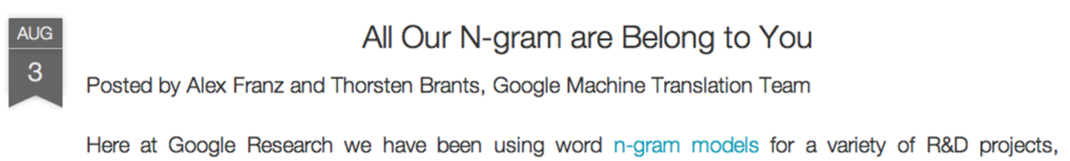
Google N-gram
……

Slide 18
Google N-gram
https://books.google.com/ngrams
serve as the incoming 92
serve as the incubator 99
serve as the independent 794
serve as the index 223
serve as the indication 72
serve as the indicator 120
serve as the indicators 45
serve as the indispensable 111
serve as the indispensible 40
serve as the individual 234

Slide 19
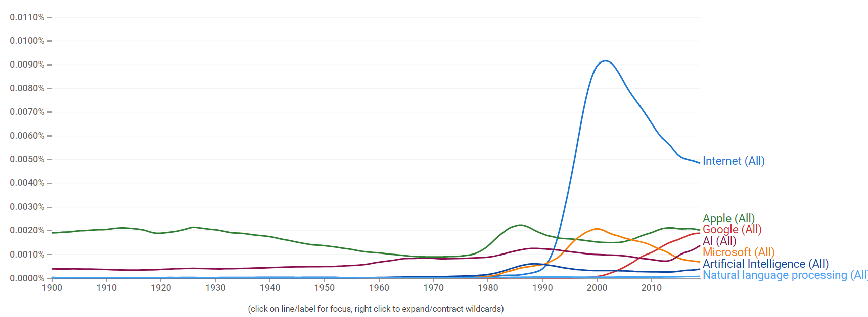
Google N-gram

Slide 20
N-gram模型效果评测
建立的语言模型是否能区分“正确语句”和“错误语句”？
N-gram模型给真实的高频语句更高的概率，对于不合语法以及低频语句如何处理？
在训练数据集上学习模型参数，在另外的测试数据集上测试模型的性能
测试数据集与训练数据集不同
基于评测指标判断语言模型在测试数据集上的表现

Slide 21
N-gram模型效果评测
第一种方法：在实际应用任务中验证模型的效果
拼接纠错——多少个错误字词被识别出来
机器翻译——多少个单词被正确翻译
……
以上评测方法需要借助外部的应用任务，操作复杂，且需要花费大量时间
第二种方法：基于语言模型的内在特征的评测
Perplexity（困惑度）
当测试数据与训练数据相似的时候，语言模型在困惑度指标上表现很好
但主要在中间测试环节使用perplexity

Slide 22
困惑度(Perplexity)
The Shannon Game
预测下一个单词
Unigram在这个游戏种效果很差
好的语言模型
对实际出现过的单词赋予更高的概率
mushrooms 0.1
pepperoni 0.1
anchovies 0.01
….
fried rice 0.0001
….
and 1e-100
I always order pizza with cheese and ____
The 33rd President of the US was ____
I saw a ____

Slide 23
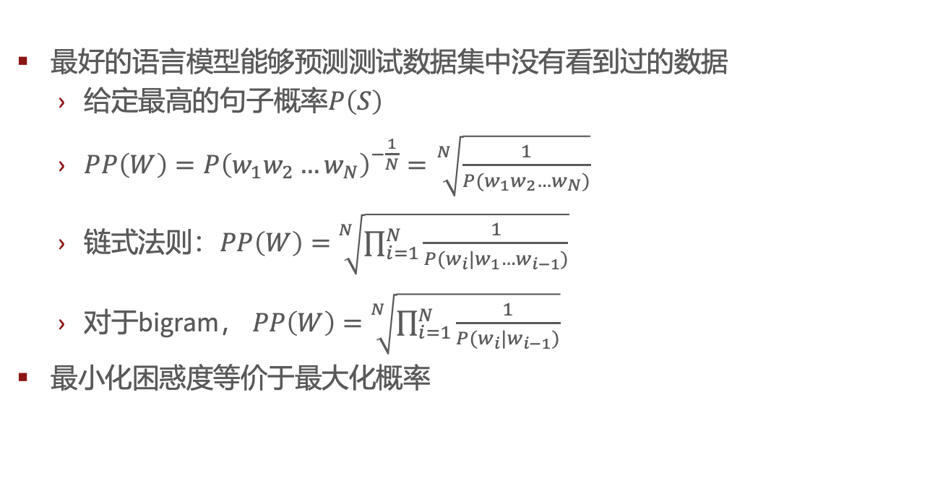
困惑度(Perplexity)
最好的语言模型能够预测测试数据集中没有看到过的数据
给定最高的句子概率$P\left(S\right)$
$PP\left(W\right)=P{\left(w_{1}w_{2}…w_{N}\right)}^{−\frac{1}{N}}=\sqrt[N]{\frac{1}{P(w_{1}w_{2}…w_{N})}}$
链式法则：$PP\left(W\right)=$ $\sqrt[N]{\prod_{i=1}^{N}{\frac{1}{P(w_{i}|w_{1}…w_{i−1})}}}$
对于bigram， $PP\left(W\right)=$ $\sqrt[N]{\prod_{i=1}^{N}{\frac{1}{P(w_{i}|w_{i−1})}}}$
最小化困惑度等价于最大化概率

Slide 24
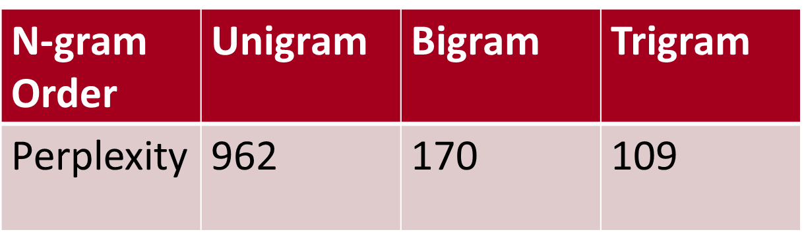
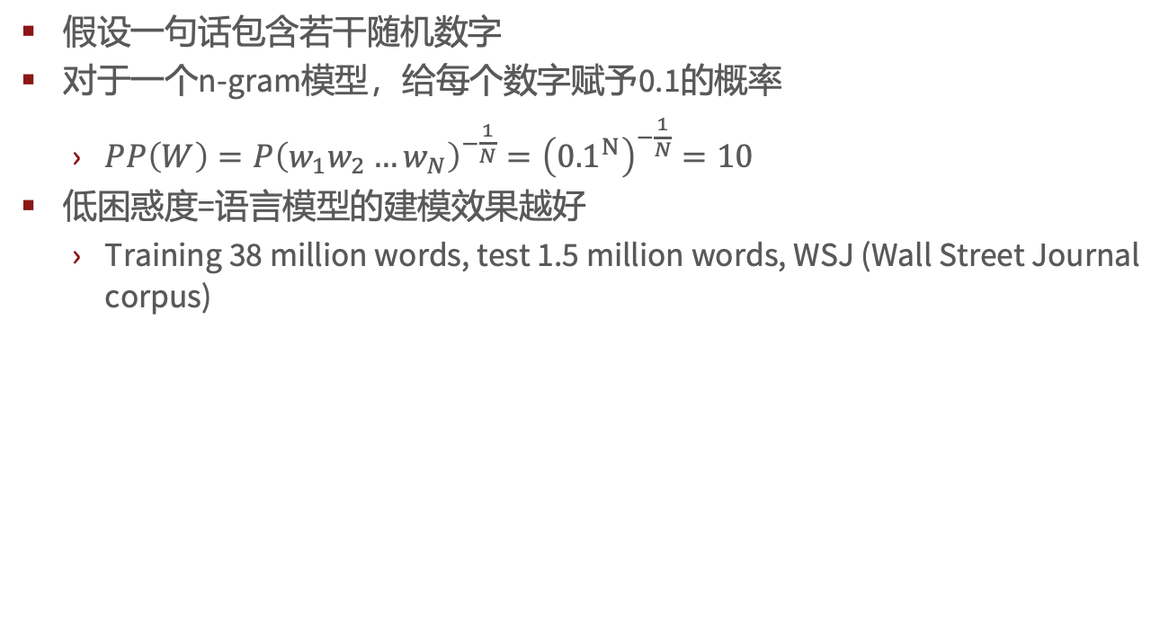
困惑度(Perplexity)
假设一句话包含若干随机数字
对于一个n-gram模型，给每个数字赋予0.1的概率
$PP\left(W\right)=P{\left(w_{1}w_{2}…w_{N}\right)}^{−\frac{1}{N}}={\left({0.1}^{N}\right)}^{−\frac{1}{N}}=10$
低困惑度=语言模型的建模效果越好
Training 38 million words, test 1.5 million words, WSJ (Wall Street Journal corpus)

Slide 25
困惑度(Perplexity)
根据概率随机选择一个bigram(<s>,w)
根据概率选择一个bigram(w,x)
直到选中句子结束符号</s>
得到生成的句子。
<s> I
I want
want to
to eat
eat Chinese
Chinese food
food </s>
I want to eat Chinese food

Slide 26
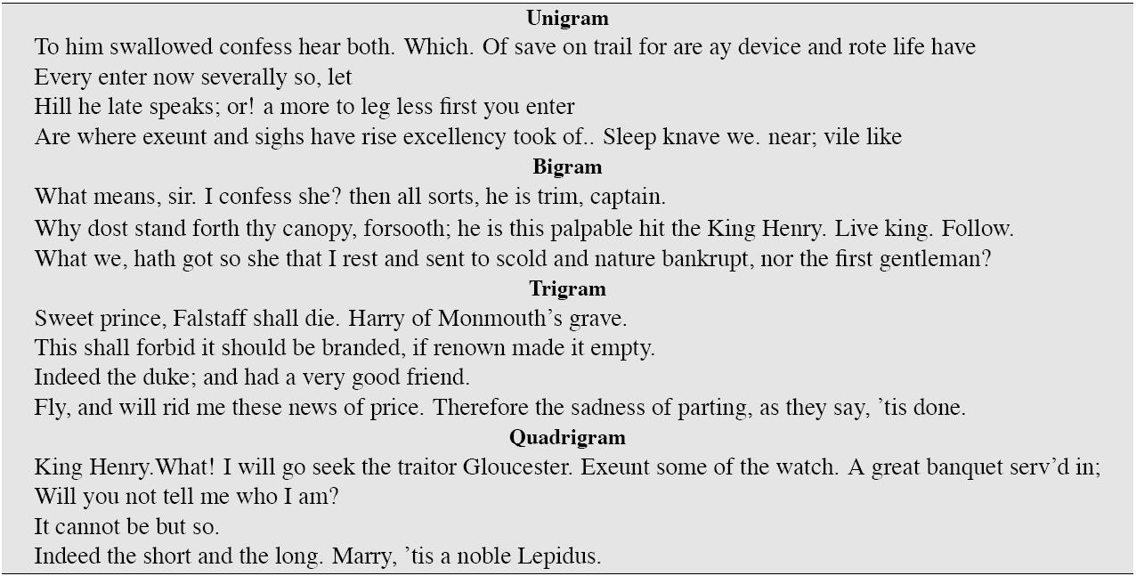
基于n-gram生成的莎士比亚的作品

Slide 27
以莎士比亚的作品作为语料库
共包括N=884 647个token(单词)，词规模V是29066
莎士比亚的作品共包括300 000bigram，而29066个词可以构成约8.44亿个bigram
99.96%的bigram在莎士比亚的作品中是不存在的，这意味着，bigram模型中大多数概率都是0
对于trigram以及quadrigram，数据稀疏的问题更加严重

Slide 28
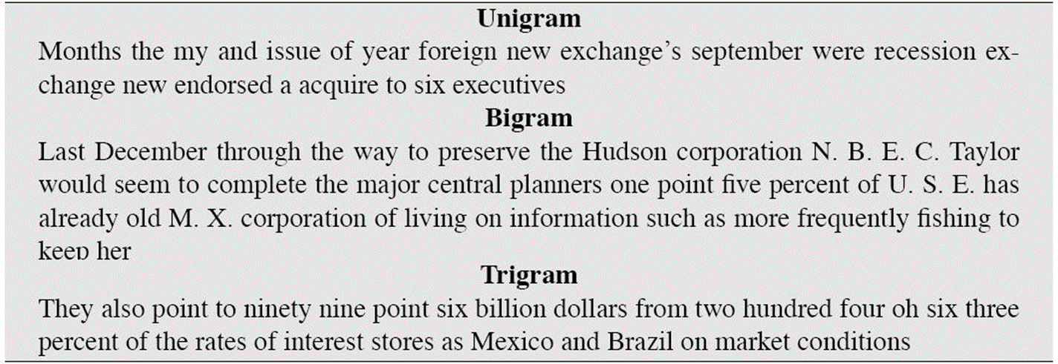
基于wall street journal的n-gram模型生成的语句

Slide 29
0概率与过拟合
只有测试数据集与训练数据集非常相似的时候，n-gram模型在词预测方面表现良好。
在真实应用中，测试数据集与训练数据集往往差别很大
需要训练具有良好泛化能力的语言模型
方法之一
对0概率问题进行平滑处理（在训练集中没出现过，但在测试数据集中存在）
对于0概率的bigram
在测试数据中对应的bigram的概率也为0
因此，对于0概率的bigram，无法计算perplexity
利用平滑方法实现

Slide 30

0概率平滑
对于右图的稀疏统计数据：$P(w|denied the)$
3 allegations, 2 report,1 claims
1 request, 7 total
劫富济贫，$P(w|denied the)$
2.5 allegations, 1.5 report,0.5 claims
0.5 request, 2 other, 7 total
allegations
attack
man
reports
outcome
…
claims
request
allegations
allegations
attack
man
outcome
reports
…
claims
request

Slide 31
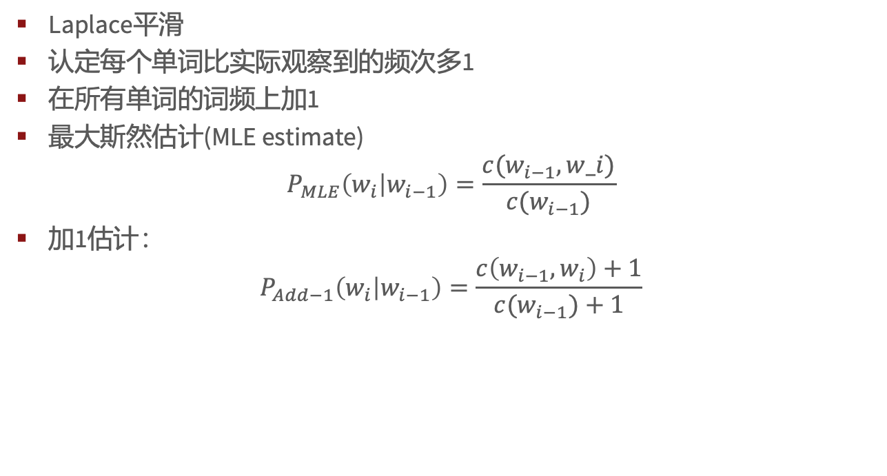
0概率平滑-加1估计
Laplace平滑
认定每个单词比实际观察到的频次多1
在所有单词的词频上加1
最大斯然估计(MLE estimate)
$$P_{MLE}\left(w_{i} | w_{i−1}\right)=\frac{c(w_{i−1},w_i)}{c(w_{i−1})}$$
加1估计：
$$P_{Add−1}\left(w_{i} | w_{i−1}\right)=\frac{c\left(w_{i−1},w_{i}\right)+1}{c(w_{i−1})+1}$$

Slide 32
0概率平滑-最大似然估计
Maximum likelihood estimate
最大似然估计从训练数据集T中估计模型M的参数
给定模型M，使得模型在训练数据T上具有最大的似然概率
假如在包含100万个token的语料中，“北邮”出现了400次
对于其它文本中的任意一个单词刚好是“北邮”的概率是多少？
MLE估计400/100 0000 = 0.0004
这个概率估计对其它语料可能不理想，但至少在训练数据集上是这样的概率。

Slide 33
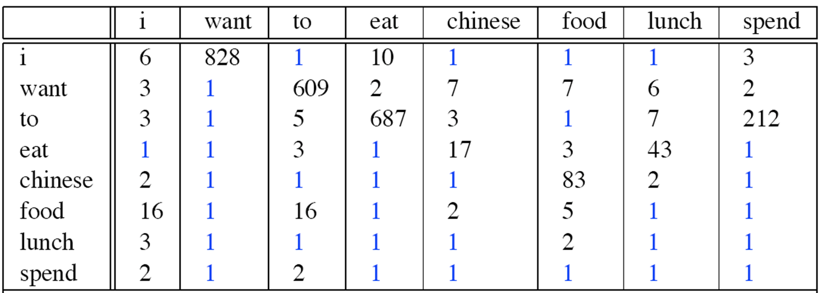
0概率平滑-Laplace平滑后的bigram计数频次

Slide 34
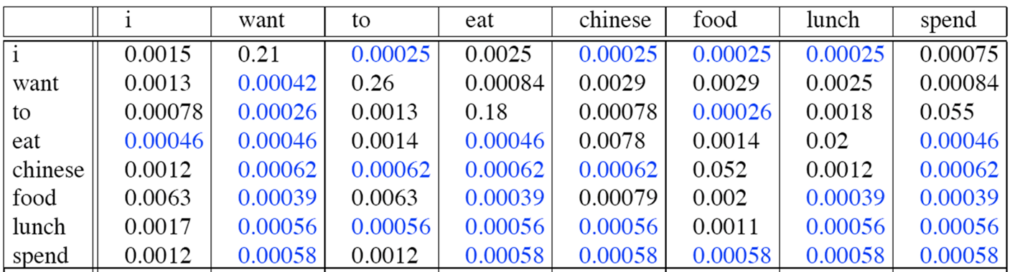

0概率平滑- Laplace平滑后的bigram模型
$$P^{∗}\left(w_{n} | w_{n−1}\right)=\frac{c\left(w_{n−1}w_{n}\right)+1}{c\left(w_{n−1}\right)+1}$$

Slide 35
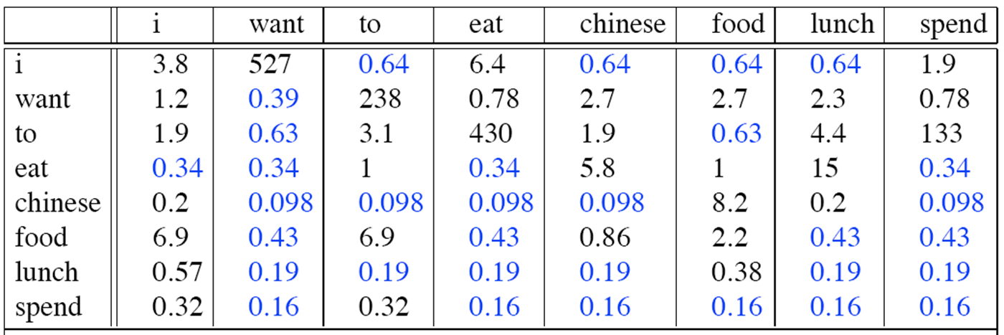

0概率平滑-频次重构
$$c^{∗}(w_{n−1}w_{n})=\frac{\left[c\left(w_{n−1}w_{n}\right)+1\right]∗c(w_{n−1})}{c\left(w_{n−1}\right)+V}$$

Slide 36
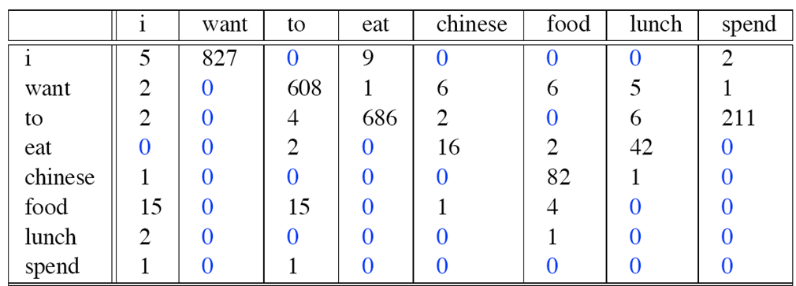

0概率平滑-对比bigram计数结果

Slide 37
0概率平滑-回退（backoff）与插值（interpolation）
回退和插值适用于基于小规模训练语料的模型学习
在小规模的文本语料中，模型学到的信息并不多
回退
当有很好的数据样本时使用trigram
否则使用bigram或者unigram
插值
混合使用（unigram，bigram，trigram）
插值法通常效果不错

Slide 38
N-gram模型计算技巧
如Google N-gram语料库
剪枝(pruning)
仅存储出现频次大于指定阈值（threshold）的n-grams
基于信息熵的剪枝
应用效率
使用高效的数据结构tries
布隆过滤器(Bloom Filter)
以索引的方式存储单词
降低概率的精度，如8位将为4位

Slide 39
编程练习

