Slide 1
“MAJOR PROJECT” TOPIC – COLLEGE CLUB MANAGEMENT System

Slide 2
DEPARTMENT –CSE(AI)
TEAM MEMBER DETAILS -
EMAIL.ID-
NAME-
1. Anuj Gupta
2. Vinit Vishwakarma
3. Vineet Singh
4. Vipin Yadav
1. anuj.2226cseai1117@kiet.edu
2.vinit.2226cseai1051@kiet.edu
3.Vineet.2226cseai1106@kiet.edu
4. Vipin.2226cseai1082@kiet.edu
MENTOR – Mr. Mukesh Lomror

Slide 3

Introduction to College Club Management
College clubs play a crucial role in enriching the campus experience by fostering student engagement, promoting shared interests, and providing opportunities for personal growth.

Slide 4

Challenges in Traditional Club Management
1
Inefficient Communication
2
Limited Reach
Reaching all members can be challenging with traditional methods, limiting participation and engagement.
Traditional methods like email or paper flyers can be inefficient and lead to missed information.
3
Time-Consuming Processes
4
Lack of Transparency
Manual processes like membership management and event registration can be time-consuming and prone to errors.
Limited access to information about club activities and finances can lead to a lack of trust and accountability.

Slide 5
Leveraging MERN Stack for Club Management
MongoDB
Express.js
React
Provides a flexible and scalable database for storing club data, such as member information, events, and financial records.
Offers a robust framework for building the backend API, handling requests, and managing data interactions.
Enables the creation of a user-friendly and interactive front-end interface for managing club activities.

Slide 6

User Registration and Authentication
User Registration
Authorization
A secure form allows users to create accounts with unique usernames and passwords.
Access to different features and data is controlled based on user roles and permissions.
1
2
3
Authentication
Users are authenticated using secure login procedures to verify their identity before accessing club data and features.

Slide 7

Event Planning and Scheduling
Event Creation
Event Scheduling
Notification System
Allows users to create new events with details like date, time, location, description, and RSVP options.
Provides a calendar view to visualize scheduled events and manage conflicts, ensuring seamless planning.
Sends notifications to members about upcoming events, reminders, and important updates.

Slide 8
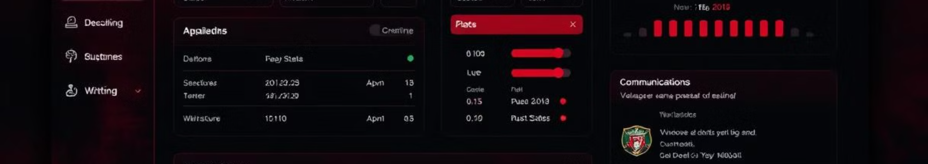
Club Membership and Dues Management
Membership Management
Allows users to join clubs, update their information, and manage their memberships.
Dues Management
Facilitates online payment processing, tracks dues status, and sends reminders for overdue payments.
Member Directory
Provides a searchable directory of members, fostering communication and collaboration within the club.

Slide 9
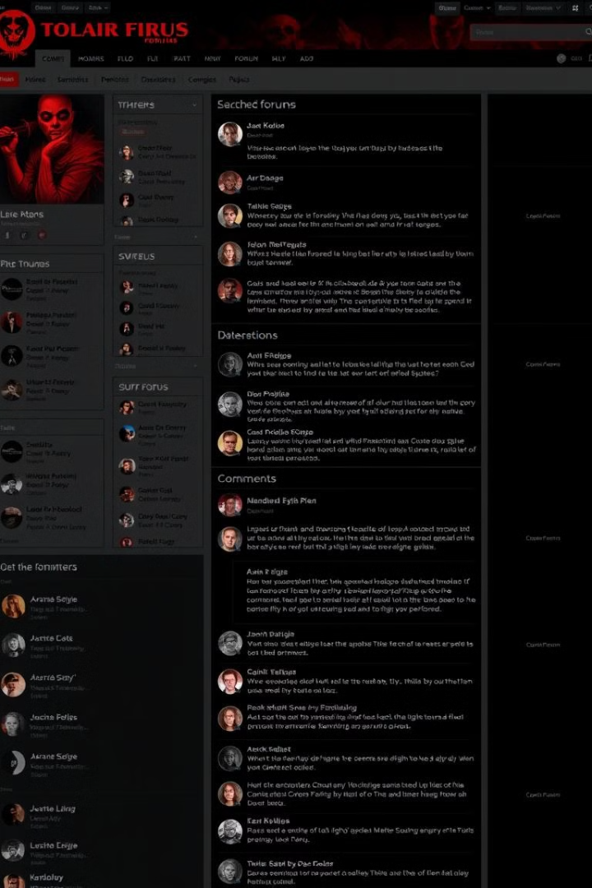



Communication and Collaboration Tools
Discussion Forum
Enables members to discuss club-related topics, share ideas, and ask questions.
Chat Feature
Provides real-time communication channels for quick discussions and updates.
Document Sharing
Facilitates collaborative document editing and sharing for club projects and presentations.

Slide 10




Conclusion and Future Considerations
Cloud Integration
Integrating with cloud storage services like Google Drive or Dropbox for secure and accessible file storage.
Mobile App Development
Creating a dedicated mobile app to enhance user experience and provide on-the-go access to club features.
Data Analytics
Implementing analytics tools to gain insights into member engagement, event attendance, and club performance.

Slide 11
THANK YOU

Slide 12
Problem Statement
Traditional club management faces several issues:
- Inefficient communication using email/paper flyers
- Limited reach and engagement among members
- Manual and time-consuming processes
- Lack of transparency in activities and finances

Slide 13
Novelty of the Project
Unlike traditional methods, this project:
- Provides a centralized digital platform
- Uses modern MERN stack for scalability
- Enables real-time communication and collaboration
- Incorporates transparent dues and membership management
- Future-ready with cloud, analytics, and mobile integration

Slide 14
Working of the Project
1. User Registration and Authentication
- Secure login and role-based access
2. Club Membership Management
- Join clubs, update details, manage dues
3. Event Planning and Scheduling
- Create events, calendar view, notifications
4. Communication Tools
- Discussion forum, chat, document sharing

Slide 15
Technology Stack (MERN)
MongoDB – NoSQL database for flexible storage
Express.js – Backend framework for API and server logic
React.js – Frontend for interactive user interface
Node.js – Runtime environment for backend

Slide 16
Conclusion
The College Club Management System:
- Simplifies and automates club activities
- Enhances student engagement and collaboration
- Provides transparency and accountability
- Offers scalability for multiple institutions
— Thank You —

