Slide 1
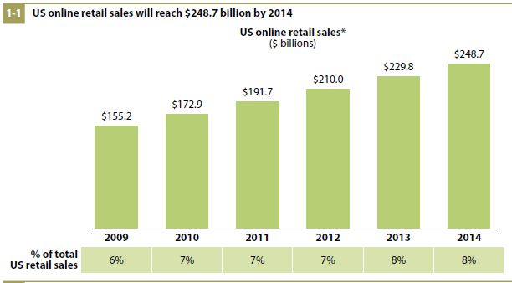
Online Shopping

Slide 2

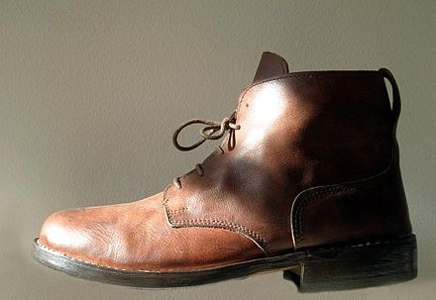
Implicit FeedBack Ranking
Sales = Searches * s2v * v2a * a2b
Search Results
Product Details
Shopping Cart
Purchase
s2v
v2a
a2b
s2v: search to view: probability that a user selects a displayed item
v2a: view to add: probability that a user add a given item to the shopping cart
a2b: add to book: probability that a user purchases an item in the shopping cart

Slide 3
Structure
Motivation
Challenges
  Position Bias
  Relative Bias
  Data Size
Thought Experiments
  Assumptions
  Position Bias
  Relative Bias

Slide 4
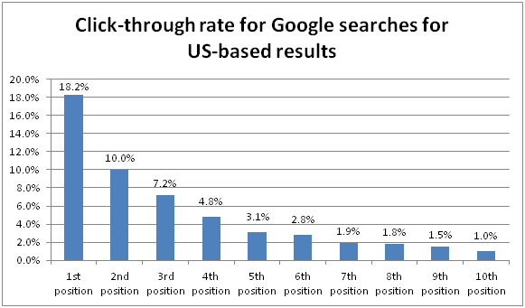
Position Bias Google

Slide 5
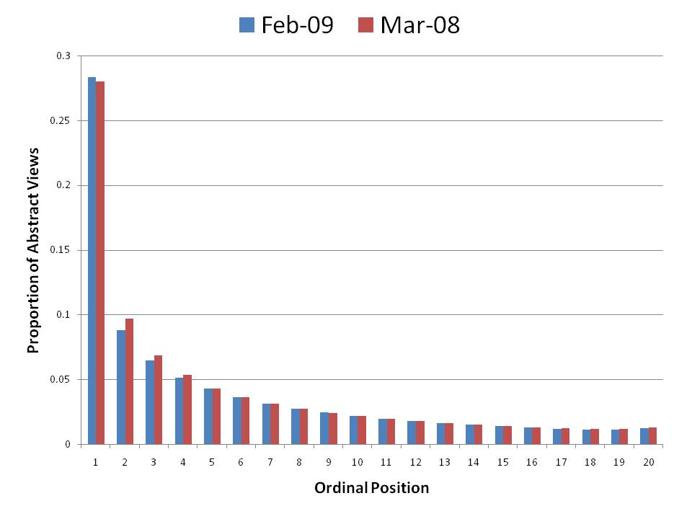
Position Bias PubMed

Slide 6
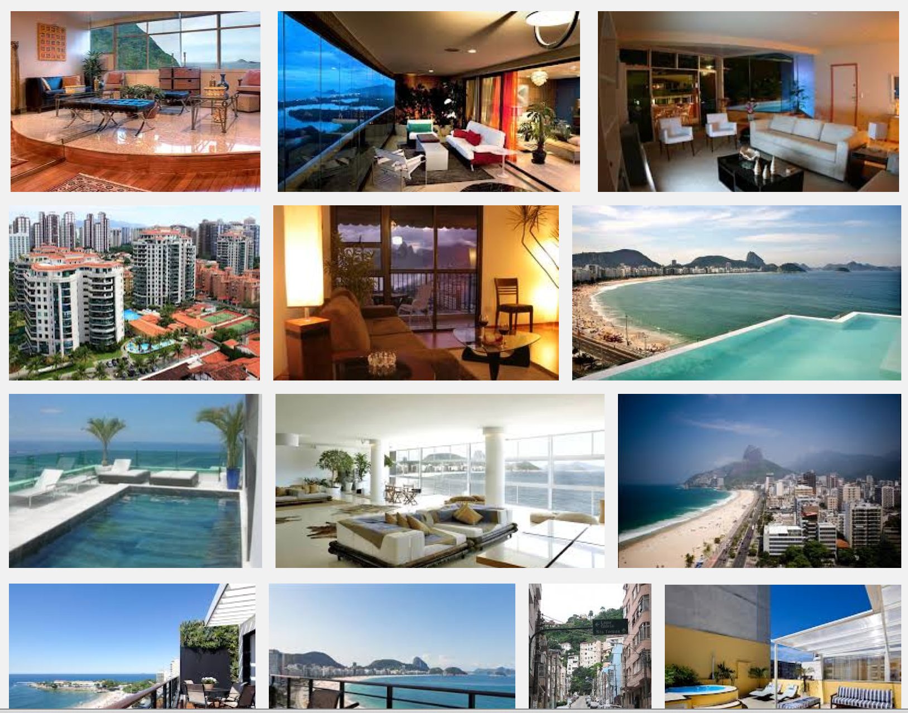
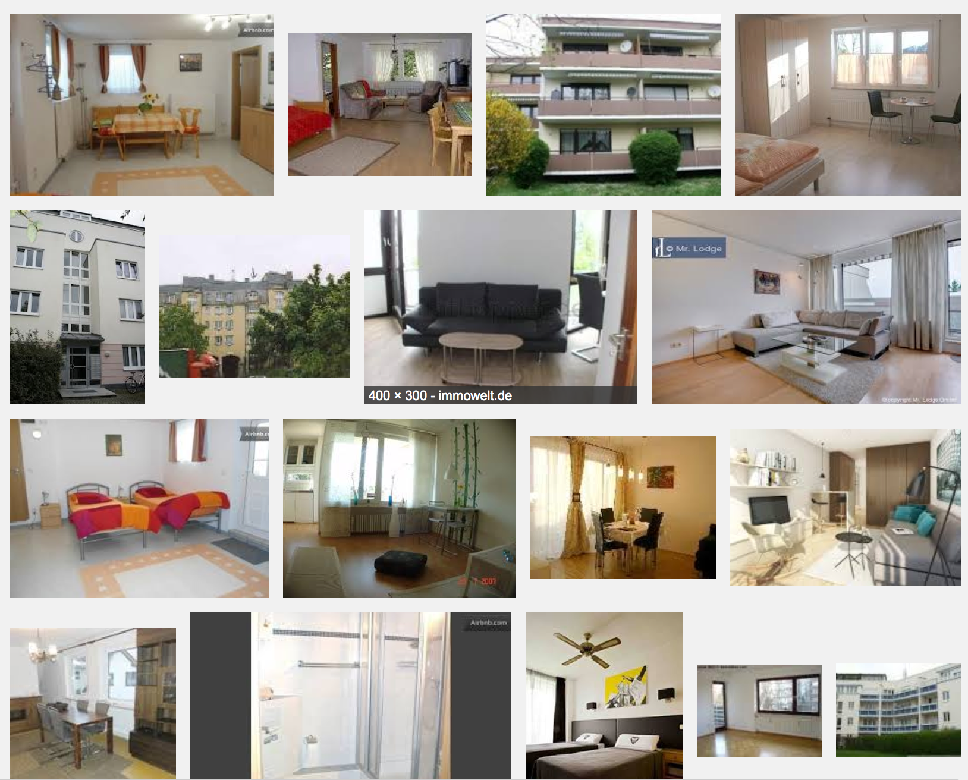
Relative Bias

Slide 7
Quantitative Bias and Cold Start
Images displayed more often have the chance of getting more scores.
Images ranked low may not have the chance to improve their ranking since they are never displayed.
=> Ranking Algorithms must be immune to
  Position Bias
  Relative Bias
  Quantitative Bias

Slide 8
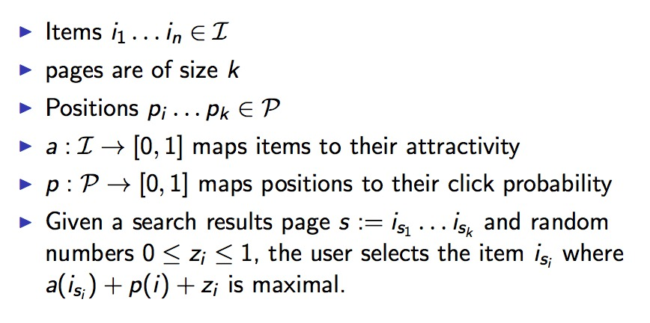
Assumptions

Slide 9
Ranking Algorithms
Additive Algorithm
  Add a score for each click
Redistribution Algorithm
  Redistribute scores from not-clicked items to clicked items
Order Maintenance Algorithm
  Compute a partial order from a directed cyclic weighted graph.

Slide 10
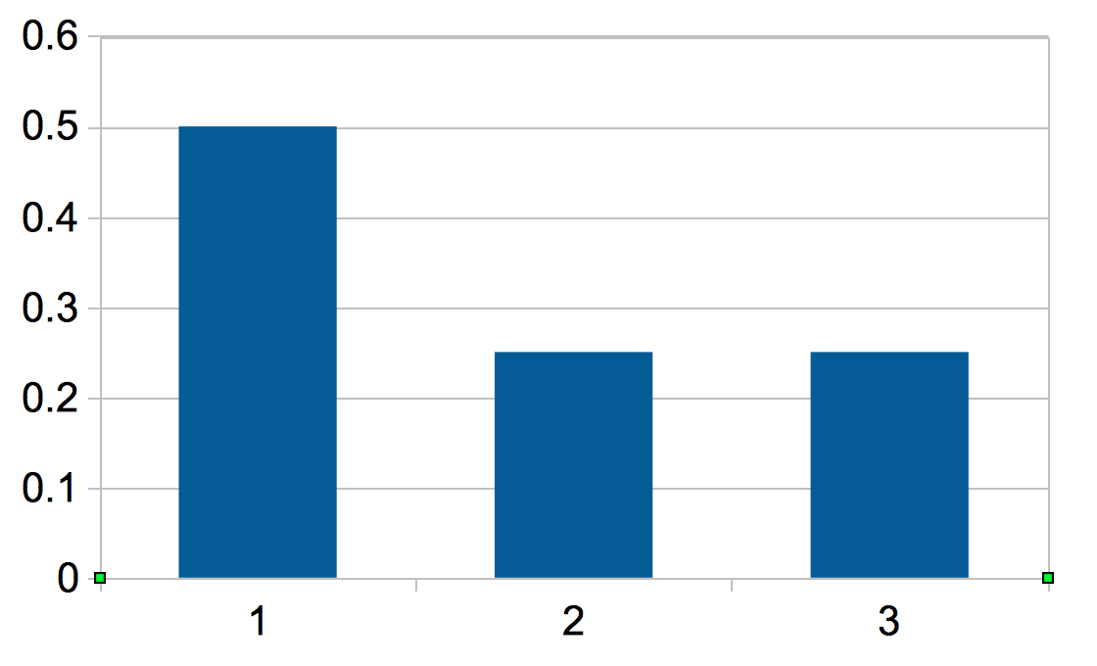
Thought Experiment Position Bias
3 items per page
All items equally attractive
The page A,B,C is displayed 4 times.
Clicks: C,A,B,A
Weight all edges equally
A will be ranked higher than B,C
A
1
A
2
1
2
1
B
1
C
B
C
1
1

Slide 11
Thought Experiment Position Bias (2)
3 items per page
All items equally attractive
The page A,B,C is displayed 4 times.
Clicks: C,A,B,A
Edges are weighted according to the probability of their sink nodes
A
0.5
A
0.25+0.25
0.25+
0.25
0.5
B
C
B
C
0.25
0.25

Slide 12
Thought Experiment Relative Bias
Assumptions:
  2 items per page
  No position bias
  Items A,B,C with attractivity
    a(A) = 0.1
    a(B) = 0.5
    a(C) = 0.9
  Feedback
    ([A,B], B)
    ([B,C], C)
    ([B,C], C)
    ([B,C], B)
    ([B,C], C)
A
1
1
B
C
3

Slide 13
Interest Shift Problem
Interest for an item may change due to
  Changes to the item itself
  Seasonal changes
  External changes
    Competitors
    Fashion
    Advertisement

Slide 14
AHRSZ Algorithm
Insertion of 1st Edge
A
B
C
D
E
F
Insertion of 1st Edge
-1
0
Linear expansion
A
C
D
E
F
B
-2
-1
0
1
Tree structures
A
C
D
E
F
B
Tree structures
Tree structures
-2
-1
0
2
1
A
C
D
B
F
E
Reordering
-2
-1
0
1
2
Cycle Removal
A
C
D
B
F
E
-2
-1
0
1
2

Slide 15
Use Case 1
1) save(Student : { first: “some”, last : “body” }, null, null) -> lid : 1
2) save(Student : { first: “some”, last : “head”, lid: 1 }, null, 2001)
3) save(Student : { first: “bud”, last : “head”, lid: 1 }, 1996, 2001)
1996
2001
Actual Time
LID: 1, TMPID: 1, TCHID: 1
LID: 1, TMPID: 2, TCHID: 2
LID: 1, TMPID: 1, TCHID: 3
LID: 1, TMPID: 2, TCHID: 2
LID:1, TMPID: 2, TCHID: 5
LID: 1, TMPID: 3, TCHID: 4
LID: 1, TMPID: 1, TCHID: 3
Transaction Time

Slide 16
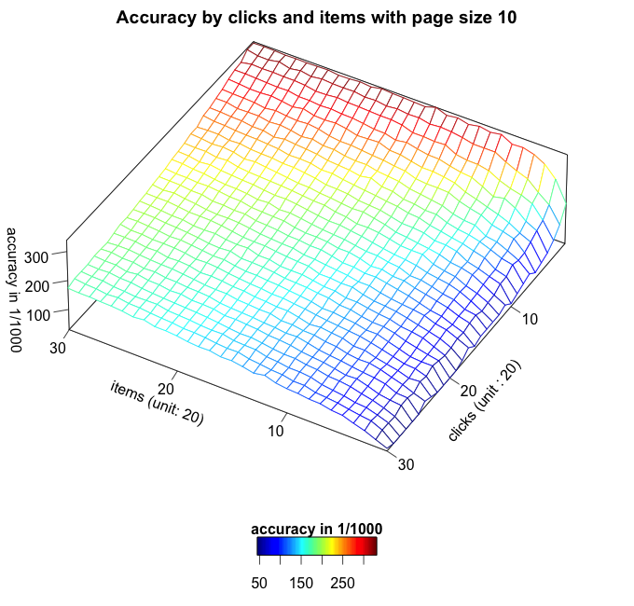
Accuracy By Clicks And Items

Slide 17
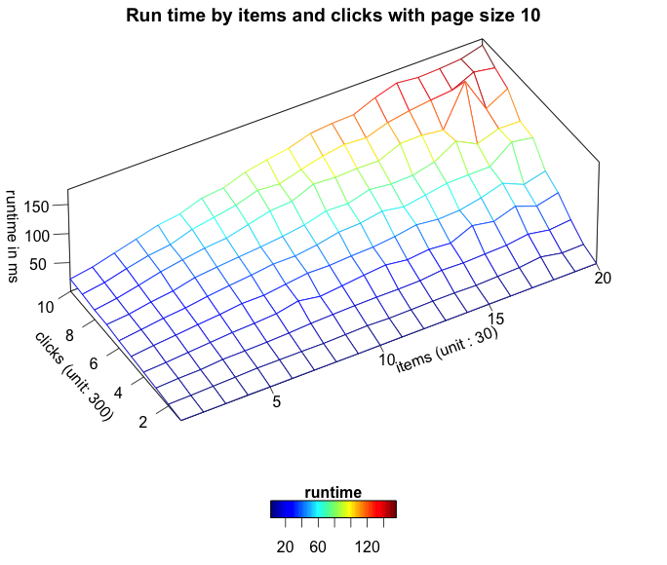
Runtime by Clicks And Items

