Slide 1
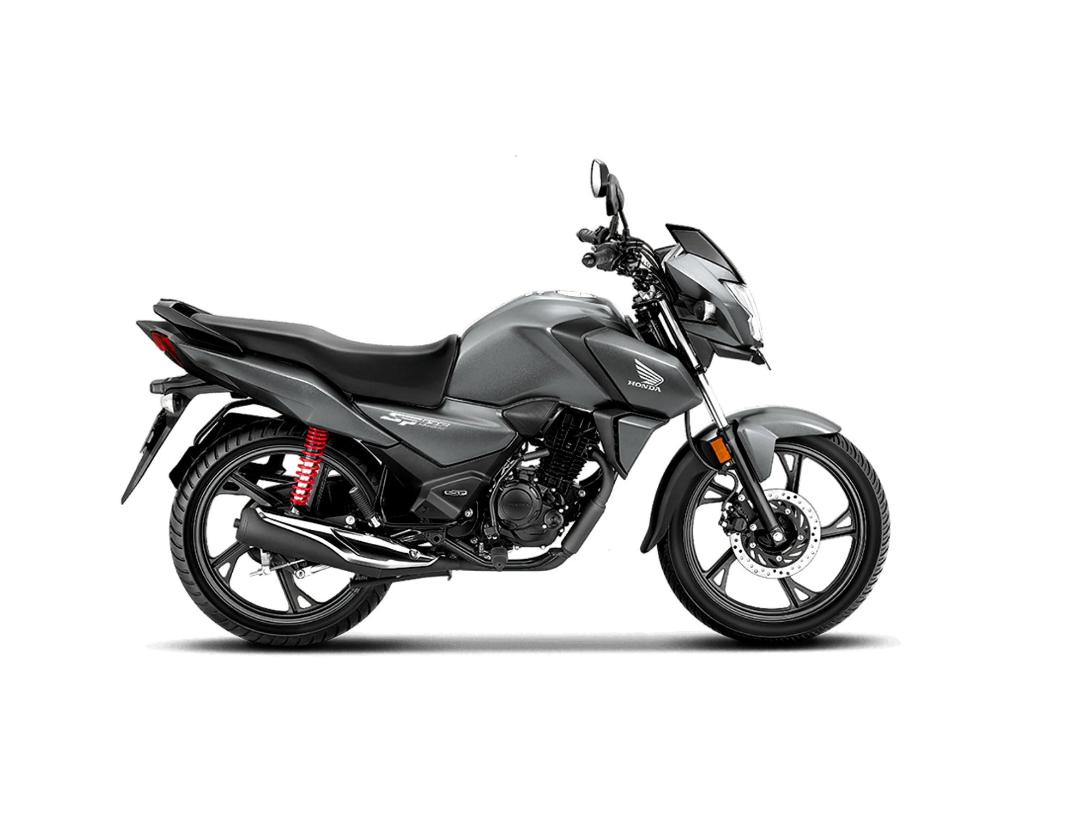
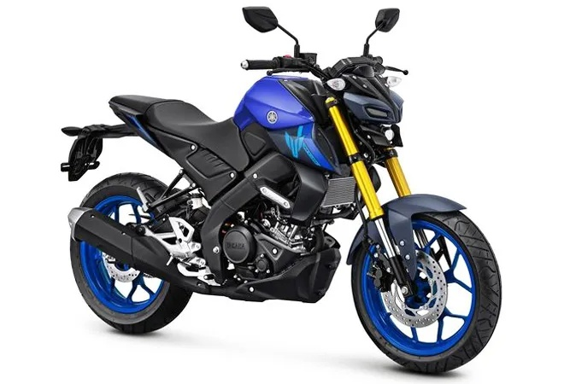
SDL LAB PROJECT
Biker Gallery
Online Bike Rental System
Ride Smart, Pay Less
Student Name:
S. Nithish, D. Padmasaran
Register No.:
112334071, 11234072
Course:
BCA
Institution:
Sri Chandarsekharendra Saraswathi viswa mahavidyalaya
2026

Slide 2
OVERVIEW
Project Title
Biker Gallery – Online Bike Rental System
"Ride Smart, Pay Less"
Web-based bike rental management system for Kanchipuram
Serves both Customers and Administrators through separate modules
Supports booking, availability tracking, payment, and revenue reporting
Developed using HTML, CSS, JavaScript, PHP, and MySQL on XAMPP
4+
Bikes
₹22/hr
Starting Rate
₹2,500
Deposit
18%
GST Applied

Slide 3
TECH STACK
Software & Hardware Details
Front End
Back End
Tools & Platform
Security
HTML5
CSS3
Bootstrap
JavaScript (ES6)
PHP (Pure – no framework)
MySQL 8.x
Visual Studio Code
XAMPP Server 2.4
Windows OS
Tesseract.js (OCR)
SHA-256 (browser hashing)
bcrypt password storage
Session-based auth
Prepared statements
Hardware Requirements
Intel Core i3+
4 GB RAM+
500 GB HDD
15" Monitor
Internet (Broadband)

Slide 4
PROJECT GUIDE
Guide Details
Guide Name
Mr. J. Seetharaman
Designation
Assistant Professor
Department
Computer Science Application
Institution
Sri Chandarsekharendra Saraswathi viswa mahavidyalaya
Project Year
2025 – 2026

Slide 5
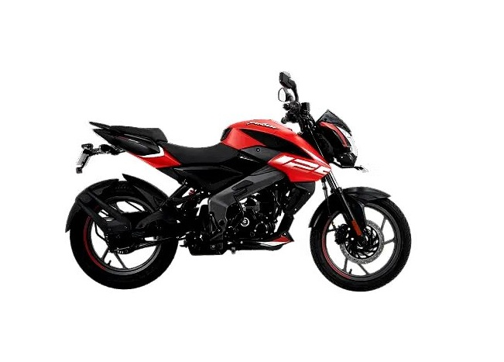
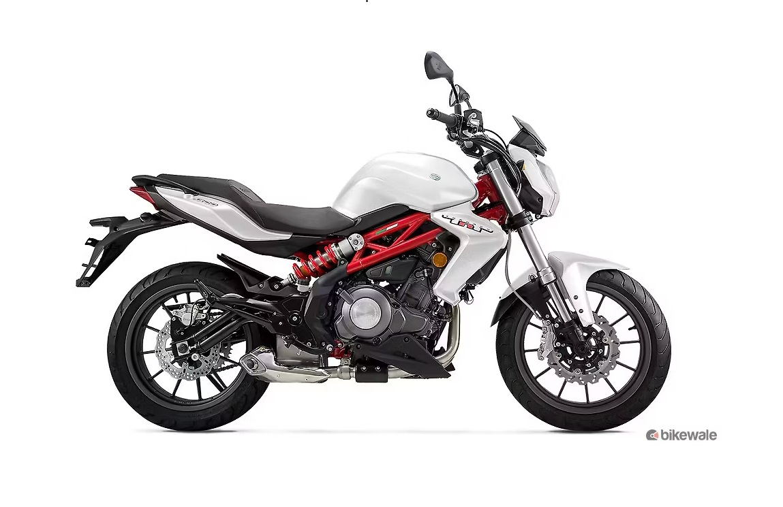
INTRODUCTION
Introduction
What is Biker Gallery?
A web-based Online Bike Rental Management System
Designed specifically for a single rental outlet in Kanchipuram
Manages the complete rental lifecycle: browsing → booking → payment → return
Serves two user types: Customer and Administrator
Offers bikes ranging from 125cc commuters to premium 300cc motorcycles
Automates booking validation, availability checking, and revenue tracking

Slide 6
EXISTING SYSTEM
Existing System
How the current system works:
📞 Phone Call
All bookings are recorded manually in physical registers
Customer inquiries and confirmations are handled over phone calls
No centralized database — data scattered across notebooks and files
Bike availability is tracked manually, leading to double-booking risks
Revenue calculations done manually without any automation
📒 Manual Register
🤷 No Validation
💵 Cash Only

Slide 7
DRAWBACKS
Drawbacks of Existing System
Redundancy
Inconsistency
Duplicate customer data with no normalization or consistency
Redundant records cause conflicting booking information
Time Consuming
Improper Validation
Retrieving specific booking details from registers is slow and tedious
Same bike can be double-booked for the same date without detection
Tedious Maintenance
High Human Resource Cost
Daily updates to registers are difficult and error-prone
Requires dedicated staff for data entry and tracking

Slide 8
PROPOSED SYSTEM
Proposed System
Normalized Database
Real-time Availability
All data stored in MySQL with proper structure — no redundancy
Customers see live bike availability; double-booking is prevented
Online Booking
Admin Dashboard
Select bike → pick date & time slot → pay ₹2,500 deposit online
Admin manages returns, computes GST charges, monitors revenue
Automated Revenue
Reduced Manpower
System auto-calculates base rent, 18% GST, and refund amounts
Automated processes reduce reliance on manual staff effort

Slide 9
MODULES
Module Description – Customer Side
Login / Register
Home Page
Menu Page
Username + SHA-256 hashed password login
Registration with PAN Card & DL document upload
OCR verification via Tesseract.js
Age validation (18+) on date of birth
Hero section with live bike count
Quick navigation: Browse, Book, Contact
Feature highlights: Rates, Maintenance, Location
All bikes grouped by 125cc / 200cc / Premium
Filter by category
Real-time availability chip (green/red)
Specs: engine, mileage, gearbox, price/hr, price/day
Book a Ride
Payment Page
Contact Page
Bike selector + personal details form
Date picker + time slot grid (8 AM – 10 PM)
Blocked slots shown in red
₹2,500 refundable deposit summary
Booking confirmation summary
Deposit payment flow
Transaction ID generated on success
Document verification reminder displayed
Name, phone, email & message form
Stored in contacts table
Visible in Admin panel under Customer Messages

Slide 10
MODULES
Module Description – Admin Side
Admin Login
Dashboard
Active Bookings
Secure login via admin_login table
SHA-256 hash + bcrypt server verification
Session created on successful authentication
Summary cards: Bikes Booked, Available, Revenue (excl/incl GST)
Real-time counts from database
Quick overview at a glance
Lists all bookings with status = 'active'
Mark Available button to process returns
Enter actual hours used on return
Booking History
Revenue Reports
Contact Messages
All returned bookings with full charge details
Actual hours, GST, total charged, refund amount
Filter: Last 25 / All transactions
Total base revenue (excl. GST)
Total charged (incl. 18% GST)
Count of active vs returned bookings
All messages from Contact Us page
Customer name, phone, email, and message
Read-only view for admin reference

Slide 11
SCREENSHOTS
System Screens – Login & Home Page
LOGIN SCREEN
HOME PAGE
BikerGallery Home Menu Book Contact Logout
Welcome Back to Biker Gallery
● BIKES AVAILABLE NOW
USERNAME
Ride Smart,
Pay Less
PASSWORD
Login →
SHA-256 hashing • bcrypt server verify • Session auth
4+ Bikes | ₹22/hr | 8–10 Available | Kanchipuram

Slide 12
SCREENSHOTS
System Screens – Menu & Book a Ride
MENU PAGE – BIKE FLEET
BOOK A RIDE PAGE
All Bikes 125cc 200cc Premium
Book Your Ride
125CC BIKES
Honda SP 125 — ₹20/hr ● Available
● Available
9 AM
10 AM
11 AM
12 PM
1 PM
2 PM
3 PM
4 PM
● Available ● Booked ● Your pick
Refundable Deposit: ₹2,500
Honda SP 125
Proceed to Payment →
₹20/hr • ₹480/day • Manual • Commuter
Real-time availability • Category filter • Specs per bike
Date picker • Time slots • Deposit summary • Real-time check

Slide 13
SCREENSHOTS
System Screens – Payment & Admin Dashboard
BOOKING SUCCESSFUL
ADMIN DASHBOARD
0
Booked
10
Available
✓
Booking Successful!
₹140
Revenue
₹165
Total
TXN#BG653581YBT
Bike: Bajaj Pulsar NS125
Booking History
Customer: Saran
Deposit Paid: ₹2,500
Customer
Bike
Hrs
Charged
Refund
Bring: DL • PAN • Aadhaar
saran
Yamaha MT15
1hr
₹47
₹2,453
saran
Hero Xtreme
1hr
₹26
₹2,474
Transaction ID generated • Document checklist displayed
Stat cards • Active bookings • History • GST auto-calculated

Slide 14
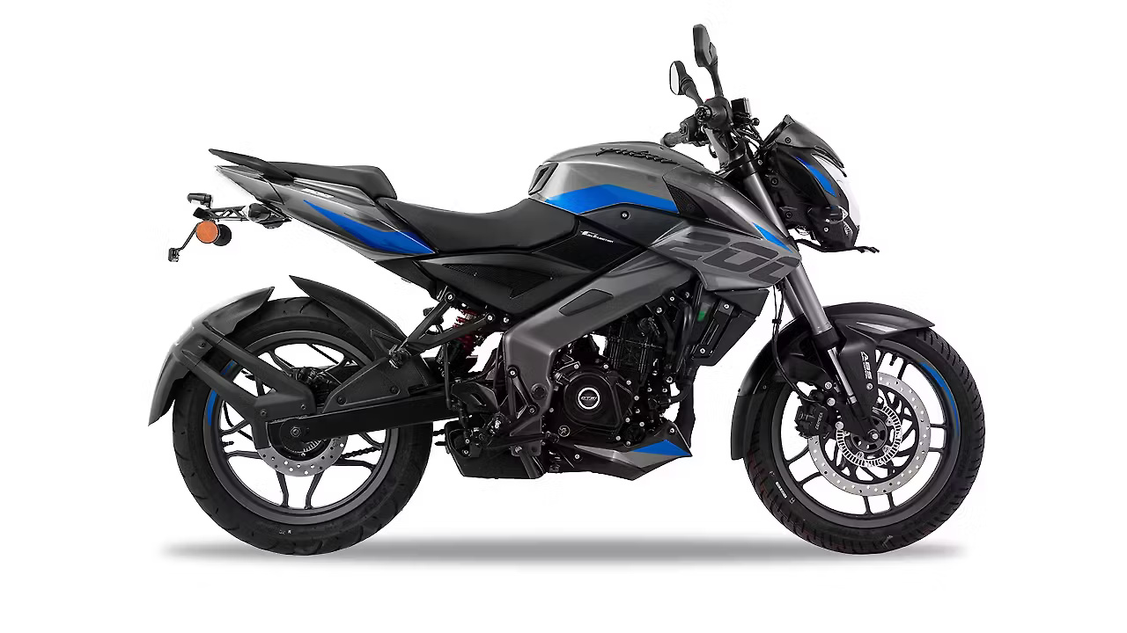
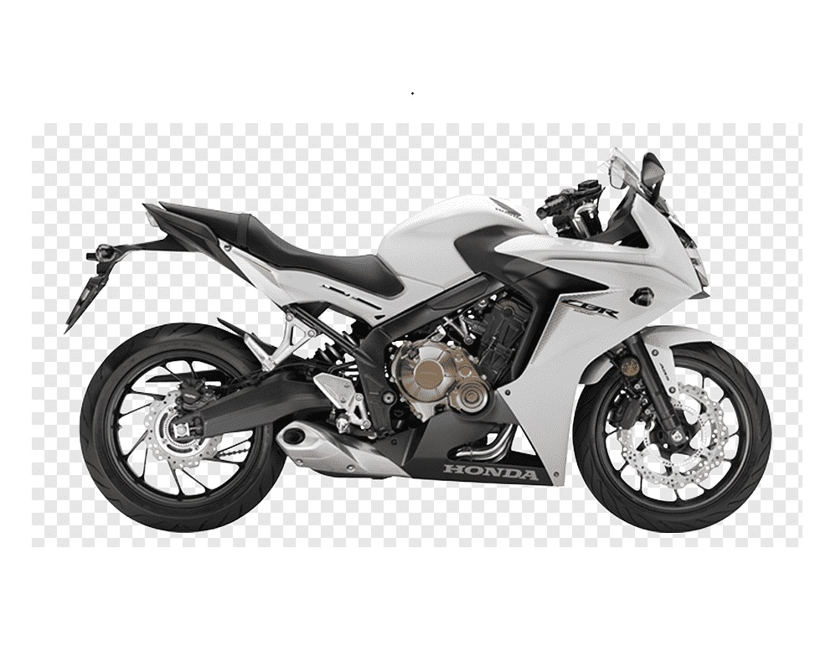
SCREENSHOTS
Bike Fleet – Available in the System
Honda SP 125
Bajaj Pulsar NS125
Yamaha MT-15
125cc · ₹20/hr
125cc · ₹22/hr
200cc · ₹35/hr
Bajaj Pulsar NS200
Benelli TNT300
Honda CBR300R
200cc · ₹40/hr
Premium · ₹60/hr
Premium · ₹65/hr

Slide 15
REPORTS
Reports Generated by the System
Revenue Summary Report
Booking History Report
Active Bookings Report
Total active bookings count
Total returned bookings count
Base revenue (excluding 18% GST)
GST collected amount
Grand total charged (incl. GST)
Accessible from Admin Dashboard
All returned bookings listed in a table
Customer name, phone, bike name
Pickup date, pickup time, actual hours used
Hourly rate, GST charged, total amount
Deposit paid, refund amount issued
Return timestamp recorded
All ongoing (active) bookings at a glance
Customer name, contact, selected bike
Pickup date and time slot
Deposit status and booking status
Mark Available action for return processing
Real-time updates from MySQL database

Slide 16
CONCLUSION
Conclusion
Successfully developed a fully functional web-based bike rental system
Eliminates manual record-keeping — all data managed through a normalized MySQL database
Customers can browse, check availability, and book bikes without visiting the shop
Administrators gain real-time visibility into bookings, returns, and revenue
SHA-256 + bcrypt security ensures safe authentication for both users and admins
18% GST computation and refund calculations are fully automated
System is responsive, user-friendly, and designed for a real-world Kanchipuram rental shop

Slide 17
FUTURE SCOPE
Scope for Further Development
💳 Online Payment Gateway
📱 Mobile App (Android & iOS)
Integrate Razorpay or UPI for digital ₹2,500 deposit collection — no more cash transactions
Native app for customers to browse, book, and manage rentals on the go
📩 SMS / WhatsApp Notifications
✉️ Email Verification
Auto-send booking confirmation, pickup reminders, and return alerts to customer phone
Verify new customer accounts via email OTP at time of registration
⭐ Rating & Review System
🔍 Advanced Admin Analytics
Allow customers to rate their rental experience and leave feedback after bike return
Dashboard charts for revenue trends, peak booking hours, and bike utilization rates

Slide 18
REFERENCES
References & Bibliography
Web Technologies
Developer Community
www.w3schools.com — HTML, CSS, JavaScript, PHP references
www.stackoverflow.com — Debugging and implementation support
PHP Documentation
Learning Resources
www.php.net — Official PHP manual and function references
www.youtube.com — Video tutorials for PHP, MySQL, and web dev
Source Code Hosting
Database
www.github.com — Version control and project repository reference
MySQL 8.x Documentation — Query syntax and schema design
Security
OCR Library
OWASP Web Security Guidelines — Password hashing, session management
Tesseract.js Documentation — Browser-based OCR for document scanning

