Slide 1
A Comparative Study of Classical Filters and Deep Learning for Image Denoising
1123524 1123505 1123506
Introduction to Image Processing × Artificial Intelligence and Applications
Notes:
Final project combining the two courses: comparing five classical denoising filters against a deep CNN (DnCNN) under one common, reproducible protocol.

Slide 2
Motivation: Why Image Denoising?
• Images are inevitably corrupted by noise during capture and transmission
– sensor thermal noise, photon shot noise, low light, high ISO
• Degradation model: y = x + n (x = clean image, n = noise)
• Denoising is a key pre-processing step for recognition, segmentation, medical imaging
• The problem is ill-posed — every method needs a prior about natural images:
– hand-crafted (smoothness, edges, self-similarity) vs. learned from data
• Core question: how does deep learning compare with classical filters — in quality, speed, and robustness?
2/12
Notes:
Because many clean images explain the same noisy observation, denoising relies on assumptions/priors. Classical methods encode these by hand; deep models learn them from data. We compare both fairly.

Slide 3
Objectives and Contributions
• A unified, reproducible benchmark under identical noise and metrics
• Methods compared:
– Classical: Gaussian, Median, Bilateral, NLM, BM3D
– Deep learning: DnCNN (residual learning, blind denoising)
• Conditions: grayscale & color · Gaussian σ = 15 / 25 / 50 · salt-and-pepper
• Metrics: PSNR, SSIM, and inference time
• All code, weights, and results released on GitHub
3/12
Notes:
Emphasis on a FAIR comparison: same images, same noise, same metrics — and we also measure runtime, which most quality-only comparisons ignore.

Slide 4
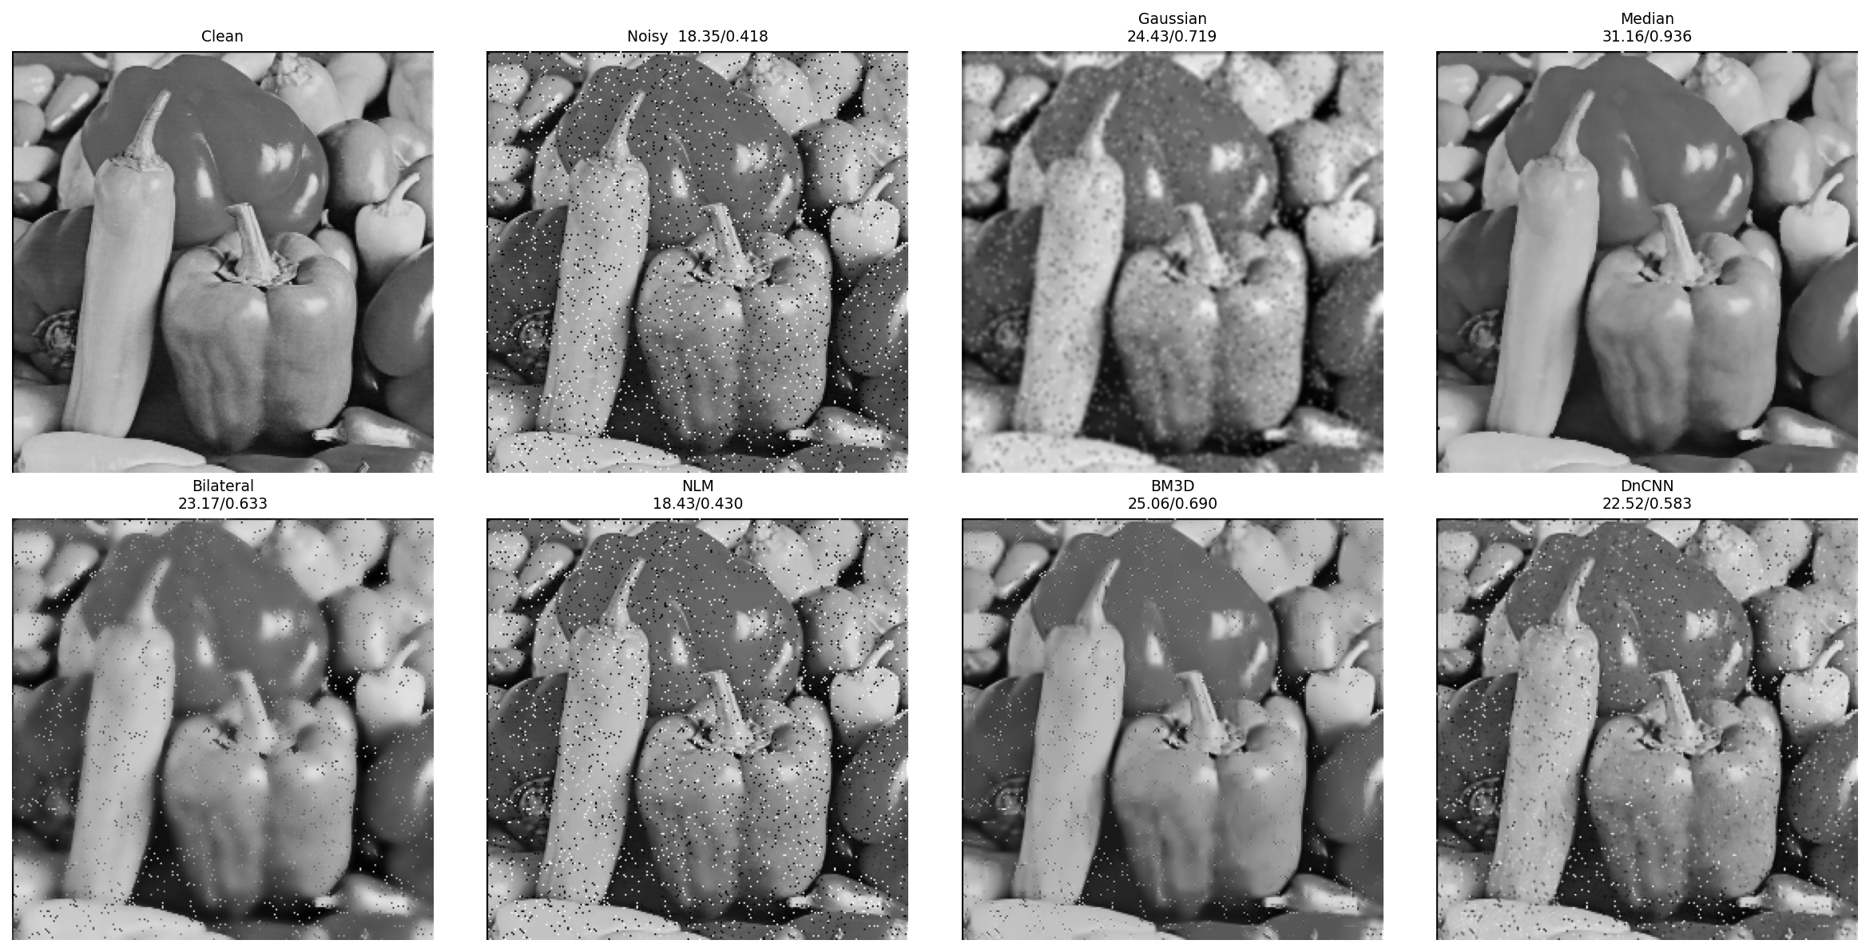
Two Types of Noise
• Gaussian noise: additive, each pixel + N(0, σ²) — models sensor noise
• Salt-and-pepper: random black/white pixels — impulse noise
• Larger σ → harder restoration; methods behave very differently per type
4/12
Notes:
We synthesize both noise types so we have a clean ground truth and can compute PSNR/SSIM. Salt-and-pepper is included specifically to test generalization.

Slide 5
Classical Denoising Methods (Image Processing)
• Gaussian filter — weighted local average; simple but blurs edges
• Median filter — replaces pixel by neighborhood median; great for impulse noise
• Bilateral filter — adds an intensity-range weight; preserves edges
• Non-Local Means (NLM) — averages similar patches from the whole image
• BM3D — groups similar patches into 3-D stacks + transform-domain filtering
– the strongest classical method — our 'upper bound' baseline
5/12
Notes:
Ordered by increasing modeling power: from local linear filtering, to edge-aware, to non-local self-similarity, to BM3D's collaborative transform-domain filtering.

Slide 6
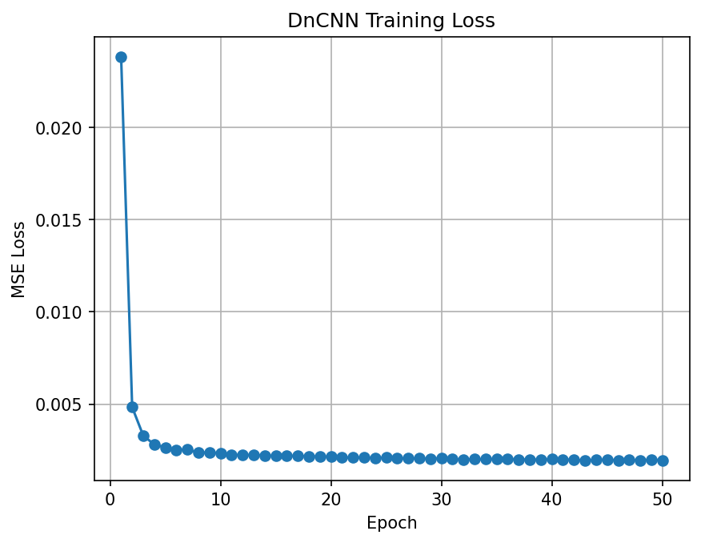
Deep Learning Method: DnCNN (AI)
• 17-layer CNN (Conv – BatchNorm – ReLU)
• Residual learning: predict the NOISE, then clean = input − noise
• Blind denoising: trained with random σ ∈ [0, 55]
– a single model handles many noise levels
• Training: 40×40 patches from Train400, Adam, 50 epochs (Colab T4)
6/12
Notes:
Residual learning makes training easier and faster: the network output is the estimated noise map. BatchNorm stabilizes training. Blind training trades a little peak accuracy for flexibility across noise levels.

Slide 7
Evaluation Metrics and Setup
• PSNR (dB) — pixel-level fidelity; higher is better
• SSIM — structural similarity, closer to human perception; max = 1
• Inference time — average seconds per image
• Datasets: Set12 / BSD68 (grayscale), Kodak (color)
• Training set: Train400 (Berkeley images)
• Platform: Google Colab T4 GPU, PyTorch + OpenCV + bm3d
7/12
Notes:
PSNR and SSIM are complementary: PSNR measures raw error, SSIM measures perceived structure. Reporting runtime is what reveals the real trade-off in this study.

Slide 8
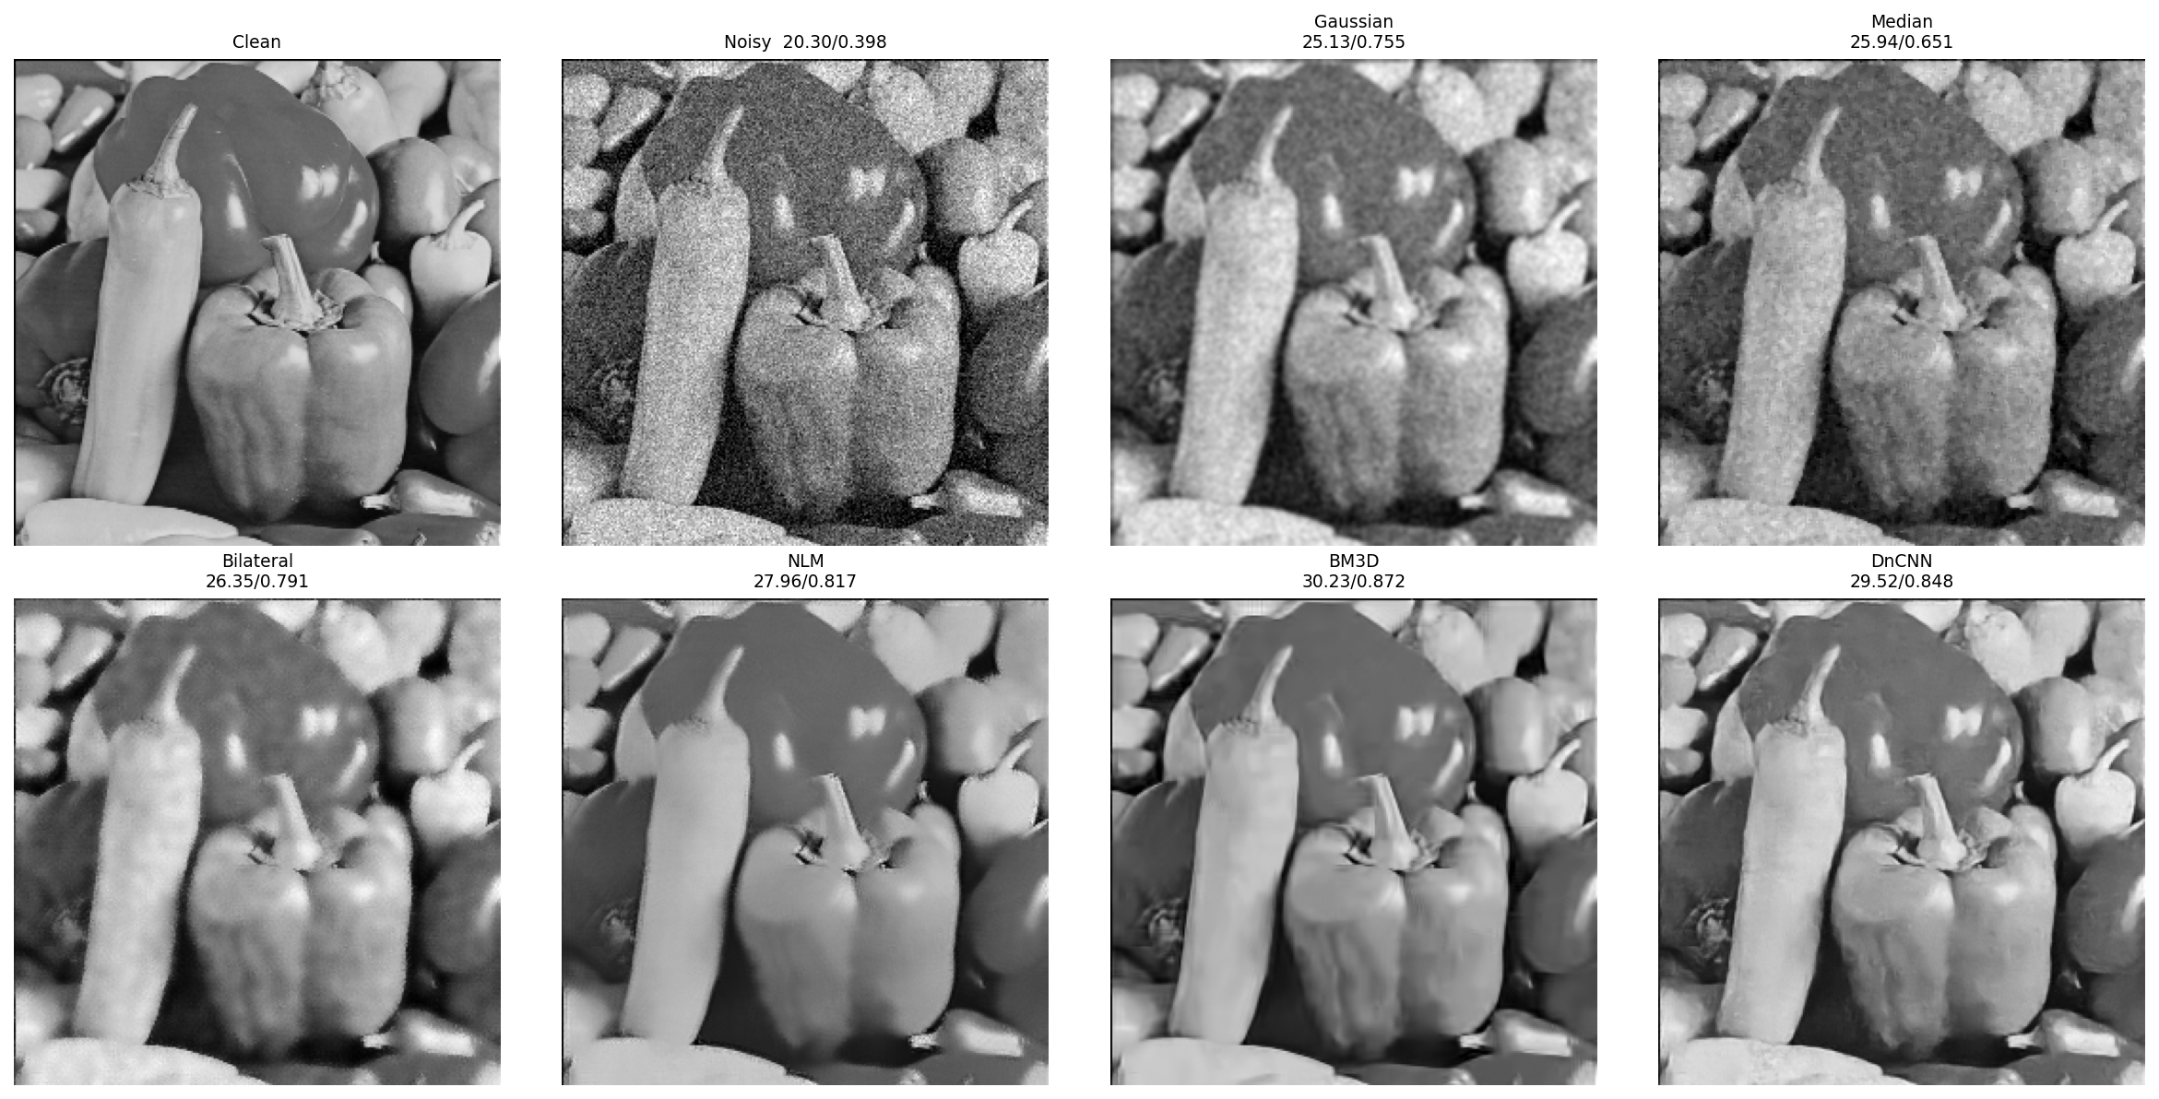
Results: Grayscale (Set12)
Method | σ15 | σ25 | σ50
Gaussian | 27.32 | 26.25 | 23.37
Median | 27.78 | 25.45 | 21.07
Bilateral | 26.90 | 26.40 | 22.04
NLM | 30.35 | 27.81 | 23.36
BM3D | 32.39 | 29.99 | 26.75
DnCNN | 31.41 | 29.23 | 25.70
PSNR (dB). Ranking: BM3D > DnCNN > NLM > simple filters
8/12
Notes:
BM3D is best at every noise level; our blind DnCNN is a close second, ~0.7–1.0 dB behind. Both clearly beat simple local filters, and the gap widens as σ grows.

Slide 9
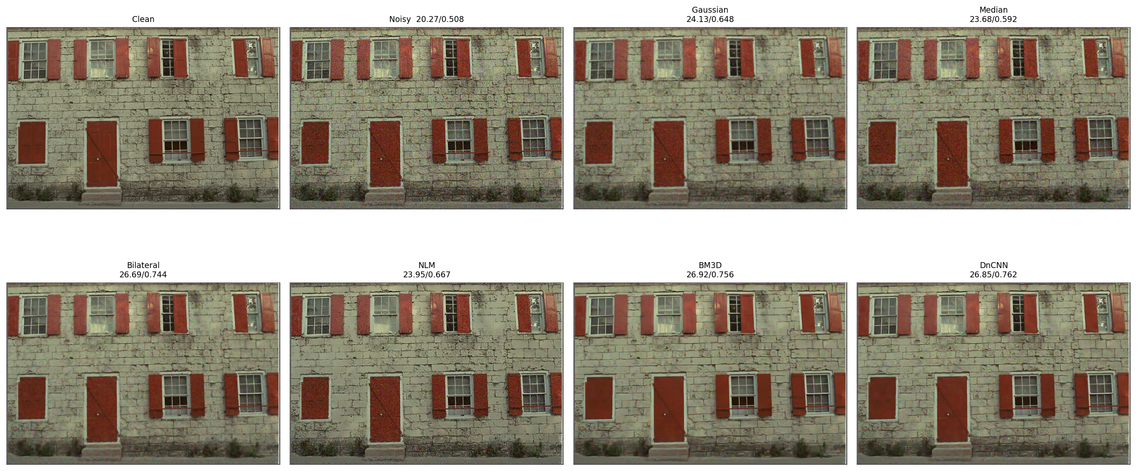
Results: Color and Salt-and-Pepper
• Color (Kodak): same ranking as grayscale
– conclusions are not specific to grayscale
• Salt-and-pepper noise:
– Median = 31.16 dB (best by far)
– DnCNN = 22.5 dB (trained only on Gaussian)
• → No single method wins everywhere — it depends on the noise type
9/12
Notes:
The salt-and-pepper case is the key insight: a learned model fails outside its training noise distribution, while the rank-order median filter — built for impulse noise — dominates.

Slide 10
Key Analysis: Accuracy vs. Speed
• Quality: DnCNN trails BM3D by < 1 dB
• Speed (per grayscale image):
DnCNN — 0.06 s
NLM — 0.20 s
BM3D — 11.05 s
→ DnCNN is ~185× faster than BM3D (≈200× on color)
10/12
Notes:
This is the headline result. DnCNN trades a sub-1 dB quality deficit for one-to-two orders of magnitude faster inference — decisive for real-time or large-scale use. Note the time axis is log-scaled.

Slide 11
Conclusion
• Quality: BM3D is strongest; DnCNN follows within < 1 dB
• Speed: DnCNN is ~100× faster → best choice for real-time / large-scale
• Generalization: a learned model cannot exceed its training noise distribution
– classical filters (e.g. median) remain irreplaceable for specific noise
• Classical and learned methods are complementary, not competing
11/12
Notes:
End on the mature takeaway: not 'deep learning wins', but 'each has its place'. This nuance is what distinguishes a strong project.

Slide 12
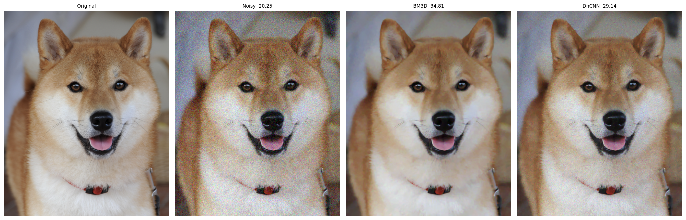
Future Work & Demo
• Noise-specific and longer DnCNN training
• Native color model / denoise only the Y channel (YCbCr)
• Real camera-noise datasets (e.g. SIDD)
• Transformer-based denoisers
GitHub
github.com/1123524/ai-image-denoising
Demo: a user-supplied photo, denoised at σ=25 (below).
Thank you! Q & A
12/12
Notes:
Demo on a real out-of-dataset photo confirms the methods generalize. BM3D scores highest here thanks to the repetitive fur texture that non-local methods exploit.

