Slide 1




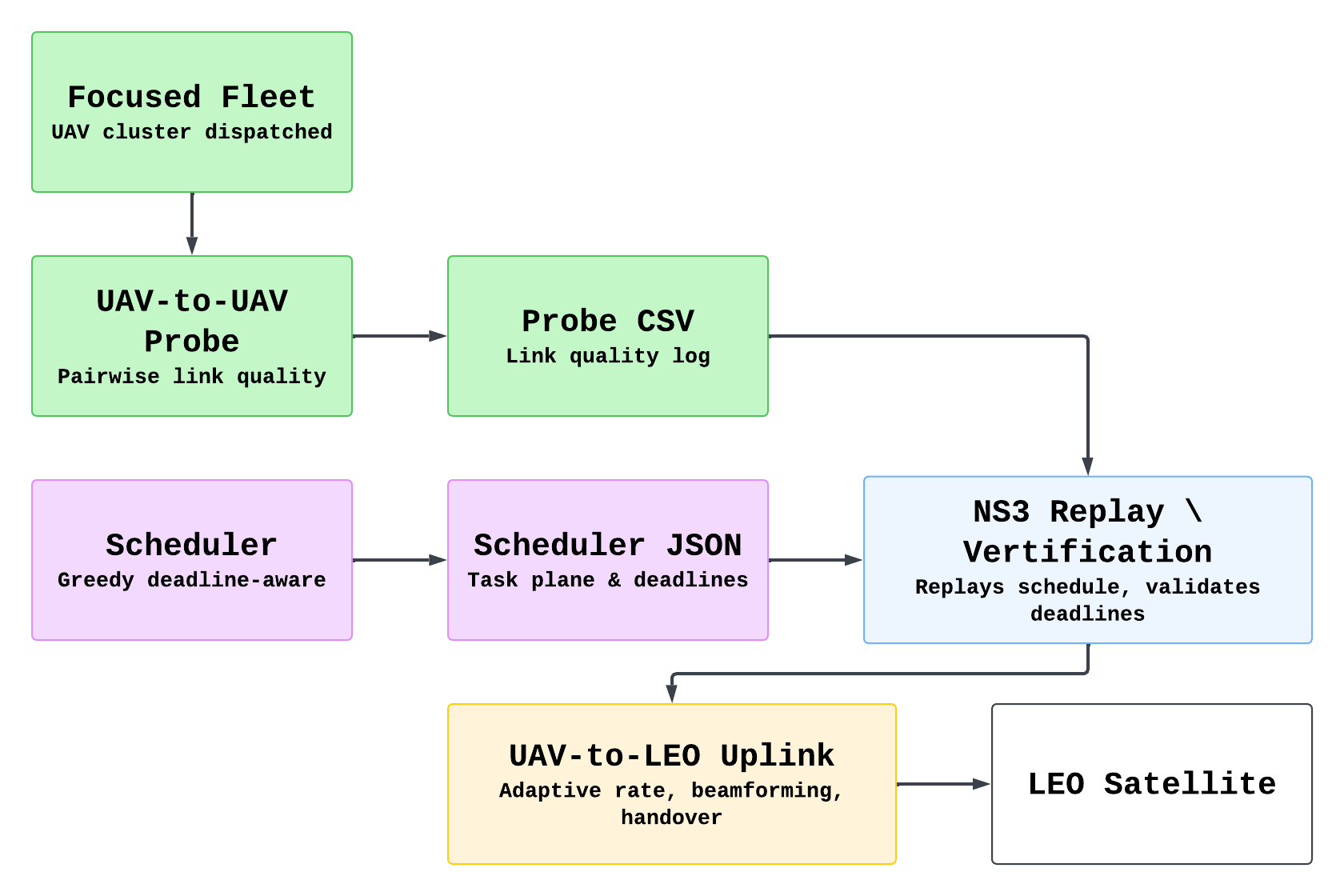
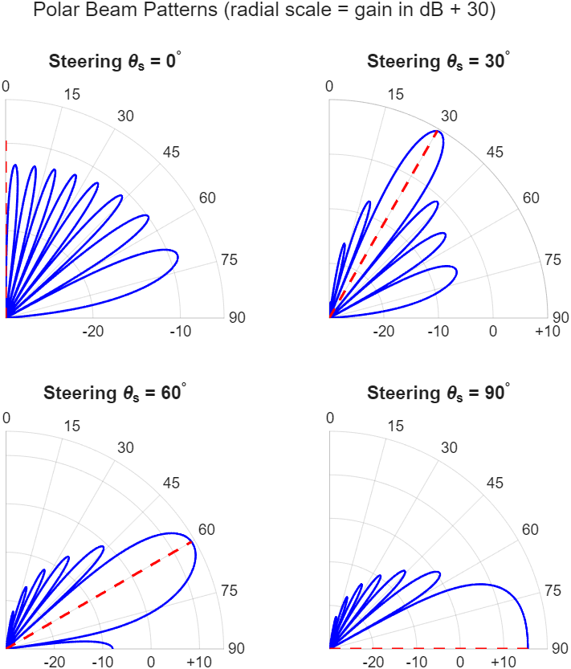
Performance Evaluation for Deadline-Aware Hierarchical IoT Data Collection in SAGIN
Author : 112550039 李宗諺, 112550139 簡士原
Department/University : Computer Science/National Yang Ming Chiao Tung University
Advisor : Kate Ching-Ju Lin
Background and Motivation
• UAV and LEO networks are important for wide-area communication and task delivery.
• Scheduling and validating communication tasks in such networks is challenging.
• Simulation-based evaluation is crucial for analizing the performance of data collection in SAGIN.
Problem Statement
• Implement channel variation and link quality for UAV-to-UAV and UAV-to-LEO communications.
• Replay the data collection schedule in NS-3 and evaluate end-to-end communication performance.
Methods & Results
UAV-to-UAV Probe
System Architecture & Data Flow
Goal • Intra-fleet link quality measurement • Slave UAV → CH/master UAV
Method • Distance → Friis path loss → SNR → Shannon rate • UDP probing packets • Tx/Rx bytes, delivery ratio, throughput
Output • Per-link CSV log • 3D position, distance, SNR • Estimated rate, measured throughput
Probing Packets
Fleet
Master
Link | Distance (m) | SNR (dB) | Est. Rate (Mbps) | Eff. Throughput (Mbps)
S1 → M | 120 | 18.4 | 34.2 | 28.7
S2 → M | 175 | 14.1 | 24.9 | 20.3
S3 → M | 230 | 10.6 | 16.8 | 12.5
Slave
Slave
Slave
NS-3 Schedule Replay / Verification
Fig. 2: System Architecture
Goal • Schedule feasibility validation • Trace-driven NS-3 replay Input • Scheduler JSON • MOVE / ROLE_SET • SENSOR_TO_UAV/SLAVE_TO_MASTER
Verification • UAV mobility and role changes • UAV buffer dependency • Task completion and deadline check Output • Completed tasks • Mission finish time • Deadline satisfaction
Scenario | UAVs | Sensors | Transfers | Completed | Deadline Met
Simple trace | 3 | 50 | 79 | 79 / 79 | Yes
Normal trace | 5 | 500 | 212 | 212 / 212 | Yes
UAV-to-LEO Uplink
Fig. 3: Data Flow
Goal
Establish high-capacity uplink between Cluster Head UAV and fast-moving LEO satellite
Method
Link Budget Model: Pipeline: FSPL → SNR → Shannon capacity.
Hybrid Beamforming Gain (Fig. 1)
SNR-Adaptive Rate Control
Output
Link related data (e.g. SNR)
Visible time window
SAGIN hierarchy: Sensor → Slave UAV → CH UAV → LEO satellite
Role split: Slave UAVs collect IoT data; CH UAV holds the satellite backhaul
Why pipeline? Intermittent LEO visibility + massive access congestion demand offline scheduling before uplink
NS-3.35 + ns-3-leo: each link simulated independently: uas-probe.cc (intra-fleet), uav-to-leo.cc (backhaul)
Fig. 1: Polar Beamforming Patterns
Conclusion
We built an NS-3-based framework to support link probing, schedule replay, and end-to-end performance measurement in SAGIN scenarios.
The framework provides a platform for analyzing various scheduling decisions.
Future work: integrate scheduling algorithm into the simulation framework to enable interactive network planning

