Slide 1




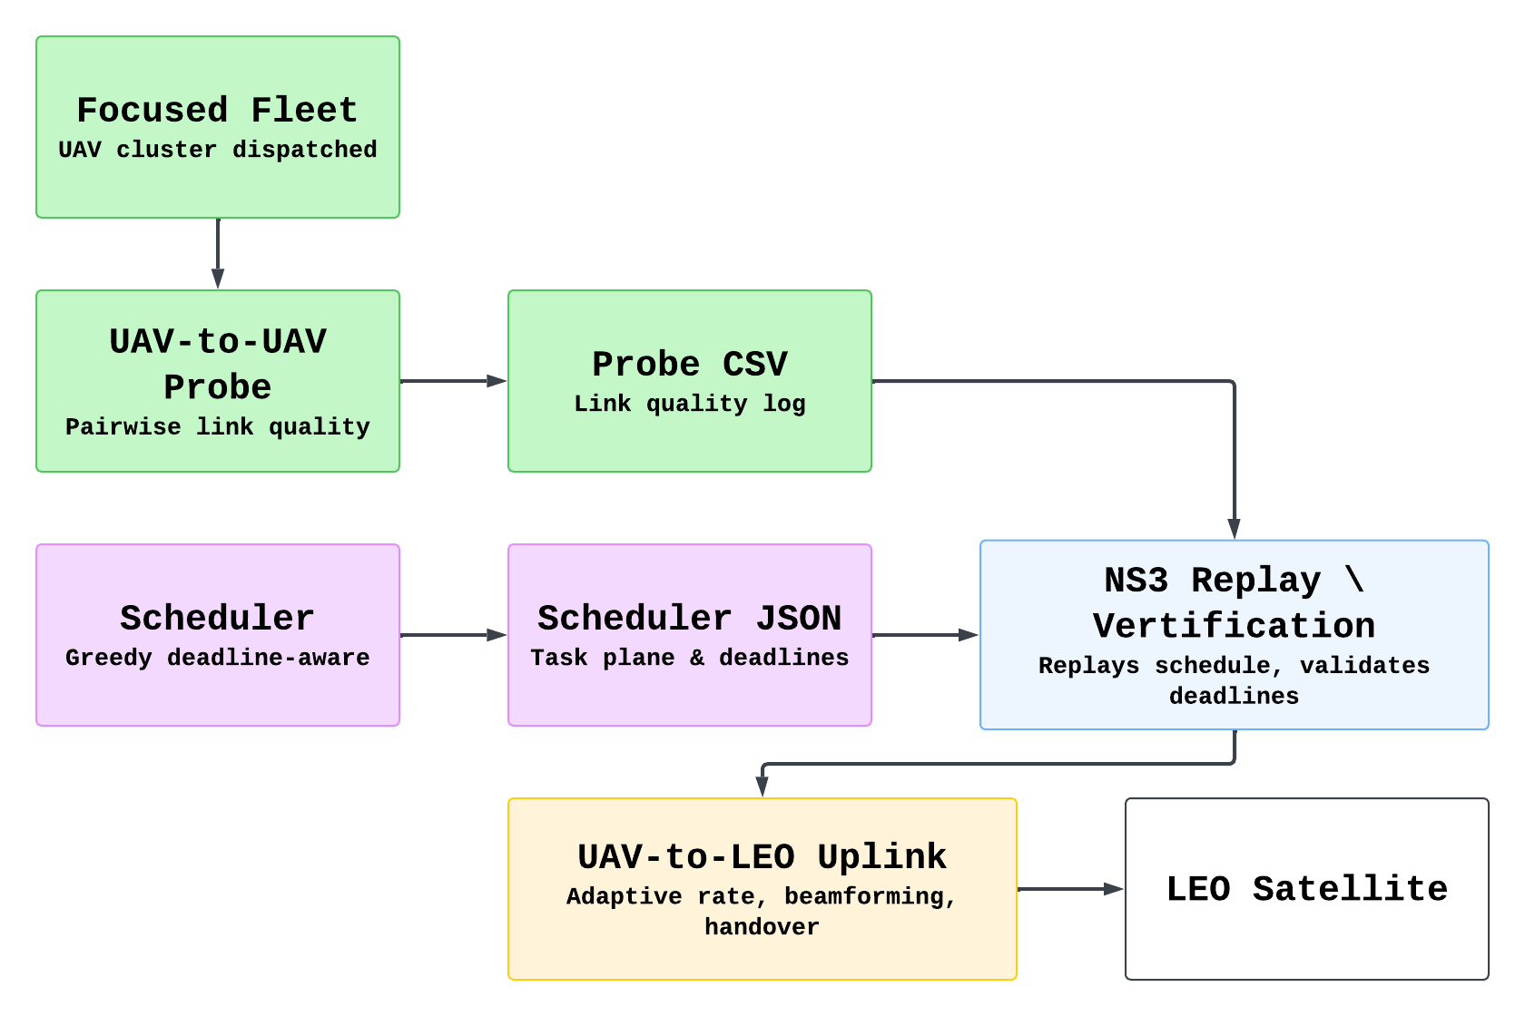
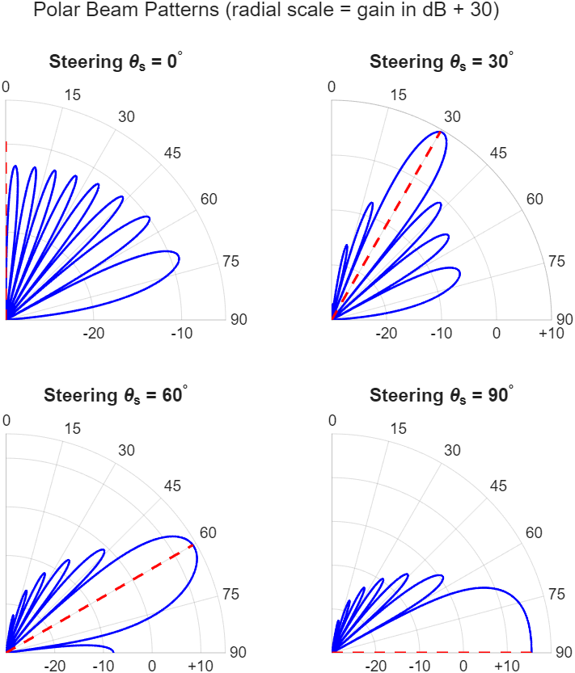
An NS-3-Based Framework for Schedule Replay, Link Probing, and Mission Verification in UAV-LEO Networks
Author : 112550039 李宗諺, 112550139 簡士原
Department/University : Computer Science/National Yang Ming Chiao Tung University
Advisor : Kate Ching-Ju Lin
Background and Motivation
• UAV and LEO networks are important for wide-area communication and task delivery.
• Scheduling and validating communication tasks in such networks is challenging.
• A simulation framework is needed to replay schedules and verify whether mission deadlines can be met.
Problem Statement
• External schedulers may generate communication schedules, but their feasibility must be verified.
• We need a framework that can replay task schedules in NS-3 and evaluate communication performance.
• We also need to estimate or measure link quality for UAV-to-UAV and UAV-to-LEO communication.
Methods & Results
UAV-to-UAV Probe
System Architecture & Data Flow
This section aims to characterize the intra-fleet wireless links between slave UAVs and the CH/master UAV before scheduling, and export scheduler-ready link quality logs.
Link Budget Model: Pipeline: distance → Friis path loss → SNR → Shannon capacity.
Active Packet Probing: Send UDP probing packets on each candidate UAV-to-UAV link and record Tx/Rx packets, bytes, delivery ratio, and effective throughput.
Scheduler-Oriented Output: Export per-link CSV logs including src/dst roles, 3D positions, distance, SNR, estimated rate, and measured throughput.
Fleet
Master
Link | Distance (m) | SNR (dB) | Est. Rate (Mbps) | Eff. Throughput (Mbps)
S1 → M | 120 | 18.4 | 34.2 | 28.7
S2 → M | 175 | 14.1 | 24.9 | 20.3
S3 → M | 230 | 10.6 | 16.8 | 12.5
Slave
Slave
Slave
Probing Packets
Fig. 2: System Architecture
NS-3 Schedule Replay / Verification
This section validates whether a scheduler-generated task plan can besuccessfully executed in the NS-3 network simulator under UAV mobility,role changes, and wireless transmission constraints.
Trace-Driven Replay: Read scheduler JSON containing MOVE, ROLE_SET, SENSOR_TO_UAV, and SLAVE_TO_MASTER events.
Data Dependency Model: Sensor data must first arrive at the assigned UAV buffer before the slave UAV can forward it to the CH/master UAV.
Verification Output: Record task completion time, deadline satisfaction, total completed tasks, mission finish time, and effective throughput.
Scenario | UAVs | Sensors | Transfers | Completed | Deadline Met
Simple trace | 3 | 50 | 79 | 79 / 79 | Yes
Normal trace | 5 | 500 | 212 | 212 / 212 | Yes
Fig. 3: Data Flow
SAGIN hierarchy: Sensor → Slave UAV → CH UAV → LEO satellite
Role split: Slave UAVs collect IoT data; CH UAV holds the satellite backhaul
Why pipeline? Intermittent LEO visibility + massive access congestion demand offline scheduling before uplink
NS-3.35 + ns-3-leo: each link simulated independently: uas-probe.cc (intra-fleet), uav-to-leo.cc (backhaul)
UAV-to-LEO Uplink
This section aims to establish a high-capacity uplink between the Cluster Head UAV and a fast-moving LEO satellite, the backhaul bottleneck of the entire SAGIN.
Link Budget Model: Pipeline: FSPL → SNR → Shannon capacity.
Hybrid Beamforming Gain: Physical Model (Fig. 1)
SNR-Adaptive Rate Control: Recompute SNR from current geometry.
Fig. 1: Polar Beamforming Patterns
Conclusion
• We built an NS-3-based framework to support link probing, schedule replay, and UAV-to-LEO uplink evaluation in UAV-assisted SAGIN scenarios.
• This work does not directly solve the scheduling problem, but provides a simulation and measurement foundation for evaluating scheduler decisions.
• The UAV-to-UAV probing module provides scheduler-ready link information, including SNR, estimated rate, delivery ratio, and measured throughput.
• The schedule replay engine verifies generated task plans using task completion, finish time, and deadline satisfaction.
• Future work: integrate scheduler decisions with UAV-to-UAV and UAV-to-LEO simulations for complete end-to-end mission validation.

