Slide 1

Video - Deliverable #0

Slide 2

Video Requirements
Format:
MP4
Resolution:
1280x720
YouTube & Dropbox:
Post on due date

Slide 3

Cover Screen
Team name
Team members
Logo
Be creative
Background Image capturing idea

Slide 4

Introduce Yourself 10 seconds/Per Team Member
Put yourself on camera
Give your name
Where are you from
Department, Year

Slide 5

30 seconds – The pitch
Make your case
Why do we care?

Slide 6

30 seconds – Support your pitch
Tell us more

Slide 7

30 seconds – The technology
Hardware/software
Components
APIs Packages/Modules you will use
Cloud services you will use
Others?

Slide 8
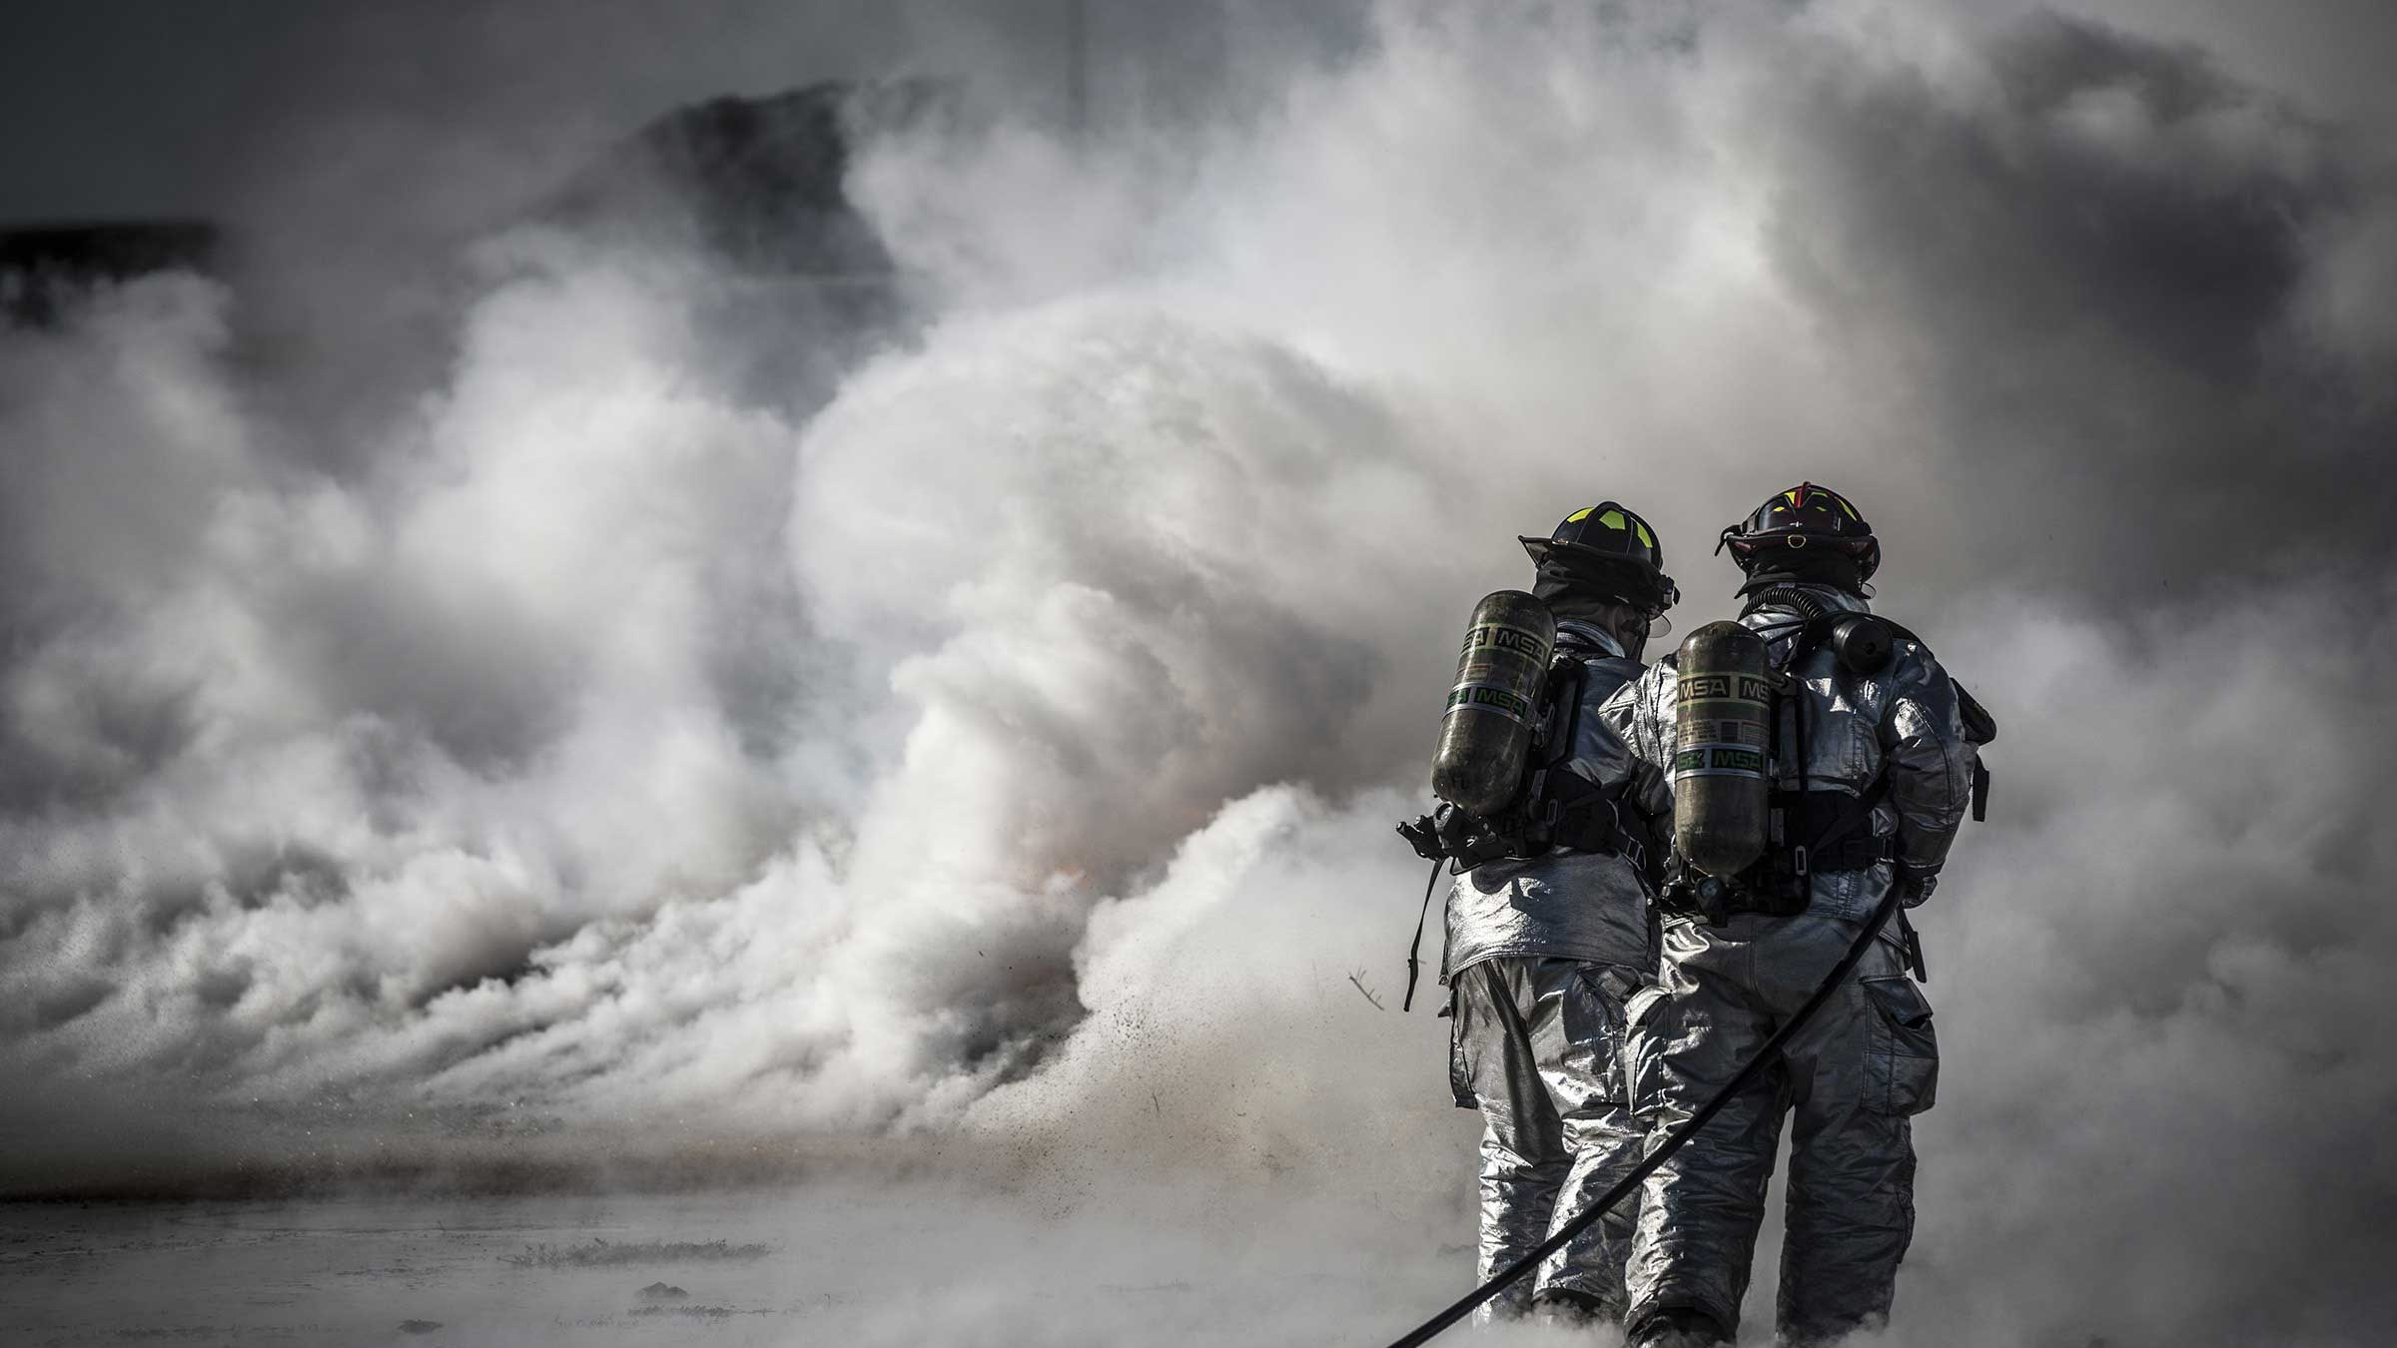
30 seconds - Risk Management
Identify
Assess
Monitor
Control
Mitigate

Slide 9

30 seconds – Next steps

